Slide 1
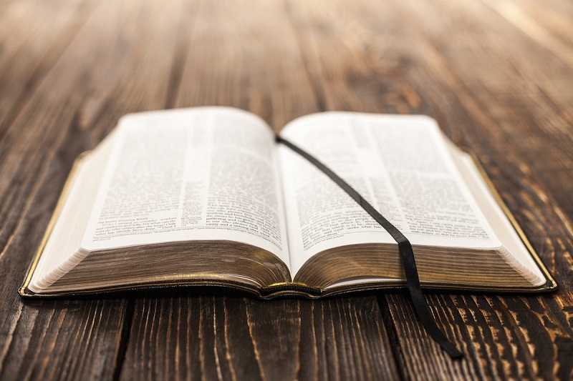
LO: to know that the Bible contains different styles of writing.

Slide 2
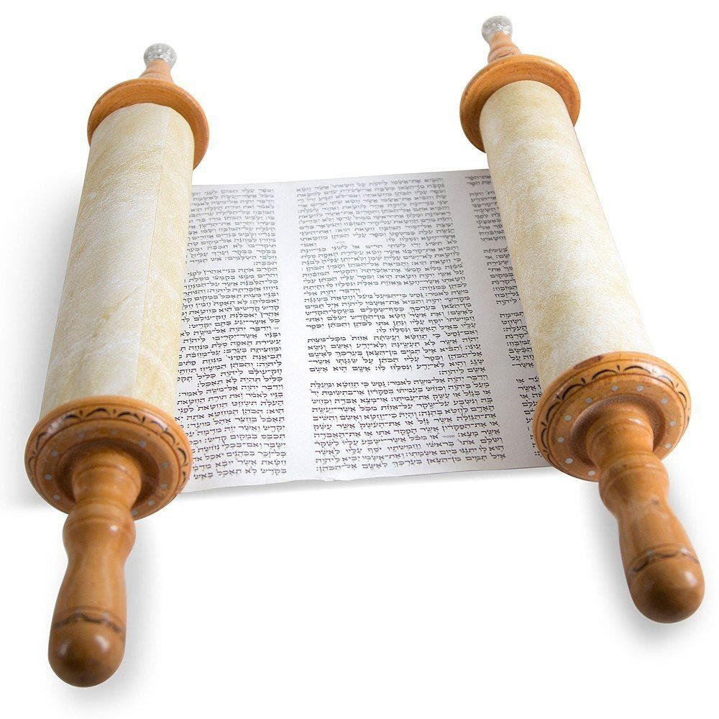
What is The Pentateuch?
Can you name the books of the Pentateuch?

Slide 3
The Pentateuch is the name of the first 5 books of the Bible. The Bible is God’s
living Word handed on in the living tradition of the Church. The first five books of the Old Testament are the Torah (Law) of
the Jewish faith.
Genesis
Exodus
Leviticus
Numbers
Deuteronomy

Slide 4
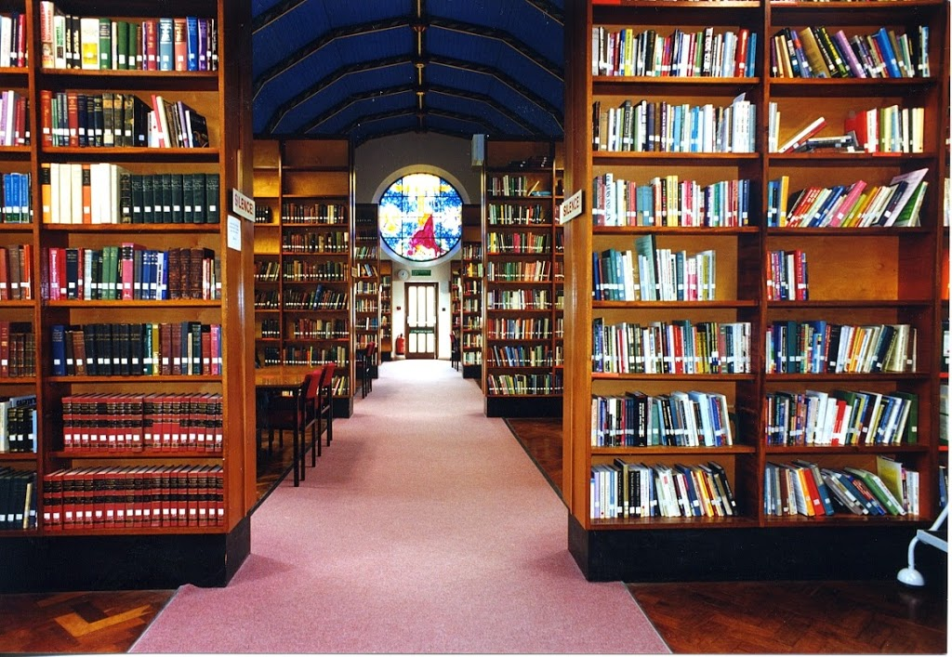
The Bible is like a library. It contains lots of books of all different types.
Like a library, it is divided into sections with diferent subjects and styles of writing.

Slide 5
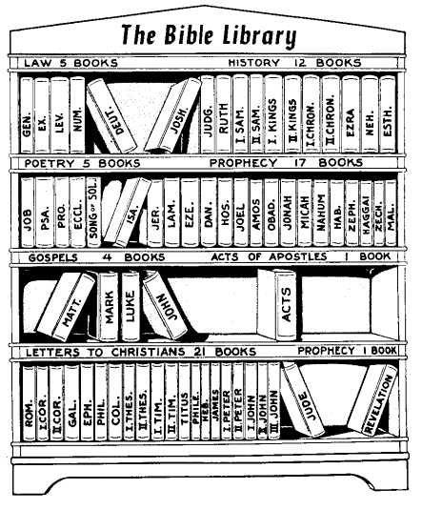

Slide 6
David's Song of Victory
18 How I love you, Lord!
You are my defender.
² The Lord is my protector;
he is my strong fortress.
My God is my protection,
and with him I am safe.
He protects me like a shield;
he defends me and keeps me safe.
³ I call to the Lord,
and he saves me from my enemies.
Praise the Lord
What type of writing is this?
How can you tell?
Which book of the Bible would contain this?

Slide 7
David's Song of Victory
18 How I love you, Lord!
You are my defender.
² The Lord is my protector;
he is my strong fortress.
My God is my protection,
and with him I am safe.
He protects me like a shield;
he defends me and keeps me safe.
³ I call to the Lord,
and he saves me from my enemies.
Praise the Lord
David’s song is a psalm.
It is written to be sung.
It is like a poem or the lyrics of a song.
A psalm has verses and often includes repetition.
Can you spot the metaphors and similes? The ways David compares other protection with the Lord

Slide 8
Hannah's Prayer
2 Hannah prayed:
“The Lord has filled my heart with joy;
how happy I am because of what he has done!
I laugh at my enemies;
how joyful I am because God has helped me!
² “No one is holy like the Lord;
there is none like him,
no protector like our God.
³ Stop your loud boasting;
silence your proud words.
For the Lord is a God who knows,
and he judges all that people do.
What type of writing is this?
How can you tell?
Where in the Bible might you find this prayer?

Slide 9
This is a prayer. Hannah is a figure in the Old Testament. She is found in the Book of Samuel.
Hannah's Prayer
2 Hannah prayed:
“The Lord has filled my heart with joy;
how happy I am because of what he has done!
I laugh at my enemies;
how joyful I am because God has helped me!
² “No one is holy like the Lord;
there is none like him,
no protector like our God.
³ Stop your loud boasting;
silence your proud words.
For the Lord is a God who knows,
and he judges all that people do.
This is a prayer of praise.
Thanking God and worshipping him for his help and protection.

Slide 10
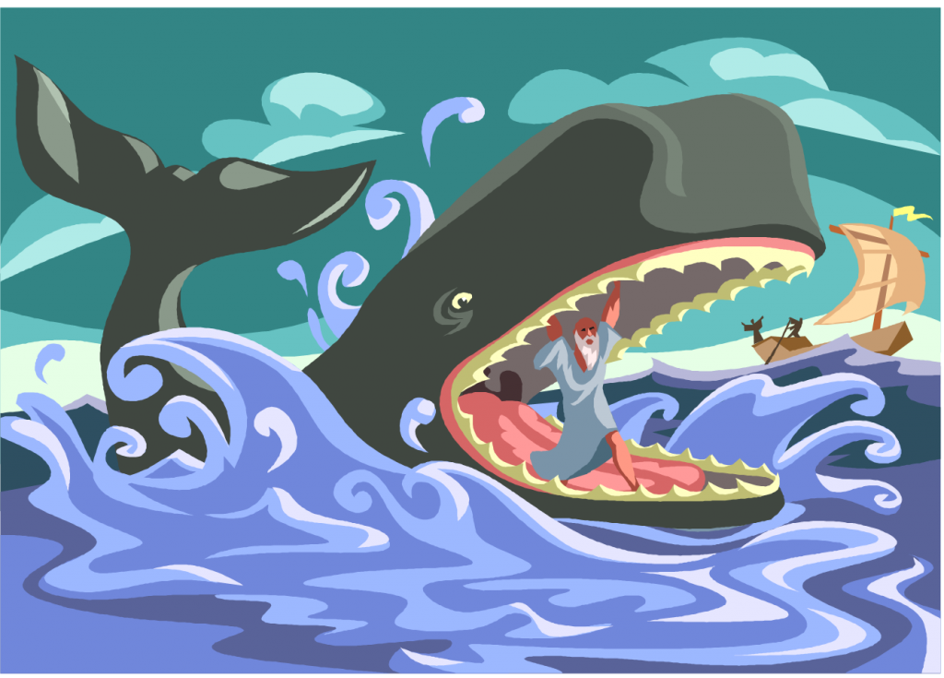
Do you recognise this story from the Bible?

Slide 11
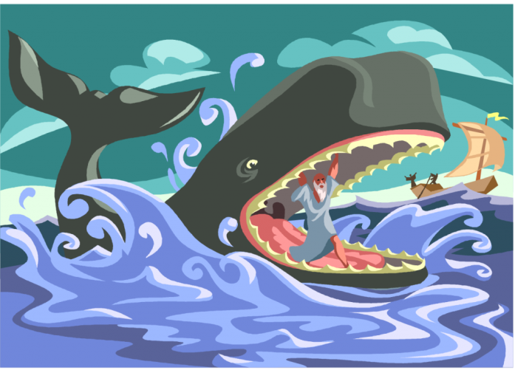
In the story of Jonah. God sends Jonah to Nineveh. He doesn’t want to go and tries to run away.
Do you know how he ends up inside the whale?
Find out in The Book of Jonah
This book is like an adventure story.
Even though the prophet tries to disobey God, God finds a way of saving him and setting him on the right path.

Slide 12
Proverbs 3:5-6
⁵ Trust in the Lord with all your heart. Never rely on what you think you know. ⁶ Remember the Lord in everything you do, and he will show you the right way.
A proverb is a wise saying or short story that teaches a lesson or expresses a truth in very few words. Biblical proverbs may take the form of a saying or a riddle.
A proverb is written in expressive language, often metaphorically.

Slide 13
Proverbs 3:5-6
⁵ Trust in the Lord with all your heart. Never rely on what you think you know. ⁶ Remember the Lord in everything you do, and he will show you the right way.
What is the message of this proverb?

Slide 14
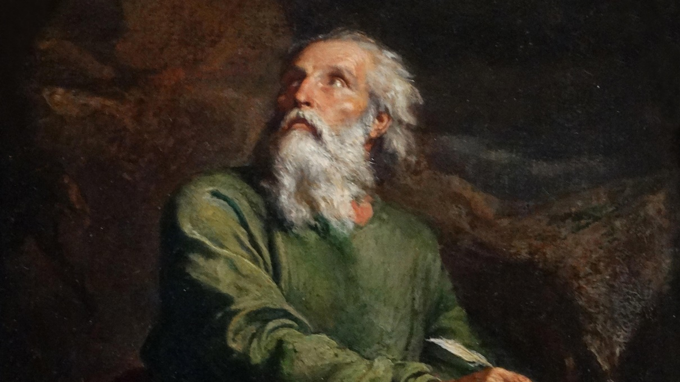
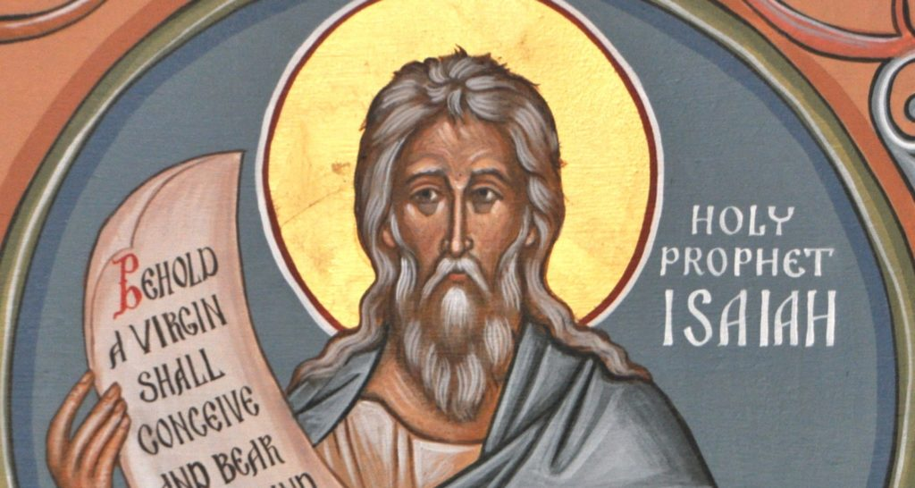
Who is Isaiah?
What is a prophet?
Read the prophecy.

Slide 15
The Peaceful Kingdom
11 The royal line of David is like a tree that has been cut down; but just as new branches sprout from a stump, so a new king will arise from among David's descendants.
² The spirit of the Lord will give him wisdom
and the knowledge and skill to rule his people.
He will know the Lord's will and honor him,
³ and find pleasure in obeying him.
He will not judge by appearance or hearsay;
⁴ he will judge the poor fairly
and defend the rights of the helpless.
At his command the people will be punished,
and evil persons will die.
⁵ He will rule his people with justice and integrity.

Slide 16
The Peaceful Kingdom
11 The royal line of David is like a tree that has been cut down; but just as new branches sprout from a stump, so a new king will arise from among David's descendants.
A prophet is a person chosen by God to foretell the future.
Isaiah is a great prophet who foretells Jesus’ birth.
The Messiah who will rule forever.

