Slide 1
Edwardian Britain
LO: to understand historical setting

Slide 2
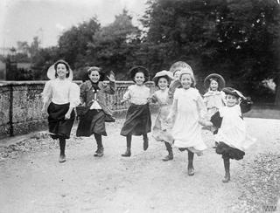

Slide 3
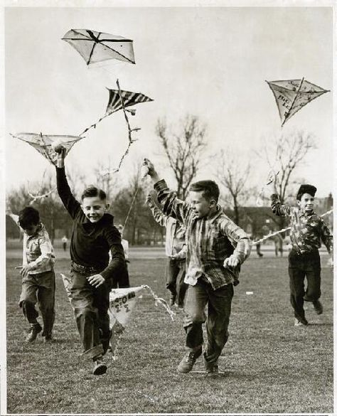

Slide 4
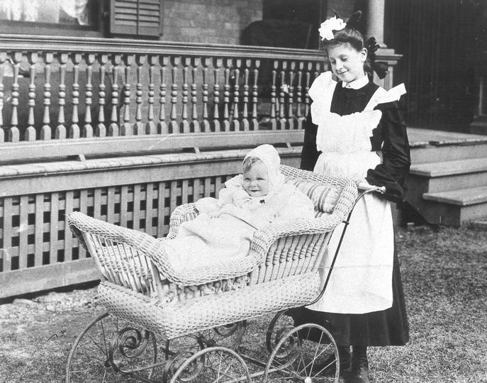

Slide 5
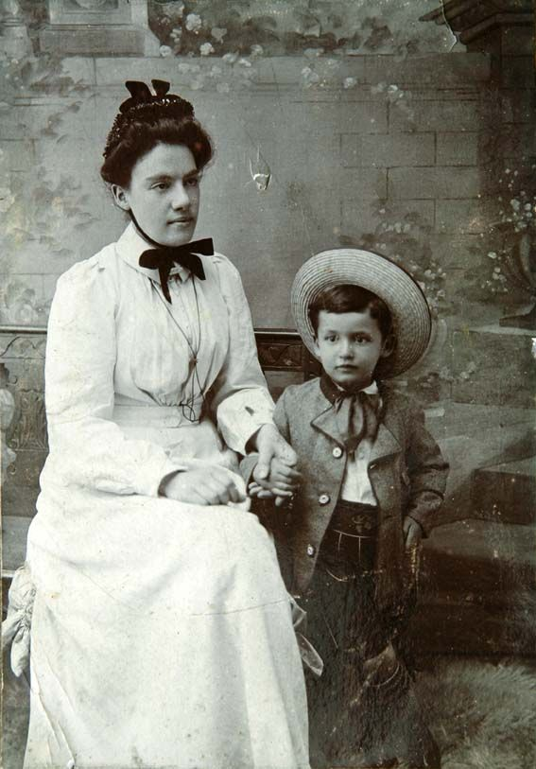

Slide 6


