Slide 1
Week 7
OUTCOME: to write a personal account using fronted adverbial phrases.

Slide 2
LO:to understand fronted adverbials and adverbial phrases.
Word of the day-clouded The old lady seemed suddenly clouded with sadness. What does the word mean?

Slide 3
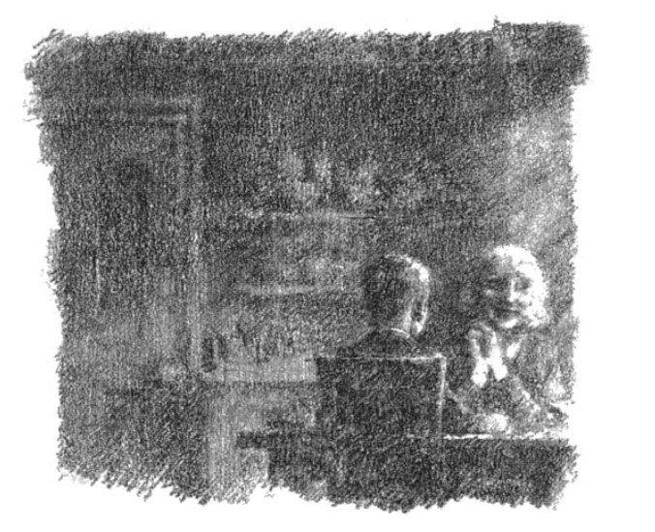
The old lady drank her tea and wrinkled her nose in disgust. “I’m always doing that,” she said. “I’m always letting my tea go cold.” The dog scratched his ear, groaning with the pleasure of it, but eyeing me all the time.
“Is that the end then?”
I asked. She laughed and put down her cup. “I should say not,” she said. And then she went on, picking a tea leaf off the tip of her tongue. “Up till now it’s been just Bertie’s story. He told it to me so often that I almost feel I was there when it happened. But from now on it’s my story too.”
“What about the white lion?” I had to know. “Did he find the white lion?
Did he keep his promise?” The old lady seemed suddenly clouded with sadness. “You must remember,” she said, putting a bony hand on mine, “that true stories do not always end just as we would wish them to. Would you like to hear the truth of what happened, or shall I make something up for you just to keep you happy?”

Slide 4
Think back to the work we did on characterisation and senses.
Which words from today’s reading, describe the old lady?
disgusted, wrinkled
What word group do they belong to?
Which do you find most effective?
Why do you think this?

Slide 5
LO:to understand fronted adverbials and adverbial phrases. Understand the purpose and use of fronted adverbials. To establish, where? when? and how? A fronted adverbial is when the adverbial phrase is at the front (or start) of the sentence, before the verb. For example: Earlier today, Dexter ate a banana. Here, 'earlier today' is a fronted adverbial as it adds detail about when Dexter ate the banana at the front of the sentence, before the verb ‘ate’.

Slide 6
Fronted adverbials
A fronted adverbial goes at the beginning of a sentence
It describes the verb in the sentence
It describes where, when and how

Slide 7
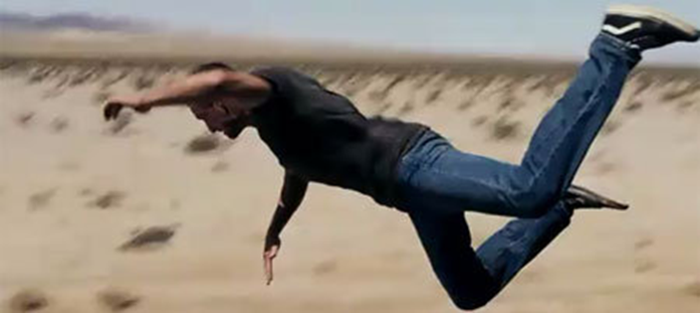
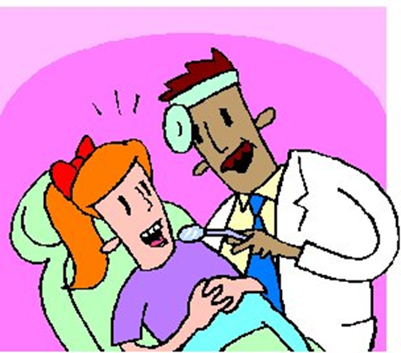
As soon as he could, Tom jumped off the train.
Last week, I went to the dentist.

Slide 8


In the winter, some animals hibernate
Outside my house, I found a pizza.

Slide 9
Task 1
Which fronted adverbial?
Can you match the fronted adverbial to each sentence so they all make sense?
Gently,
Before I go to bed,
At last,
Suddenly,
At the park,
Every playtime
I clean my teeth.
the ground began to shake.
I lost my coat.
I play football.
she lifted the sleeping baby.
I reached the finish line.

Slide 10
Day after day, his father went out looking for the white lion.
Suddenly, I wasn’t hungry any more.
Behind her and on unsteady legs, came what looked like a lion cub.
One morning, a week or so later, Bertie was woken by a chorus of urgent neighing.
Unfortunately, he was over from France looking for lions.
Understandably, Bertie was distraught.
Use the mat on the next slide to have a go for yourself- aim to write at least 8 sentences
That begin with a fronted adverbial!

Slide 11
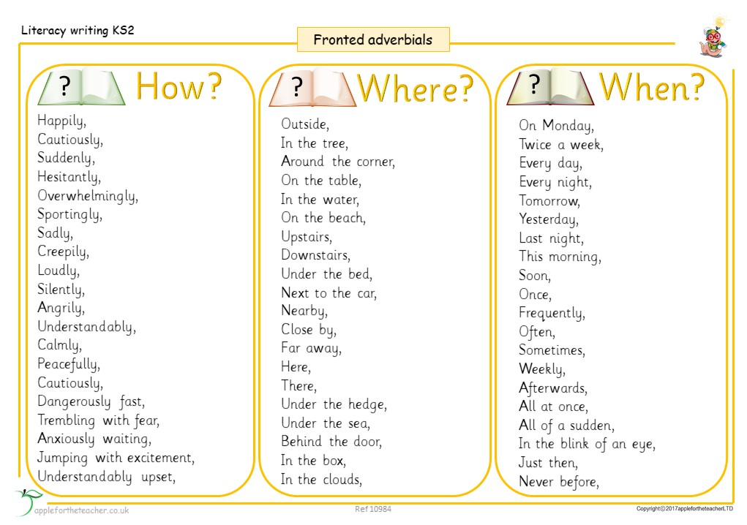

Slide 12
Day 2
Word of the day -echoing What does the word mean? Can you make a simple sentence using the word? Now try writing a complex sentence.

Slide 13
“I want to know what really happened,” I replied.
“Then you shall,” she said. She turned from me and looked out of the window again at the butterfly lion, still blue and shimmering on the hillside.
Whilst Bertie was growing up on his farm in Africa with his fence all around, I was growing up here at Strawbridge in this echoing cold cavern of a house with its deer park and its high wall all around. And I grew up, for the most part, alone. I too was an only child. My mother had died giving birth to me, and Father was rarely at home. Maybe that was why the two of us, Bertie and I, got on so well from the first moment we met. We had so much in common from the very start.

Slide 14
Reading Skills
What do you think about the old lady’s upbringing? Why do you think this?
What do we learn about her?
What do you think will happen?
Which words indicate this?

Slide 15
Sentence structure
Look at the sentences used in this chapter.
How do they open?
Are they long or short?
Which is the shortest?
Why has Michael Morpurgo begun the sentence And…
She laughed and put down her cup. “I should say not,” she said. And then she went on, picking a tea leaf off the tip of her tongue.

Slide 16
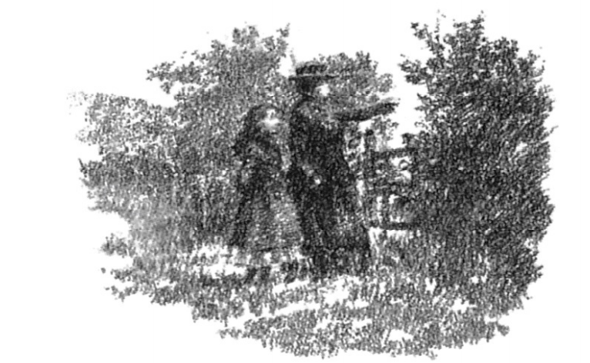
Like Bertie, I scarcely ever left the confines of my home, so I had few friends. I didn’t go to school either, not to start with. I had a governess instead, Miss Tulips – everyone called her “Nolips” because she was so thin-lipped and severe. She moved around the house like a cold shadow. She lived on the top floor, like Cook, and like Nanny. Nanny Mason – bless her heart – brought me up and taught me all the do’s and don’ts of life like all good nannies should. But she was more than just a nanny to me, she was a mother to me, and a wonderful one too, the best I could have had, the best anyone could have had.

Slide 17
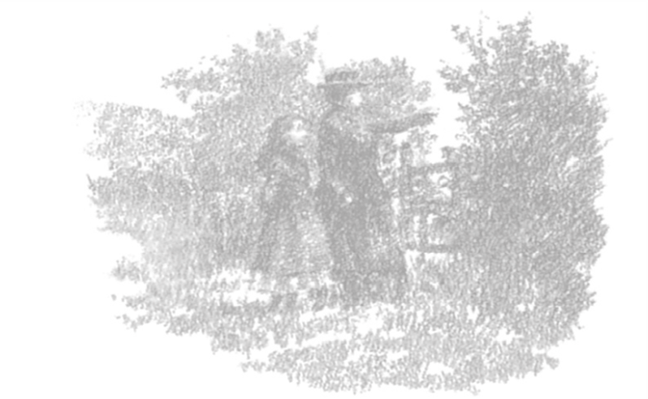
My mornings were always spent at my studies with Nolips, but all the while I was looking forward to my afternoons out walking with Nanny Mason – except on Sundays, when I was allowed to be on my own all day, if Father wasn’t home for the weekend, which he usually wasn’t. Then I could fly my kites when it was fine, and read my books when it wasn’t. I loved my books – Black Beauty, Little Women, Heidi – I loved them all, because they took me outside the park walls, they took me all over the world. I met the best friends I ever had in those books – until I met Bertie, that is.

Slide 18
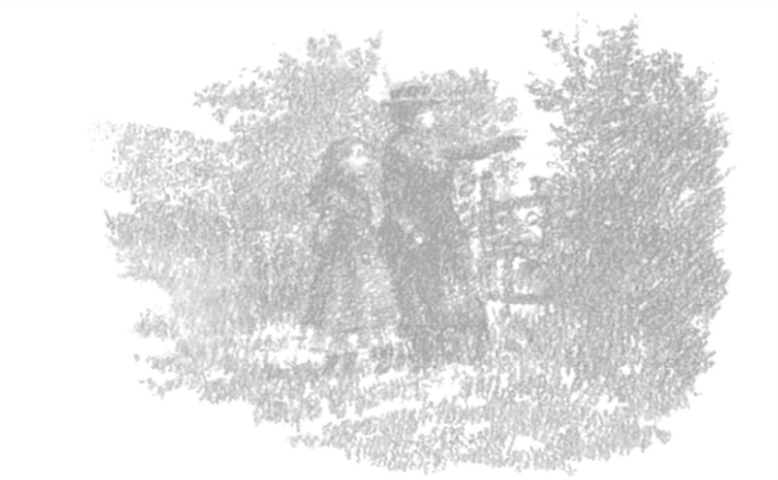
What was the old lady’s life like as a child?
What is a nanny?
What do you think of Miss Tulips?
We are going to write about the lady’s child hood using fronted adverbial phrases.

Slide 19
Sadly,…………………………………………………………………………………………….
Unfortunately,…………………………………………………………………………….
Day after day,…………………………………………………………………………….
Happily,…………………………………………………………………………………………
In the mornings,…………………………………………………………………………
On Saturday,……………………………………………………………………………….
Frequently,…………………………………………………………………………………..

Slide 20
Day 3
Word of the day – soared Can you write a sentence using the word of the day.

Slide 21
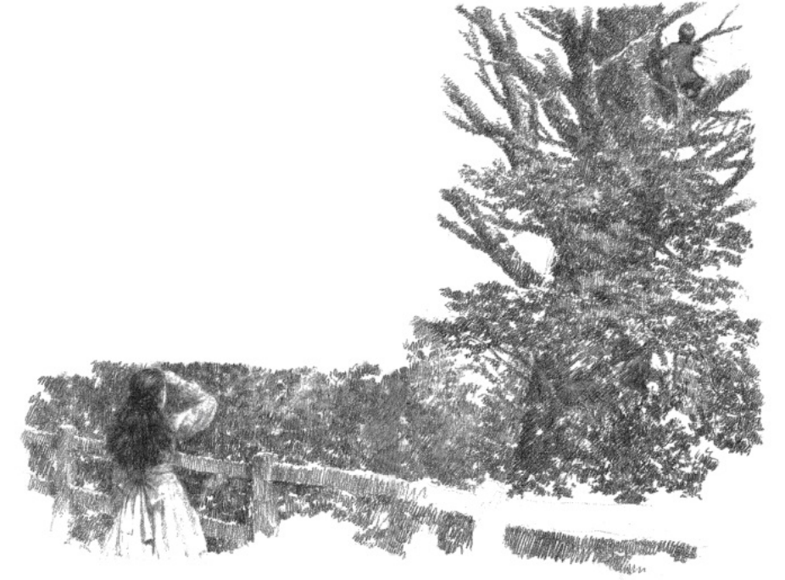
I remember it was just after my tenth birthday. It was Sunday and I was out flying my kites. But there wasn’t much wind, and no matter how hard I ran, I just couldn’t get even my best box kite to catch the wind and fly. I climbed all the way up Wood Hill, looking for wind. And there at the top I found it at last, enough to send my kite soaring. But then the wind gusted and my kite swirled away crazily towards the trees. I couldn’t haul it in in time. It caught on a branch and stuck fast in a high elm tree in amongst the rookery. The rooks flew out cawing in protest whilst I tugged at my line, crying in my fury and frustration. I gave up, sat down and howled. That was when I noticed a boy emerging from the shadow of the trees.
“I’ll get it down for you,” he said, and began to climb the tree. Easy as you like, he crawled along the branch, reached out and released my kite.
It floated down and landed at my feet. My best kite was torn and battered, but at least I had it back. Then he was down the tree and standing there in front of me.
“Who are you? What do you want?” I asked.

Slide 22
L.O: to write sentences using fronted adverbial phrases and powerful verbs
Write your sentences from a viewpoint.
Frustratingly, On the hillside,
Tugging Under the tree,
Catching Soaring
Climbing On Sunday,
Silently, Never before,
Frustratingly, my best box kite got stuck in a tree.
Tugging as hard as I could, I tried to release it.
Some verbs you may use to complete your sentence:
leapt
discovered
sneaked
walked
strolled
danced
You can always use a dictionary to find even more!

Slide 23
Day 4
Words of the day- proper
What is meant by “a proper home,”? How else can the word be used?

Slide 24
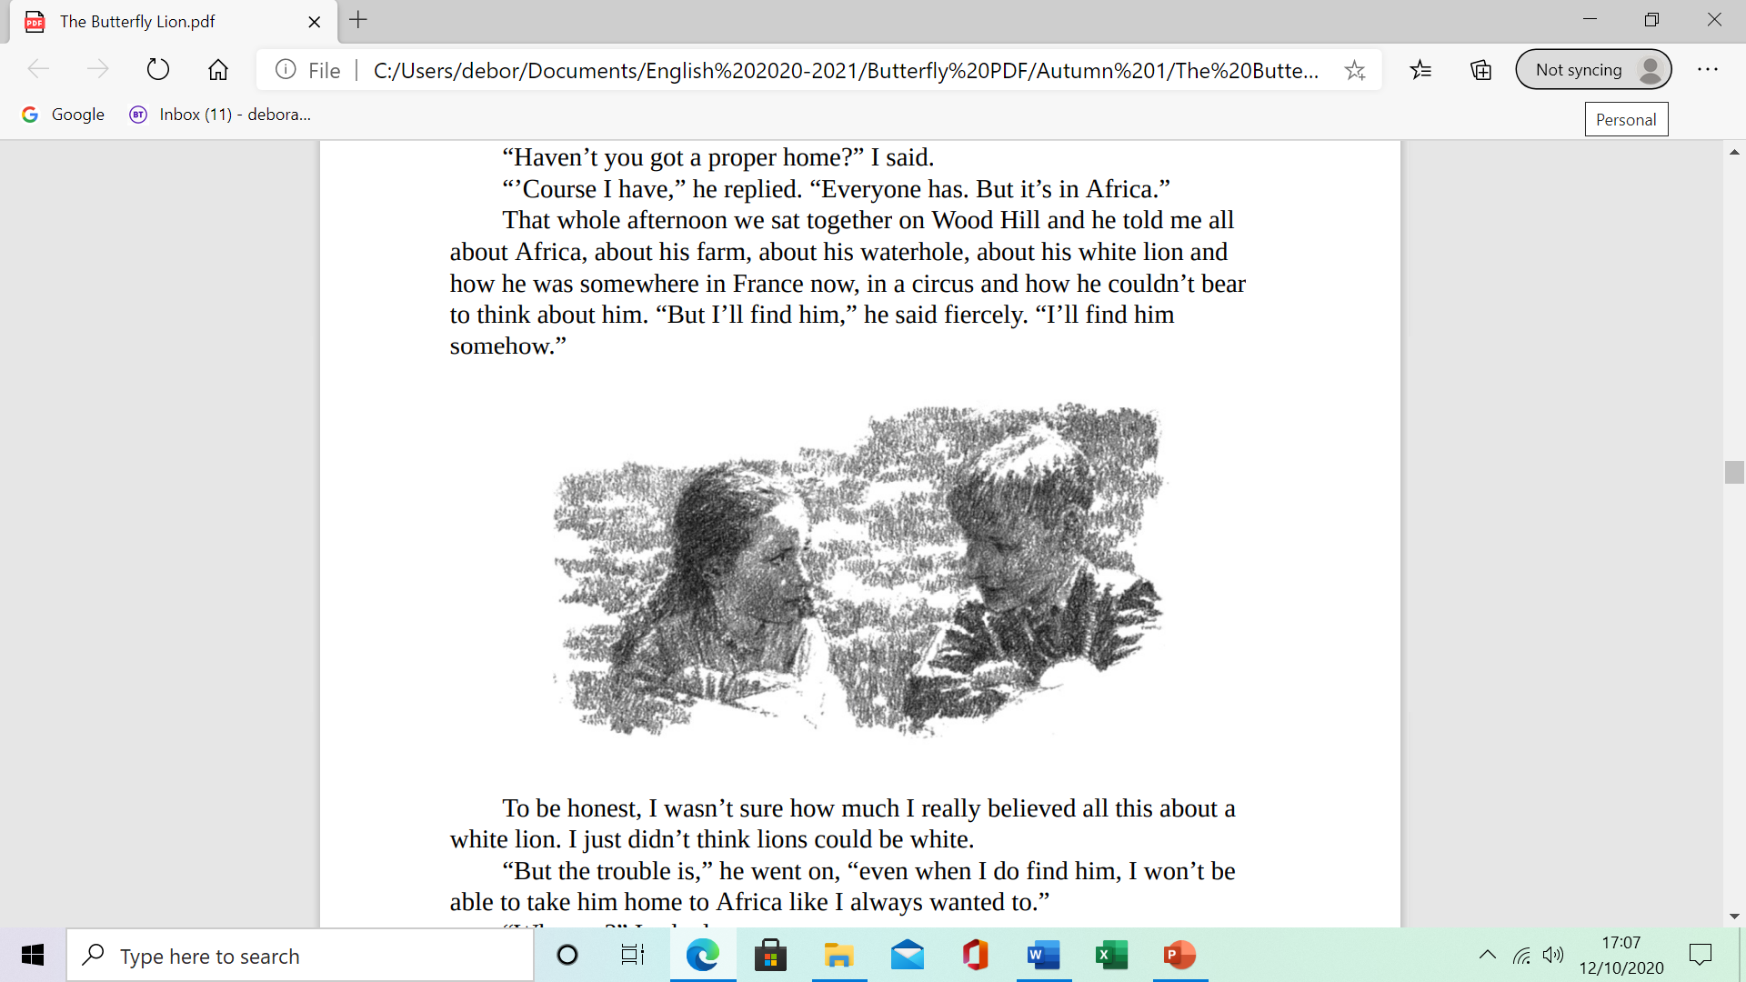
“I can mend it, if you like,” he said. “Who are you?” I asked again.
“Bertie Andrews,” he replied. He was wearing a grey school uniform, and one I recognised at once. From the lion gateway I had often watched them on their walks, two by two, blue school caps, blue socks.
“You’re from the school up the road, aren’t you?” I said. “You won’t tell on me, will you?” His eyes were wide with sudden alarm. I saw then that his legs were scratched and bleeding.
“Been in the wars, have you?” I said.
“I’ve run away,” he went on. “And I’m not going back, not ever.”
“Where are you going?” I asked him.
He shook his head. “I don’t know. In the holidays I live at my Auntie’s in Salisbury, but I don’t like it there.”

Slide 25
“Haven’t you got a proper home?” I said. “’Course I have,” he replied. “Everyone has. But it’s in Africa.”
That whole afternoon we sat together on Wood Hill and he told me all about Africa, about his farm, about his waterhole, about his white lion and how he was somewhere in France now, in a circus and how he couldn’t bear to think about him. “But I’ll find him,” he said fiercely. “I’ll find him somehow.”
To be honest, I wasn’t sure how much I really believed all this about a white lion. I just didn’t think lions could be white. “But the trouble is,” he went on, “even when I do find him, I won’t be able to take him home to Africa like I always wanted to.”

Slide 26
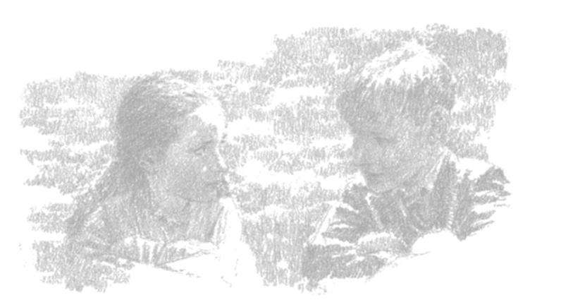
LO: to write a passage using fronted adverbial phrases and powerful verbs. Using the work you did yesterday, write a passage recalling the meeting of Bertie and the old lady, as children.

Slide 27
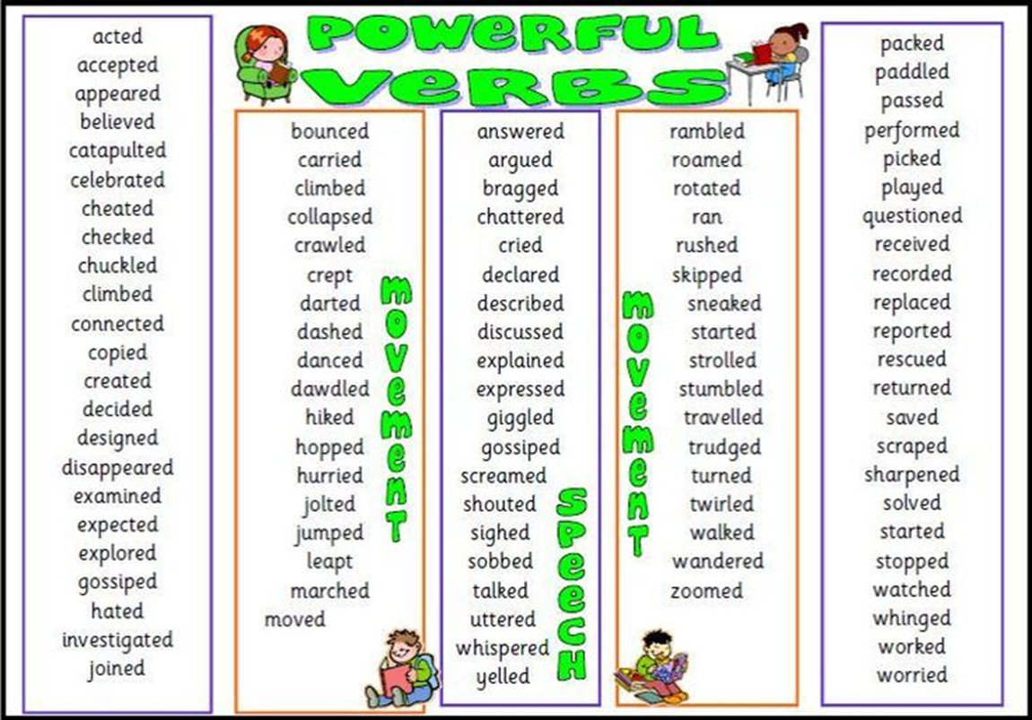

Slide 28
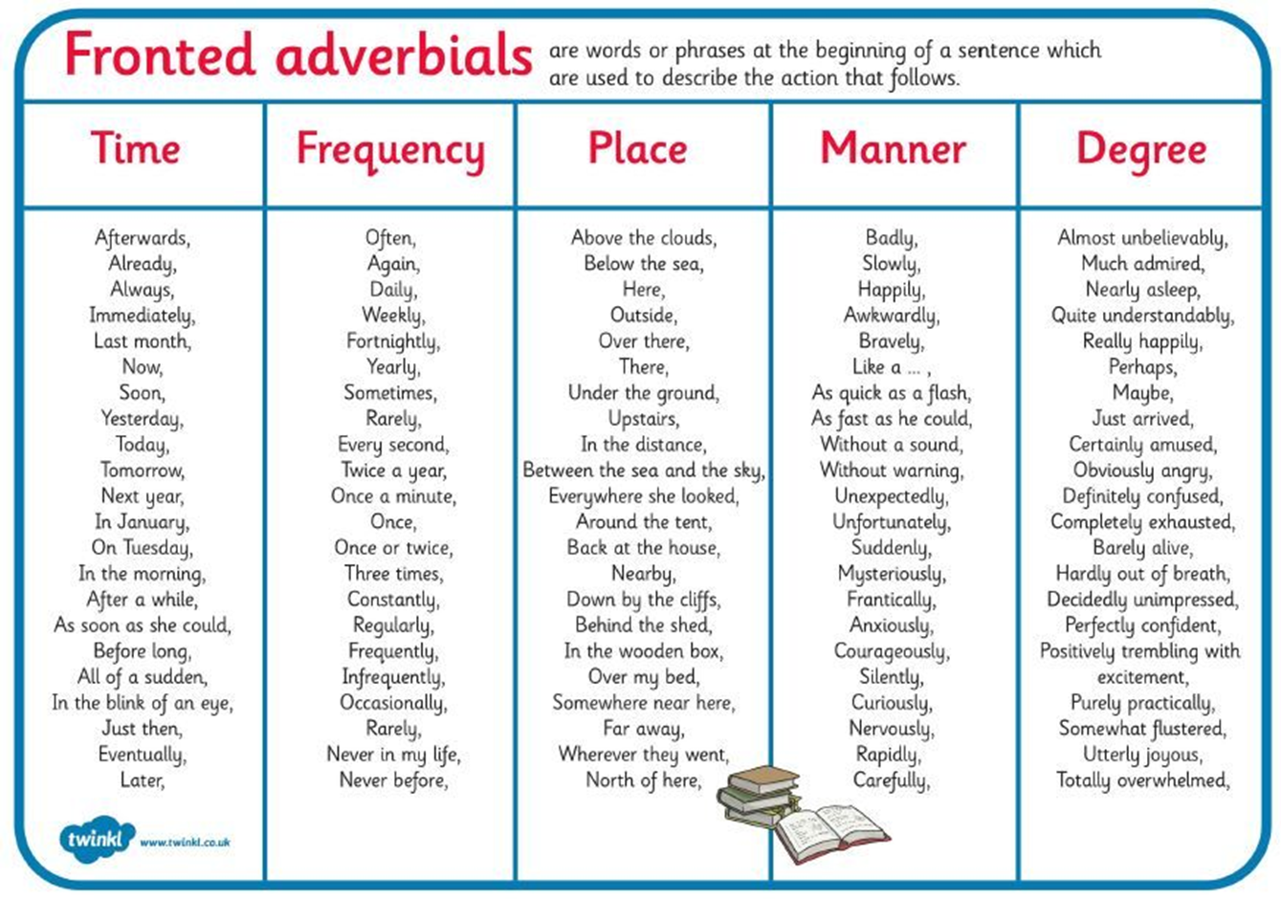

Slide 29
In the morning, I studied with my governess, Miss Tulips or “Nolips” as she was known by all. I didn’t go to school and consequently I had no friends or companions of my own age. As soon as I could, I went up to visit Nanny Mason who lived on the top floor. Nanny taught me all about life and was a loving mother to me.
Every week day, I worked hard at my lessons, looking forward to the afternoons strolling around the gardens with Nanny Mason. On Sunday, I was allowed the whole day to myself.

Slide 30
Day 5
Reading Comprehension

Slide 31
“Why not?” I asked.
“Because my mother died.” He looked down and pulled at the grass beside him. “She had malaria, but I think she really died of a broken heart.”
When he looked up his eyes were swimming with tears. “You can, you know. Then my father sold the farm and married someone else. I never want to go back. I never want to see him again, never.”
I wanted to say how sorry I was about his mother, but I couldn’t find the right words to say it.
“You really live here, do you?” he said. “In that big place? It’s as big as my school.”
I told him then what little there was to know of me, all about Father being away in London so much, about Nolips and Nanny Mason. He sucked at the purple clover as I talked; and when neither of us had anything more to say we lay back in the sun and watched a pair of mewing buzzards wheeling overhead. I was wondering what would happen to him if he got caught.
“What are you going to do?” I said at last.
“Won’t you get into trouble?”
“Only if they catch me.”
“But they will, they’re bound to, in the end,” I said.
“You’ve got to go back, before they miss you.”

Slide 32
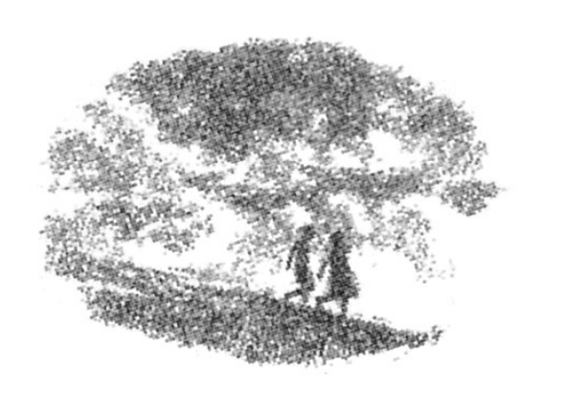
After a while he propped himself up on his elbow and looked down at me. “Maybe you’re right,” he said. “Maybe they won’t have missed me yet. Maybe it’s not too late. But if I go back, could I come again? I can face it if I can come again. Would you let me? I’ll mend your kite, really I will.”
And he gave me a smile so melting that I couldn’t refuse him. So it was arranged. He would meet me under the big wych elm on Wood Hill every Sunday afternoon at three, or as close to three as he could. He would have to come through the woods so that he could never be seen from the house. I knew full well that if Nolips ever found out, there’d be merry hell to pay – for both of us, probably. Bertie shrugged, and said that if he got caught, all they could do at school was beat him, and that once more wouldn’t make much difference anyway. And if they expelled him, well then, that would suit him fine.

Slide 33
Strawbridge
What makes the old lady wrinkle her nose in disgust?
What does the old lady say about true stories?
What did she have in common with Bertie?
Who were Miss Tulips and Nanny Mason?
Why did she enjoy reading so much?
What was she doing when she met Bertie?
What did Bertie do for her?
What was Bertie doing out of school?
Where was Bertie planning to go?
What has Bertie’s father done?

