Slide 1
Week 6
OUTCOME: to write a persuasive argument
Theme: animals used in entertainment
Audience WWF, Born Free Foundation

Slide 2
LO:to read, sort and present information
Word of the day-fury Day after day his father went out looking for the white lion, but each evening he came back empty-handed and blazing with fury. What does the word mean? If you are not sure, is there any way to find out? What is the verb used to describe this feeling? Is it effective? Consider the emotions in the book so far.

Slide 3
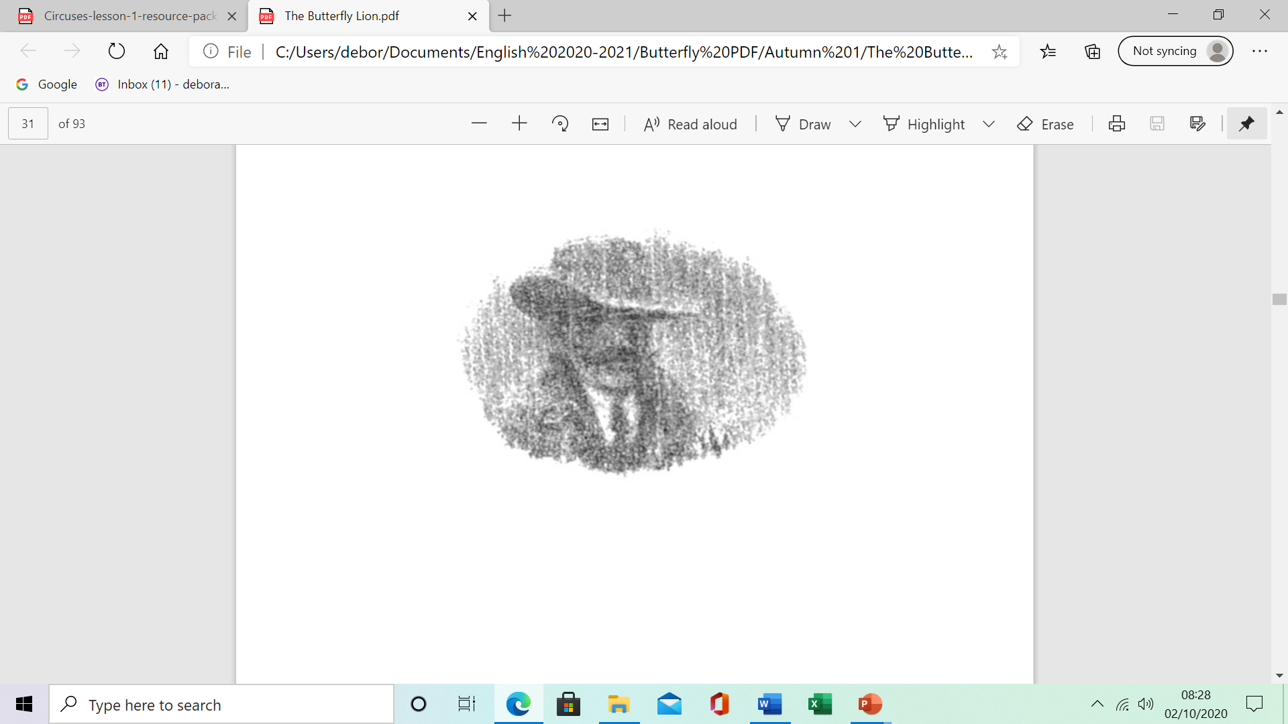
The Frenchman
They were there waiting on the veranda, his mother in her nightgown, his father in his hat, his horse saddled, ready to come after him. “I’ve set him free,” Bertie cried. “I’ve set him free, so he won’t ever have to live behind bars.” He was sent to his room at once, where he threw himself on his bed and buried his face in his pillow.
Day after day his father went out looking for the white lion, but each evening he came back empty-handed and blazing with fury.

Slide 4
Spot the verbs in the passage. Which do you find most effective? Why?
Can you find a synonym for this?
Day after day his father went out looking for the white lion, but each evening he came back empty-handed and blazing with fury.
anger rage ferocity vehemence passion

Slide 5
“What’ll I tell the Frenchman when he comes, eh? Did you for one minute think of that, Bertie? Did you? I should strap you. Any father worth his salt would strap you.” But he didn’t.
Bertie spent all day and every day at the fence, or up his tree in the compound, or at his bedroom window, his eyes scanning the veld for anything white moving through the grass. He prayed at his bedside every night until his knees were numb, prayed that his white lion would learn how to kill, would somehow find enough to eat, would avoid the hyenas, and other lions too, come to that. Above all, he prayed he would not come back, at least not until the Frenchman from the circus had come and gone.

Slide 6
LO: to read and present information Have you ever been to a circus? Did the circus have any animals performing? We are going to research what life would be like for The White Prince.

Slide 7
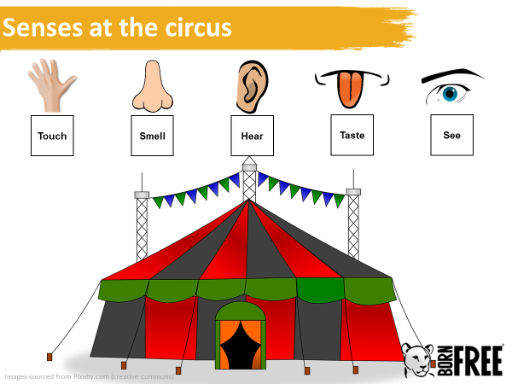

Slide 8
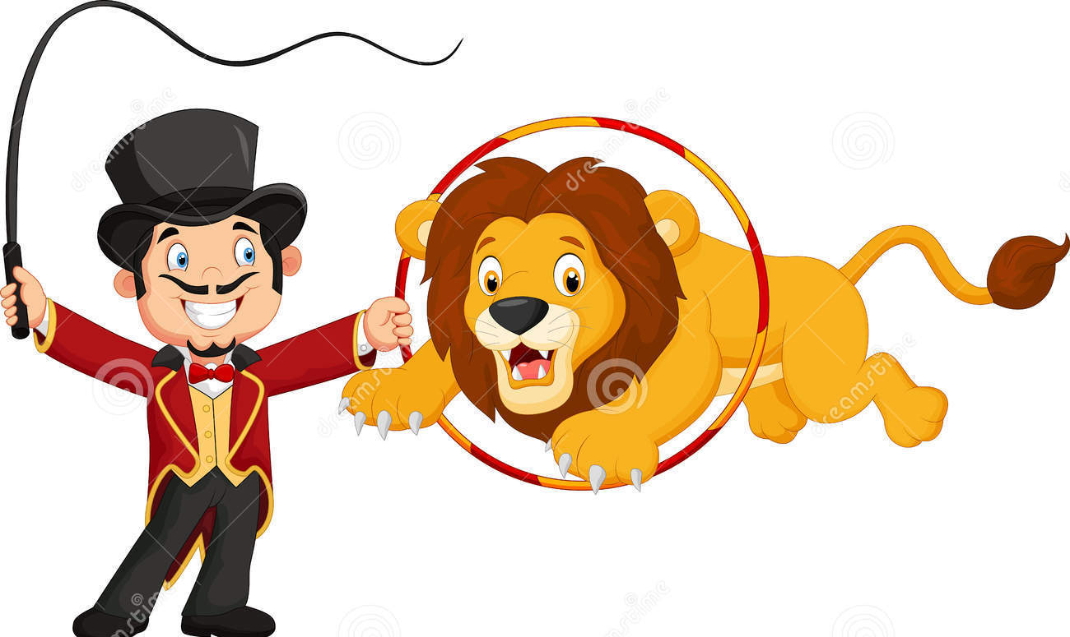
Would you expect to see animals at the circus?
Circuses can be fun and entertaining places where performers show incredible skill, but are they an appropriate environment for wild animals?

Slide 9
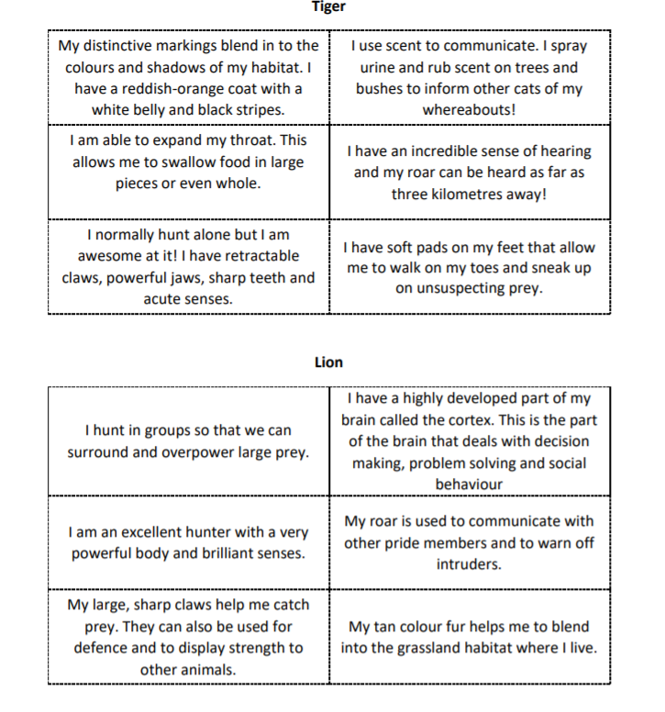
Read the cards about tigers and lions.
Choose one of the animals.
Use the information and present it as a fact file or poster.

Slide 10
Day 2
Word of the day- ravenously What does the word mean? They all helped to rub him down, and then looked on as he ate ravenously. Can you write a sentence using the word?

Slide 11
Read the next part of the story
The day the Frenchman came, it rained, the first rain for months, it seemed. Bertie watched him as he stood there, dripping on the veranda, his thumb hooked into his waistcoat pocket, as Bertie’s father broke the news that there was no white lion to collect, that he had escaped. That was the moment when Bertie’s mother put her hand to her throat, cried out and pointed. The white lion was wandering through the open compound gate, yowling pitifully. Bertie ran to him and fell on his knees and held him. The lion was soaked to the skin and trembling. He was panting with hunger and so thin that you could see his rib cage. They all helped to rub him down, and then looked on as he ate ravenously.
Identify the verbs and adverbs.
What does this tell us has happened to Bertie’s lion cub?

Slide 12
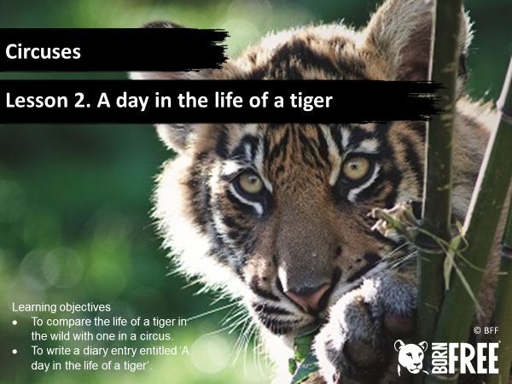
LO: To use personal writing - diary

Slide 13
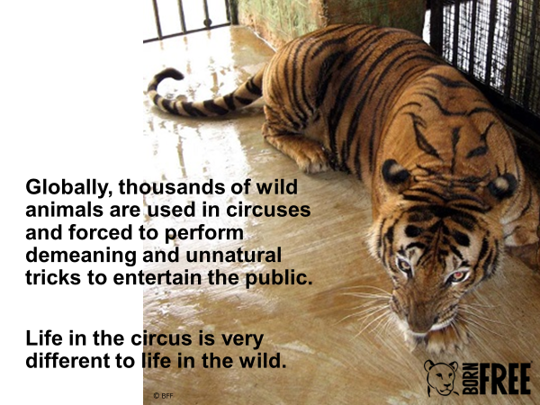
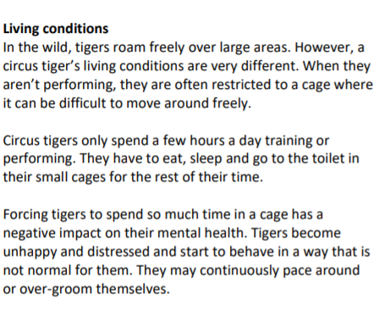
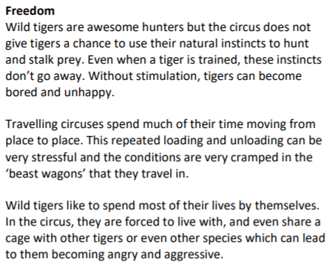

Slide 14
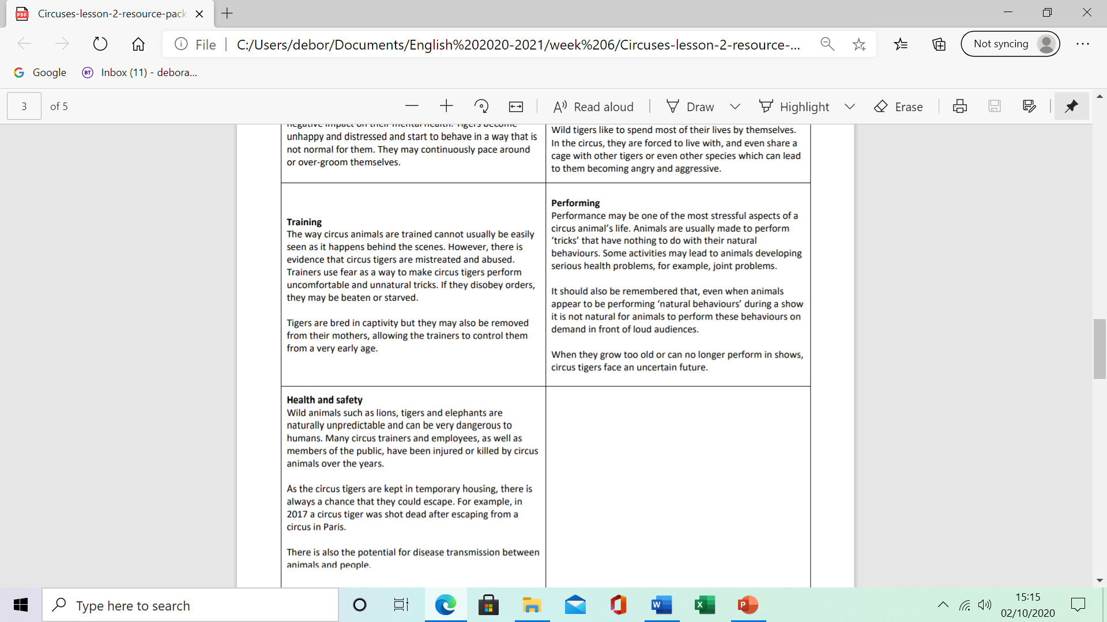

Slide 15
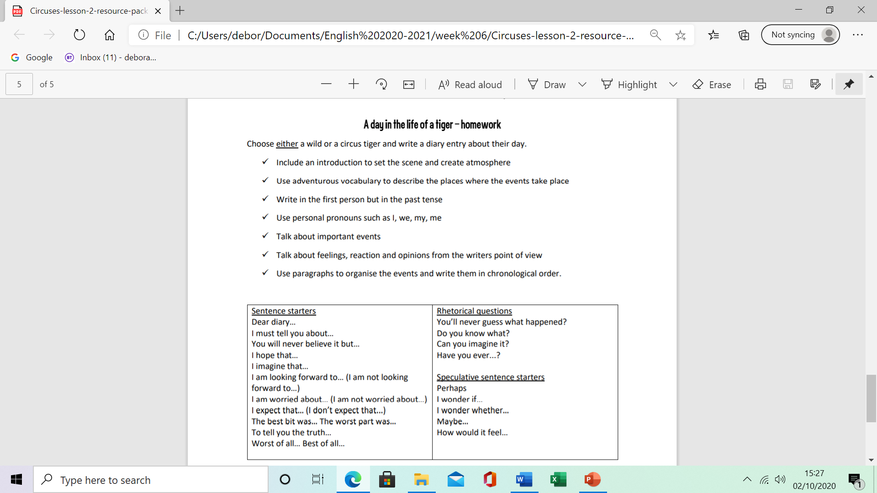

Slide 16
Day 3
Word of the day-earnest It was a kind face, not smiling, yet earnest and trustworthy.

Slide 17
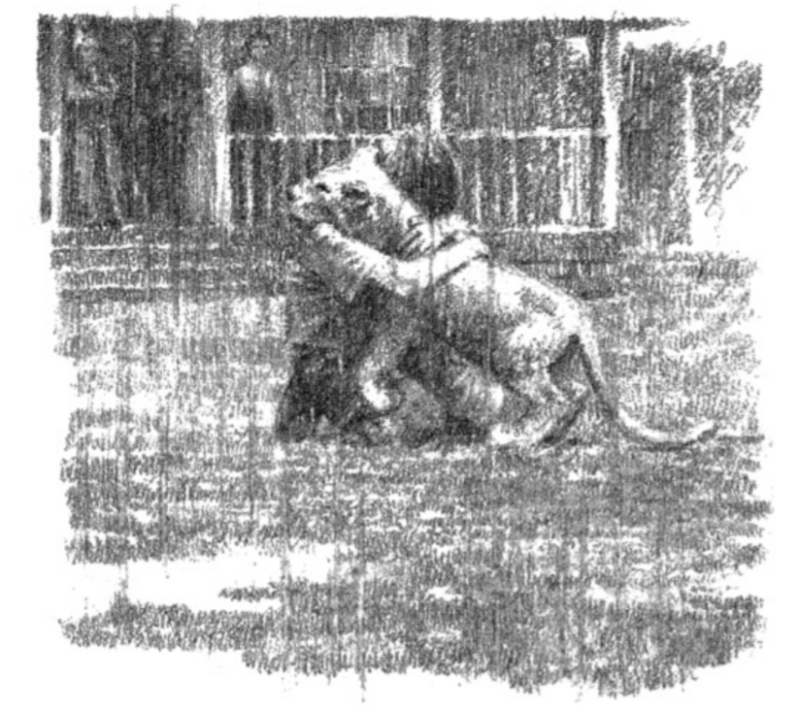
“Incroyable! Magnifique!” said the Frenchman. “And white, just as you said, white like the snow, and tame too. He will be the star of my circus. I shall call him ‘Le Prince Blanc’, ‘The White Prince’. He will have all he needs, all he wants, fresh meat every day, fresh straw every night. I love my animals, you know. They are my family, and this lion of yours, he will be my favourite son. Have no fear, young man, I promise you that he will never be hungry again.” He put his hand on his heart. “As God is my witness, I promise it.”
Bertie looked up into the Frenchman’s face. It was a kind face, not smiling, yet earnest and trustworthy. But even so, it did not make Bertie feel any better. “There, you see,” said Bertie’s mother. “He’ll be happy, and that’s all that matters, Bertie, isn’t it?”
Bertie knew that there was no point in begging. He knew now that the lion could never survive on his own in the wild, that he would have to go with the Frenchman. There was nothing else for it.

Slide 18
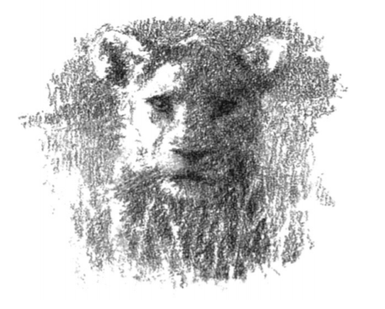
L.O: to plan a persuasive argument
Considering what you know about life in the wild and the circus.
Provide descriptions of animal adaptation of lions in the wild.
Create a chart listing points for and against using animals as entertainment.

Slide 19
Day 4
Word of the day- haze
As the last of Table Mountain vanished in a heat haze, he said goodbye to Africa and was not at all unhappy.

Slide 20
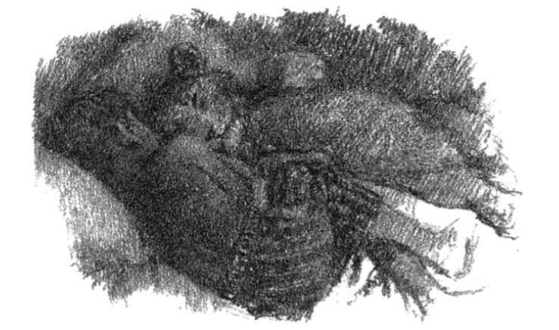
That night as they lay in the dark together side by side, Bertie made him a last promise. “I will find you,” he whispered. “Always remember that I will find you. I promise I will.”
The next morning the Frenchman shook hands with Bertie on the veranda and said goodbye. “He’ll be fine, don’t you worry. And one day you must come to France and see my circus, Le Cirque Merlot. It is the best circus in all of France.” Then they left, the white lion in a wooden crate rocking from side to side in the back of the Frenchman’s wagon. Bertie watched until the wagon disappeared from view.
A few months later, Bertie found himself on a ship steaming out of Cape Town, bound for England and school and a new life. As the last of Table Mountain vanished in a heat haze, he said goodbye to Africa and was not at all unhappy. He had his mother with him, for the time being at least. And after all, England was nearer France than Africa was, much nearer.

Slide 21
LO: to write a persuasive argument Write an argument for or against keeping animals for entertainment. I don't believe animals should be subjected to the conditions of circus life. Regular transport, cramped and bare temporary housing, forced training and performance, loud noises and crowds of people are often unavoidable realities for the animals. A circus show called "An Evening with Lions and Tigers" used specially trained animals to perform tricks in front of a live audience. Thomas Chipperfield, ran the show and said, “the big cats have regular health checks with vets.”

Slide 22
Day 5
Reading Comprehension

Slide 23
The Frenchman
Questions
What happened when Bertie arrived home?
What mood was Bertie’s father in when he returned from searching for the lion?
How did Bertie spend his time?
What happened when the Frenchman arrived?
What condition was the lion in?
What did the Frenchman think of the lion?
Why did Bertie decide that the lion would have to go with the Frenchman?
What promise did Bertie make the lion?
How will the lion be transported?
How did Bertie feel about leaving Africa?

