Slide 1
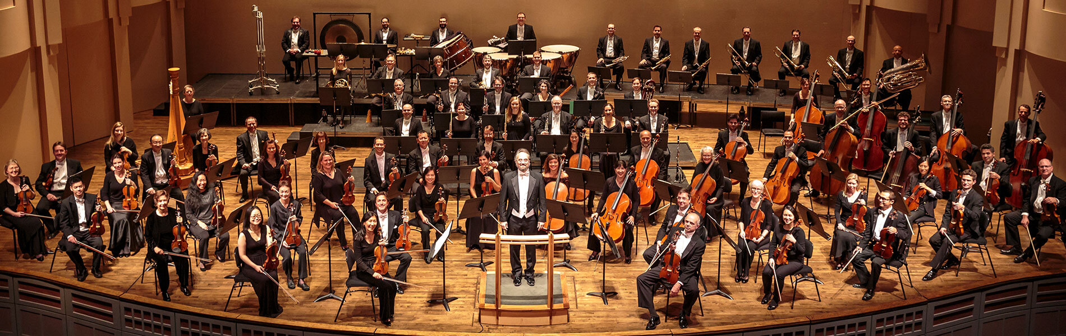

Year 4
Autumn 1
Lesson 4
Let’s Join The Orchestra

Slide 2
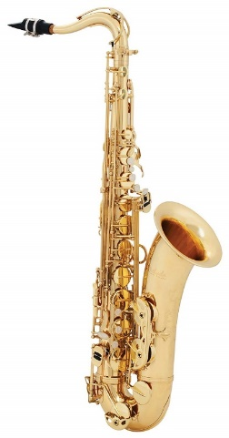
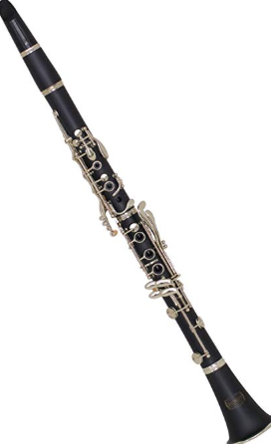
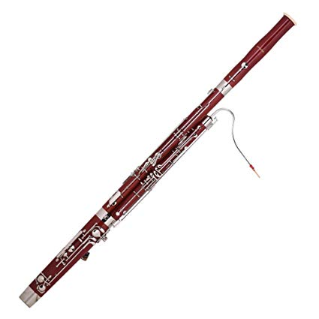
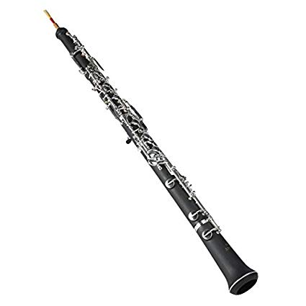
Teach
In reed instruments the sounds or vibrations are made when the air travels across a thin piece of wood called a reed.
Some instruments have one reed, like the clarinet and saxophone .
Other instruments use two reeds to vibrate against each other like the oboe and the bassoon
How woodwind instruments are made
https://www.bbc.com/teach/class-clips-video/music-science-ks2-how-woodwind-instruments-make-sound/zk3py9q

Slide 3
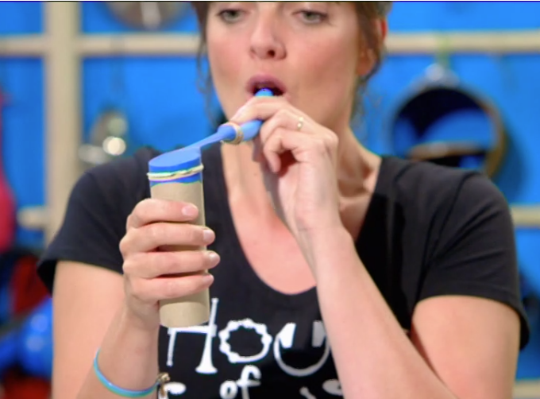
Task
You are going to make your own woodwind instrument
Use a balloon, a tube of cardboard, elastic band and a piece of plastic hose pipe

