Slide 1
Week 5
OUTCOME: to write from a character’s perspective

Slide 2
LO: to empathise with a character.
Word of the day-winced She wouldn’t look him in the eye and she winced whenever she tried to smile at him. What does the word mean? If you are not sure, is there any way to find out? Read the passage to compound p48 – How do we know how the characters feel? Look at the clues in the passage- focus on verbs

Slide 3
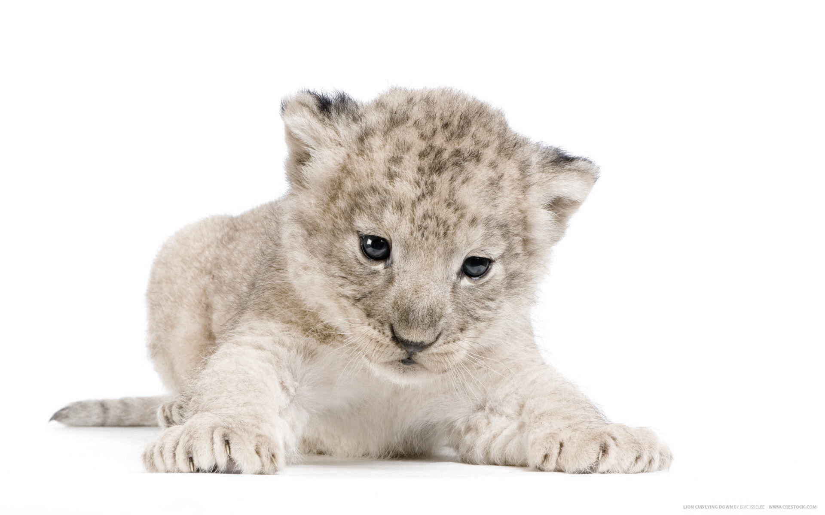
It was the best year of Bertie’s young life. But when it ended, it ended more painfully than he could ever have imagined. He’d always known that one day when he was older he would have to go away to school, but he had thought and hoped it would not be for a long time yet. He’d simply put it out of his mind.
His father had just returned home from Johannesburg after his yearly business trip. He broke the news at supper that first evening. Bertie knew there was something in the wind. His mother had been sad again in recent days, not sick, just strangely sad. She wouldn’t look him in the eye and she winced whenever she tried to smile at him. The lion had just lain down beside him, his head warm on Bertie’s feet, when his father cleared his throat and began. It was going to be a lecture. Bertie had had them before often enough, about manners, about being truthful, about the dangers of leaving the compound.

Slide 4
Spot the verbs in the passage. Which do you find most effective? Why?
Can you find a synonym for this?
She winced whenever she tried to smile at him.
recoiled flinched cringed jumped shrank shuddered gasped

Slide 5
“You’ll soon be eight, Bertie,” he said. “And your mother and I have been doing some thinking. A boy needs a proper education, a good school. Well, we’ve found just the right place for you, a school near Salisbury in England. Your Uncle George and Aunt Melanie live nearby and have promised to look after you in the holidays, and to visit you from time to time. They’ll be father and mother to you for a while. You’ll get on with them well enough, I’m sure you will. They are fine, good people. So you’ll be off on the ship to England in July. Your mother will accompany you. She will spend the summer with you in Salisbury and after she has taken you to your school in September, she’ll then return here to the farm. It’s all arranged.”
As his heart filled with a terrible dread, all Bertie could think of was his white lion. “But the lion,” he cried, “what about the lion?”

Slide 6
“I’m afraid there’s something else I have to tell you,” his father said. Looking across at Bertie’s mother, he took a deep breath. And then he told him. He told him he had met a man whilst he was in Johannesburg, a Frenchman, a circus owner from France. He was over in Africa looking for lions and elephants to buy for his circus. He liked them young, very young, a year or less, so that he could train them up without too much trouble. Besides, they were easier and cheaper to transport when they were young. He would be coming out to the farm in a few days’ time to see the white lion for himself. If he liked what he saw, he would pay good money and take him away.

Slide 7
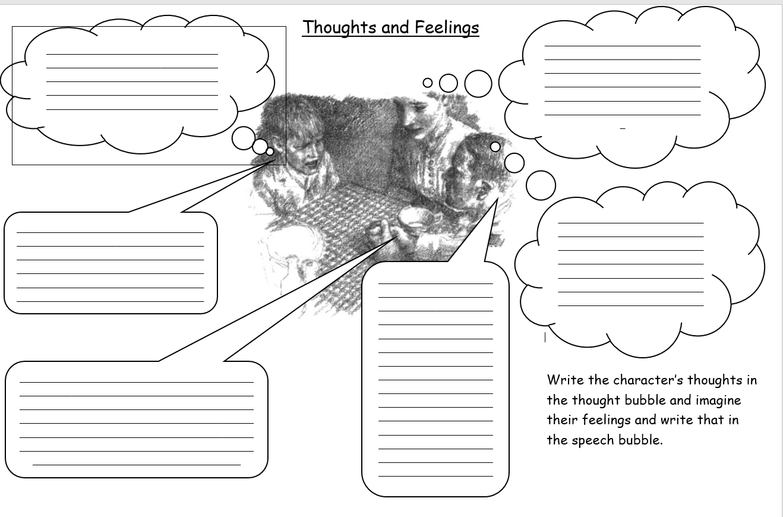
Complete the thoughts and feelings sheet.

Slide 8
Day 2
Word of the day- dread What does the word mean? Can you make a simple sentence using the word? Now try writing a complex sentence.

Slide 9
He told him he had met a man whilst he was in Johannesburg, a Frenchman, a circus owner from France. He was over in Africa looking for lions and elephants to buy for his circus. He liked them young, very young, a year or less, so that he could train them up without too much trouble. Besides, they were easier and cheaper to transport when they were young. He would be coming out to the farm in a few days’ time to see the white lion for himself. If he liked what he saw, he would pay good money and take him away.
What do we know about the Frenchman?
What do you think he is like?
Have you any evidence?

Slide 10
LO: To use personal writing
How is Bertie feeling? Do you keep a diary? A diary has only the author as its audience and can convey true emotion. This is an example of a Jewish child’s wartime diary, based on the diary of Anne Frank. 11th July, 1942 I can't tell you how oppressive it is never to be able to go outdoors, also I'm scared to death that we shall be discovered and shot. That is not exactly a pleasant prospect. We have to whisper and tread lightly during the day, otherwise the people in the warehouse might hear us. Write a short diary entry, in first person, as Bertie. Write it for the day he heard about the fate of his lion cub.

Slide 11
It was the only time in his life Bertie had ever shouted at his father. “No! No, you can’t!”
It was rage that wrung the hot tears from him, but they soon gave way to silent tears of sadness and loss. There was no comforting him, but his mother tried all the same.
“We can’t keep him here for ever, Bertie,” she said. “We always knew that, didn’t we? And you’ve seen how he stands by the fence gazing out into the veld. You’ve seen him pacing up and down. But we can’t just let him out. He’d be all on his own, no mother to protect him. He couldn’t cope. He’d be dead in weeks. You know he would.”
“But you can’t send him to a circus! You can’t!” said Bertie. “He’ll be shut up behind bars. I promised him he never would be. And they’ll point at him. They’ll laugh at him. He’d rather die. Any animal would.” But he knew as he looked across the table at them that it was hopeless, that their minds were quite made up.
For Bertie the betrayal was total. That night he made up his mind what had to be done. He waited until he heard his father’s deep breathing next door. Then, with his white lion at his heels, he crept downstairs in his pyjamas, took down his father’s rifle from the rack and stepped out into the night. The compound gate yawned open noisily when he pushed it, but then they were out, out and running free. Bertie had no thought of the dangers around him, only that he must get as far from home as he could before he did it.

Slide 12
Day 3
Word of the day -wandering Can you find out what a homophone is ? Write two simple sentences using wandering and wondering.

Slide 13
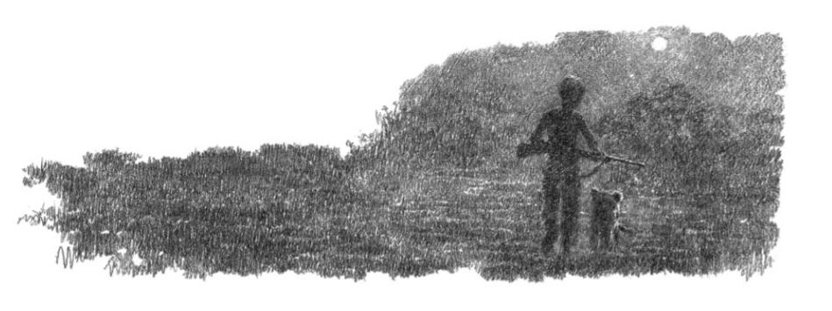
The lion padded along beside him, stopping every now and again to sniff the air. A clump of trees became a herd of elephants wandering towards them out of the dawn. Bertie ran for it. He knew how elephants hated lions. He ran and ran till his legs could run no more. As the sun came up over the veld he climbed to the top of a kopje and sat down, his arm round the lion’s neck. The time had come.
“Be wild now,” he whispered. “You’ve got to be wild. Don’t come home. Don’t ever come home. They’ll put you behind bars. You hear what I’m saying? All my life I’ll think of you, I promise I will. I won’t ever forget you.” And he buried his head in the lion’s neck and heard the greeting groan from deep inside him. He stood up. “I’m going now,” he said. “Don’t follow me. Please don’t follow me.” And Bertie clambered down off the kopje and walked away.
When he looked back, the lion was still sitting there watching him; but then he stood up, yawned, stretched, licked his lips and sprang down after him. Bertie shouted at him, but he kept coming. He threw sticks. He threw stones. Nothing worked. The lion would stop, but then as soon as Bertie walked on, he simply followed at a safe distance.

Slide 14
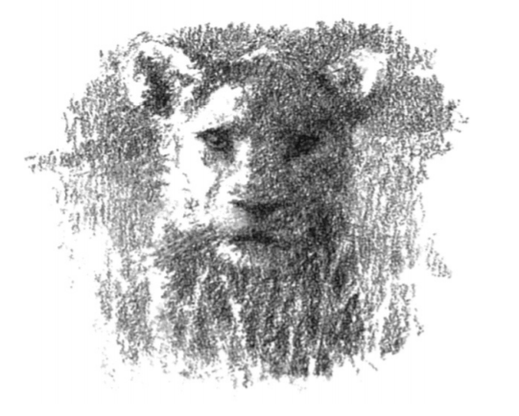
L.O: to write from an alternative perspective
Imagine you are the lion.
How do you feel?
Think of some interesting adjectives, adverbs and verbs that describe your emotions.
Write an account of the scene from the lion’s perspective – emphasise first person.

Slide 15
Day 4
Word of the day -captivity

Slide 16
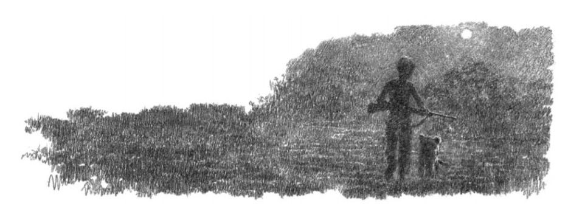
“Go back!” Bertie yelled, “you stupid, stupid lion! I hate you! I hate you! Go back!” But the lion kept loping after him whatever he did, whatever he said.
There was only one thing for it. He didn’t want to do it, but he had to. With tears filling his eyes and his mouth, he lifted the rifle to his shoulder and fired over the lion’s head. At once the lion turned tail and scampered away through the veld. Bertie fired again. He watched till he could see him no more, and then turned for home. He knew he’d have to face what was coming to him. Maybe his father would strap him – he’d threatened it often enough – but Bertie didn’t mind. His lion would have his chance for freedom, maybe not much of one. Anything was better than the bars and whips of a circus

Slide 17
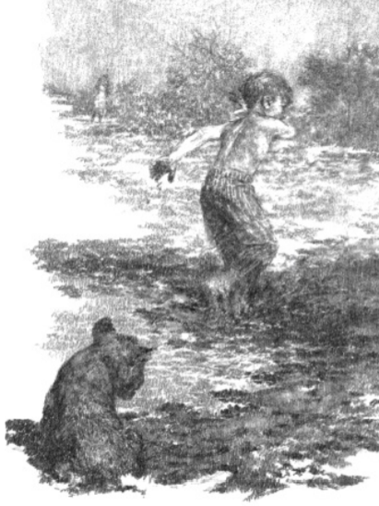
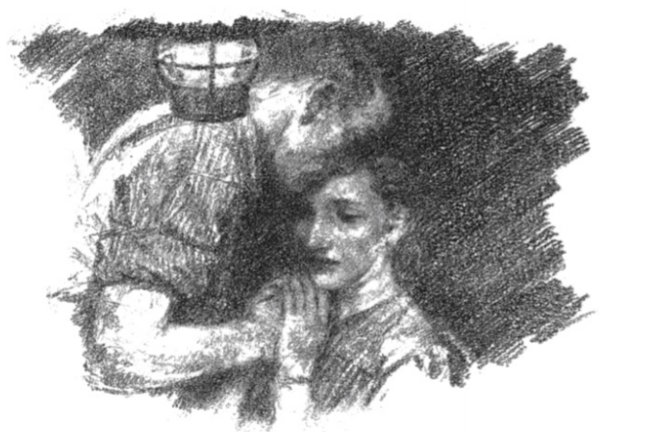
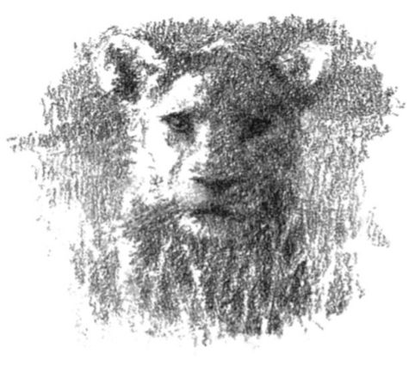
LO: to write from a character’s perspective. Using the work you did yesterday, and knowledge of the novel so far, decide the character’s perspective you would like to write. Choose and write an account of the finding, rearing and eventual release of the white lion. Bertie Bertie’s Father Bertie’s Mother White Lion Cub

Slide 18
Day 5
Reading Comprehension

Slide 19
“ Running Free”
Questions
How did Bertie know “there was something in the wind”?
What was his father’s lecture about?
What would happen to Bertie’s lion?
How did Bertie react when he heard his father’s plan?
Why was Bertie so against the idea of a circus?
What did Bertie do that night?
Why did Bertie run when he saw a herd of elephants wandering towards them?
Why did Bertie throw stones and sticks at the lion?
Why did Bertie shout “ I hate you!” at the lion?
How did the lion respond to the gunfire?

