Slide 1
Place Value
Week 5

Slide 2
Recap
3x25= 30x25=
5x25= 50x25=
8x25= 80x25=
What did you notice?

Slide 3
LO: to use negative numbers.
Discuss with your partner.
What does negative mean?
What is the inverse of negative?
How do we record negative numbers?

Slide 4
Can you use the word negative in a sentence?

Slide 5
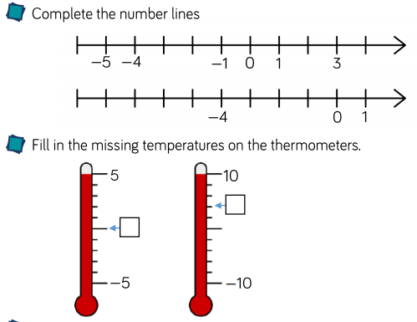
LO: to use negative numbers.

Slide 6
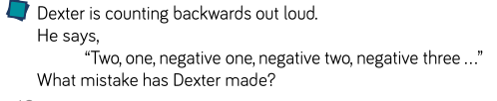
LO: to use negative numbers.
Discuss with your partner

Slide 7
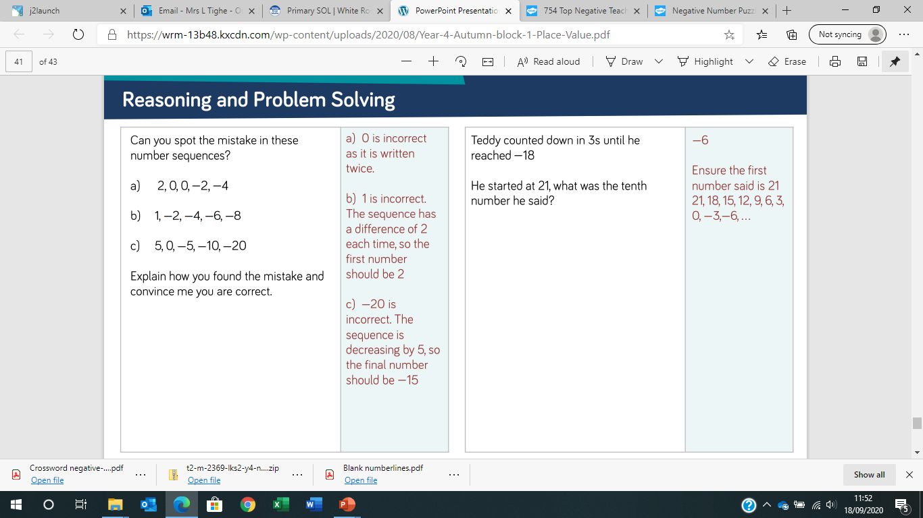
LO: to use negative numbers.

Slide 8
LO: to use Roman numerals to 100.
On white boards show these numbers as Roman Numerals
1
3
6
5
9
10
12

Slide 9
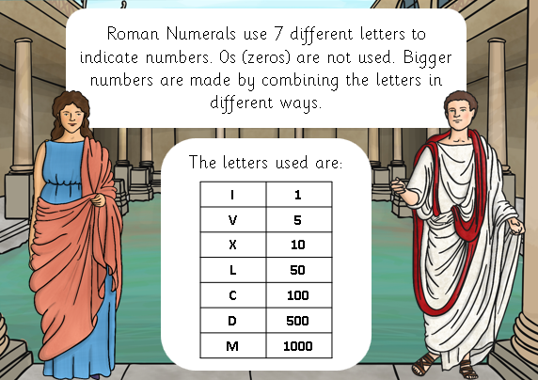

Slide 10
Lollipop activity
Using the lollipop sticks make the Roman numeral
4

Slide 11
Lollipop activity
Using the lollipop sticks make the Roman numeral
4= IV
Repeat

Slide 12
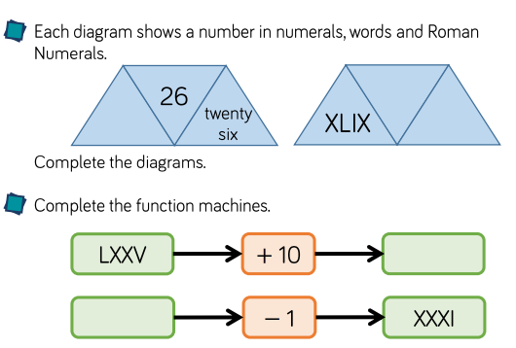

Slide 13
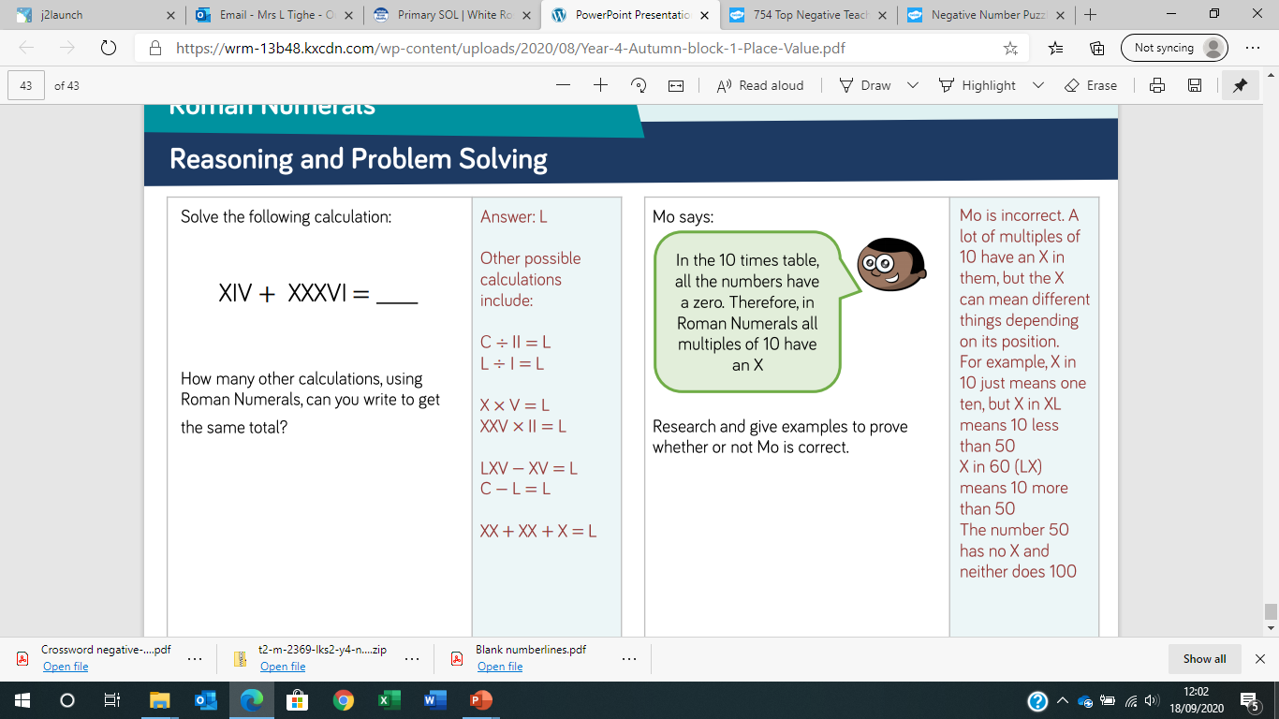
Answer

Slide 14
Answer

