Slide 1
Year 4 Autumn
Block 2 Addition and Subtraction
Week 5 lessons 3-5

Slide 2
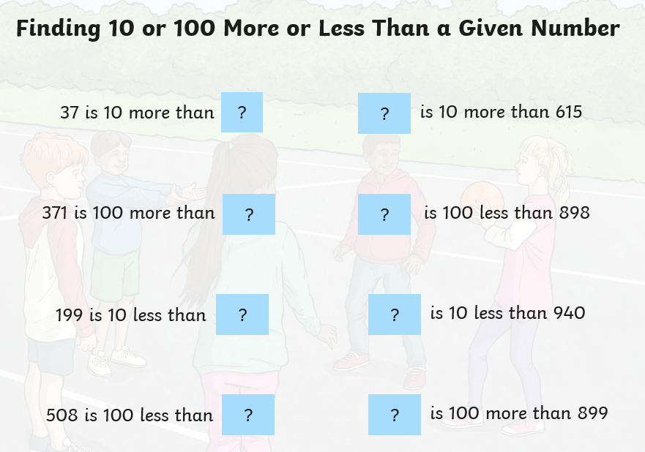
https://www.topmarks.co.uk/maths-games/hit-the-button

Slide 3
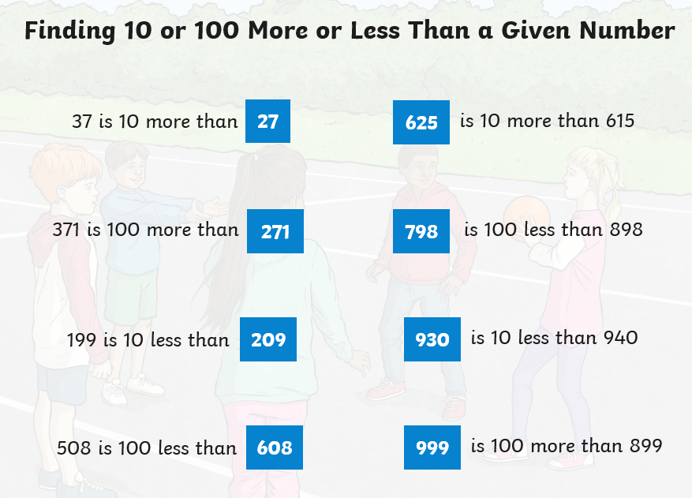

Slide 4
LO: to add and subtract 1’s, 10’s, 100’s and 1000’s.

Slide 5
What are the four calculations?
LO: to add and subtract 1’s, 10’s, 100’s and 1000’s.
What does inverse mean?

Slide 6

LO: to add and subtract 1’s, 10’s, 100’s and 1000’s.
Add
Subtract
Multiply
Divide

Slide 7
Using your whiteboards write the number three hundred and fifty four in digits.
LO: to add and subtract 1’s, 10’s, 100’s and 1000’s.

Slide 8
Using your whiteboards write the number three hundred and fifty four in digits.
LO: to add and subtract 1’s, 10’s, 100’s and 1000’s.
354
Show this using Base ten.
How many tens are there?
How many ones would we need to add to get to the next ten?
What number would you have if you added two hundreds?
Repeat

Slide 9
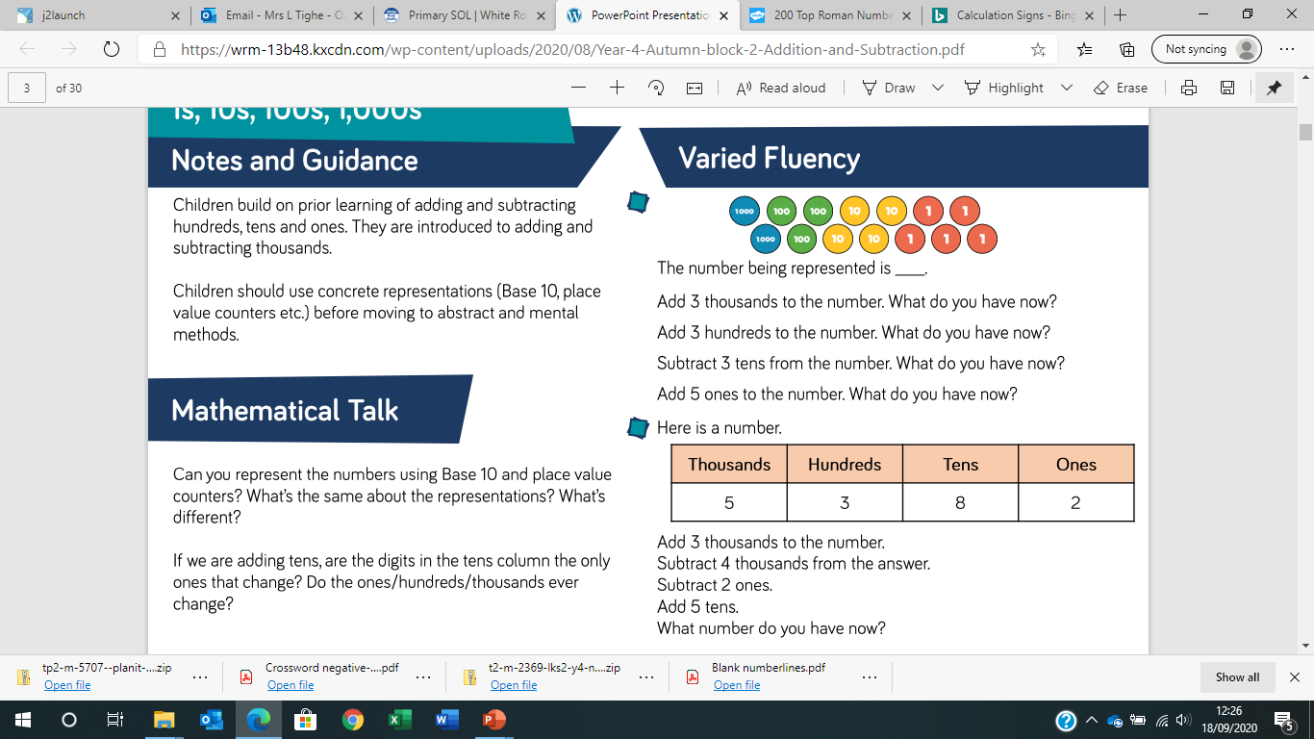
LO: to add and subtract 1’s, 10’s, 100’s and 1000’s.

Slide 10
LO: to add and subtract 1’s, 10’s, 100’s and 1000’s.

Slide 11
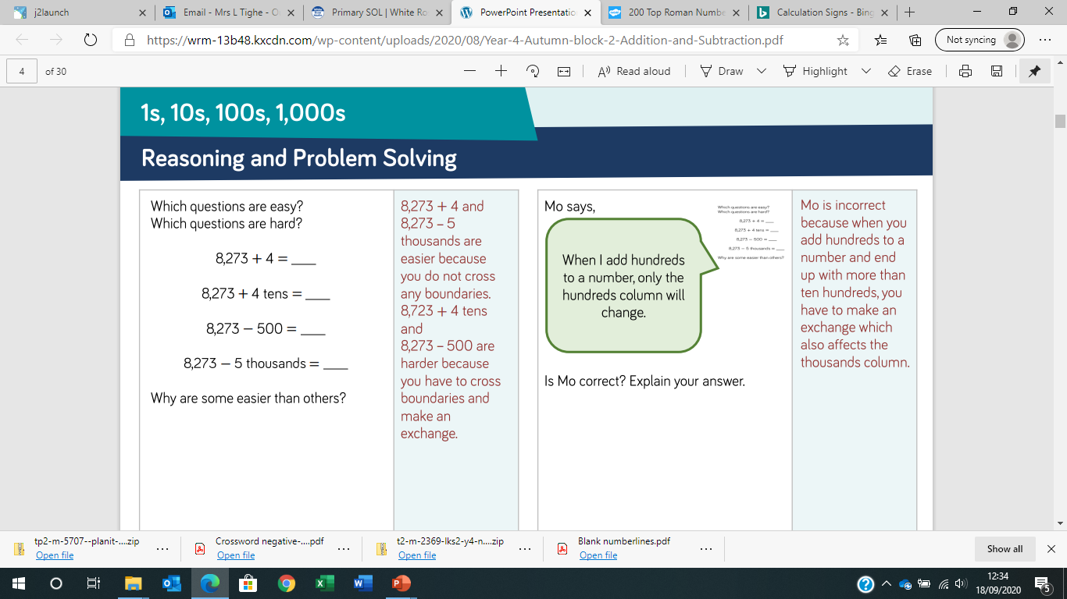
LO: to add and subtract 1’s, 10’s, 100’s and 1000’s.
Discuss with your partner

Slide 12
LO: to add two three digit numbers.

Slide 13
LO: to add two three digit numbers.
Using a dice/ place value cards generate a 2 digit number.
Roll the dice and then add that number. Show answers on whiteboards
Repeat but this time subtract.
Show answer on whiteboards

Slide 14
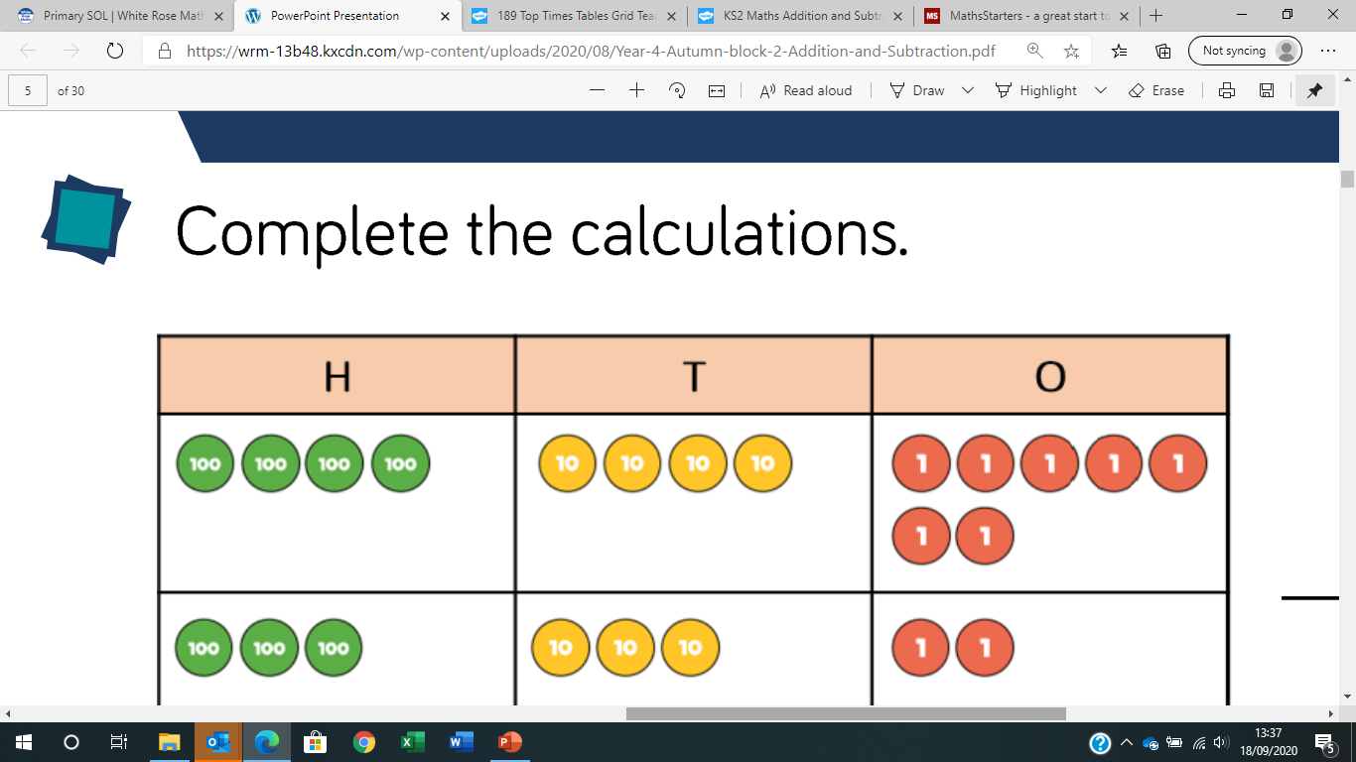
LO: to add two three digit numbers.
What calculation is shown here?

Slide 15
LO: to add two three digit numbers.
What calculation is shown here?
36+22
What is the answer?

Slide 16
LO: to add two three digit numbers.
What calculation is shown here?
What is this calculation?

Slide 17
LO: to add two three digit numbers.
What calculation is shown here?
45+33

Slide 18
LO: to add two three digit numbers.
What calculation is shown here?
What’s different about this calculation?
What do you notice about the columns?

Slide 19
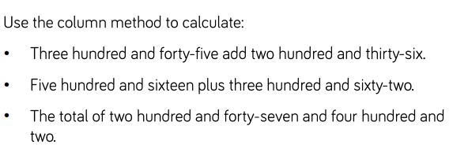
LO: to add two three digit numbers.

Slide 20
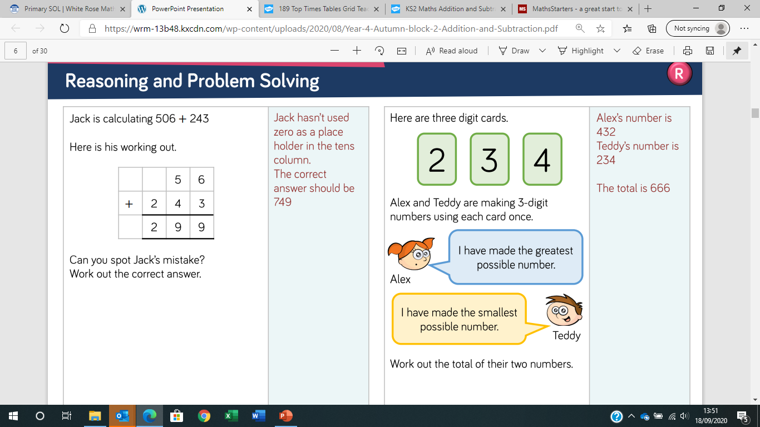
LO: to add two three digit numbers.

Slide 21
LO: to add two four digit numbers.
Discuss with your partner what must we remember when adding?

Slide 22
LO: to add two four digit numbers.
Discuss with your partner what must we remember when adding?
Make sure the numbers are in the correct column
Start adding with the ones column and move left

Slide 23
LO: to add two four digit numbers.
Using counters or base ten show the calculation
602+243
Explain your method to your partner.

Slide 24
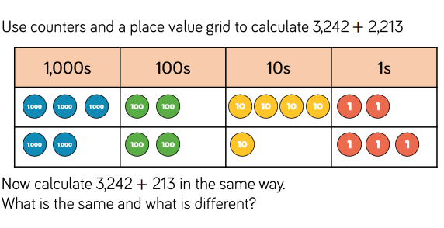
LO: to add two four digit numbers.

Slide 25
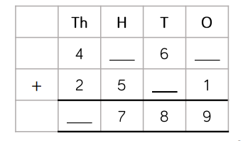
LO: to add two four digit numbers.
What are the
missing values?

Slide 26
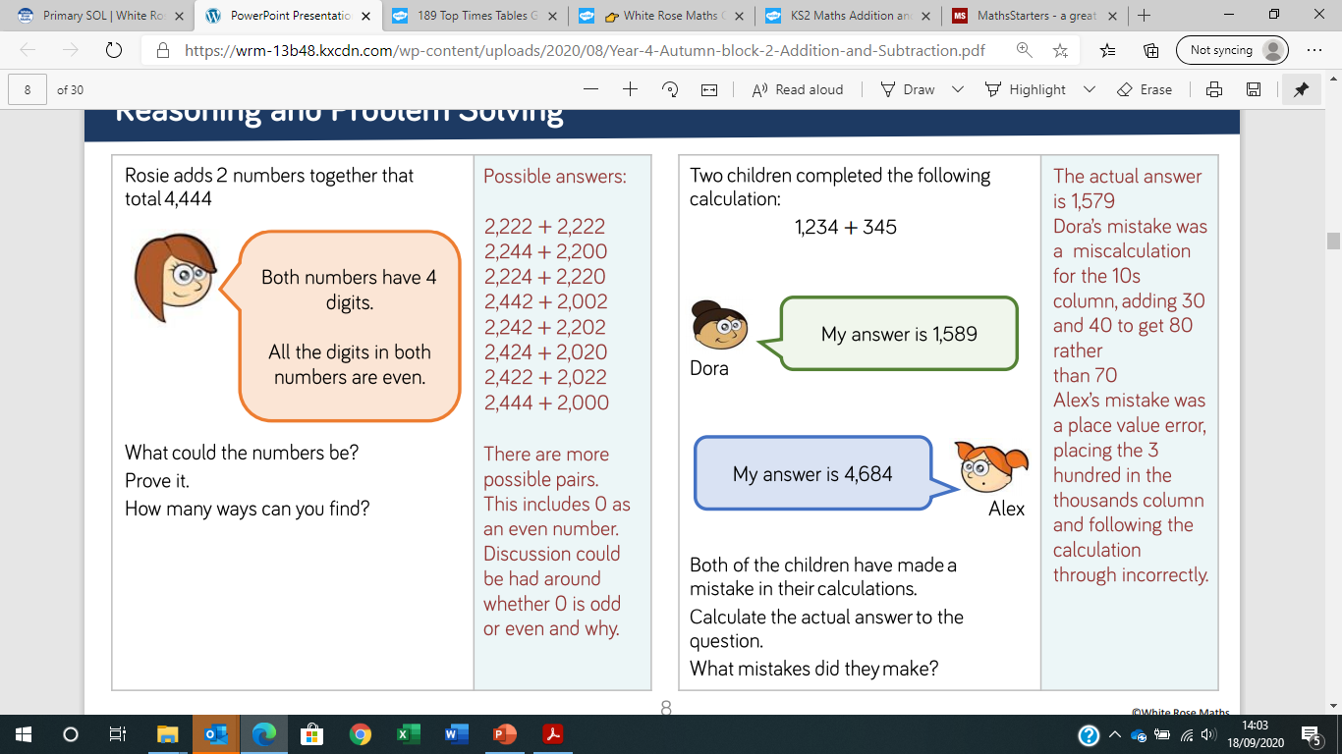
LO: to add two four digit numbers.

