Slide 1
Week 4
OUTCOME:
to write using a varied sentence structure

Slide 2
LO: to understand sentence structure and write simple sentences.
Word of the day-intrusion Startled at this sudden intrusion, the hyenas turned tail and ran, but not far. What does the word mean? If you are not sure, is there any way to find out?

Slide 3
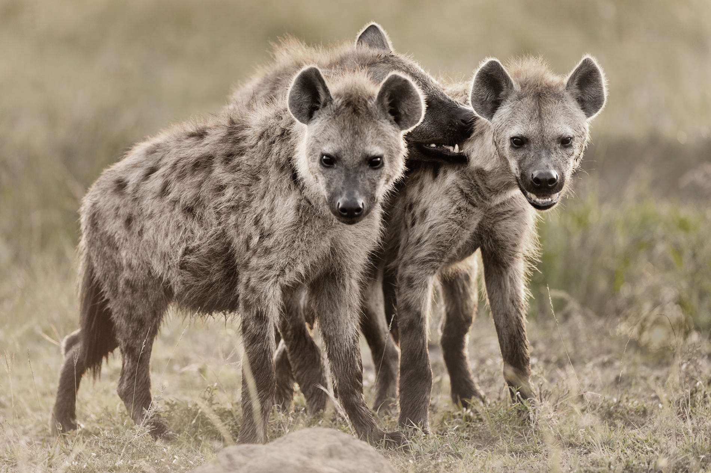
One morning, a week or so later, Bertie was woken by a chorus of urgent neighing. He jumped out of his bed and ran to the window. A herd of zebras was scattering away from the waterhole, chased by a couple of hyenas. Then he saw more hyenas, three of them, standing stock still, noses pointing, eyes fixed on the waterhole. It was only now that Bertie saw the lion cub. But this one wasn’t white at all. He was covered in mud, with his back to the waterhole, and he was waving a pathetic paw at the hyenas who were beginning to circle. The lion cub had nowhere to run to, and the hyenas were sidling ever closer.

Slide 4
Bertie was downstairs in a flash, leaping off the veranda and racing barefoot across the compound, shouting at the top of his voice. He threw open the gate and charged down the hill towards the waterhole, yelling and screaming and waving his arms like a wild thing. Startled at this sudden intrusion, the hyenas turned tail and ran, but not far. Once within range Bertie hurled a broadside of pebbles at them, and they ran off again, but again not far. Then he was at the waterhole and between the lion cub and the hyenas, shouting at them to go away. They didn’t. They stood and watched, uncertain for a while. Then they began to circle again, closer, closer…

Slide 5
He jumped out of his bed and ran to the window.
They didn’t.
These sentences have been taken from the extract you have just read.
What do you think they have in common?
How are they different?

Slide 6
Sentences
Linking words together in the right way makes your writing easy to understand and interesting to read.
When you are writing, words are grouped together into sentences.
There are a few simple rules you need to follow to make sure your sentences are clear.
Firstly, a sentence needs a capital letter at the beginning and a punctuation mark at the end, like a full stop (.), a question mark (?) or an exclamation mark (!).
A sentence also needs a verb in it and it must make complete sense all on its own.

Slide 7
Simple sentences
A simple sentence is built from the minimum of a subject and a main verb. It can be very short in length but doesn't have to be.
There are several reasons for using simple sentences. For example, a series of short simple sentences used together may be used to create tension, as in this extract:
'We rounded the corner. He was there. We stood in awe at the sight.'
Short simple sentences are frequently used to offer facts, so that they are easily understood by a reader. For example:
'Paris is the capital city of France.'
Short, simple sentences can make their meaning clear, easily. For that reason, they are often used in texts that are aimed at younger readers as well as in children’s rhymes:
Where are you going to little brown mouse? Come for a feast in my log pile house.
The Gruffalo by Julia Donaldson

Slide 8
We are going to write some simple sentences based on the chapters we have read from the book.
Nouns/subject verbs
Timbavati is in South Africa.
Bertie was watching the waterhole.
Hyenas laughed.
Butterflies shimmered in the sunshine.
Bertie’s father farmed cattle.
There was a waterhole near the farm.
His hands gripped the fence.
Write as many simple sentences, based on the Butterfly Lion, as you can.

Slide 9
Day 2
Word of the day- chorus One morning, a week or so later, Bertie was woken by a chorus of urgent neighing. What does the word mean? Can you make a simple sentence from this complex sentence?

Slide 10
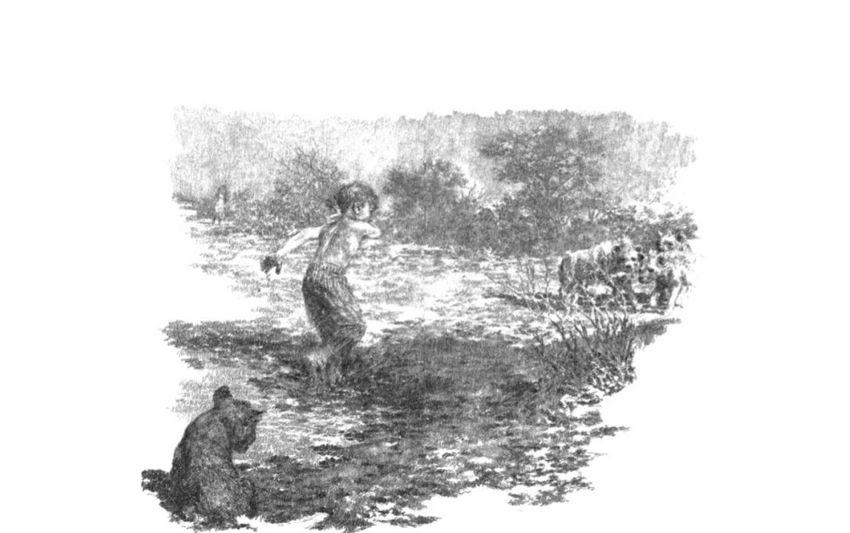
That was when the shot rang out. The hyenas bolted into the long grass, and were gone. When Bertie turned round he saw his mother in her nightgown, rifle in hand, running towards him down the hill. He had never seen her run before. Between them they gathered up the mud-matted cub and brought him home. He was too weak to struggle, though he tried. As soon as they had given him some warm milk, they dunked him in the bath to wash him. As the first of the mud came off, Bertie saw he was white underneath. “You see!” he cried triumphantly. “He is white! He is. I told you, didn’t I? He’s my white lion!” His mother still could not bring herself to believe it. Five baths later, she had to. They sat him down by the stove in a washing basket and fed him again, all the milk he could drink, and he drank the lot. Then he lay down and slept.
He was still asleep when Bertie’s father got back at lunch time. They told him how it had all happened. “Please, Father. I want to keep him,” Bertie said.

Slide 11
L.O: to add detail to the simple sentences
Timbavati is in South Africa.
Remote, sun-baked Timbavati is a settlement in South Africa.
Bertie was watching the waterhole.
Anxiously, Bertie was watching the distant waterhole.
His hands gripped the fence.
His hands gripped the tall, wire fence.
Re-write five of your simple sentences adding detail.

Slide 12
Day 3
Word of the day – triumphantly “You see!” he cried triumphantly.

Slide 13
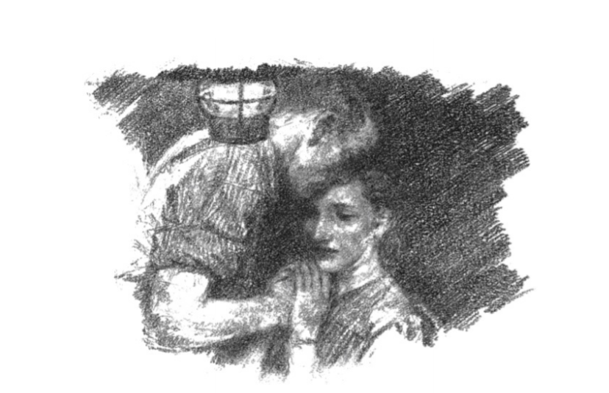
“And so do I,” said his mother. “We both do.” And she spoke as Bertie had never heard her speak before, her voice strong, determined. Bertie’s father didn’t seem to know quite how to reply. He just said: “We’ll talk about it later,” and then he walked out. They did talk about it later when Bertie was supposed to be in bed. He wasn’t, though. He heard them arguing. He was outside the sitting-room door, watching, listening. His father was pacing up and down. “He’ll grow up, you know,” he was saying. “You can’t keep a grown lion, you know that.” “And you know we can’t just throw him to the hyenas,” replied his mother. “He needs us, and maybe we need him. He’ll be someone for Bertie to play with for a while.” And then she added sadly: “After all, it’s not as if he’s going to have any brothers and sisters, is it?” At this, Bertie’s father went over to her and kissed her gently on the forehead. It was the only time Bertie had ever seen him kiss her.
“All right then,” he said. “All right. You can keep your lion.”

Slide 14
Sentence Types
Compound sentences
A compound sentence joins more than one major clause with a conjunction (such as ‘and’, ‘but’, ‘or’).
The lion cub had nowhere to run to and the hyenas were sidling ever closer.
Write three compound sentences.
Underline the two main clauses.

Slide 15
Day 4
Words of the day- pealed There was a spring in her step and her laughter pealed around the house.

Slide 16
So the white lion cub came to live amongst them in the farmhouse. He slept at the end of Bertie’s bed. Wherever Bertie went, the lion cub went too – even to the bathroom, where he would watch Bertie have his bath and lick his legs dry afterwards. They were never apart. It was Bertie who saw to the feeding – milk four times a day from one of his father’s beer bottles – until later on when the lion cub lapped from a soup bowl. There was impala meat whenever he wanted it, and as he grew – and he grew fast – he wanted more and more of it. For the first time in his life Bertie was totally happy. The lion cub was all the brothers and sisters he could ever want, all the friends he could ever need. The two of them would sit side by side on the sofa out on the veranda and watch the great red sun go down over Africa, and Bertie would read him Peter and the Wolf, and at the end he would always promise him that he would never let him go off to a zoo and live behind bars like the wolf in the story And the lion cub would look up at Bertie with his trusting amber eyes. “Why don’t you give him a name?” his mother asked one day. “Because he doesn’t need one,” replied Bertie.

Slide 17
“He’s a lion, not a person. Lions don’t need names.” Bertie’s mother was always wonderfully patient with the lion, no matter how much mess he made, how many cushions he pounced on and ripped apart, no matter how much crockery he smashed. None of it seemed to upset her. And strangely, she was hardly ever ill these days. There was a spring to her step, and her laughter pealed around the house. His father was less happy about it. “Lions,” he’d mutter on, “should not live in houses. You should keep him outside in the compound.” But they never did. For both mother and son, the lion had brought new life to their days, life and laughter.

Slide 18
AUTHORIAL INTENT
How does the author make us share in Bertie and his mother’s happiness?
Contrast the passage ending the previous chapter “plaintive…lament” to this chapter “spring in her step,” “laughter pealed,”
What does this tell you about Bertie’s mother?

Slide 19
Day 5
Reading Comprehension
What woke Bertie?
What were the hyenas about to do?
How did Bertie react?
Who fired the shot that scared the hyenas?
How did Bertie and his mother care for the lion cub?
How did Bertie’s father feel about keeping the lion?

Slide 20
7. What did Bertie do when he was supposed to be in bed?
8. What objection did Bertie’s father have to keeping the lion?
9. What did you learn about Bertie’s family from his parents’ conversation?
10. Why didn’t Bertie give the lion a name?
11. How did Bertie’s mother treat the lion?
12. What is the mood like at the end of the chapter?

