Slide 1
Year 4 Place Value
Autumn
Week 4

Slide 2
LO: to find 1000 more and less than a number.

Slide 3
https://www.topmarks.co.uk/learning-to-count/place-value-basketball
LO: to find 1000 more and less than a number.

Slide 4
LO: to find 1000 more and less than a number.
What is 1 less?
428
What is this digit worth?
What is 10 more?
What is 100 less?

Slide 5

Count in 1000’s
Start from-
0
14
754
What do you notice?

Slide 6
Count in 1000’s
What do you notice?
Start from-
0
14
754
All the answers had a the digits 14
They all end in zero?
All the answers had the digits 754

Slide 7
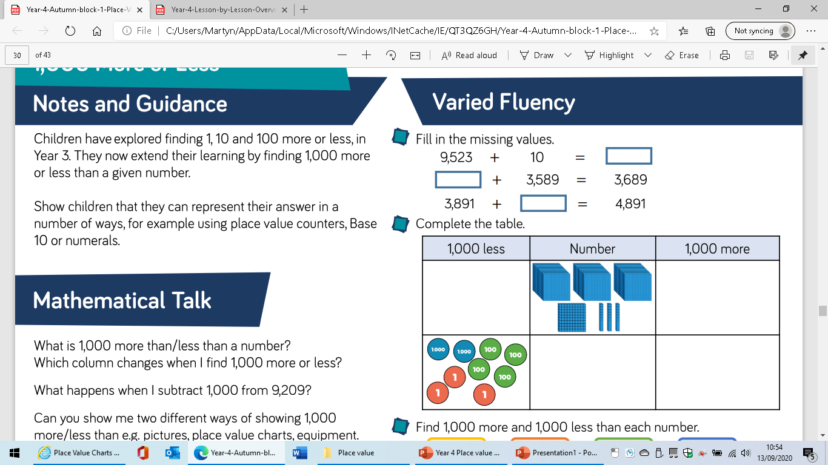

Slide 8

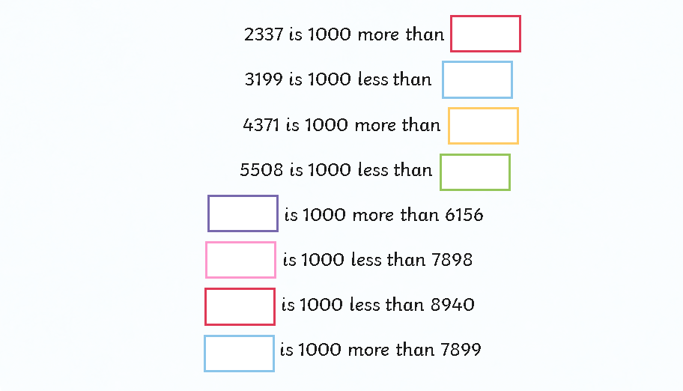

Slide 9
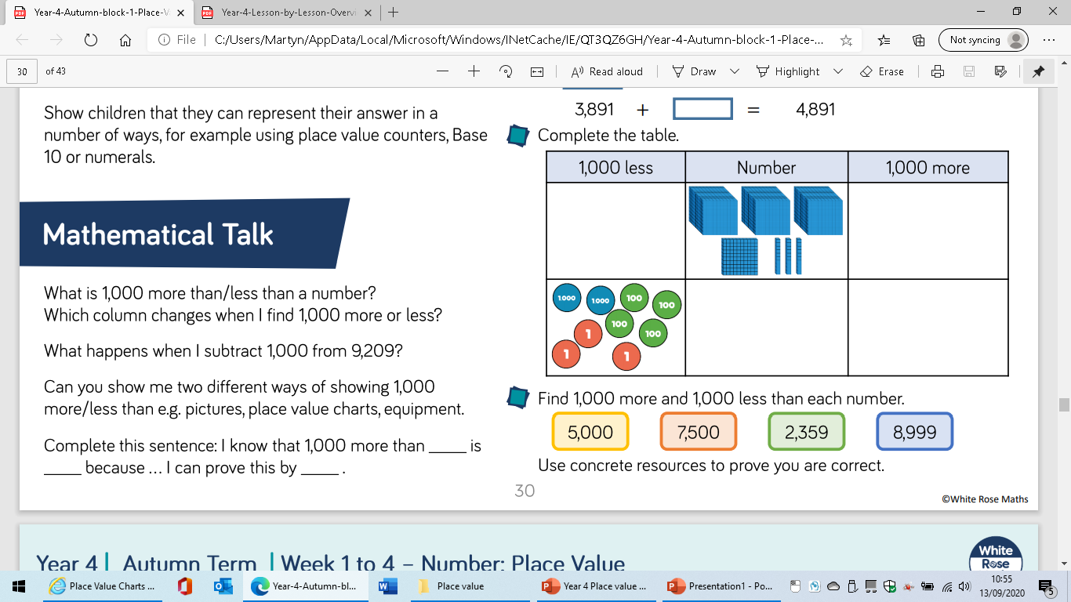
LO: to find 1000 more and less than a number.

Slide 10
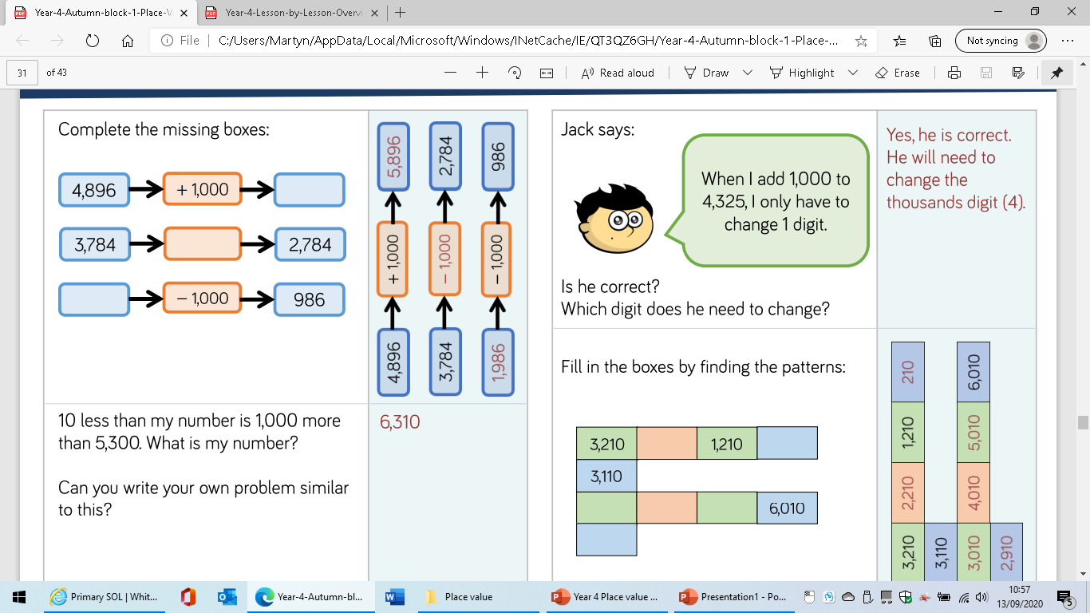

Slide 11
LO: to find 1000 more and less than a number.

Slide 12
LO: to compare 4-digit numbers.

Slide 13
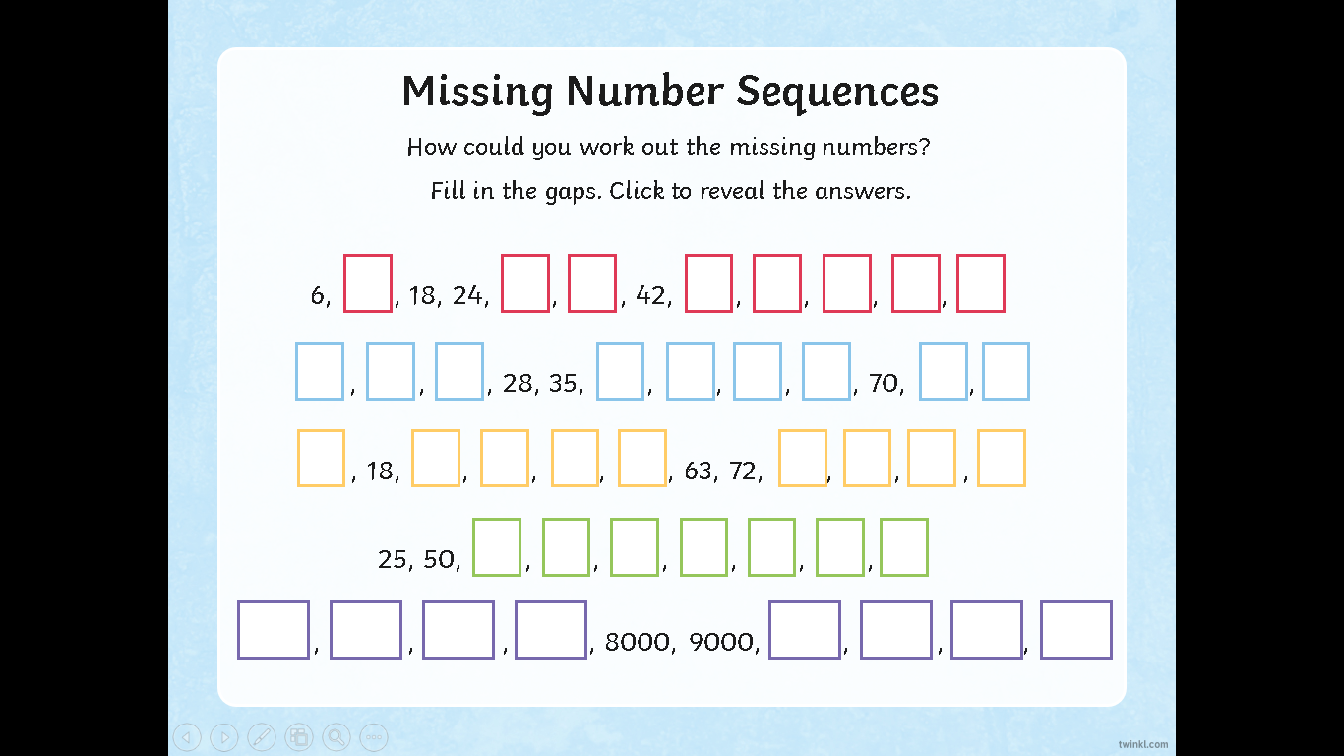
LO: to compare 4-digit numbers.

Slide 14


What do these symbols represent?
=

Slide 15
What do these symbols represent?
=
Equal to
More than
Less than

Slide 16
Complete this number sentence
60

Slide 17
Complete these number sentences
0 2990
100
0 7870
9090 9900

Slide 18
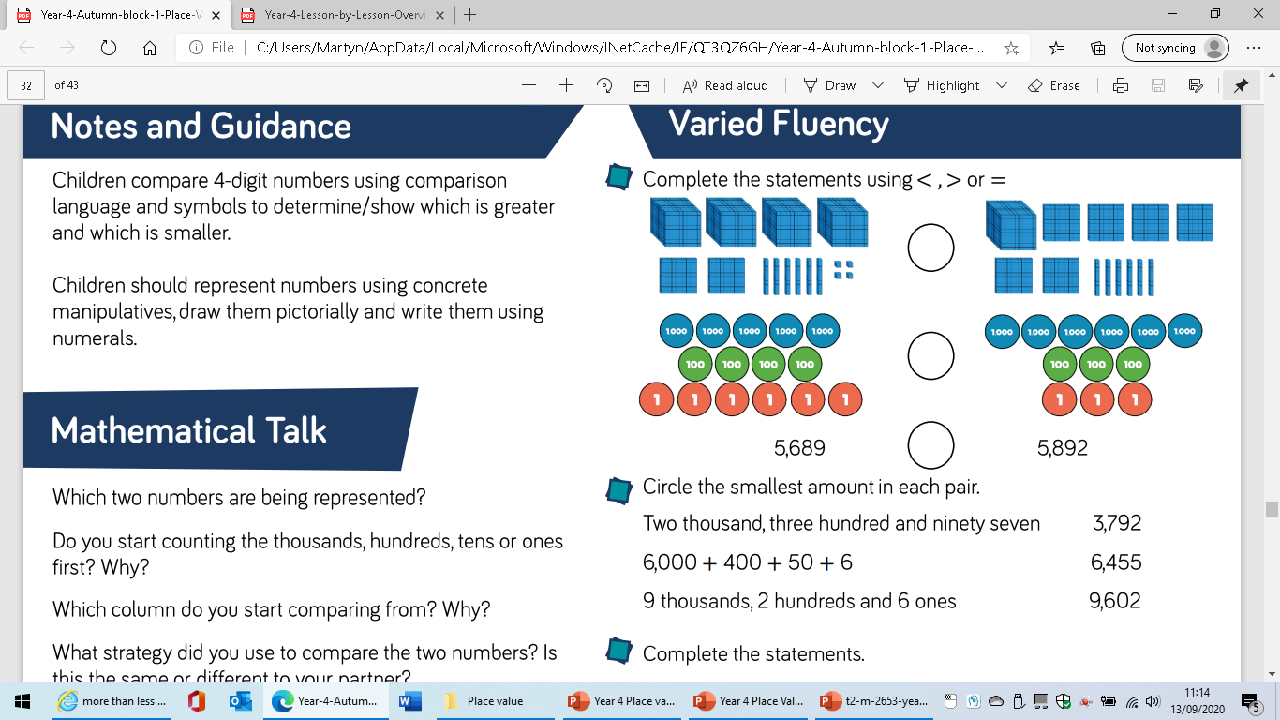

Slide 19
LO: to compare 4-digit numbers.

Slide 20
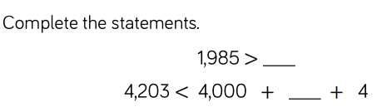

Slide 21
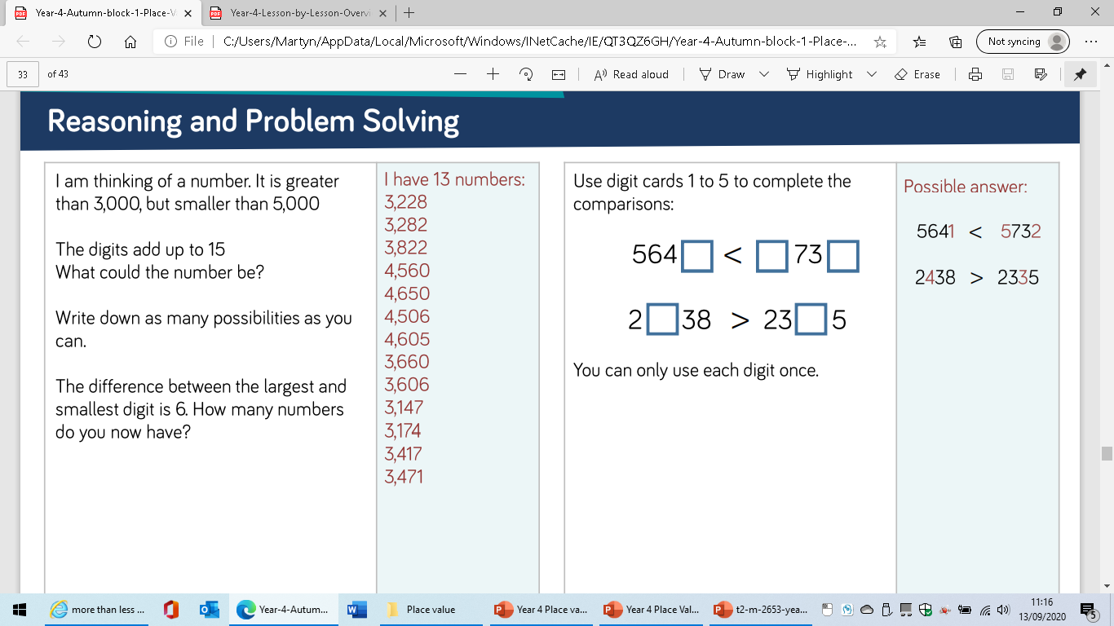

Slide 22
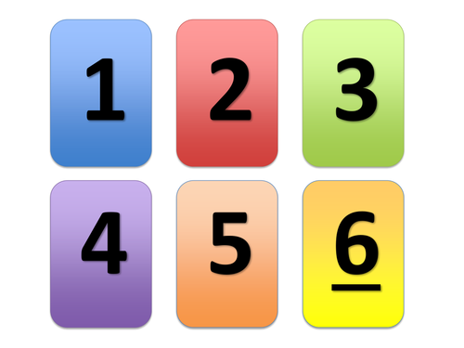
LO: to compare 4-digit numbers.

Slide 23
LO: to order numbers.

Slide 24

Which of these are Roman Numerals?
A
D
C
I
E
X
IV
III
V

Slide 25
Which of these are Roman Numerals?
A
D
C
I
E
X
IV
III
V

Slide 26
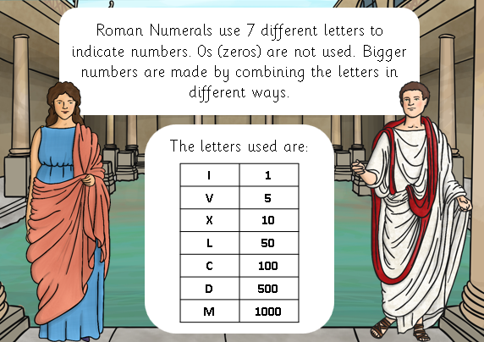
Remember

Slide 27
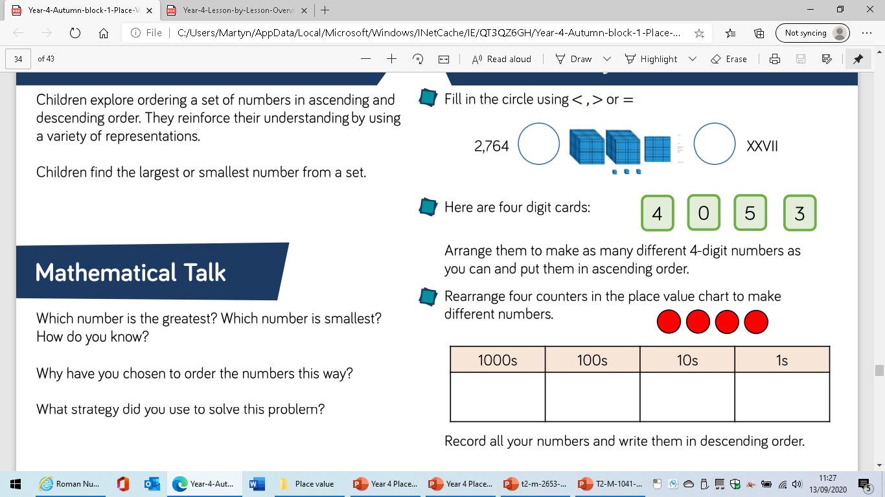
LO: to order numbers.

Slide 28
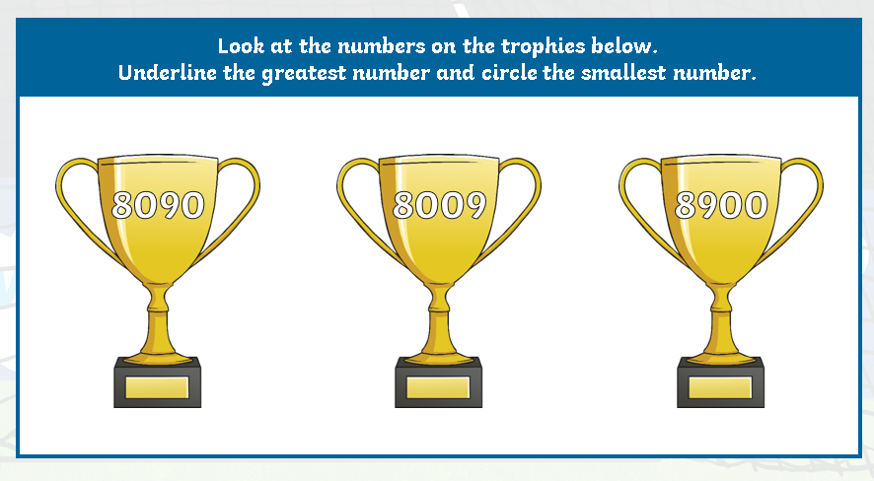
LO: to order numbers.

Slide 29
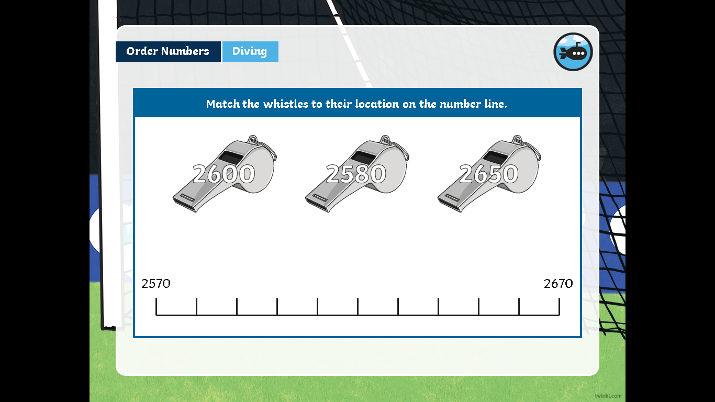
LO: to order numbers.

Slide 30
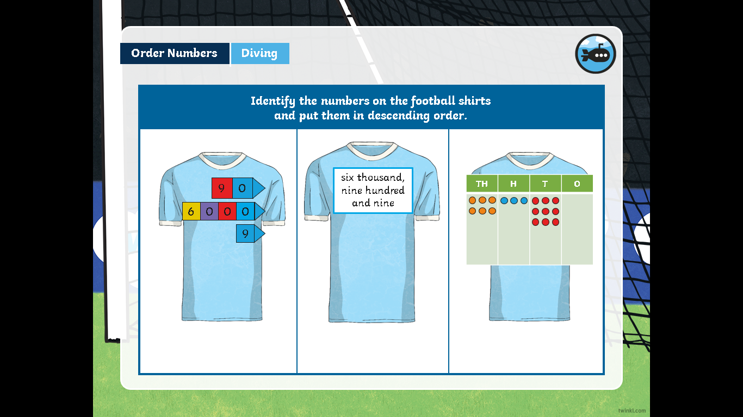

Slide 31
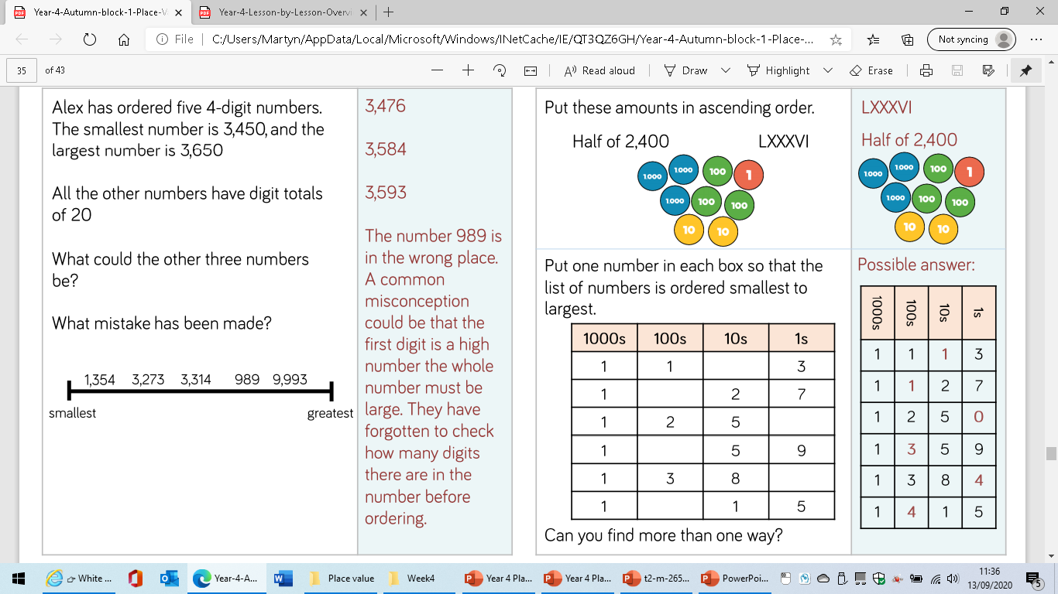

Slide 32
LO: to order numbers.

Slide 33
LO: to round to the nearest thousand.

Slide 34

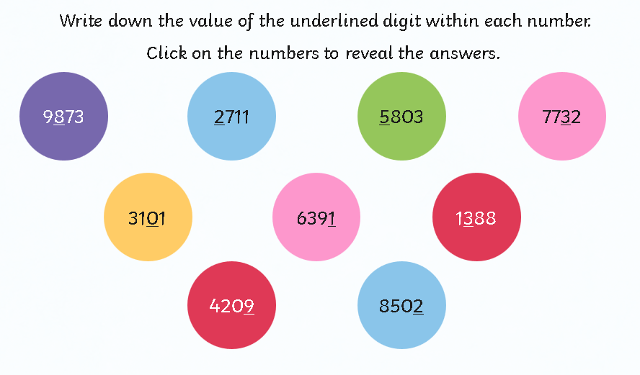

Slide 35
Can you describe what has happened in each number sentence?
7=10
43=40
28=30
71=70
89=90
97=100

Slide 36
What has happened here?
7=10
43=40
28=30
71=70
89=90
97=100
The numbers have been rounded to the nearest 10

Slide 37
LO: to round to the nearest thousand.
130=100
430=400
760=800
1231=1200

Slide 38
LO: to round to the nearest thousand.
The numbers have been rounded to the nearest 100
130=100
430=400
760=800
1231=1200
How do you decide to round up or down?

Slide 39
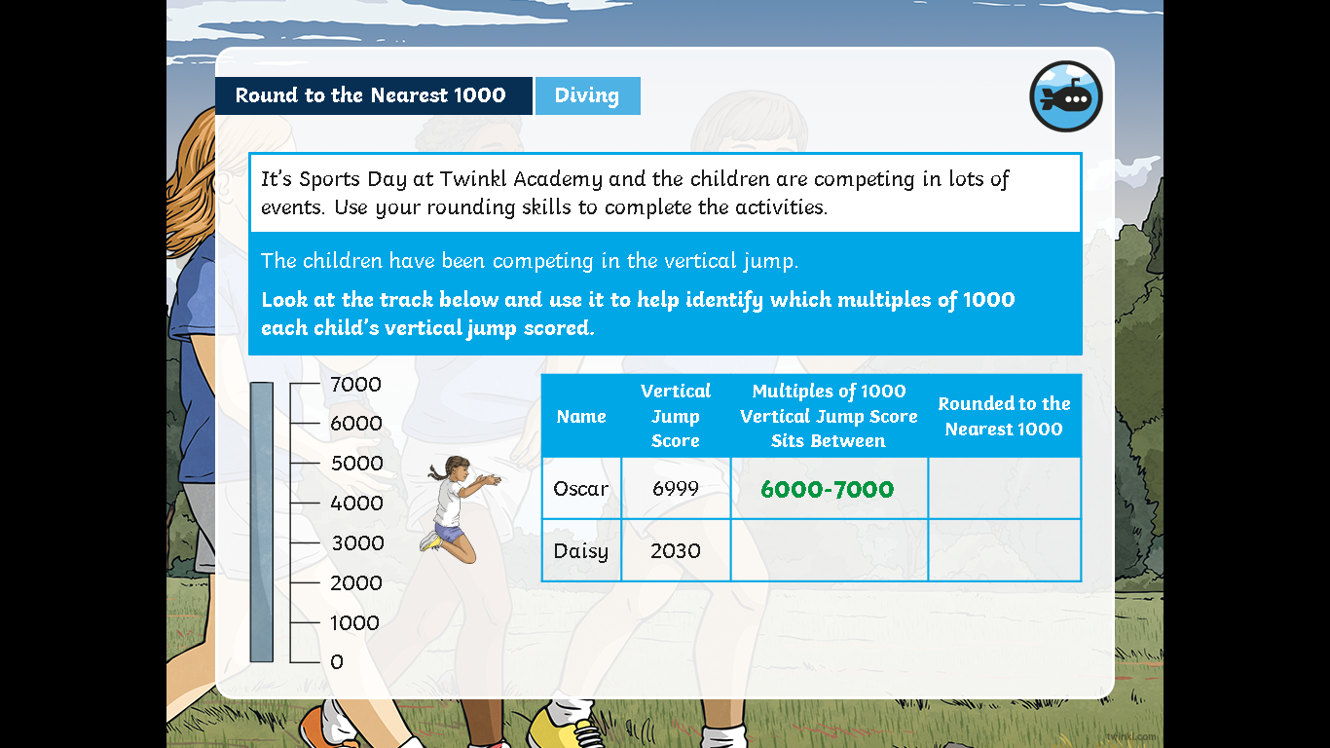

Slide 40
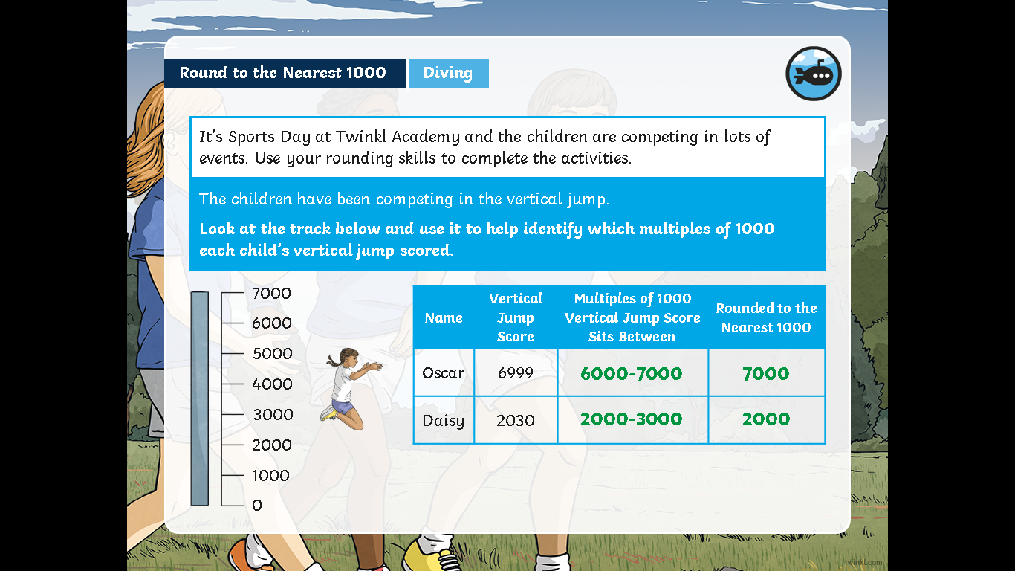

Slide 41
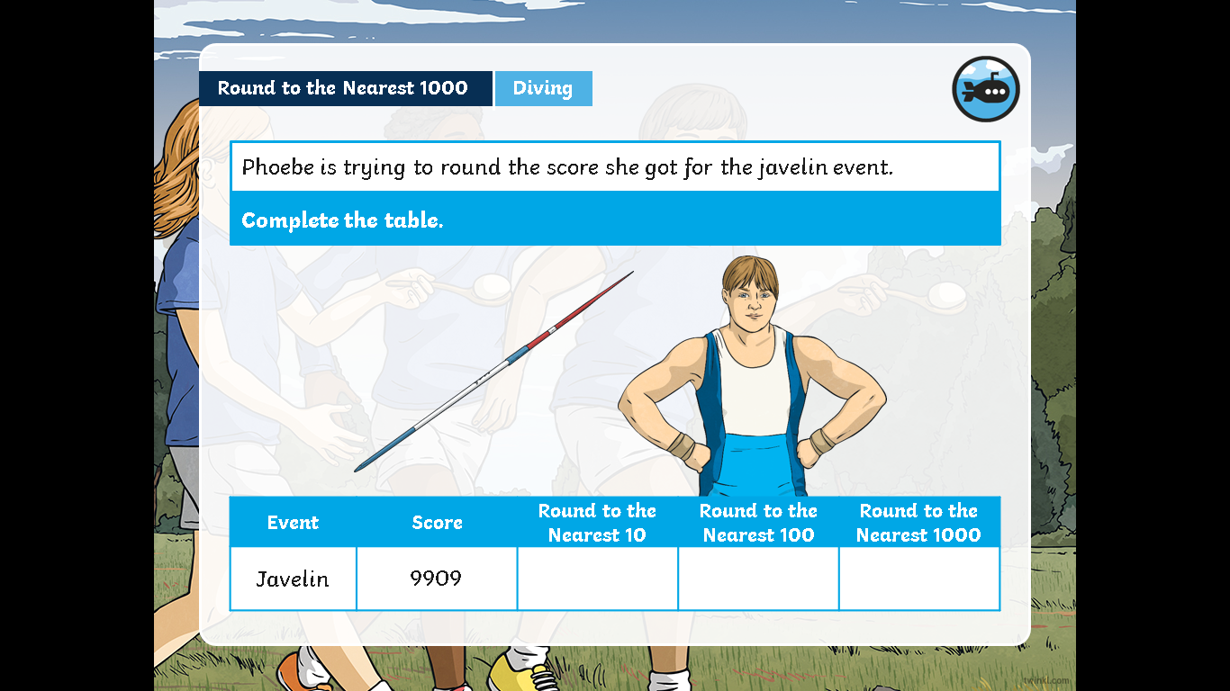

Slide 42
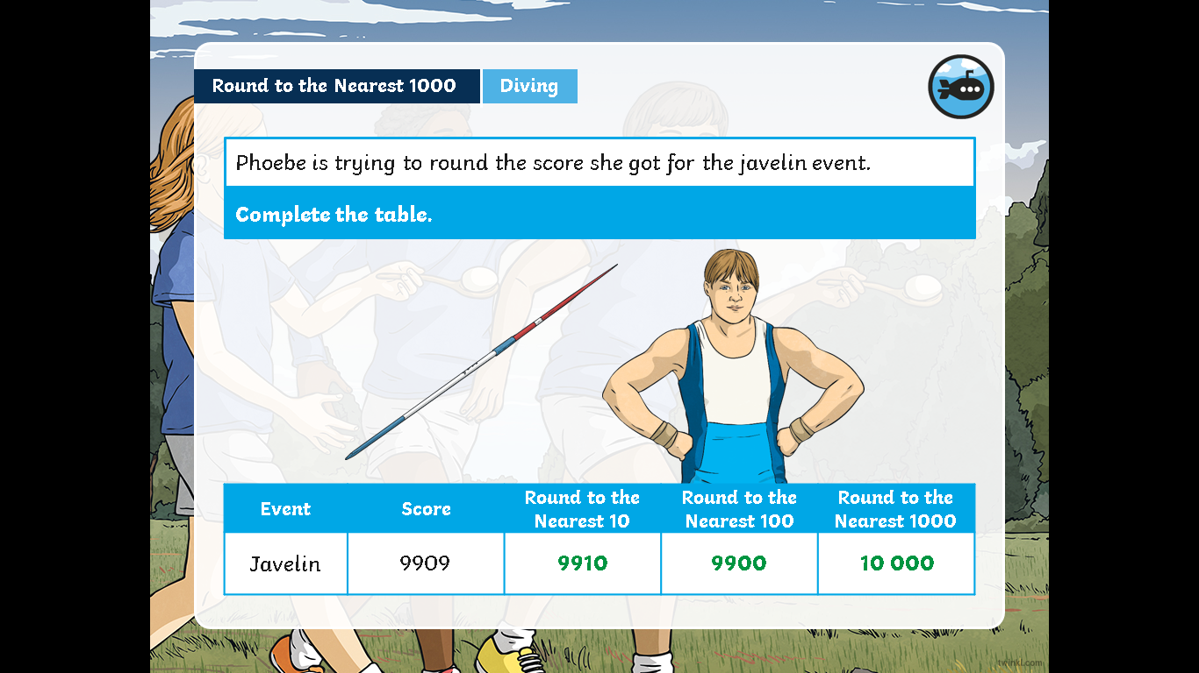

Slide 43
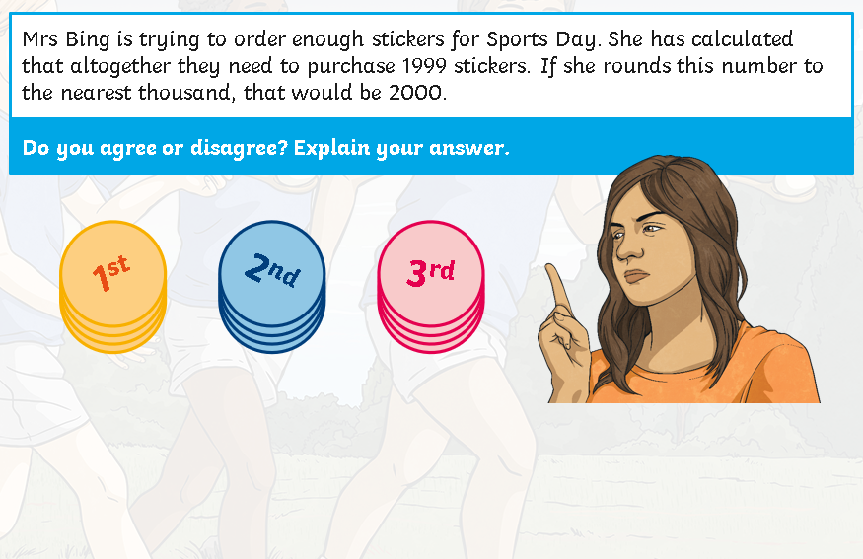

Slide 44
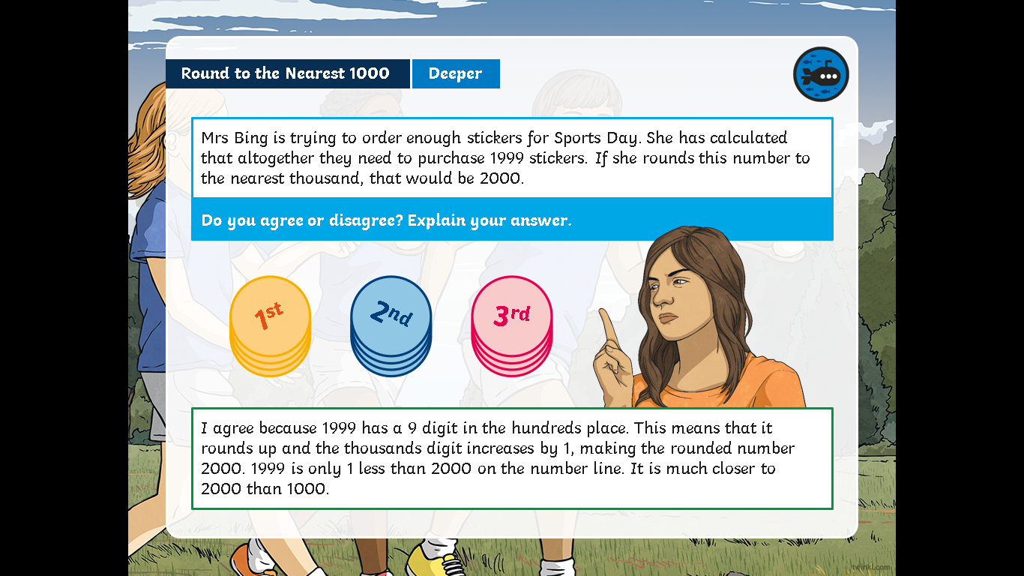

Slide 45
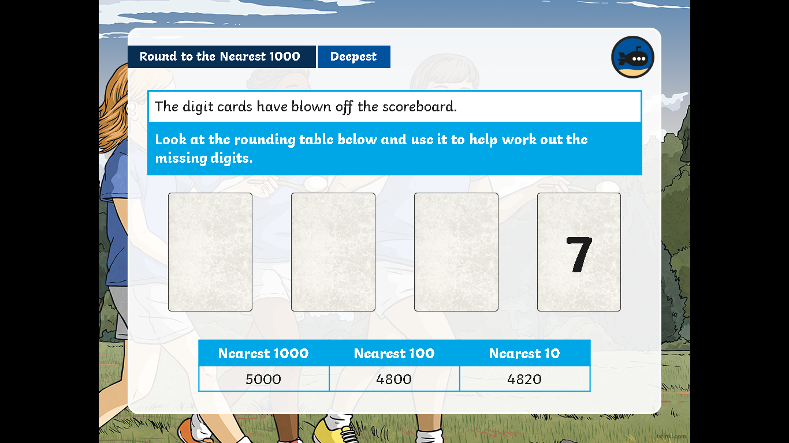

Slide 46
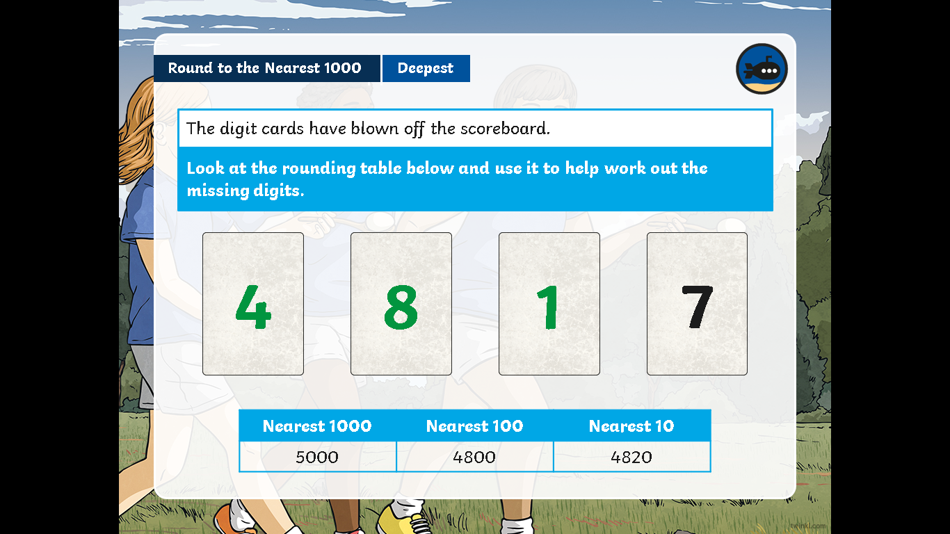

Slide 47
LO: to count in 25’s

Slide 48
LO: to count in 25’s
Round these numbers to the nearest 1000
8730
230
3530
9830
6230
2730
2300
1240

Slide 49
LO: to count in 25’s
Counting on and back on 25’s- see PP
6x25=
7x25=
8x25=
9x25=
10x25=
On whiteboards complete –
1x25=
2x25=
3x25=
4x25=
5x25=
Do you notice a pattern?

Slide 50
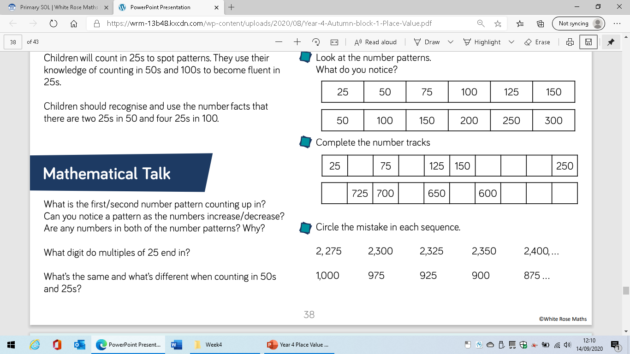
LO: to count in 25’s

Slide 51
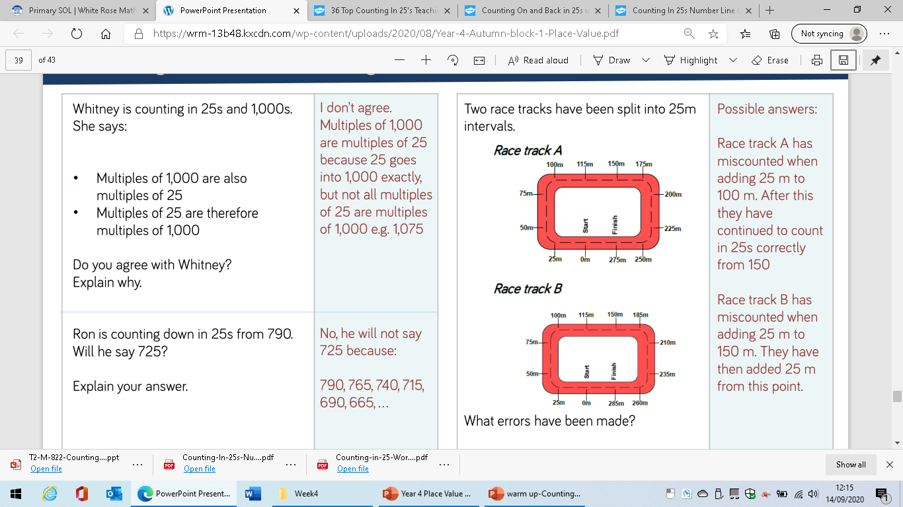
LO: to count in 25’s

