Slide 1
Week 2
Outcome
To write a character description

Slide 2
Day 1
Word of the day: scrutinised
VOCABULARY
Parts of speech
introduce colour coding for parts of speech.
What is the function of each of these word types?
nouns
verbs
adverbs
adjectives

Slide 3
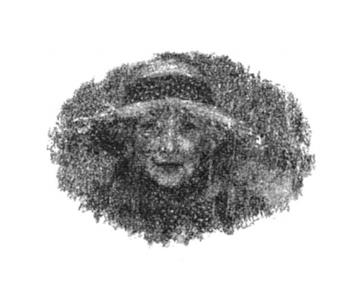
LO:to explore characterisation.
TASK: to collect verbs and adverbs and create a mind map

Slide 4
I was still deciding which direction to take when I heard a voice from behind me.
“Who are you? What do you want?”
I turned.
“Who are you?” she asked again. The old lady who stood before me was no bigger than I was. She scrutinised me from under the shadow of her dripping straw hat. She had piercing dark eyes that I did not want to look into.
“I didn’t think it would rain,” she said, her voice gentler. “Lost, are you?”
I said nothing. She had a dog on a leash at her side, a big dog. There was an ominous growl in his throat, and his hackles were up all along his back.

Slide 5
She smiled. “The dog says you’re on private property,” she went on, pointing her stick at me accusingly. She edged aside my raincoat with the end of her stick. “Run away from that school, did you? Well, if it’s anything like it used to be, I can’t say I blame you. But we can’t just stand here in the rain, can we? You’d better come inside. We’ll give him some tea, shall we, Jack? Don’t you worry about Jack. He’s all bark and no bite.” Looking at Jack, I found that hard to believe.
Complete underlining the words in the passage and write on your mind map.

Slide 6
Day 2
Word of the day- miraculous
INFERENCE
What is the lady like? Do you trust her? Explain why. Why do you think Michael followed her?

Slide 7
I don’t know why, but I never for one moment thought of running off. I often wondered later why I went with her so readily. I think it was because she expected me to, willed me to somehow. I followed the old lady and her
dog up to the house, which was huge, as huge as my school. It looked as if it had grown out of the ground. There was hardly a brick or a stone or a tile to be seen. The entire building was smothered in red creeper, and there were a
dozen ivy-clad chimneys sprouting skywards from the roof.

Slide 8
We sat down close to the stove in a vast vaulted kitchen. “The kitchen’s always the warmest place,” she said, opening the oven door. “We’ll have you dry in no time. Scones?” she went on, bending down with some difficulty and reaching inside. “I always have scones on a Sunday. And tea to wash it down. All right for you?” She went on chatting away as she busied herself with the kettle and the teapot. The dog eyed me all the while from his basket, unblinking. “I was just thinking,” she said. “You’ll be the first young man I’ve had inside this house since Bertie.” She was silent for a while.

Slide 9
The smell of the scones wafted through the kitchen. I ate three before I even touched my tea. They were sweet and crumbly, and succulent with melting butter. She talked on merrily again, to me, to the dog – I wasn’t sure which. I wasn’t really listening. I was looking out of the window behind her. The sun was bursting through the clouds and lighting the hillside. A perfect rainbow arched through the sky. But miraculous though it was, it wasn’t the rainbow that fascinated me. Somehow, the clouds were casting a strange shadow over the hillside, a shadow the shape of a lion, roaring like the one over the archway

Slide 10
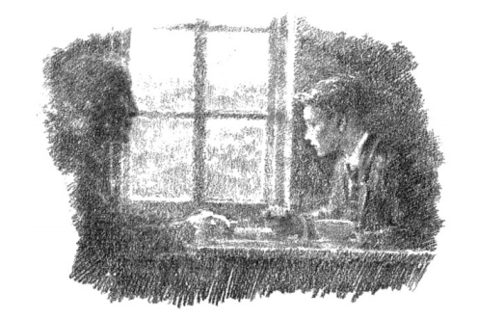
“Sun’s come out,” said the old lady, offering me another scone. I took it eagerly. “Always does, you know. It may be difficult to remember sometimes, but there’s always sun behind the clouds, and the clouds do go in the end. Honestly.”
She watched me eat, a smile on her face that warmed me to the bone.

Slide 11
Parts of speech
What is the function of each of these word types?
nouns
verbs
adverbs
adjectives

Slide 12
LO: to understand how sensory images create atmosphere.
Revise senses:- explain that the atmosphere is created by all we see, hear, smell, taste and feel.
What was Michael’s school diet? How does that contrast with this scene?
Complete the sensory mind map of the scene. – Use word colour coding

Slide 13
LO: to understand how sensory images create atmosphere.
see
hear
smell
feel
taste

Slide 14
Day 3
Word of the day - succulent
PREDICTION-
How did we finish yesterday? What do the children think will happen?

Slide 15
LO: To use small details to create atmosphere and develop characterisation
Explore the vocabulary gathered yesterday “succulent and melting,” “merrily again,” etc.
Use the words to create a warm and comforting scene with a kindly character.

Slide 16
LO: To use small details to create atmosphere and develop characterisation
Please try to include: (SC:)
Use adventurous verbs and adverbs.
Use all your senses.
Suggest and show, rather than say, e.g. ‘her eyes twinkled,’ ‘a kindly face,’

Slide 17
Day 4
Word of the day – gazing
Read to the end of the chapter- AUTHORIAL INTENT- Are you intrigued? Discuss the use of questions as a device to interest the reader. How will Michael be taken on a journey?

Slide 18
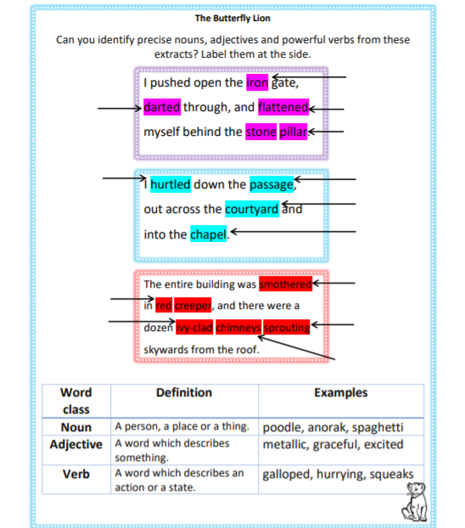

Slide 19
Day 5
Word of the day – vaulted
Reread the chapter
LO: to read for meaning
Complete comprehension sheet

