Slide 1
Year 4 Place value week 3
Lesson 1
LO: to count in 1000’s.

Slide 2
LO: to count in 1000’s
Complete missing labels
 | Hundreds |  | Ones
 |  | T
1000 |  |  | 1

Slide 3
LO: to count in 1000’s
Thousands | Hundreds | Tens | Ones
Th | H | T | O
1000 | 100 | 10 | 1

Slide 4
Using Base ten make these numbers and record these numbers on a place value table
21
3461
170
201
2001
2020

Slide 5
21
3461
170
Which number has the smallest value?
201
Which number has the highest value?
2001
2020

Slide 6
21
3461
170
Which numbers have the same thousands value?
201
Which numbers have the same tens value?
2001
2020

Slide 7
Counting
Starting from zero count in hundreds to one thousand
Counts to ten thousand in thousands and back.
What did you notice?
Starting from 1231 count on in thousands ten times.
Repeat with 345.

Slide 8
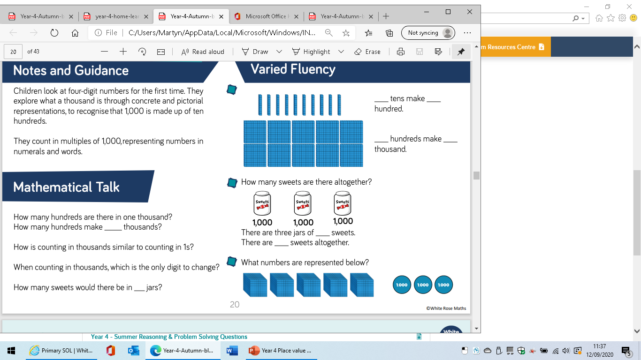

Slide 9
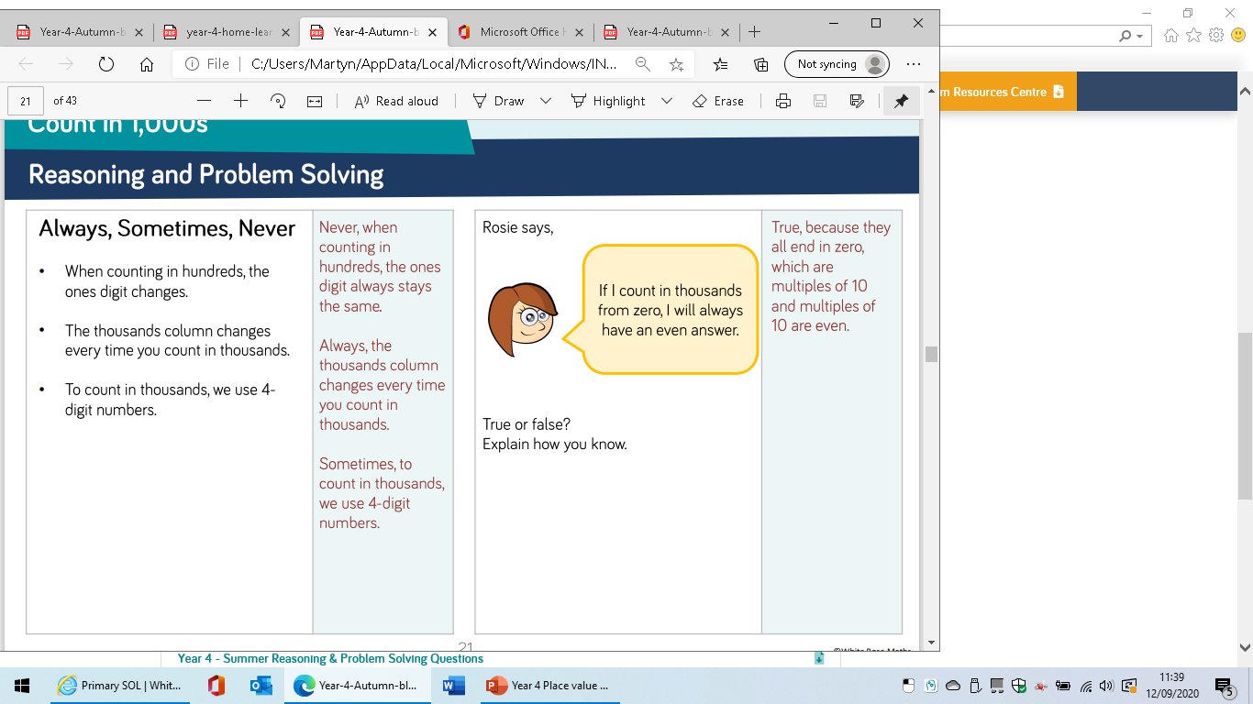

Slide 11
Year 4 Place value week 3
Lesson 2
LO: to know the place value of 4 digits numbers.

Slide 12
Roman numerals rehearsal
One=1=I
Two=2=II
Three=3=III
Four=4=IV
Five=5=V
Six=6=VI
Seven=7=VII
Eight=8=VIII
Nine=9=IX
Ten=10=X

Slide 13
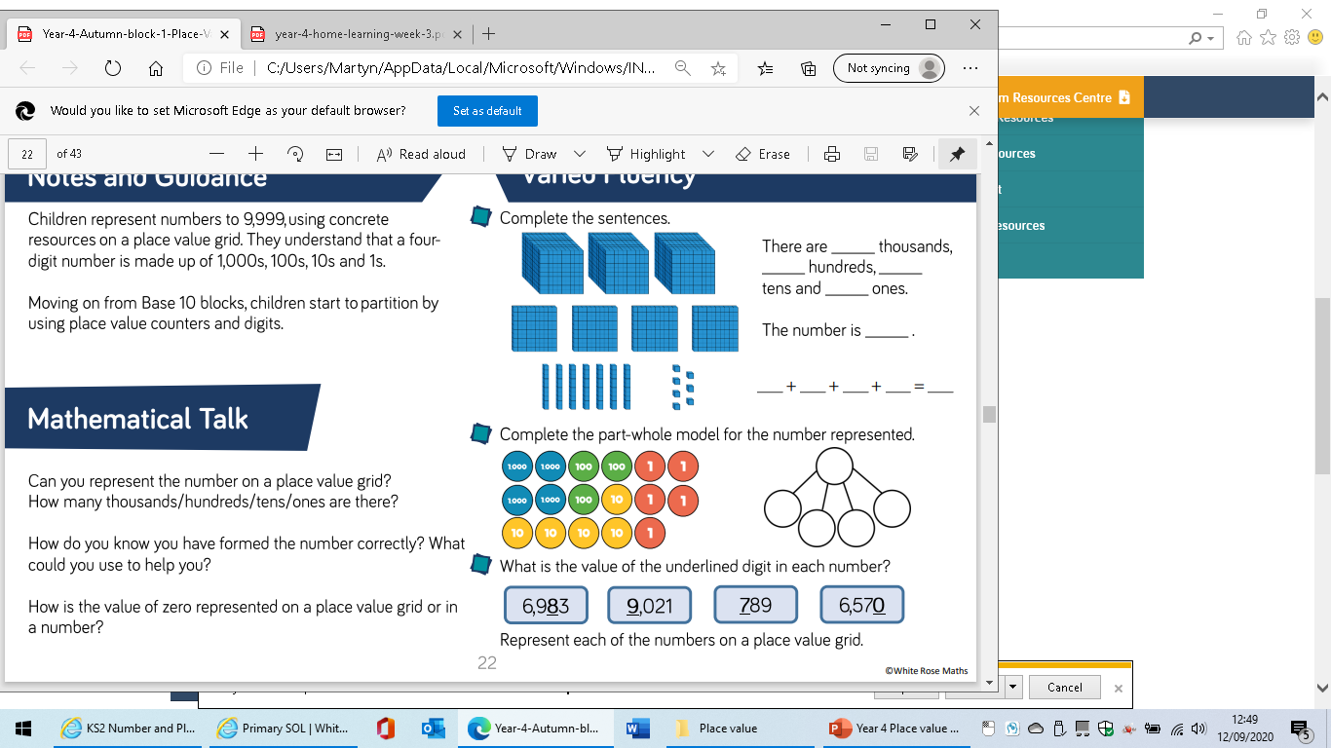
Using base ten make 2341
What is 1000 more?
What is 20 less?

Slide 14
Using base ten make 2041
How did we represent the zero?

Slide 16
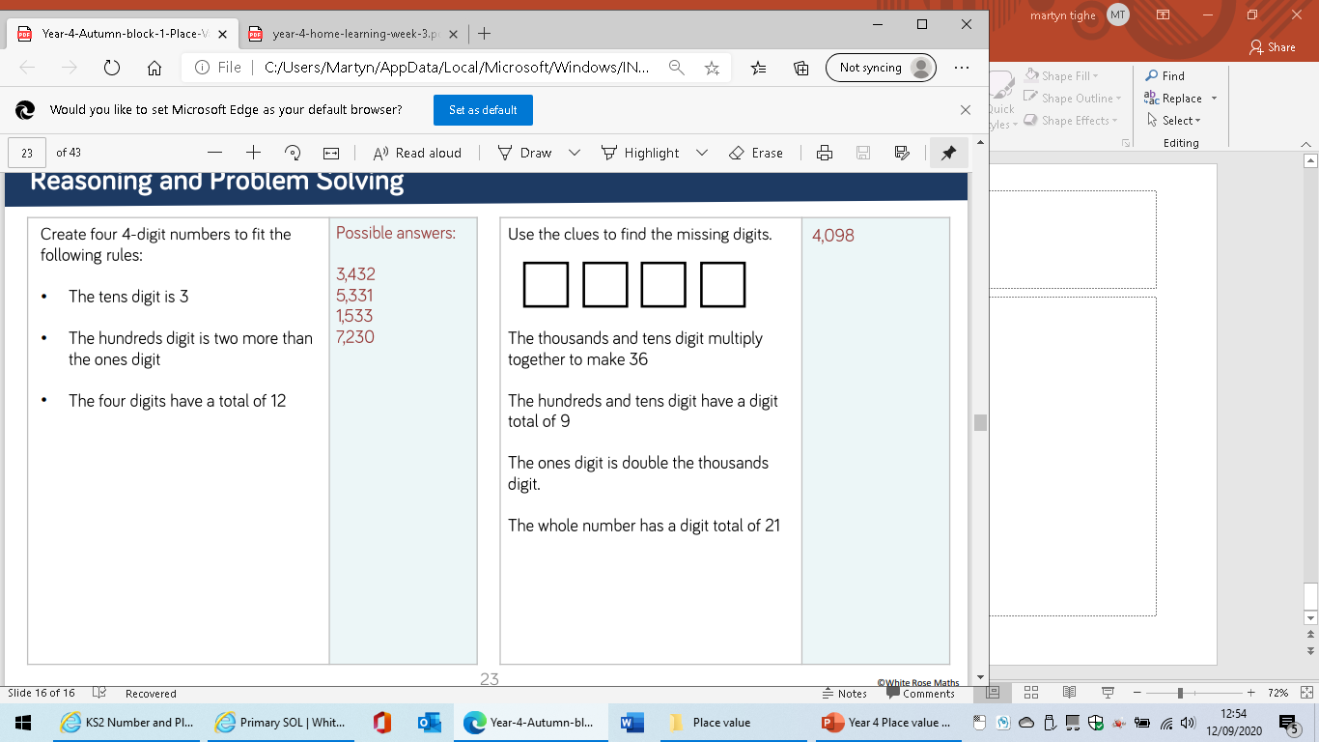

Slide 18
Year 4 Place value week 3
Lesson 3
LO: to partition four digit numbers.

Slide 19
What number is being represented?

Slide 20
What number is being represented?
3000+500+10+4
2000+1500+11+3
Which is correct?

Slide 21
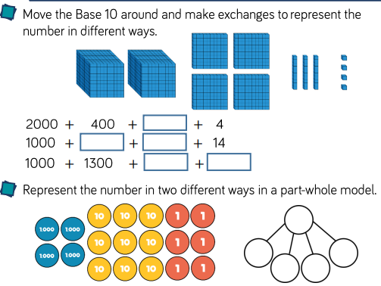

Slide 22
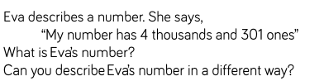

Slide 23
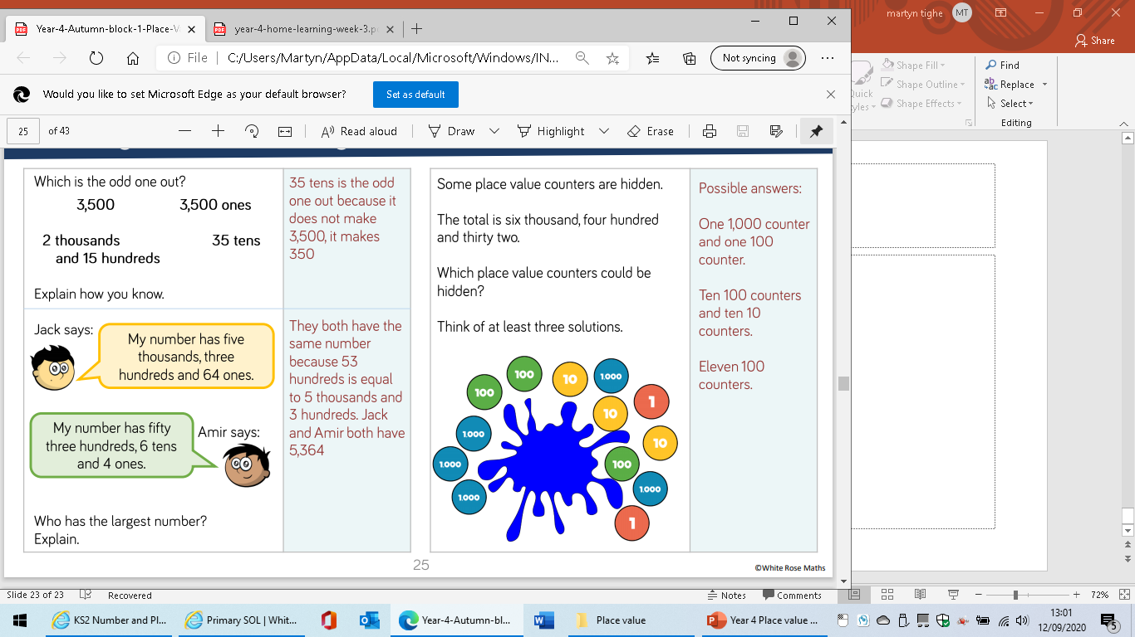

Slide 25
Year 4 Place value week 3
Lesson 4
LO: to use a numberline to order numbers up to 10,000.

Slide 26
Match the equivalent values.
2
5
III
II
4
IV
I
1
3
V

Slide 27
Counting
Starting from zero count in hundreds to two thousand.
Starting from two thousand count in thousands to ten thousand.
What do you notice?

Slide 28
Number lines
What value does the arrow represent?
0
1000
Could the arrow represent 100? Why?
Which direction do we count with a number line?

Slide 29
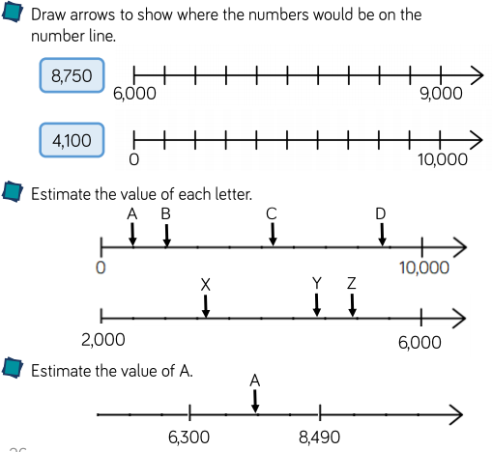

Slide 30
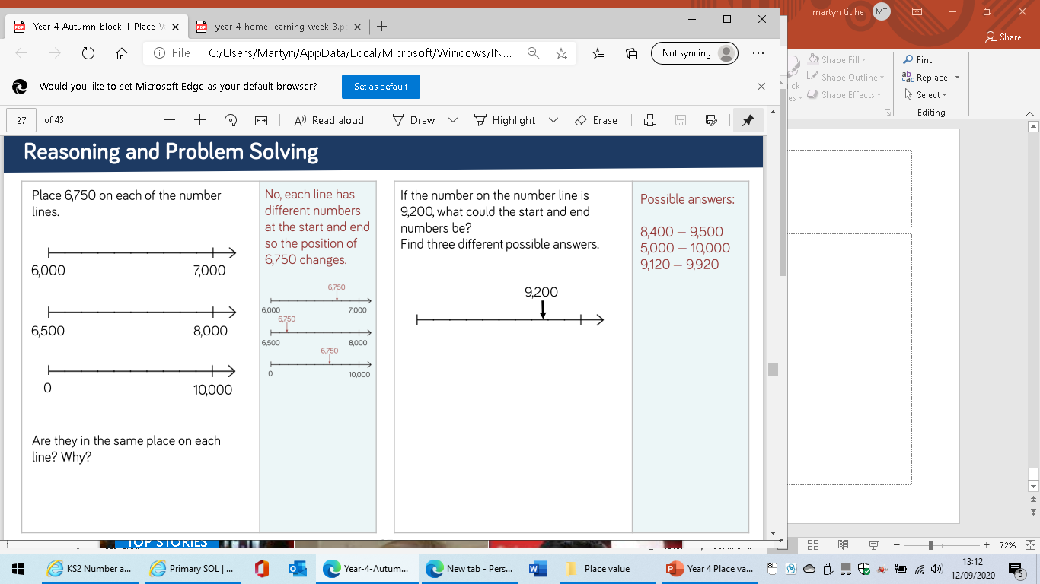

Slide 32
Year 4 Place value week 3
Lesson 5
LO: to find 1, 10 or 100 more or less than.

Slide 33
Number bonds
Complete these calculations to make 100
20+___
50+___
25+___
10+___
35+___
41+___
75+___
Complete these calculations to make 1000
200+___
500+___
250+___
150+___
65+___
510+___
705+___

Slide 34
What is my number
10 more is 22. (11)
1 less is 99 100
100 less is 50 150
Repeat with different numbers

Slide 35
What is 10 more than
43
12
230
48

Slide 36
What is 1 less than
10
100
500
49
2
1

Slide 37
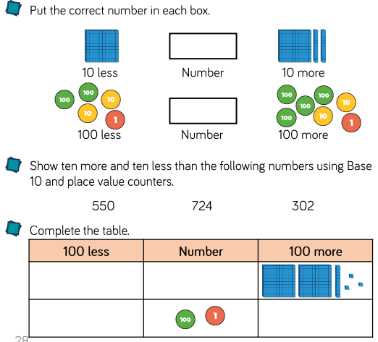

Slide 38
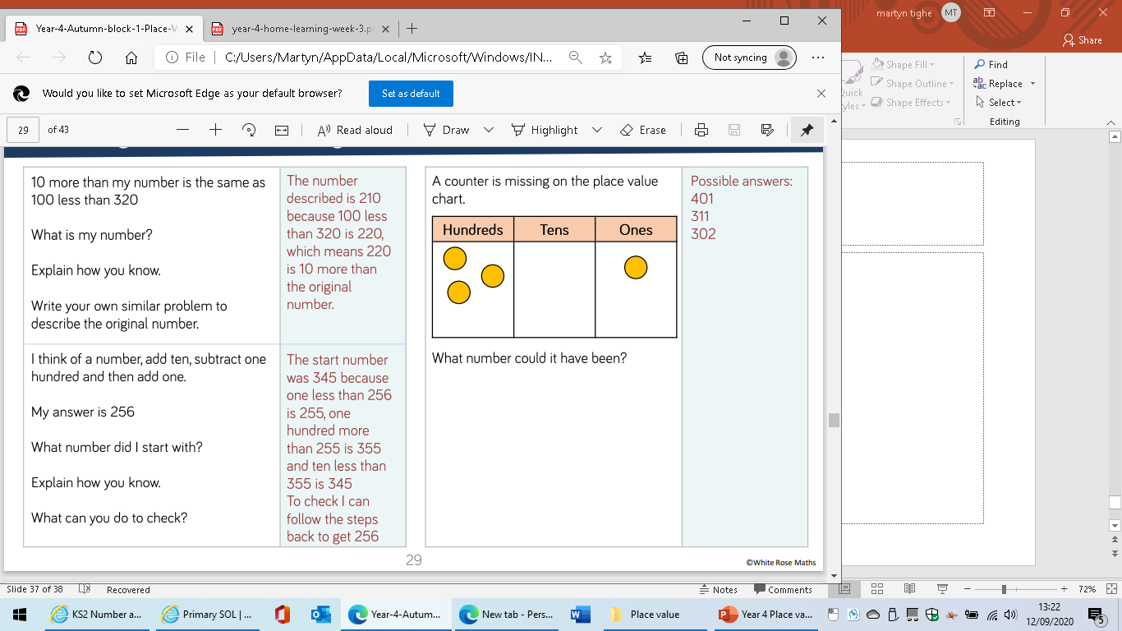

Slide 40
Could there be another answer?

