Slide 1
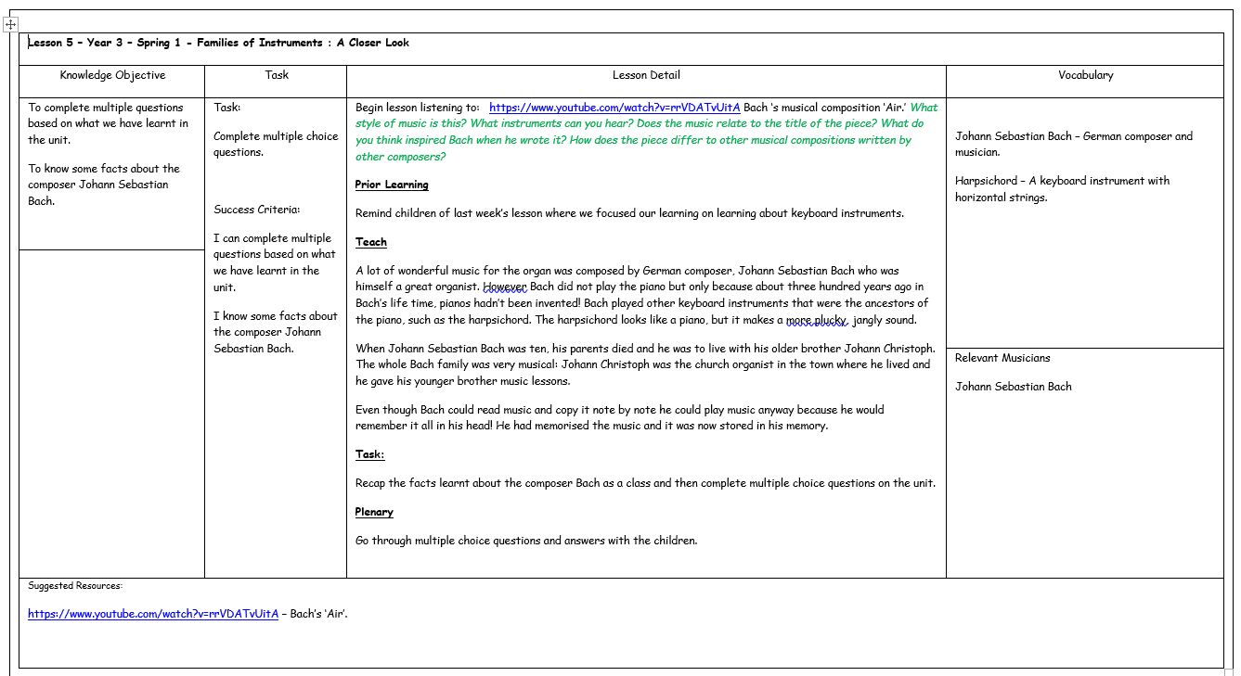
Lesson 5 Families of Instruments

Slide 2
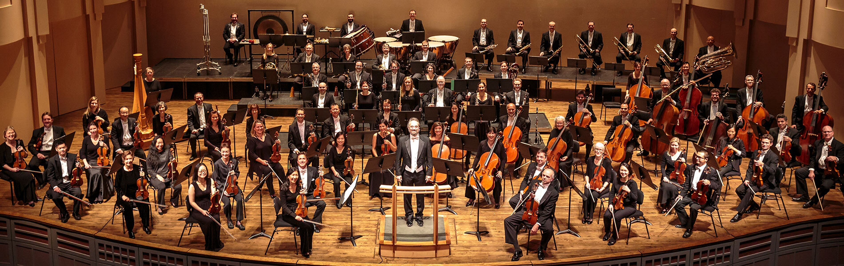

Year 3
Spring 1
Lesson 5
Families of Instruments

Slide 3
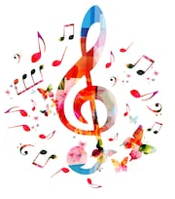
Let’s Listen
https://www.youtube.com/watch?v=rrVDATvUitA
Bach’s Musical Composition ‘Air’
What instruments can you hear?
What style of music do you think this is?
Do you know what type of piano he is playing?
Does this music relate to the title of the piece?
What do you think inspired Bach when he wrote it?

Slide 4
Prior Learning
What can you remember about keyboards and pianos?

Slide 5
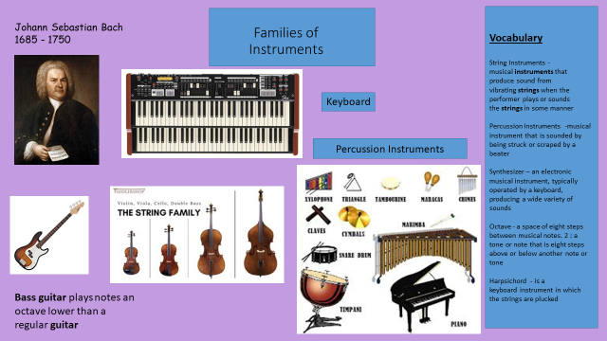
Our Knowledge Organiser

Slide 6
Key Vocabulary
Piano – A large keyboard musical instrument.
Organ – A large musical instrument having rows of pipes supplied with air from bellows.
Digital keyboard – Electronic musical instrument that has a built in synthesizer with replicates the sounds of a piano and other instruments.
Harpsichord – A keyboard instrument with horizontal strings.
Johann Sebastian Bach – German composer and musician.
Auditorium – Music or performance venue.

Slide 7
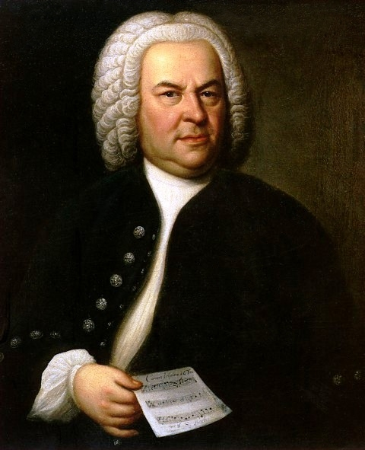
L.O: To know some facts about Johann Sebastian Bach.
Success Criteria: I can complete multiple questions based on what we have learnt in the unit. I know some facts about the composer Johann Sebastian Bach.
Here are today’s key words:
Johann Sebastian Bach
Harpsichord

Slide 8
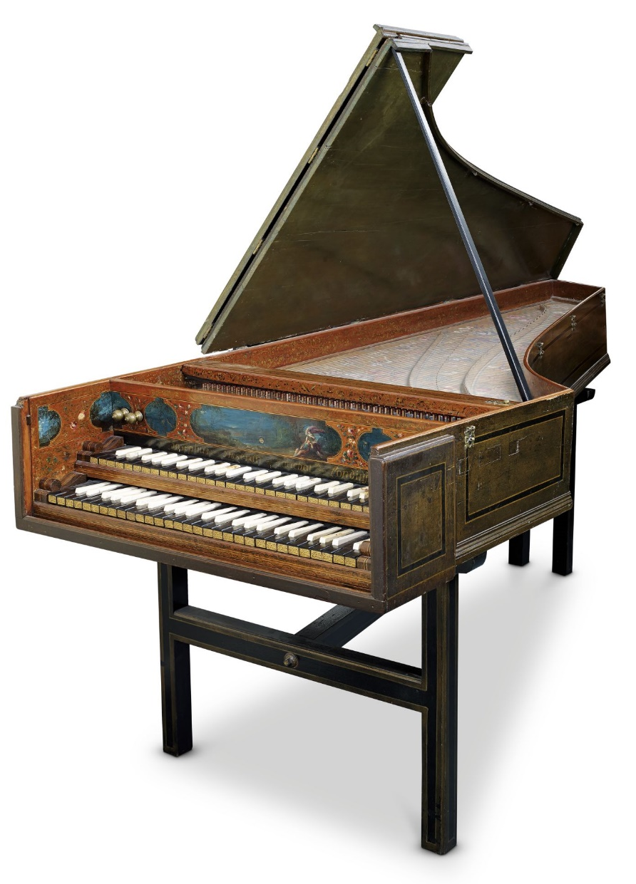
Teach
A lot of wonderful music for the organ was composed by German composer, Johann Sebastian Bach who was himself a great organist.
However, Bach did not play the piano but only because about three hundred years ago in Bach’s life time, pianos hadn’t been invented!
Bach played other keyboard instruments that were the ancestors of the piano, such as the harpsichord. The harpsichord looks like a piano, but it makes a more plucky, jangly sound.

Slide 9
Teach
When Johann Sebastian Bach was ten, his parents died and he was to live with his older brother Johann Christoph.
The whole Bach family was very musical: Johann Christoph was the church organist in the town where he lived and he gave his younger brother music lessons.
https://www.bbc.co.uk/programmes/articles/5bcNZHMc9D9Z8xXZBw01lTm/6-bach-vivaldi-mozart-and-haydn-part-1

Slide 10
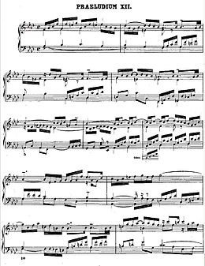
Teach
Even though Bach could read music and copy it note by note he could play music anyway because he would remember it all in his head! He had memorised the music and it was now stored in his memory.
https://www.classicsforkids.com/composers/composer_profile.php?id=4

Slide 11
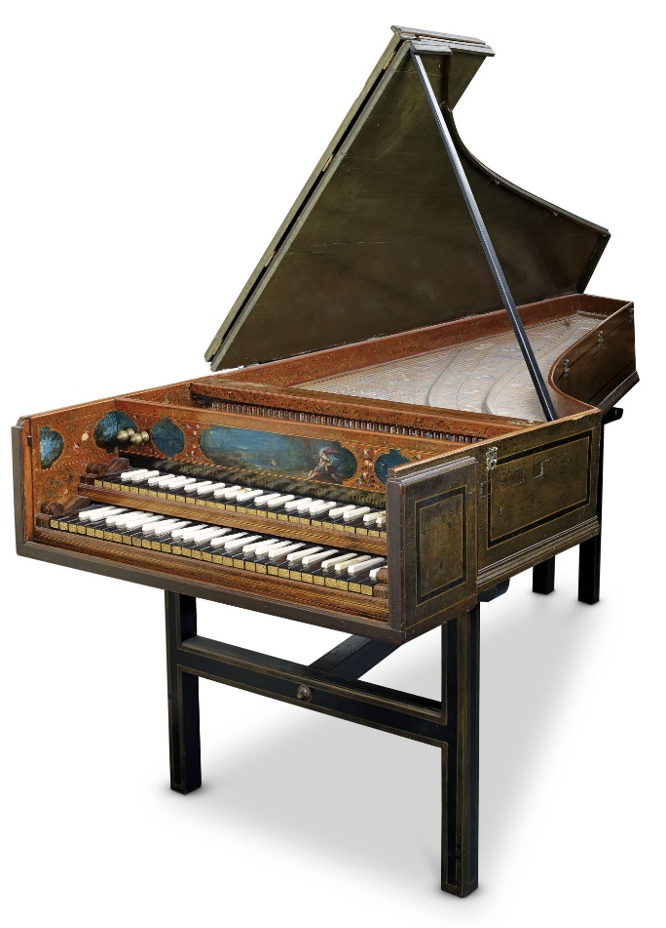
Task
In groups, write a list of facts you can remember about Bach.
Complete the multiple choice questions on the unit.

Slide 12
And finally…
Multiple Choice Quiz answers.

