Slide 1


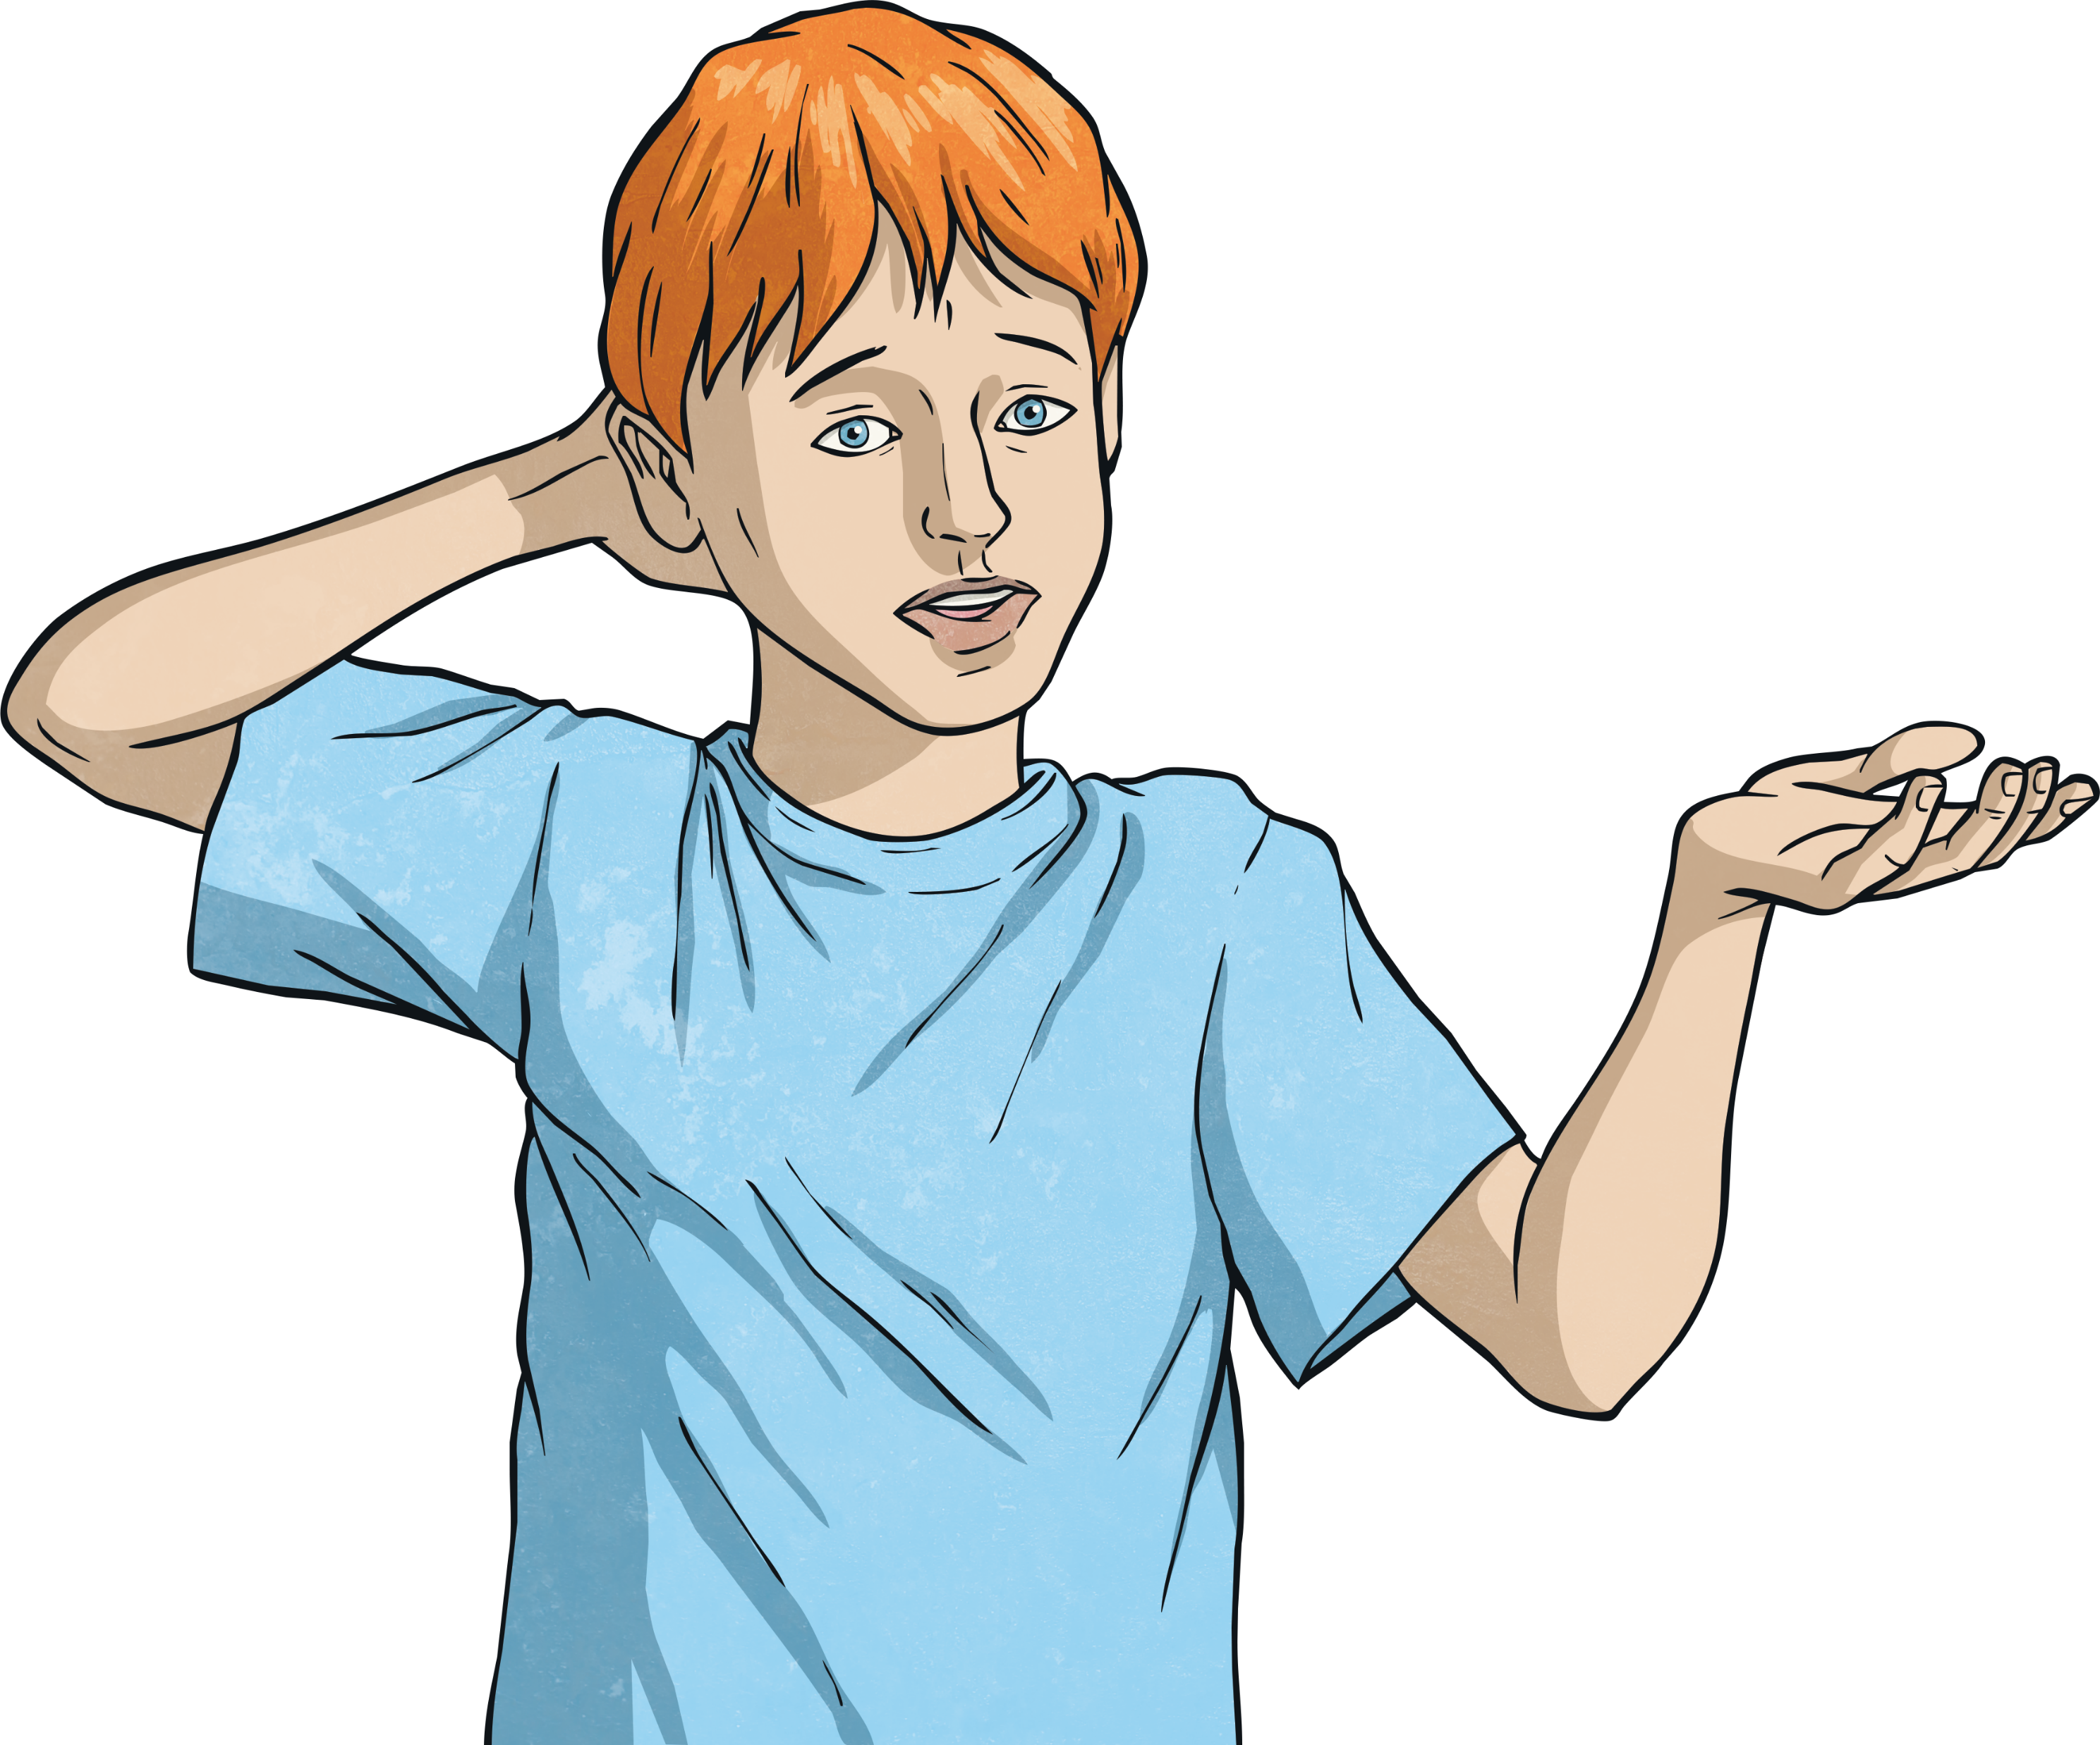
LO – to create negative meanings using prefix /mis/
What do you notice about these words?
misbehave
misplace
misheard
Click to hear

Slide 2
Here are this week’s spellings to practise.
misspell
mislead
mistreat
misbehave
mistrust
misprint
misuse
misplace
misheard
misread

