Slide 1
Lesson 3: The string family
Lesson 2 – Year 3 – Spring 1 - Families of Instruments : A Closer Look
Knowledge Objective | Task | Lesson Detail | Vocabulary
To take a closer look at the String family. To know the differences in sound, size and pitch of the violin, viola, cello and double bass instruments. | Task: To create a mind map in music journals of the four instruments, violin, viola, cello and double bass. Children to record the differences between the four instruments. Success Criteria: I know the difference between a violin, viola, cello and double bass. I know what sounds and pitches the violin, viola, cello and double bass have, | Begin lesson listening to: https://www.youtube.com/watch?v=G7xiFVAyZw8 which shows Vanessa Mae performing ‘Storm’ at the classical Brit Awards. What instrument is Vanessa playing? What other instruments are being played in the background? What style of music would you class this as? Is there more than one type of genre of music that you would class Vanessa Mae’s performance as? Prior Learning: Explain to the children that in last week’s lesson we took a closer look at the guitar and bass guitar and how as members of the string family they wouldn’t normally appear in orchestras and are most popular in the genre of rock music. Also remind the children of the prior learning they did in year 1 when they looked at the composer Camille Saint – Saens and his composition ‘The Carnival of the animals’. Within that piece he used the cello, one of the instruments we are going to focus on today, to make us think of a lovely swan floating gracefully on the water. Play the children https://www.youtube.com/watch?v=3qrKjywjo7Q which shows the ‘The Swan’ being played by the cello. Teach The main stringed instruments in the orchestra are the violin, viola, cello and double bass, The violin is the smallest and the others look like bigger and bigger violins. Each of these instruments has four strings. You can pluck the strings to make a sound, but most of the time you play them by sliding a bow back and fourth over the strings. When you play the violin or viola, the instrument rests between your shoulder and chin, However the cello is much bigger you sit and hold the instrument between your legs. To play the big double bass you either have to stand behind it or sit on a tall stall. To change note you press a string against the fingerboard with a left hand finger, The further up the finger board, the higher the notes. Play children the youtube clip https://www.youtube.com/watch?v=NnyxX_4zVJU which shows examples of the four instruments. Ask the children what they think the differences are between the look of the instruments and the sounds they are making. Explain that of these four instruments, the violin makes the highest sounds, the viola, can make slowly lower sounds, The cello’s sounds are even lower, while the double bass plays the lowest pitches of these four instruments. For many notes with pitches around the middle, composers choose whether to write them as low notes for the violin or high notes for the cello. Task: Children to create a mind map in music journals of the four instruments, violin, viola, cello and double bass. Children to then record the differences between the four instruments. Plenary: Come back together as a class and share ideas for whole class discussion. | Vanessa Mae - Violinist Camille Saint – Saens – French composer Violin – A wooden string instrument in the violin family. Viola – A string instrument that is bowed or played with varying techniques. Cello – A bowed string instrument of the violin family. Double bass – The largest and lowest pitched instrument in the modern Symphony Orchestra. Pitch – The degree of highness or lowness of a tone. Bowed – To play an instrument using a bow.
 |  |  | Relevant Musicians Vanessa Mae Camille Saint – Saens

Slide 2
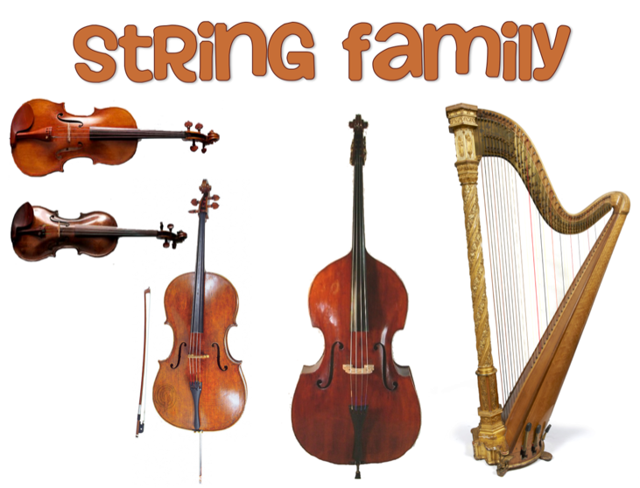

Year 3
Spring 1
Lesson 3

Slide 3
Let’s Listen
Was each instrument playing the same thing?
What tune did you hear?
How did the music make you feel?
Do you know any of these instruments?
How many instruments did you hear?
. What instrument is Vanessa playing? What other instruments are being played in the background? What style of music would you class this as? Is there more than one type of genre of music that you would class Vanessa Mae’s performance as?
Notes:
Video for listening task: https://www.youtube.com/watch?v=G7xiFVAyZw8

Slide 4
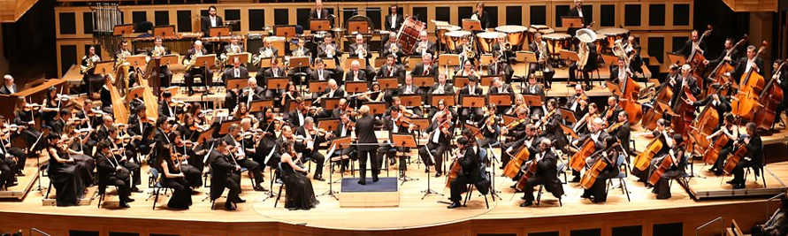

Prior Learning
What instruments did we learn about last week?
What genre of music was it?
We have previously learned about this family of instruments from the orchestra.

Slide 5
Prior Learning
Can you name a lower pitched
Sting instrument that might represent this animal?
https://www.youtube.com/watch?v=3qrKjywjo7Q

Slide 6
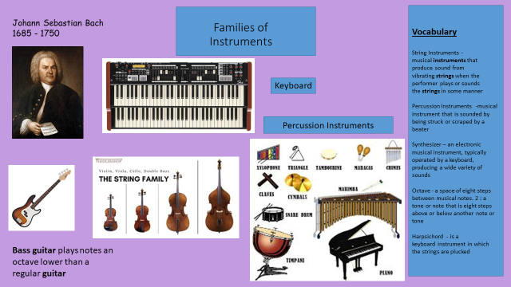
Our Knowledge Organiser

Slide 7
Key Vocabulary
Our key words for today’s lesson are:
String family
violin
viola
cello
Double bass
piano
harp
ukelele
guitar
plucking
Rubbing with bow
striking

Slide 8
L.O: to know the differences in sound, size and pitch of the violin, viola, cello and double bass instruments. .
Success Criteria: I know the difference between a violin, viola, cello and double bass. I know what sounds and pitches the violin, viola, cello and double bass have, .
Here are today’s key words:
String family
Violin
Viola
Cello
Double bass
Piano
Harp
Ukelele
Guitar
Plucking
Rubbing with bow
striking

Slide 9
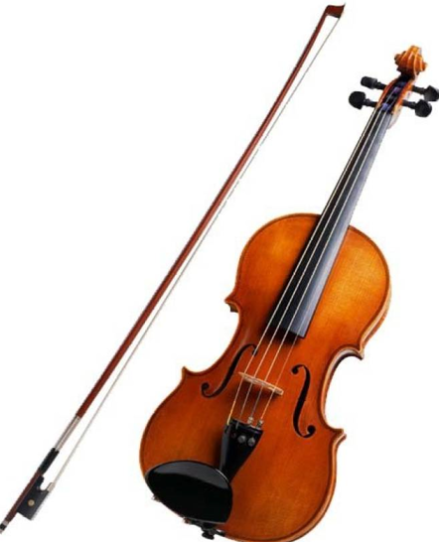
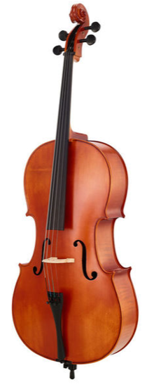
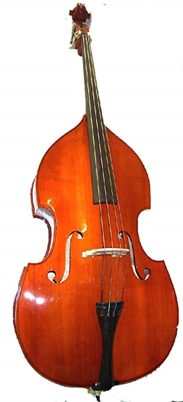
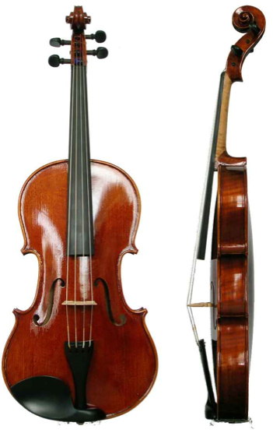
The string family
What instruments are in the string family?
violin
viola
cello
Double bass

Slide 10
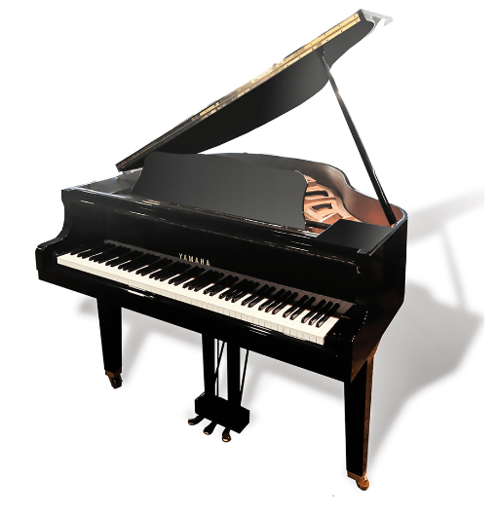
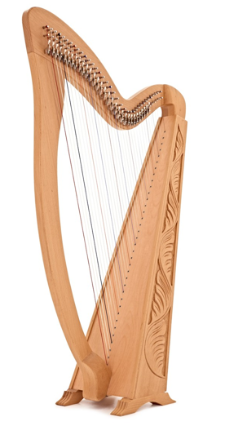
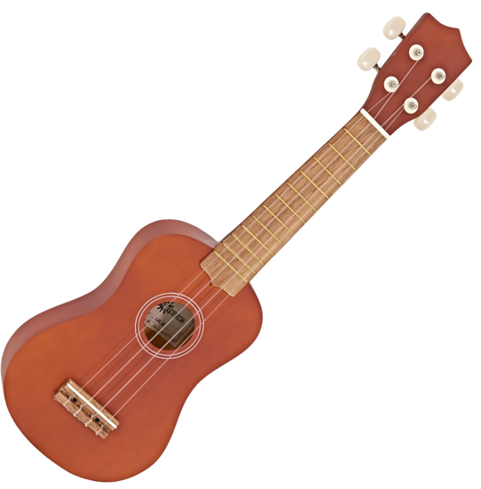
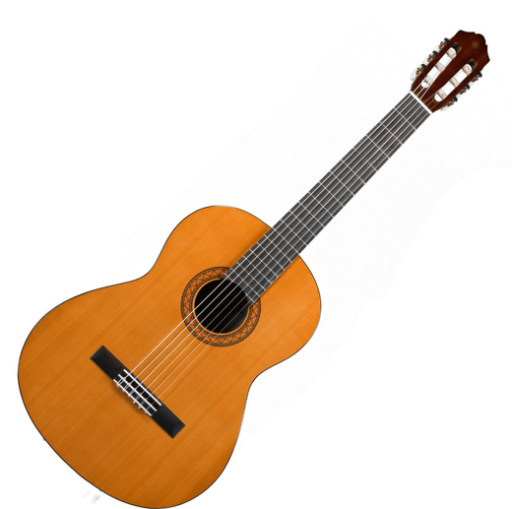
The string family
What instruments are in the string family?
ukelele
piano
harp
guitar

Slide 11
The string family
What are string instruments made of?
The string family is the largest family in the orchestra.
They are made out of wood and the body is hollow. The strings are made of nylon, string or gut.
Stringed instruments make sounds by the vibration of strings.
They have been part of history for 1000s of years and we know that Ancient Egyptians played the harp 5000 years ago.

Slide 12
Task
https://www.youtube.com/watch?v=NnyxX_4zVJU
This show examples of four instruments.
What do you think the differences are between the look of the instruments and the sounds they are making?
Which makes the highest sound?
Violin Viola Cello Double bass.
Which is the lowest pitch?
For many notes with pitches around the middle, composers choose whether to write them as low notes for the violin or high notes for the cello.
Notes:
Children to create a mind map in music journals of the four instruments, violin, viola, cello and double bass. Children to then record the differences between the four instruments.

Slide 13
Task
https://www.youtube.com/watch?v=NnyxX_4zVJU
Cellos are lower in pitch than
Violins have the
The string family.
Double bass has the
Violas are lower in pitch than
Step for depth
Can you describe the pitch of each instrument and compare to another instrument of the same pitch.
Notes:
Children to create a mind map in music journals of the four instruments, violin, viola, cello and double bass. Children to then record the differences between the four instruments.

Slide 14
Talk Task
How can we make the string vibrate?
Does the size of the instrument make a difference to the sound?
How can we make the sound louder or quieter?
Add this information to your mind map.

Slide 15
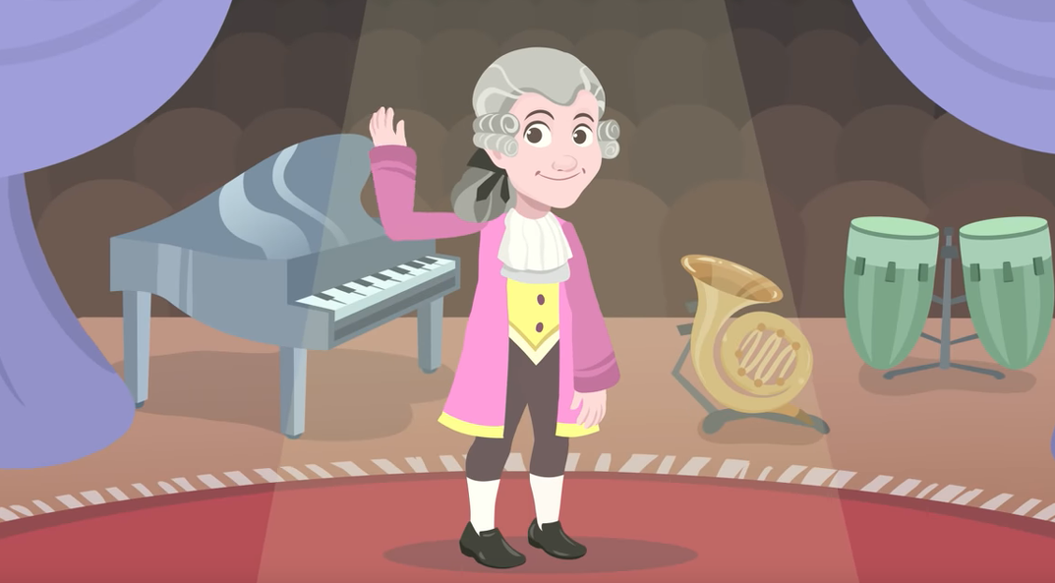
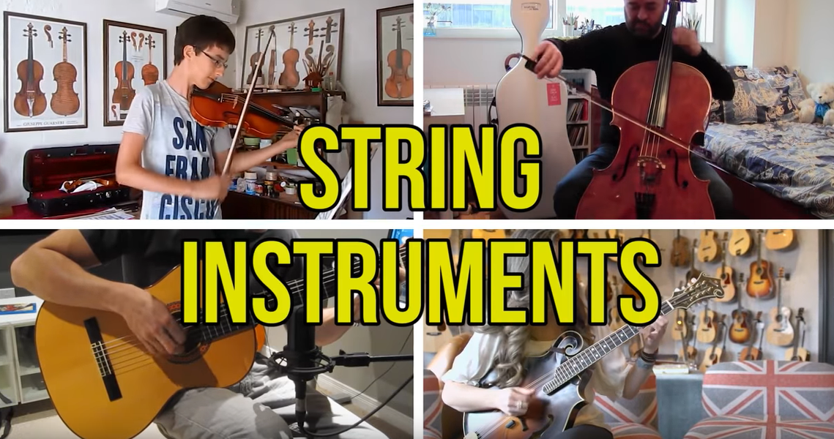
And finally…
Watch each of the clips and imitate playing the instruments.
Notes:
Extension: Draw their made instrument, jot down how it makes the sound/Draw and label the string instruments they know

