Slide 1
King Arthur

Slide 2
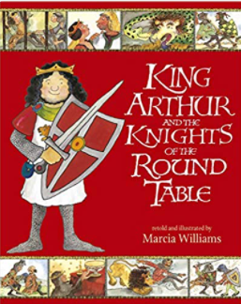
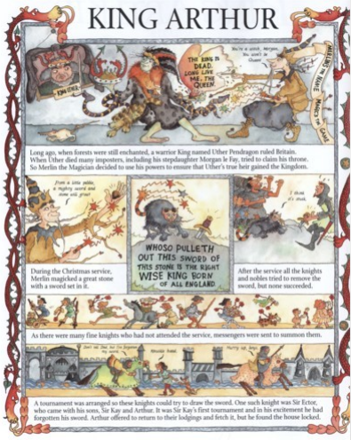

Slide 3
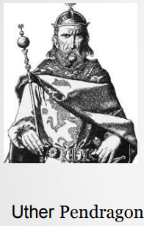
Long ago, when forests were still enchanted, a warrior King
names Uther Pendragon rules Britain. When Uther died many
imposter, including his stepdaughter Morgan Le Fay, tries to
claim the throne.

Slide 4
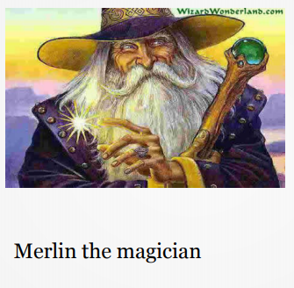
During the Christmas service, Merlin magicked a great stone with a sword set in it.
WHO SO PULLETH OUT THIS SWORD OF THIS STONE IS THE RIGHT WISE KING BORN OF ALL ENGLAND.

Slide 5
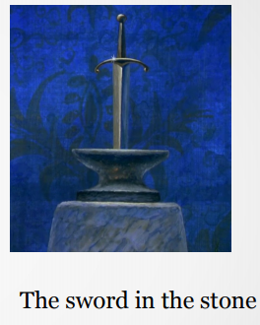
After the service all the knights and nobles tried to remove the sword, but none succeeded.
As there were many fine knights who had not attended the service, messengers were sent to summon them.
A tournament was arranged so these knights could try to draw the sword. One such knight was Sir Ector, who came with his sons, Sir Kay and Arthur. It was Sir Kay’s first tournament and in his excitement he had forgotten his sword. Arthur offered to go back to their lodgings and get the sword, but the house was locked.

Slide 6
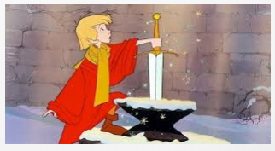
Remembering he’d seen a sword in a churchyard, Arthur decided to borrow it. Without reading the words on the stone, he withdrew the sword easily.
Sir Kay, knowing the significance of the sword told his father that he had withdrawn the sword himself, and so must be the rightful king.
Surprised, Sir Ector went to the churchyard where Arthur replaced the sword. Neither Sir Ector nor Sir Kay could pull it out again.
Then, in front of a gathering crowd, Arthur tried. The sword slid smoothly out from the stone. The awestruck onlookers fell to their knees.

Slide 7
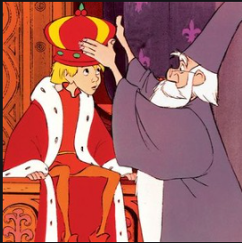
Then Sir Ector told Arthur that he was really King Uther’s son, brought to him sixteen years ago by Merlin to nurture and keep safe.
Although Arthur was only sixteen years old, everyone cheered for him to be king. So in preparation, he was first dubbed a knight.
Then the following week a grand coronation took place and all who stood for justice paid homage to Arthur Pendragon, their rightful king.

