Slide 1
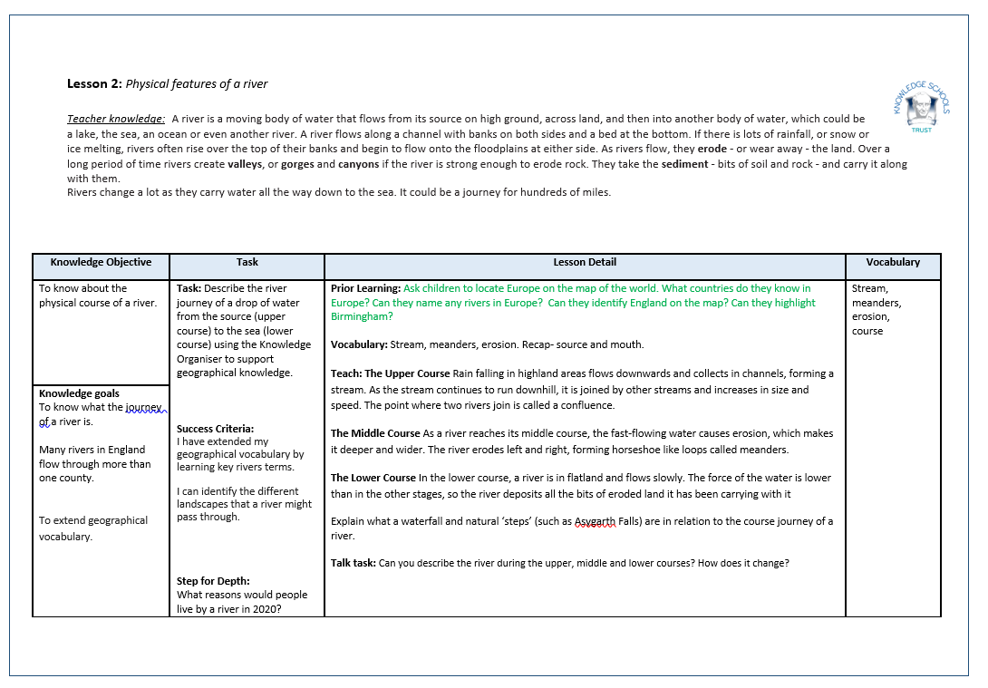
Lesson 1 – Rivers and Settlements
Insert Lesson Plan

Slide 2
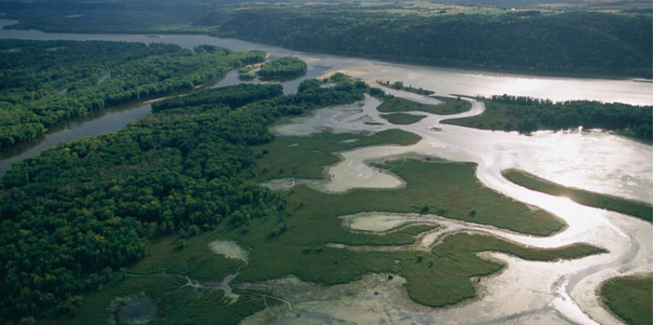
Year 3
Spring 1 Lesson 2
Rivers and Settlements
Insert Picture

Slide 3
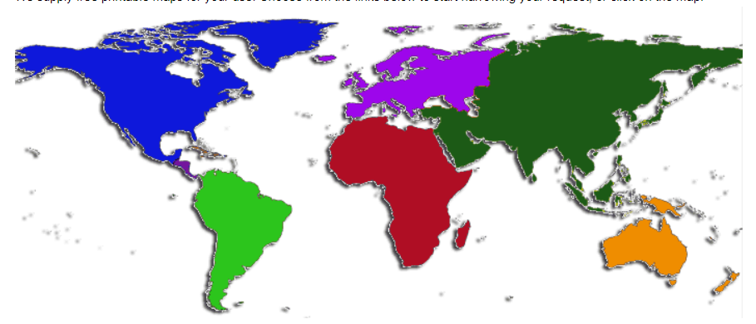
Prior Learning – Talk Task
Can you locate Europe on the map of the world?

Slide 4
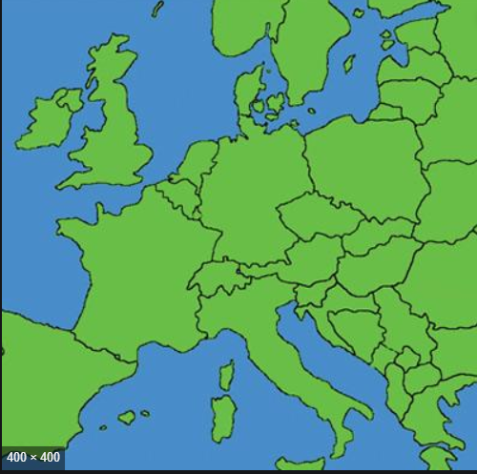
Prior Learning – Talk Task
What countries do you know in Europe?
Can you name any rivers in Europe?

Slide 5
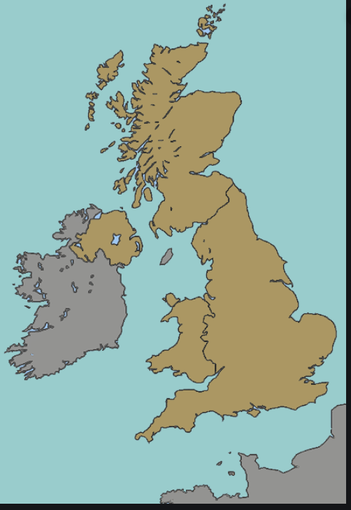
Prior Learning – Talk Task
Talk with your adult about the map. Where is England
on the map?
Together, find Birmingham.

Slide 6
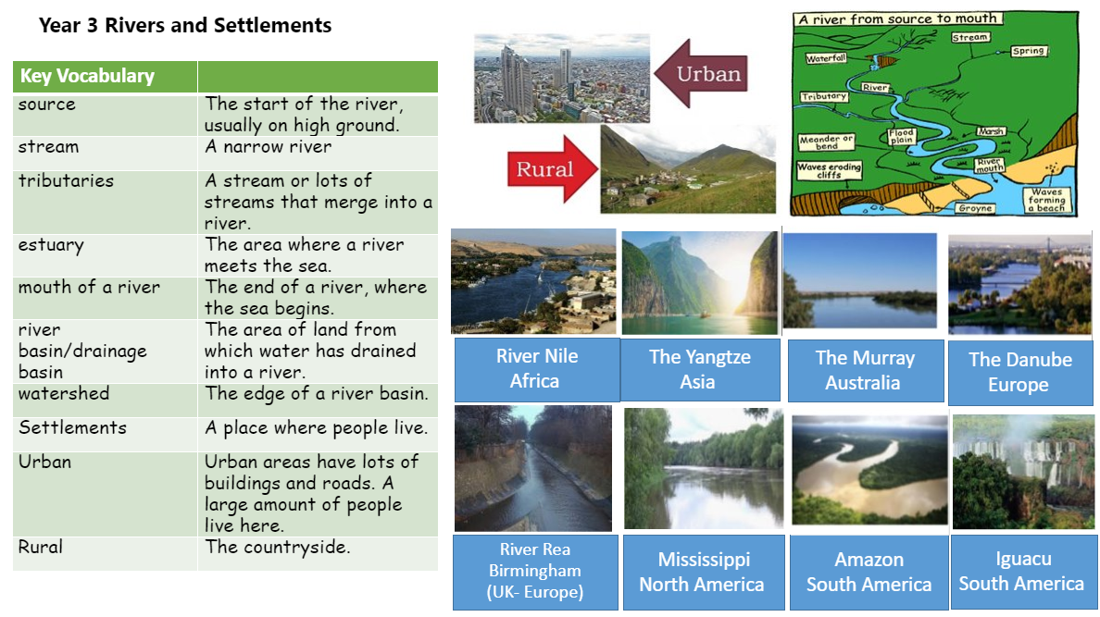
Our Knowledge Organiser
Insert knowledge organiser

Slide 7
Key Vocabulary
stream
meanders
erosion
course
A narrow river.
A bend in a river – usually in the middle or lower course.
The wearing away, in this case by water and rocks constantly rubbing.
The path of a river from it’s source to the mouth.

Slide 8
L.O: know about the physical course of a river.
Success Criteria: I have extended my geographical vocabulary by learning key rivers terms. I can identify the different landscapes that a river might pass through.

Slide 9
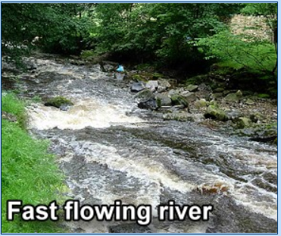
Teach
The upper course
Nearly all rivers have an upper, middle, and lower course. The beginning of a river, when it flows quickly with lots of energy, is called a young river. Rain falling in highland areas flows downwards and collects in channels, forming a stream. As the stream continues to run downhill, it is joined by other streams and increases in size and speed. The point where two rivers join is called a confluence. The
river here is smaller and usually
has a rapid, tumbling flow that
cuts a narrow channel through
rocky hills or mountains.

Slide 10
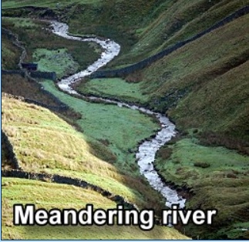
Teach
The Middle Course
As a river reaches its middle course, the fast-flowing water causes erosion, which makes it deeper and wider. The river erodes left and right, forming horseshoe like loops called meanders.

Slide 11
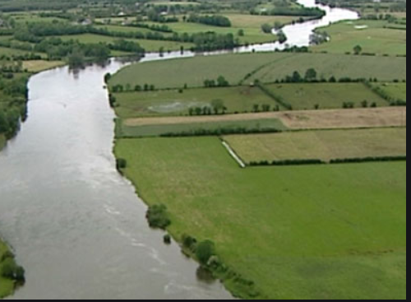
Teach
The Lower Course
In the lower course, a river is in flatland and flows slowly. The force of the water is lower than in the other stages, so the river deposits all the bits of eroded land it has been carrying with it.

Slide 12
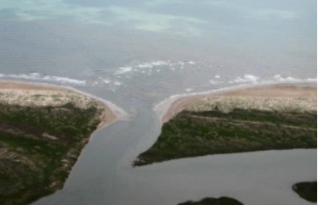
Teach
The Lower Course
When the river reaches the end of its journey, it is called an old river. The end of the river is called the mouth.

Slide 13
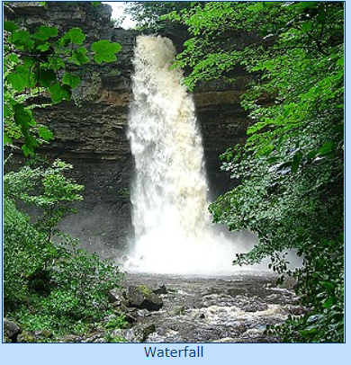
Teach
Waterfall
A Waterfall is a place where the river course is interrupted by a tall step.
Notes:
https://www.bbc.co.uk/programmes/p013jzzg

Slide 14
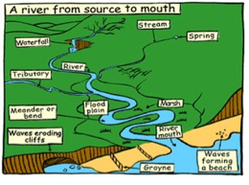
Talk Task
With your adult, describe the river during the upper, middle and lower courses? How does it change?
Write about a journey from the source, to the mouth of a river, as if you were a fish….
Notes:
https://www.youtube.com/watch?v=YPbesdTRV6Y

Slide 15
Task
L.O: know about the physical course of a river.
Success Criteria: I have extended my geographical vocabulary by learning key rivers terms. I can identify the different landscapes that a river might pass through.
Write a description of the journey of a tiny fish, from the source of a river, to the mouth of a river.

Slide 16
Step for Depth …
What reasons would people live by a river in 2021?

