Slide 1
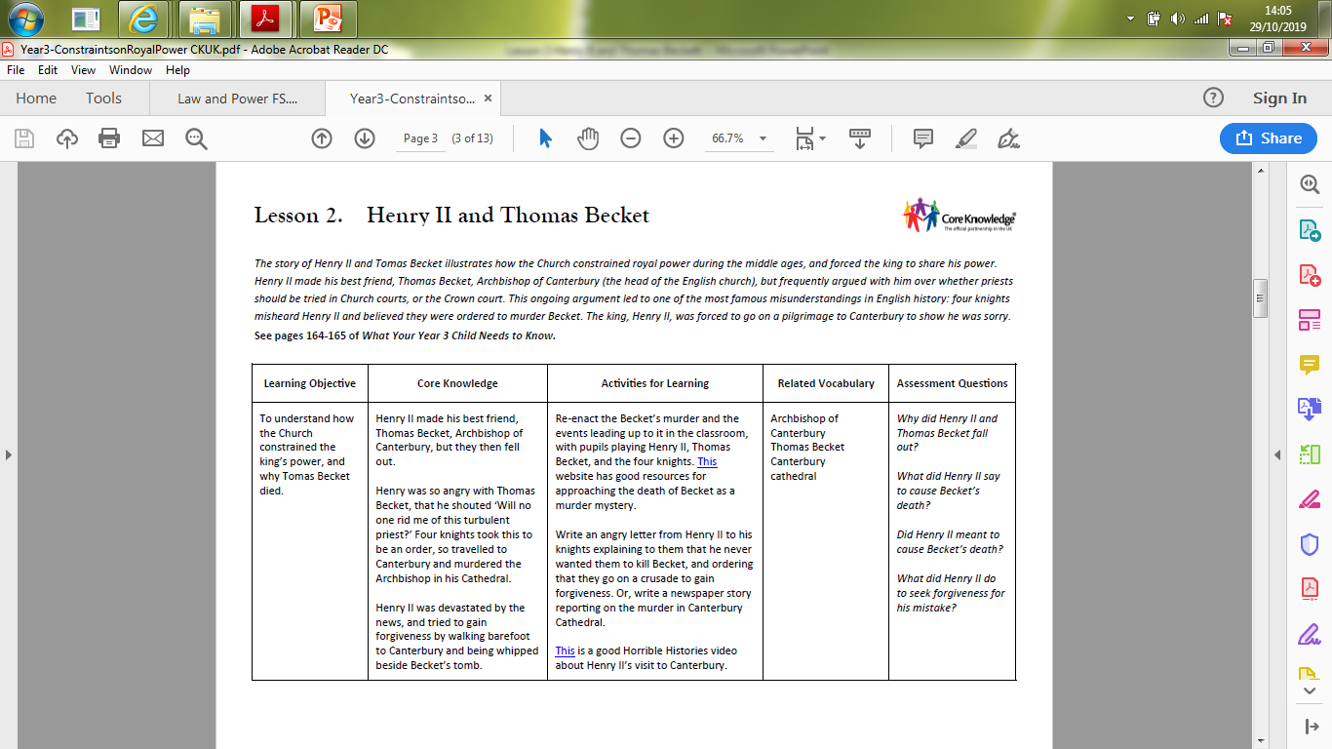

Slide 2


History
Law and Power

Slide 3
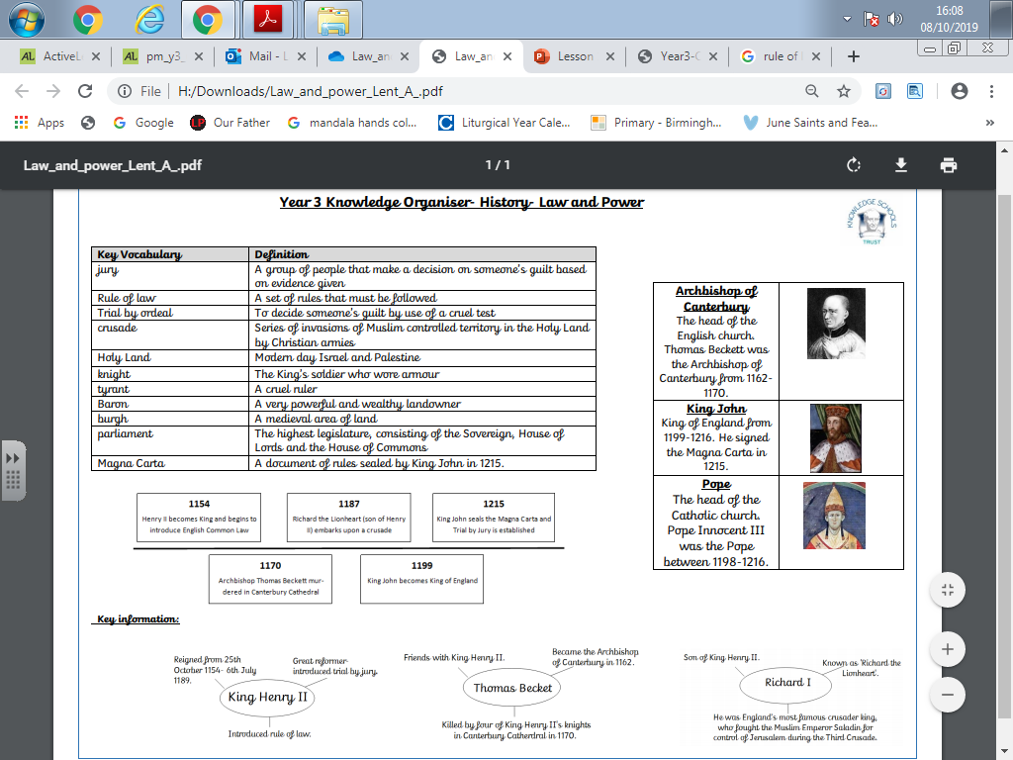

Slide 4
Prior Learning
Trial by ordeal
Trial by jury
What can you remember about these terms? Who created it?

Slide 5

Learning objective-
- To understand how the Church constrained the king’s power, and why Thomas Becket died.

Slide 6
Key vocabulary:
Excommunicated
Crusade
Archbishop of Canterbury
Thomas Becket
Canterbury cathedral

Slide 7
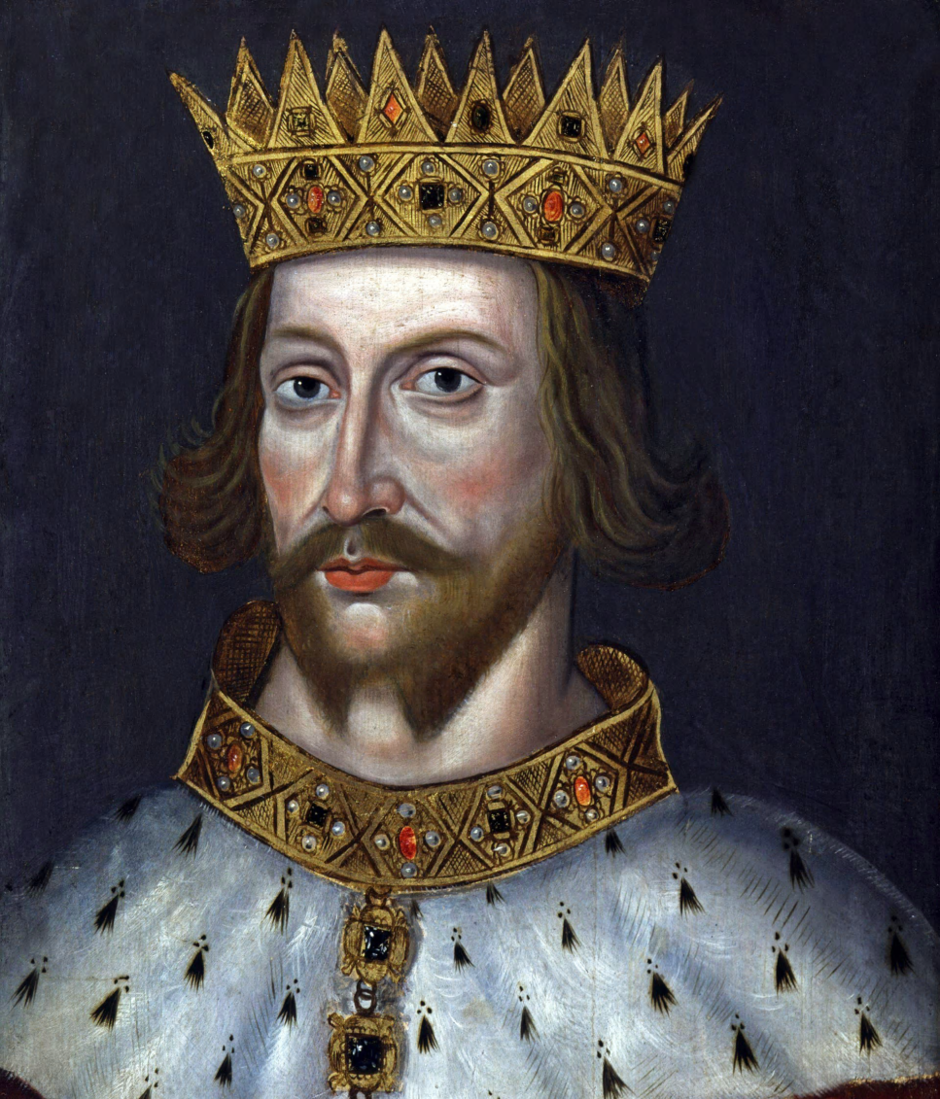
As part of his attempt to have more control over the country, he appointed his friend Thomas Becket to be Archbishop of Canterbury, the most important person in the Church of England. But it did not work out as Henry had planned!
Henry II became king in 1154.

Slide 8
When his friend started making his own decisions rather than doing what he was told, Henry was not happy. Henry wanted priests and religious leaders to be subject to the king’s court when they broke the law. He didn’t like the fact that the Catholic Church, which was led y the Pope in Rome, had so much power in England.
Thomas Becket disagreed; he thought that priests should only ever be tried by the Church itself and because both Henry and Thomas were stubborn, neither would back down. The argument became very bitter.

Slide 9
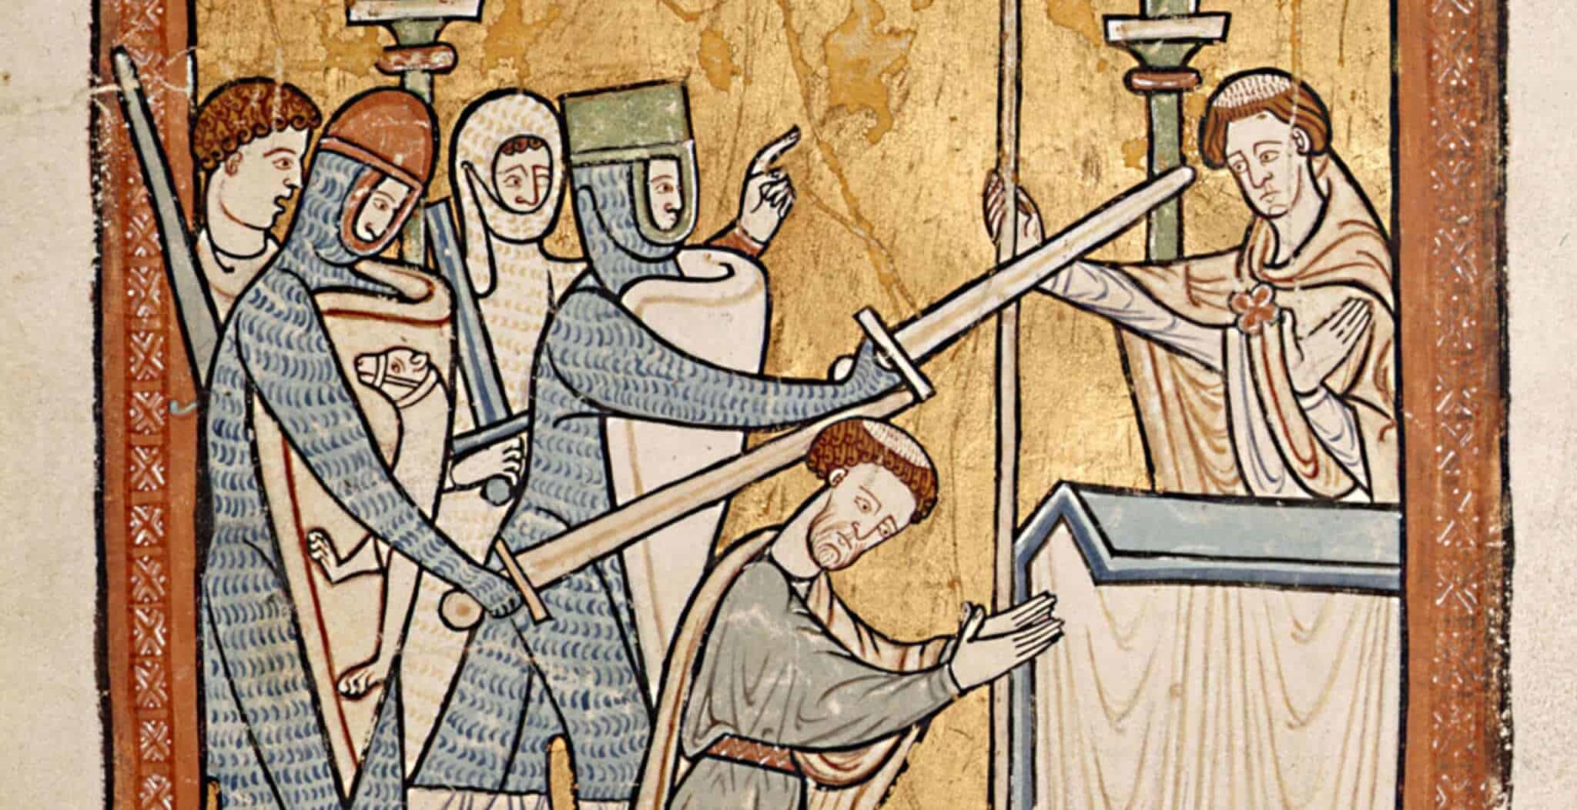
Henry became so fed up with Thomas and one day was overheard saying:
‘Will no one rid me of this troublesome priest?’
Four of his knights, who were standing near by, heard this and thought that henry was saying he wanted Thomas Becket to be killed. They travelled to Canterbury an murdered Thomas in the Cathedral.

Slide 10
Talk task
With your adult, discuss what you think Henry actually meant.
How do you think Henry reacted when he found out?

Slide 11
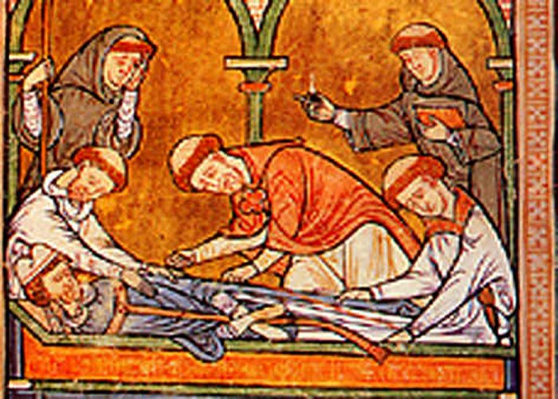
Everyone was shocked and Henry was very upset. He said he hadn’t meant his words to be acted on like that. People were very angry that an Archbishop had been killed in his own Cathedral, and they started visiting his tomb to say their prayers.
Henry II was devastated and so he went to Canterbury to pray at Thomas’ tomb. As Henry approached the city, he took off his shoes and walked the last few miles barefoot. The Pope told Henry to show that he was really sorry, he had to go on a Crusade.
The Pope ‘excommunicated’ the four Knights and ordered them to undertake the crusade with Henry.

Slide 12
Task.
With your adult, re-enact the Becket’s murder and the events leading up to it, you may use your toys as puppets to play Henry II, Thomas Becket, and the four knights.
Then, write a newspaper article about the events.

Slide 13
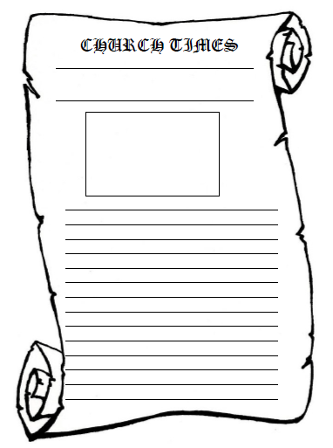

Slide 14
Step for Depth
Using the source from Benedict of Peterborough, describe how people behaved when they heard about the death of Becket. Why do you think they reacted in this way?

