Slide 1
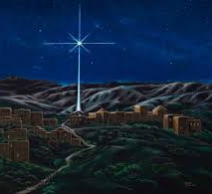
Week 8

Slide 2
Monday 4th January 2021
Inset Day!
Please take the time to read your book and
Practice spellings on Ed Shed.
You could also brush up on your times tables
On TT Rockstar.

Slide 3
Tuesday 5th January 2021
Word of the day : recite
LO – to recognise the features of a haiku poem
This week, we are exploring Haihu poems. Look through the PPT, this will explain what a Haiku is and how the lines are made up using syllables. Look at the different poems in the pack, see if you can count the syllables in each line.
Use thesaurus to see if you can change some of the words but keep to the same amount of syllables.

Slide 4

Maths
LO to know the 4 times table.
https://whiterosemaths.com/homelearning/year-3/week-12-number-multiplication-division/

Slide 5
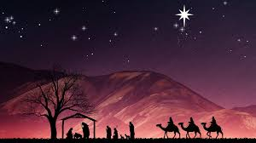
RE
LO: to know the story of the visit of the shepherds to Bethlehem.
Read Luke 2:8-10
The Angels and the Shepherds
Highlight the words and phrases that describe the surprise and shock felt by the shepherds.
Why was the message of the angels described as “news of great joy?”
The angels gave Jesus certain titles: Saviour, Christ, Lord. What do they mean? Which one do you like the best?
Imagine you are in role as one of the shepherds. Act out the events of the night. What questions would you ask about the experience? Prepare a list of questions that you would like to find the answers to.

Slide 6
PE
LO - to explore jumping techniques and link them with other gymnastic actions.
If it is safe to do so, walk around the room. ‘Jump!’, in a straight shape (stretched out) and land. Think about how you land. You should land with soft knees. Practise jumping and landing safely. Repeat a number of times and land in a balance on points (small body parts like feet, hands or knees).

Slide 7
Wednesday 6th January 2021
Word of the day – Pattern.
LO – to plan a Haiku poem with three lines with 3 syllables, 7 syllables and 3 syllables.
Look through the PPT for today and see if you can fill in the missing words to the poem.
Read the poems aloud and see if you have the correct amount of syllables on each line.
How can you make sure that you do? What will you do to ensure that you are correct/
Once complete, see if you can change the words, using more ambitious vocabulary.

Slide 8

Maths
LO :to multiply by 8.
https://whiterosemaths.com/homelearning/year-3/week-12-number-multiplication-division/
Mrs Middleton’s group
https://whiterosemaths.com/homelearning/year-1/week-12-number-place-value-within-20/

Slide 9
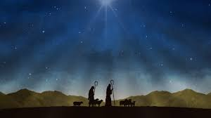
R.E.
LO – to empathise with the thoughts and feelings and reactions of the shepherds.
Re-read the scripture form the last lesson. Your task now is to write in the role of the shepherd, exploring reactions at this event. How would you describe the manger scene? What do you think the shepherds felt?
You might want to draw pictures of a shepherd and write captions to express their thoughts and feelings. You may wish to add your personal thoughts and opinions, suggesting why this scene is so important to you.

Slide 10

History
LO – to gain an understanding of the War of the Roses.
We begin our history topic by stepping back into the Middle Ages. Lets look at trial by ordeal and how King Henry developed Trial by Jury. Go through the PPT and your task is to write an explanation explaining why trial by ordeal was so cruel and ineffective.
What was it replaced with?
Was this better?

Slide 11
Thursday 7th January 2021
Word of the Day
rhyme
Writing
LO – to write a haiku using the correct syllables on each line.
Today, you are going to write your own haiku. Think about all of the features that you have looked at.
Will your poem be about an animal? Or a season? Maybe it will be about snow or ice.
Use the planner to help you, check those syllables, then off you go.
Finally, create an image to go alongside your poem.

Slide 12
Maths
LO : to divide by 8.
https://whiterosemaths.com/homelearning/year-3/week-12-number-multiplication-division/
Mrs Middleton’s Maths group, please use this link!
https://whiterosemaths.com/homelearning/year-1/week-12-number-place-value-within-20/

Slide 13
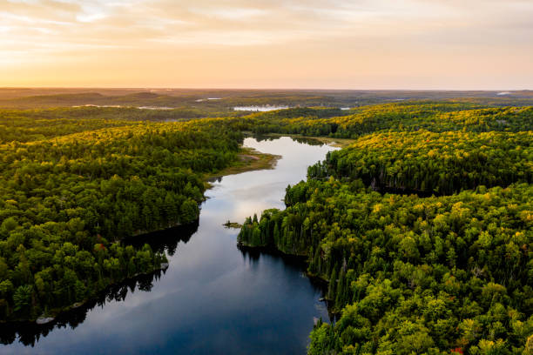
Geography
LO - to know about different stages of a river and how they are helpful to people.
Over this term, we will be looking at world rivers.
We begin the topic looking at how rivers are formed.
Follow the PowerPoint and then draw and label the stages of development.

Slide 14
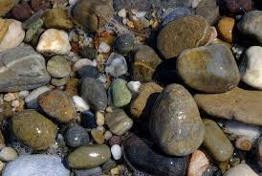
Science
LO – to set up simple practical
enquiries and present data.
Following on from last term, we are going to investigate the properties of rocks.
You will need to think about how you can test the hardness and the permiabilty of the rocks (stones) that you can find around the garden or area. With your adults permission, you will need to find between 3 and 5 items that you can scratch the rock with. You can use your fingernails too. Be careful. And wash your hands afterwards.
Permeability: See how it is that some rocks are permeable and others are not. If rock is a solid how can the water soak in? Permeable rocks have tiny air spaces in them that are too small to see and the water goes into these spaces.
Ask your grown up if you can use some vinegar. Vinegar is an acid.
Some rocks are made of a chemical that fizzes when acid is poured on it. Most rocks, however, are fairly inert and do not react.

Slide 15
Friday 8th January 2021
Word of the day
rhythm
Reading
LO – to answer comprehension questions.
Read through the Classic Poem by Robert Louis Stevenson. You have a selection of questions to answer. Read the question carefully, think about what you are being asked to do. Are you retrieving information from the text? If so find the words and copy them down. Is it a vocabulary question? You may find a dictionary will help you here. Remember that an inference question is asking you to think what something is like. And when you summarise, remember to think about the main parts of the poem and what the poem is about. Also, tell us what you like or dislike about the poem please.

Slide 16

Maths
LO :to know the 8 times table.
https://whiterosemaths.com/homelearning/year-3/week-12-number-multiplication-division/

Slide 17
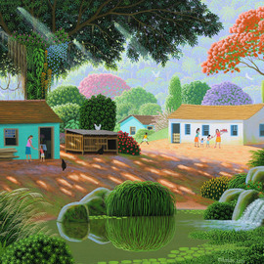
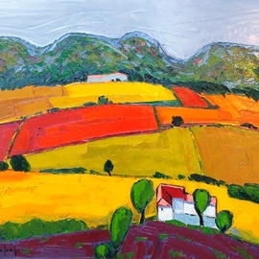
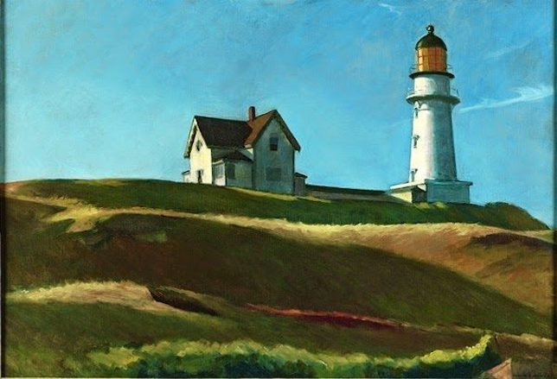
Art LO – to understand what a landscape painting is. Look at the landscape ppt. What do you notice about the artwork? What do you like about it? Which is your favourite piece? Why? Your task it to sketch a landscape, it can be real or imaginary.

Slide 18

Music
LO – to listen to and understand the job of the bass guitar.
This term we will be exploring more instruments and their families. Beginning with the bass guitar in rock music.
Rock on!
See ppt

