Slide 1
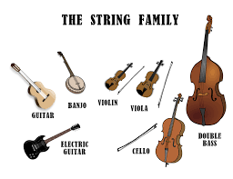
Lesson 1: Families of Instruments, a closer look.

Slide 2


Year 3
Spring 1
Lesson 1

Slide 3
Let’s Listen
https://www.youtube.com/watch?v=nnq3ZW6OyTI
What do you think of the bass guitar?
Do you like the sound it makes?
Does it sound okay when played on its own?
What sort of sound does it make?
Does it ok easy to play?
How does it differ to the sound of a guitar?

Slide 4
Prior Learning
In Year 2, you learnt about a the families in the orchestra. Can you name an instrument in the brass family?
How about an instrument in the woodwind family?
Percussion or string family?
today we will be taking a closer look at the string family and in particular the guitar and bass guitar and how they have been used to identify the genre of rock music.

Slide 5
L.O: to listen to and understand the bass guitar.
Success Criteria: I can recall instruments in the string family. I can hear the bass line in a song. I know that bass and guitars are popular within Rock music. I can sing or play a bass line riff
Bass guitar Lead guitar Electric guitar Ostinato Riff Chords Bass note
Key Vocabulary

Slide 6
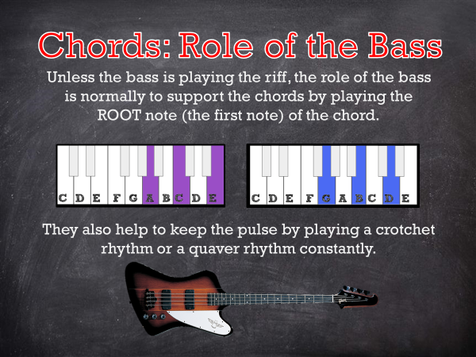
Teach

Slide 7



Slide 8

Teach

Slide 9

Teach

Slide 10

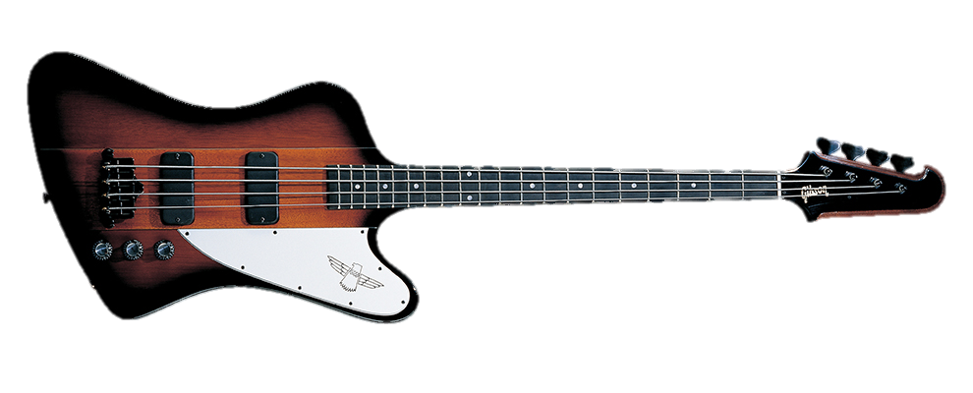
Bass Guitar
Another One Bites The Dust
Queen

Slide 11

Talk Task

Slide 12
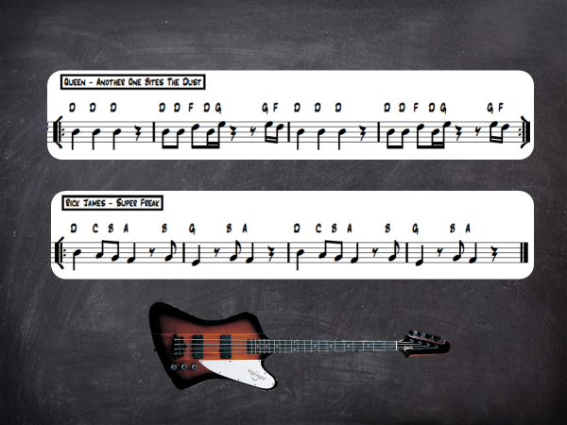
Task
Chose a riff,
See if you can hum it or if you can, tap the rhythm on your lap.
You could improvise, try different things to tap the bass rhythm on.
Keep it steady,
You must stay with the beat!

Slide 13
And finally…
Practise humming your bass riff your voice while your partner keeps the steady beat.
Perform to a member of your family. Can we spot the riff you are playing?
Make a note of any bass riffs you prefer and why. You could talk about how the drums combine to support the bass player.
Step for depth- write your bass riff in your journals, using dots for rhythm and dash for rests.

