Slide 1
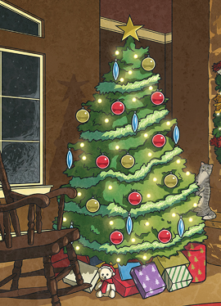
Week 7

Slide 2
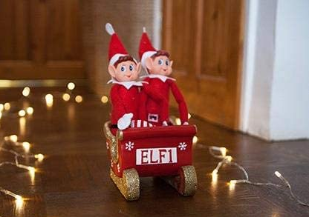
Monday 14th December 2020
Words of the day - glorious.
LO – to use interesting vocabulary to describe a character.
Read the PPT sharing the story of Socks the Elf. Think about your elf, this maybe the elf that you have at home or the elf that we have in class. Using the word mat, describe your elf and think about what it may get up to.

Slide 3

Maths
LO: to know the 4 times table.
https://whiterosemaths.com/homelearning/year-3/week-12-number-multiplication-division/ Mrs Middleton’s group https://whiterosemaths.com/homelearning/year-1/week-12-number-place-value-within-20/

Slide 4
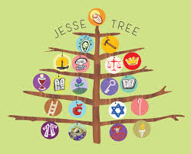
RE
LO: to know that the Jesse Tree shows Jesus’ ancestors.
You will need to research The Jesse Tree, you will discover that you already know many of the people that you find. Look through the PPT, see how many people from the Bible you know. Enjoy the quiz.
I wonder if you can create a family tree, who would it include? Jesus has a family tree. Look through the PPT about the Jesse Tree. Which of Jesus’ ancestors do you know?
Create your own symbols for a Jesse tree that you can display at home.

Slide 5
PE
To develop and investigate different ways of throwing and to know when it is appropriate to use them.
Warm up by running on the spot. Can you keep it up for 5 minutes?
Use a ball or bean bag to throw and catch. How high can you throw it?
How many times can you throw it in a minute?

Slide 6
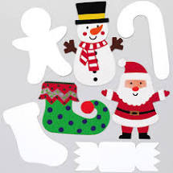
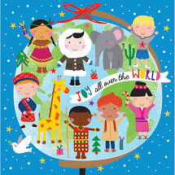
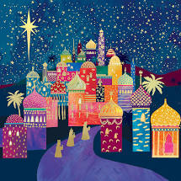
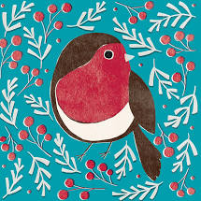
PSHE
LO – to understand others emotions.
Create a picture, card or decoration for a celebration. You may wish to make a Christmas card for someone who is feeling sad or they may be spending Christmas alone this year. Spread a little light by using lots of bright colours.

Slide 7
Tuesday 15th December 2020
Word of the day : miracle
LO - to use different sentence structures to set the scene.
Read the story starter and think about what the elf will get up to next. Will it be helpful? Could the elf get into trouble with the guinea pigs in school? Or is it an elf that really tries to help but gets into trouble instead? This is your Christmas story, it’s all up to you. Remember to use all of the grammar and punctuation that you have learned this term –
determiners; noun phrases; preposition; adverbial starters; nouns, verbs and adjectives.
Word of the day – insist - verb

Slide 8

Maths
LO :to multiply by 8.
https://whiterosemaths.com/homelearning/year-3/week-12-number-multiplication-division/
Mrs Middleton’s group
https://whiterosemaths.com/homelearning/year-1/week-12-number-place-value-within-20/

Slide 9
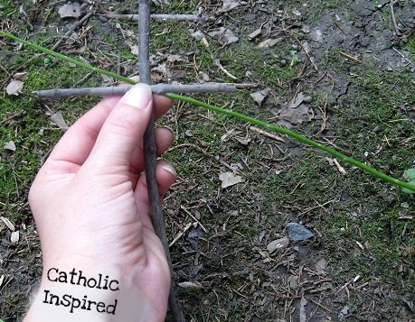
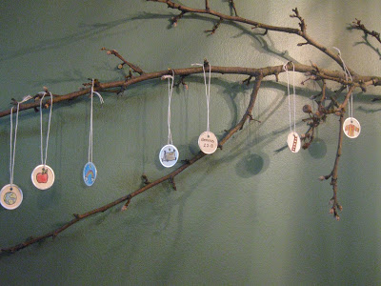
Art and design.
Design your own Jesse Tree
Have a go at creating your own Jesse tree, just follow these instructions!
Draw your own Jesse tree symbols , colour them in then cut them out.
Put a hole in the top of each symbol and tie a piece of string to it.
3. Gather 2 sticks of around 30cm long – the length of your ruler.
4. Tie them together using a bit of string, to form a cross.
5. Fill the plastic pot with soil.
6. Place your tree into the soil.
7. Attach you Jesse symbols to the branches securely.
We would love to see pictures of your creations!

Slide 10
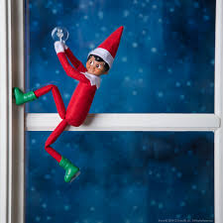
Wednesday 16th December 2020
WOTD - Icicle
LO – to organise my writing into paragraphs, with a believable and interesting problem and solution
Gather all of your ideas today and group them into sentences that all have a common theme.
Begin to write the story, plan your sentences, read them to someone to see if they make sense.
How could the sentences be improved? More adjectives? Upgraded adjectives? Using show not tell?
Have you included the problem that Elf gets into?
How is the problem resolved?
Who has helped?

Slide 11
Geography
LO - to identify similarities and differences in human features of two places
Use Google Earth to locate Birmingham. What buildings can you name that are in Birmingham? Follow the link to find Sheldon, what do you notice? What changes do you see in the map? Create a map for Father Christmas to take as he travels around Sheldon advise Father Christmas about challenges that he may face when he moves towards the city centre.

Slide 12
Maths
LO : to divide by 8.
https://whiterosemaths.com/homelearning/year-3/week-12-number-multiplication-division/
Mrs Middleton’s Maths group, please use this link!
https://whiterosemaths.com/homelearning/year-1/week-12-number-place-value-within-20/

Slide 13
R.E.
LO – to create your own symbol to represent your family.
Remember our lesson yesterday? You began discovering the Jesse tree. On there you should have found the symbols that represent Jesus’ family.
We would love for you to make your own Jesse tree symbol today. One that represents your family.
It could have baking on it if you enjoy baking together, or the park if you spend time in the park with your family.
Whatever it is that you enjoy to do as a family.

Slide 14
Science
LO – to carry out Christmas STEM tasks
Have a look at the Elf STEM challenges in the resource section. Which one could you choose to do? Take photos if you can and send them to us, we can share them on Twitter and we can add them to your Science book in the New Year.

Slide 15
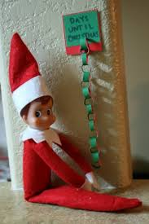
Thursday 10th December 2020
Writing
Word of the day: Worship
LO – to write a story about Socks the Elf.
It is all up to you. Write your story any way you want. Remember that you already have the starter (if you want to use it) so the rest is up to you. I am looking forward to reading the stories. We can gather them together and make a Year 3 Christmas Book
Word of the day-

Slide 16

Maths
LO : to divide by 3. https://whiterosemaths.com/homelearning/year-3/week-11-number-multiplication-division/

Slide 17
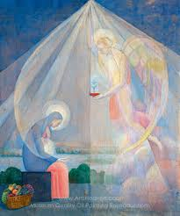
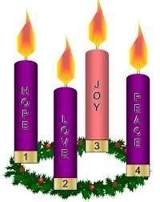
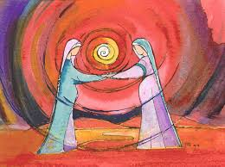
Art.
LO – to use line to sketch a Christmas picture
Sketch an image of Mary during the Annunciation
Or Mary and Elizabeth together during the Visitation.
You may also wish to create your own Advent Wreath, similar to the one
We were making at school.

Slide 18
Friday 18th December 2020
Word of the day: worship.
LO – to read my story with expression.
Let’s hear your story, maybe you can record it and email to us.

Slide 19
Maths
LO – to practise my times tables.
Play the different games on TT Rockstars!

