Slide 1

Week 6
Continuing with our reading of Stig of the Dump, this week we will continue exploring grammar. To really appreciate this classic novel, we will explore the language, the settings and the unusual characters.
Outcome: to write a conversation between characters from Stig of the Dump.

Slide 2
Monday 7th December 2020
Words of the day - restless.
Grammar focus
LO to know how to punctuate direct speech.
Follow the Oak academy link.
https://classroom.thenational.academy/lessons/to-explore-punctuating-speech-first-c9j30c

Slide 3
Read through this weeks spellings
believe
appear
often
group
beneath
continue
arrive
women
describe
height
LO: To practice year 3 spelling words.
Write your sentences out. Check that you understand the meaning of each word.

Slide 4
Maths
LO: to divide by 2 and 5.
whiterosemaths.com/homelearning/year-3/week-10-number-multiplication-division/

Slide 5
R.E.
LO: to know the story of the Visitation.
Look at todays RE powerpoint. Think about how Mary felt after visiting Elizabeth. Write a letter from Mary to Elizabeth explaining how it made her feel to have Elizabeth as a support.

Slide 6
PE
To develop and investigate different ways of throwing and to know when it is appropriate to use them.
Warm up by running on the spot. Can you keep it up for 5 minutes?
Use a ball or bean bag to throw and catch. How high can you throw it?
How many times can you throw it in a minute?

Slide 7
Tuesday 8th December 2020
LO to recognise differences between playscripts and story writing.
Word of the day – insist - verb
Look at the play script , have a read through . Can you see what is different and what is similar ?

Slide 8
Maths
LO : to divide by 10.
https://whiterosemaths.com/homelearning/year-3/week-10-number-multiplication-division/

Slide 9
R.E.
LO: To know the Jesse Tree is Jesus’ ancestors
Can you create your own family tree? Who would be part of it?
Jesus has a family tree full of people that you might have read about in year 1 and 2.
Look through the PPT and create your own Jesse tree symbol.

Slide 10
Wednesday 09th December 2020
Lo to use and explore different speech verbs.
Word of the day – barb – noun
You will need to take on the personality of a character from Stig. How would they talk? How would they move their hands or head when they are speaking.
Imagine you are them. How would you say
Speech verbs would tell us the characters mood.
See resources, write the playscript and direct speech, not a play script.

Slide 11
Maths
LO :to times by three.
https://whiterosemaths.com/homelearning/year-3/week-11-number-multiplication-division/

Slide 12
Geography
LO – to identify similarities and differences between Birmingham and Sheldon.
Use the powerpoint to explore the physical features of two countries.

Slide 13
Science
LO – to plan an investigation.(Exciting!)
My hypothesis is that all rocks sink. Am I right?
Gather a selection of rock types such as pebbles, chalk, pumice, slate, shale.(Can order them as sedimentary, metamorphic or igneous?)
Fill a big bowl with water , ask an adult first!
Then carefully, place one rock at a time in the water.
Record whether it floats or sinks.
Did they do what you expected?

Slide 14
Thursday 10th December 2020
LO: to correctly punctuate direct speech.
Read through the Stig extract in your resources file. Write the text, using inverted commas around the spoken sentences. Can you use exciting new spoken verbs?
Word of the day- trundle

Slide 15
Maths
LO : to divide by 3. https://whiterosemaths.com/homelearning/year-3/week-11-number-multiplication-division/

Slide 16
History
LO: To understand the legacy of Alexander the Great.
Look through the Power point. Was Alexander the Great a good ruler. Convince me of your opinion. Use knowledge from past lessons to support your argument. You might feel that he was good and not so good!

Slide 17
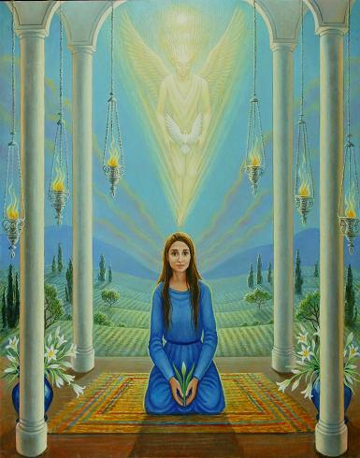
Art
Sketch a version of Mary when she was visited by the angel . Think about her facial expressions, what was she feeling at the time?
Then create an image of the angel. Think about the colours you would use for Mary and the angel.

Slide 18
Friday 11th December 2020
LO to answer comprehension questions .
See powerpoint resource for Friday.
Word of the day- surge.
See Fridays comprehension resource. Answer questions in full sentences

Slide 19
Maths
LO : to know the 3 times table.
https://whiterosemaths.com/homelearning/year-3/week-11-number-multiplication-division/

Slide 20

Music
Follow the powerpoint, then create a sound scape, that will represent Vivaldi’s sonnet of winter.
L.O: to know that we can tell a story through music.

