Slide 1
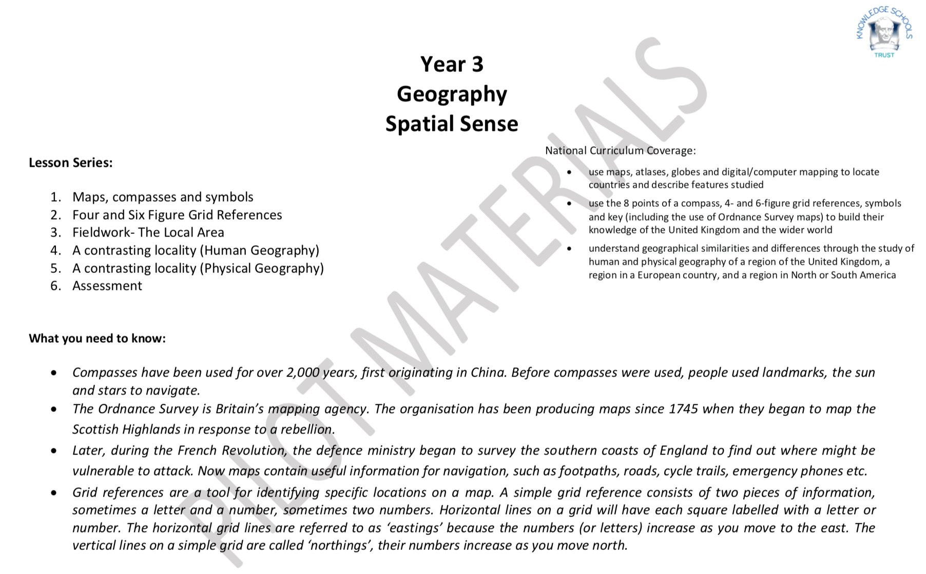

Slide 2
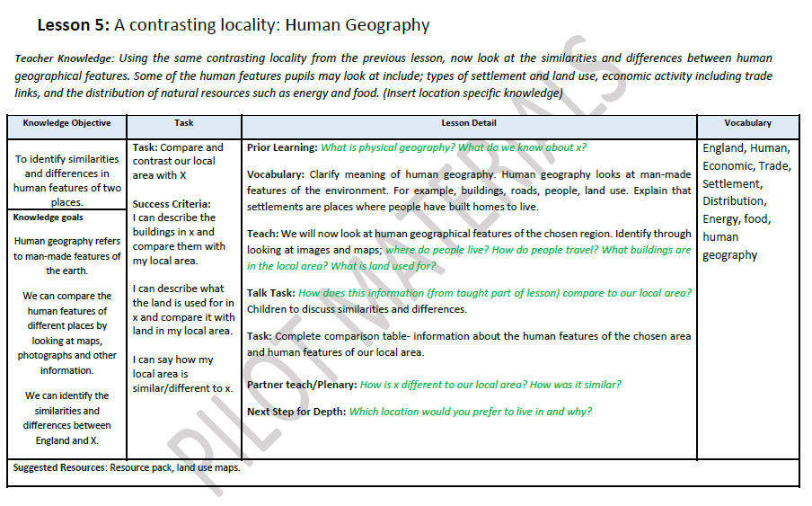

Slide 3
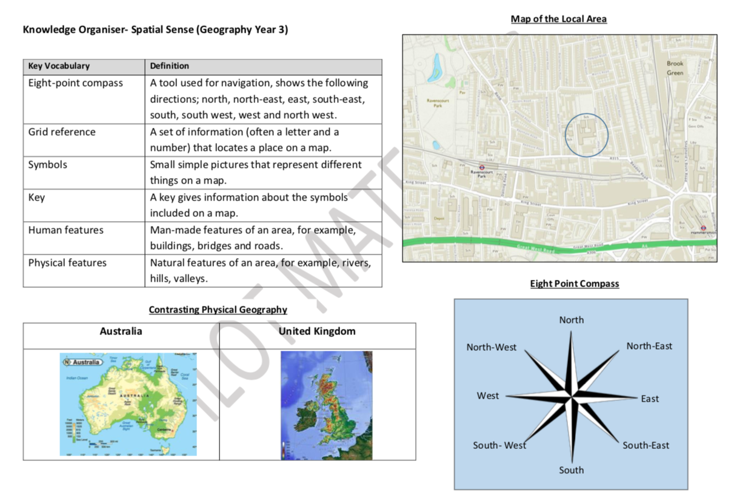

Slide 4
Prior Learning:
Physical geography
Notes:
What is physical geography? How many examples of physical geography can you think of? What do we know about Weoley Castle?

Slide 5
Key Vocabulary:
England | Human
Economic | Trade
Settlement | Distribution
Energy | Food
Human geography
Human geography refers to man-made features of the environment. E.g. buildings, roads, people, land use.
Notes:
Present the key vocab for this lesson and then explain what human geography refers to. Ask the children if they can think of some examples of things that are not human geography.
Settlements are places where people have set up to live.

Slide 6
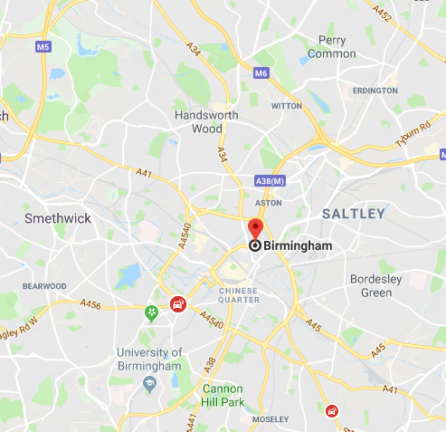
Human Features -
This is a map of Birmingham.
Where do people live?
How do people travel?
What buildings are in the local are?
What is land used for?

Slide 7
Talk task -
This is a map of Sheldon.
How is this similar or different to the human features that can be found on the map of Birmingham?
http://www.maplandia.com/united-kingdom/england/west-midlands/birmingham/sheldon/#link

Slide 8
Task –
Complete the comparison table.
Human Features
BIRMINGHAM | Wheatsheaf, Sheldon
Step for depth:
What are the advantages and disadvantages of living in Sheldon?

Slide 9
Partner Talk
How is Birmingham different to Sheldon?
Notes:
Plenary - discussion

