Slide 1
Alexander’s Death and Legacy
Lesson 5- Autumn 2

Slide 2
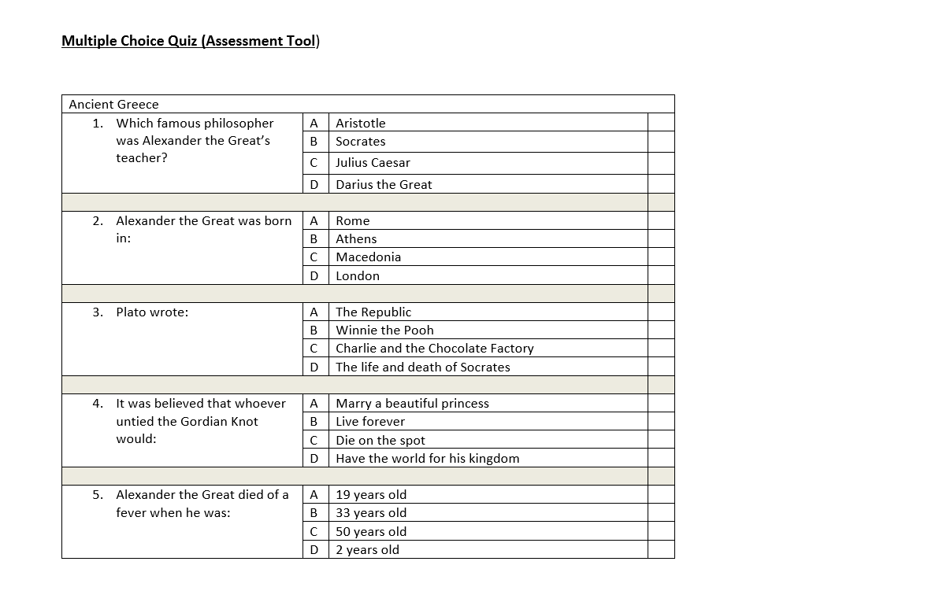

Slide 3
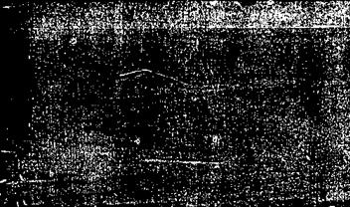
Prior Learning: In Year 2 we learnt about the Roman Empire
Prior Learning: In Year 2 we learnt about the Ancient Civilisation of Egypt.
River Nile
pyramids
hieroglyphics
Julius Caesar
55BC
Emperor Claudius
43AD
Boudicca
Hadrian’s Wall
Picts

Slide 4
Prior Learning Task:
What can you tell me about Alexander the Great and his empire ?

Slide 5
Learning Objective:
To understand the legacy of Alexander the Great.
Success Criteria:
I can say if I think he was a good or bad ruler.
I can give a reason using evidence.

Slide 6
conquer
empire
debate
Hellenism
legacy
Key Vocabulary
Egypt
evidence
defeat
Persia
war
ruler
culture

Slide 7
Do you think he was a good ruler? Why?
What is a ‘good’ ruler?
Alexander the Great died very young, but in his short life conquered the largest empire known at that time.

Slide 8
Do you think these statements about Alexander the Great make him a good or bad ruler?
Talk Task

Slide 9
He united Greece, but by force

Slide 10
He defeated the Persian Empire and killed the Persian king

Slide 11
When the city-state Thebes stood up to him, he burned the city to the ground and sold its people into slavery

Slide 12
He spread the Greek language and culture to the rest of his empire

Slide 13
He looked after his army and they remained loyal to him

Slide 14
He never lost a battle!

Slide 15
He named places he conquered after himself

Slide 16
Lots of people were killed in the battles he fought

Slide 17
Learning Objective:
To understand the legacy of Alexander the Great.
Success Criteria:
I can say if I think he was a good or bad ruler.
I can give a reason using evidence.

Slide 18
Debate Time
Task
Was Alexander the Great a good ruler?
Rule: you need to provide evidence from your history knowledge to support your argument.
Notes:
Was Alexander the Great a good ruler? Explain to children that they need to provide ‘evidence’ from their history knowledge to support their views.

Slide 19
conquer
empire
debate
Hellenism
legacy
Key Vocabulary
Egypt
evidence
defeat
Persia
war
ruler
culture

Slide 20
Plenary

