Slide 1
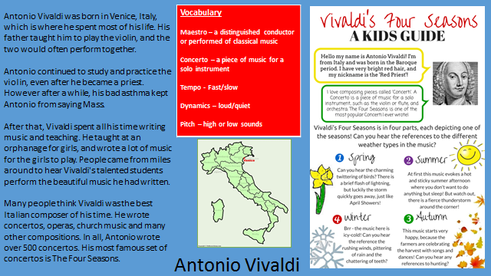
Knowledge Organiser

Slide 2
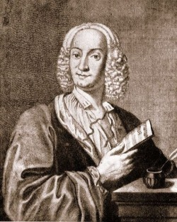

Year 3
Autumn 2
Lesson 4
Unit Title
Antonio Vivaldi

Slide 3
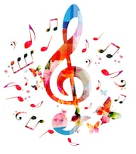
Let’s Listen
https://www.youtube.com/watch?v=8x4GC0-Z0ZI

Slide 4
Key Vocabulary
Vivaldi
Concerto
Winter
Autumn
Priest
Italy
Sonnet

Slide 5
L.O: to create and perform a musical soundscape.
Success Criteria: To know how to play with dynamics. To know play as a group. know that music can tell a story.
Here are today’s key words:
Movement
Sonnet
soundscape

Slide 6
Teach
In groups of 3-4 .
How did we create our soundscape?
What musical elements did we use?
Pitch,
tempo,
dynamics,
texture.
Which instruments can we use to replicate the sound of breaking ice?

Slide 7
Teach
Whole Class
Have a variety of shaking, scraping and tapping instruments.
Percussion instruments to be explored, modelled by the teacher. Show children how to play each instrument.

Slide 8
Task
Choose instruments that suit your sound scape.
If we move too fast, we slip and fall to the ground
Again treading heavily on the ice
Until the ice breaks up and dissolves

Slide 9
Listen and talk task
Practise in your groups, considering dynamics, timbre, tempo.

Slide 10
And finally…
Perform your compositions.
Children to listen and respond, discussing what they liked.

