Slide 1

Britain’s Landscape
LO. To identify physical and human features of the UK

Slide 2
Human vs Physical

Slide 3
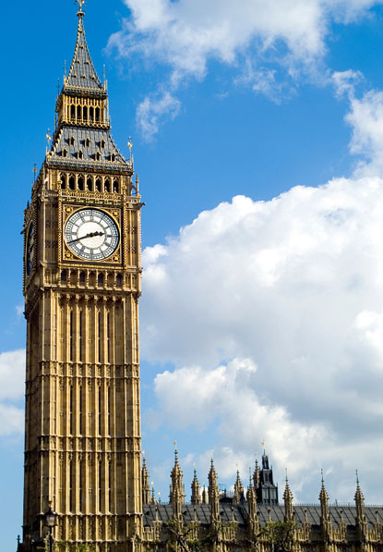
1. Human or Physical?
Big Ben and Houses of Parliament in London

Slide 4
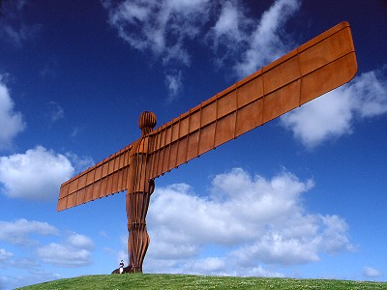
2. Human or Physical?
Angel of the North, Gateshead

Slide 5
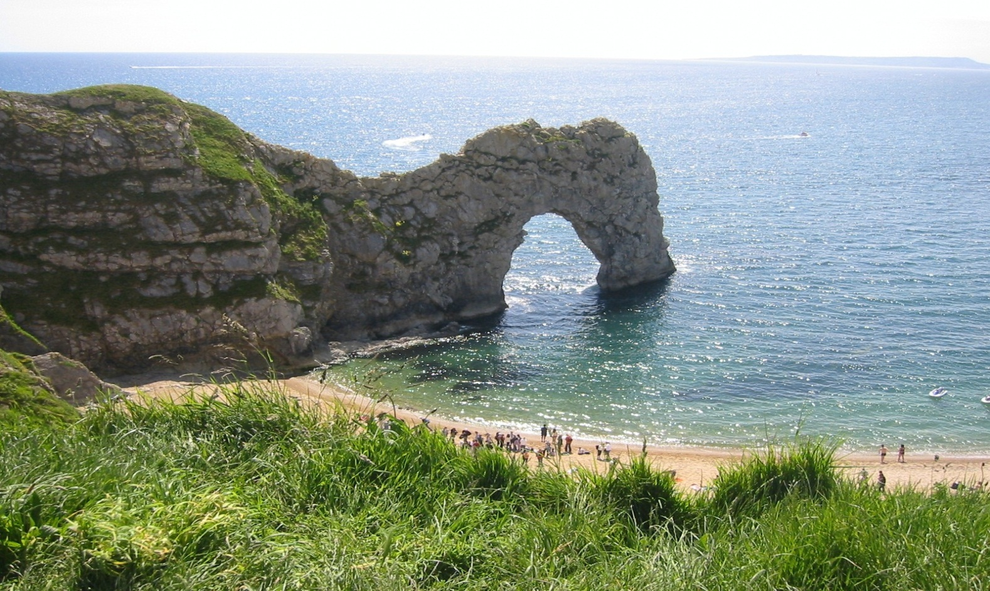
3. Human or Physical?
Durdle Door on the Jurassic Coast, Dorset

Slide 6
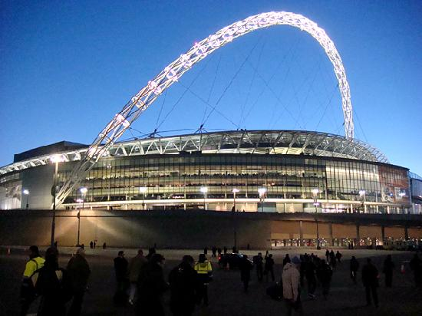
4. Human or Physical?
Wembley Stadium, London

Slide 7
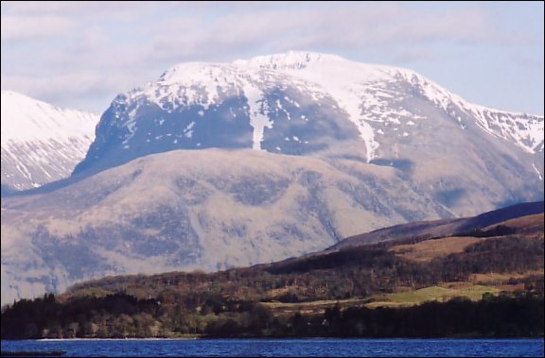
5. Human or Physical?
Ben Nevis, the highest mountain in UK

Slide 8
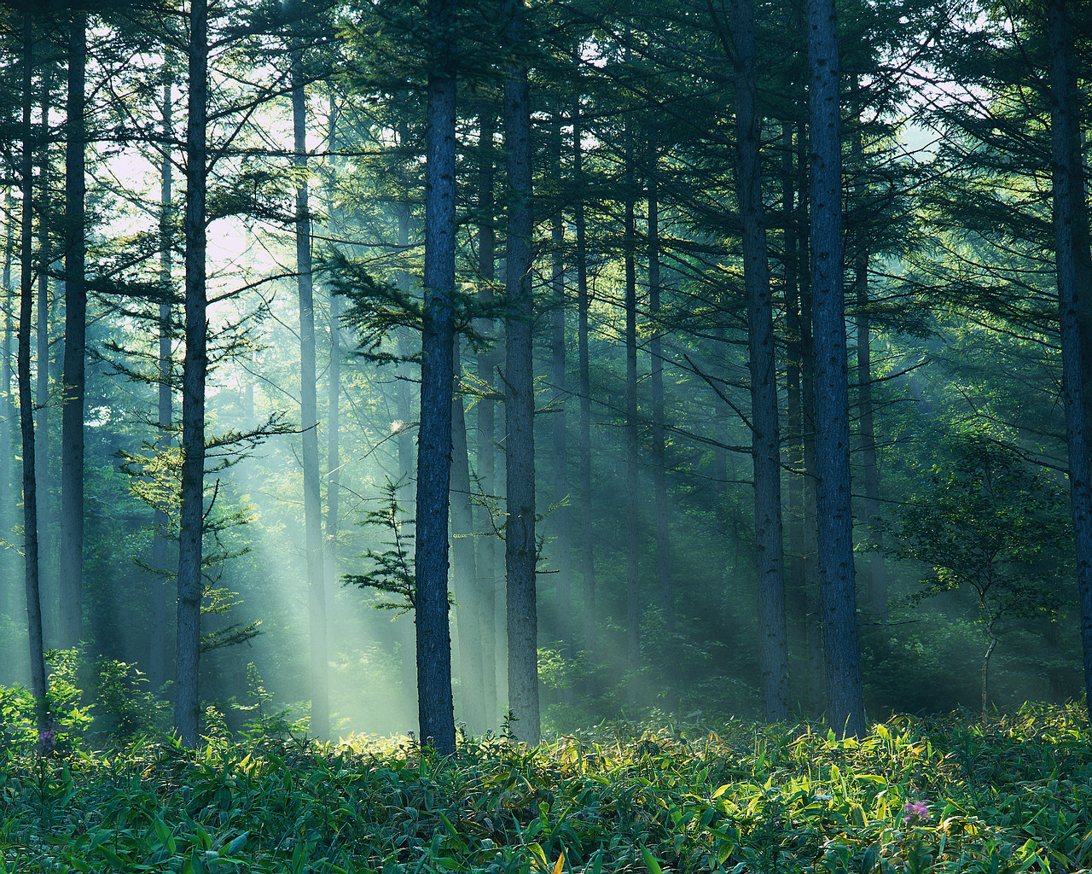
6. Human or Physical?
)
Forest of Dean in Gloucestershire

Slide 9
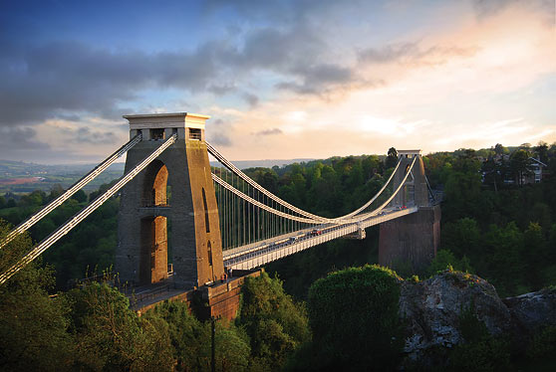
7. Human or Physical?
Clifton Suspension Bridge, Bristol

Slide 10
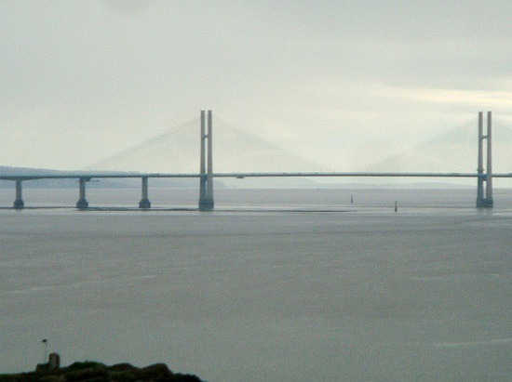
8. Human or Physical?
River Severn, the longest river in the UK

Slide 11
What is a physical feature? Give an example
What is a human feature? Give an example
Look the pictures and see if you can find the city that they can be found in on the map.
Use an online atlas to find the places on the map.

Slide 12
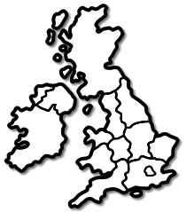

Use the atlas to find the places. Some you may need to look really hard for.
Label the feature and where it is in the UK.
Clifton Suspension Bridge (Bristol)

Slide 13
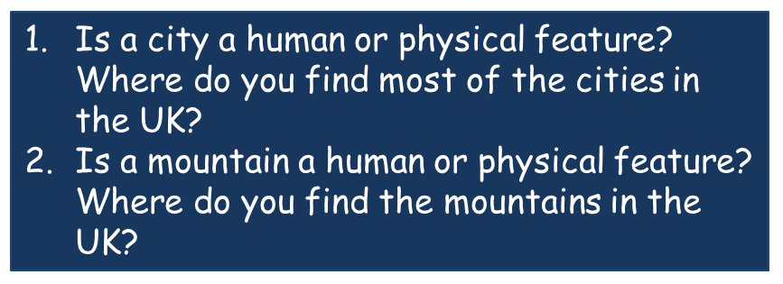
Step for depth

