Slide 1
Alexander’s Empire
Lesson 4- Autumn 2

Slide 2

Prior Learning: In Year 2 we learnt about the Roman Empire
Prior Learning: In Year 2 we learnt about the Ancient Civilisation of Egypt.
River Nile
pyramids
hieroglyphics
Julius Caesar
55BC
Emperor Claudius
43AD
Boudicca
Hadrian’s Wall
Picts

Slide 3

Prior Learning Task:
Who was Alexander the Great?

Slide 4
Learning Objective:
To understand the geographical spread of Alexander’s empire.
Success Criteria:
I have placed the events in the correct order.
I can point to where each event happened on the map.

Slide 5
Conquer
empire
army
Babylon
Key Vocabulary
Macedonia
Persian
victory
Himalayas

Slide 6
The Gordian Knot
Alexander was a strong, intelligent ruler, but he could also be hot-tempered and cruel. Not long after he became king, the Greek city- state of Thebes decided that it no longer wanted to be ruled by Alexander. The young king moved moved quickly to show his strength: he burned the city to the ground and ordered that citizens be sold as slaves.
Notes:
Teach section:
Recall the story of the Gordian Knot- what does this story tell us about Alexander the Great’s personality? Explain that once he had conquered Greece, he wanted to conquer the whole world! Look at the map of Alexander the Great’s empire. Alexander the Great had the largest empire known at that time. Every time he conquered a place, he would spread Greek ideas and learning that are still know today.
Notes:
The term “Gordian knot,” commonly used to describe a complex or unsolvable problem, can be traced back to a legendary chapter in the life of Alexander the Great.
As the story goes, in 333 B.C. the Macedonian conqueror marched his army into the Phrygian capital of Gordium in modern day Turkey. Upon arriving in the city, he encountered an ancient wagon, its yoke tied with what one Roman historian later described as “several knots all so tightly entangled that it was impossible to see how they were fastened.”
Phrygian tradition held that the wagon had once belonged to Gordius, the father of the celebrated King Midas. An oracle had declared that any man who could unravel its elaborate knots was destined to become ruler of all of Asia.

Slide 7
Alexander and his army could not be stopped. With Greece under his control, he marched eastward.
There is a famous legend about Alexander. The legend says that, hundreds of years before Alexander, a king named Gordius made a knot with so many twists and turns that nobody could untie it, a knot more tangled than the worst knot you’ve ever had in your shoelaces. This famous knot, called ‘the Gordian knot’, was tied in a rope on an oxcart.
People said that anyone who could release the knot would have the world for his kingdom.
When Alexander heard about the Gordian knot, he said: ‘Take me to it’. The people took him to a little temple. There stood the oxcart, with the famous knot tied to it.

Slide 8
‘Tell me again,’ said Alexander, ‘what you believe about this knot.’
‘It is said,’ the people replied, ‘that the person who can release it shall have the world for his kingdom.’
Alexander looked carefully at the knot. He could not find the ends of the rope because they were tucked away inside the knot. He raised his sharp sword and, with one stroke, sliced through the knot. The rope fell to the ground, and the people cheered.
‘The world is my kingdom,’ said Alexander.

Slide 9
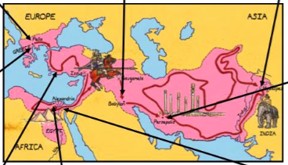
After Alexander conquered Greece , he wanted to conquer the whole world!
Notes:
Explain that once he had conquered Greece, he wanted to conquer the whole world! Look at the map of Alexander the Great’s empire. Alexander the Great had the largest empire known at that time. Every time he conquered a place, he would spread Greek ideas and learning that are still know today.

Slide 10
Do you think it was fair that one man was in charge of this massive empire? Why?
Talk Task

Slide 11
Learning Objective:
To understand the geographical spread of Alexander’s empire.
Success Criteria:
I have placed the events in the correct order.
I can point to where each event happened on the map.

Slide 12
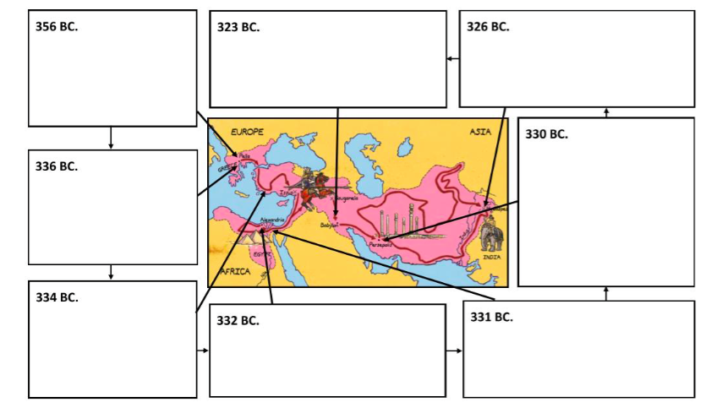
Task

Slide 13
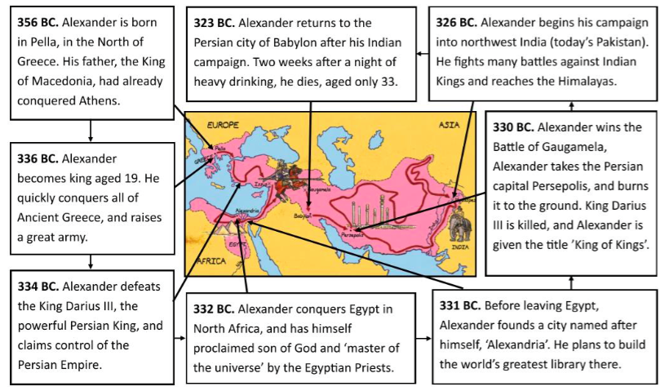

Slide 14
Step for Depth
Why do you think Alexander was so keen to defeat Persia and create such a massive empire?

Slide 15
Conquer
empire
army
Babylon
Key Vocabulary
Macedonia
Persian
victory
Himalayas

Slide 16
Using your map, explain to your partner how Alexander the Great managed to conquer such a large empire.
Plenary

