Slide 1

Week 4
In this new unit, we will be reading Stig of the Dump. To really appreciate this classic novel, we will explore the language, the settings and the unusual characters.
Outcome: to write a story with a historical setting.

Slide 2
Monday 22th November 2020
Words of the day – adoration.
Grammar focus
LO to explore being verbs.
Follow the Oak academy link.
https://classroom.thenational.academy/lessons/to-explore-being-verbs-6mr68r

Slide 3
Read through this weeks spellings
basically
frantically
dramatically
magically
tragically
Comically
actually
accidentally
occasionally
eventually
LO: To create adverbs using ly correctly when the root word ends in ic .
Write your sentences out. Check that you understand the meaning of each word.

Slide 4
Maths
LO: to understand equal grouping.
https://whiterosemaths.com/homelearning/year-3/week-9-number-multiplication-division/

Slide 5
R.E.
LO: to know that Jesus forgives us.

Slide 6
PE
To develop and investigate different ways of throwing and to know when it is appropriate to use them.
Run on the spot for 1 minute. Feel your heart beat , your heart is working harder to keep you moving.
Try this circuit:
10 jumping jacks
10 push ups
Throw the ball 10 times.

Slide 7
Tuesday 24 November 2020
LO to make predictions.
Word of the day – joyous
Look at the book cover, what might the two children be saying or thinking. Where are they? Why might they be there? Who are they? What on earth is going on? Use wonderful conjunctions to give reasons for your ideas.
I think that because

Slide 8
Maths
LO :to multiply using the symbol X.
https://whiterosemaths.com/homelearning/year-3/week-9-number-multiplication-division/

Slide 9
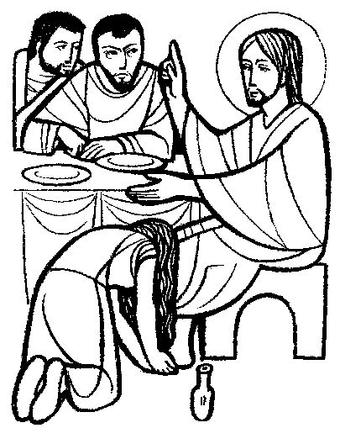
R.E.
LO: to reflect act of contrition.

Slide 10
Wednesday 24th November 2020
Lo to create an image from a verbal description.
Word of the day – playfully
Read the extract from Stig of the Dump. Can you underline all of the adjectives, expanded noun phrases and interesting descriptions. From these words, can you draw an idea of what the cave looked like?

Slide 11
Maths
LO : to use arrays.
https://whiterosemaths.com/homelearning/year-3/week-9-number-multiplication-division/

Slide 12
Geography
LO – to compare two countries .
Use the powerpoint to explore the physical features of two countries.

Slide 13
Science
LO – to explore rock formation.
https://www.bbc.co.uk/bitesize/topics/z9bbkqt/articles/zsgkdmn

Slide 14
Thursday 19th November 2020
LO: to recap expanded noun phrases.
Looking at your picture of Stig’s cave from yesterday? Write an interesting description of what was in there using expanded noun phrases. Remember
adjective, adjective noun.
Carefully practise joining your letters whilst writing
Word of the day- reveal.

Slide 15
Maths
LO : to make equal groups.
https://whiterosemaths.com/homelearning/year-3/week-9-number-multiplication-division/

Slide 16
History
LO: to create a story board to illustrate and describe the story of Alexander taming Bucephalus.

Slide 18
Friday 27th November 2020
LO to answer comprehension questions based on chapter one.
Word of the day- responsibly.
See Fridays comprehension resource. Answer questions in full sentences

Slide 19
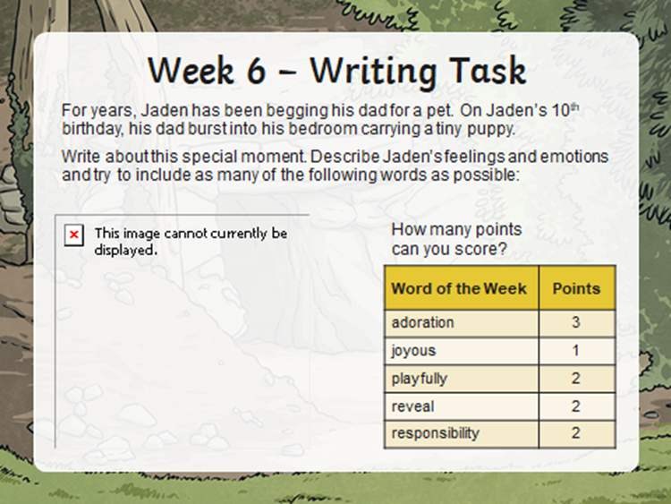

Slide 20
Maths
LO : to make equal groups.
https://whiterosemaths.com/homelearning/year-3/week-9-number-multiplication-division/

Slide 21

Music
LO to know that music can tell a story.
See music lesson power point.
L.O: to know that we can tell a story through music.

