Slide 1
What did we learn last lesson?

Slide 2
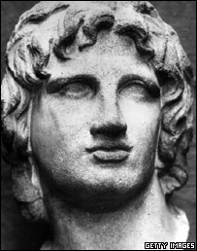
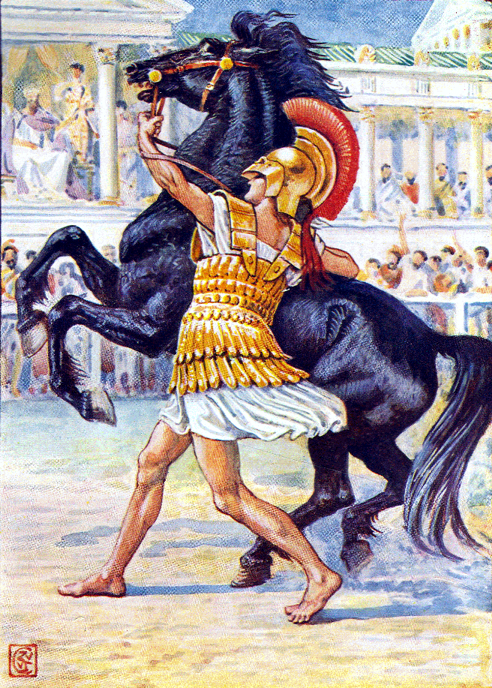
Can you name this man?

Slide 3
In this lesson we will learn about one of Aristotle’s
students, Alexander the Great

Slide 4
Vocabulary
Conquer
Philosopher
Ruler
Macedonia
Bucephalus

Slide 5
Aristotle had a student named Alexander.
Alexander the Great is one of the most important figures in world history.
Alexander was born in 356 BC in Macedonia.
His father, King Philip 11 of Macedonia, had Alexander tutored by the great Athenian philosopher Aristotle.
When he grew up, Alexander became so powerful and famous that he was called “Alexander the Great”.

Slide 6
When Alexander was very young, he was told from his mother that he would do wonderful things. His teacher, Aristotle, taught him about people and how a good king should rule.
From other teachers, he learned how to fight well.

Slide 7
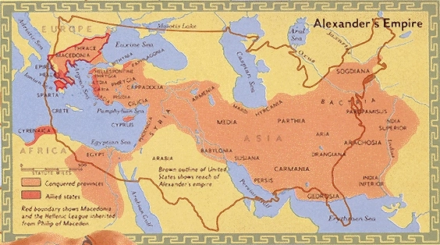
Alexander’s father was King Philip, the ruler of Macedonia in the northern part of Greece

Slide 8
Alexander’s father had already conquered many Greek city states including Athens.
What does conquered mean?

Slide 9
Alexander tames the horse
Bucephalus
There is a story that, one day King Philip took the twelve year old Alexander to a sale of horses. One horse kept snorting and bucking furiously .
“No one can ride so wild and savage a beast,” the men said. King Philip commanded the servants to take the horse away .

Slide 10
Alexander spoke up. “Those men do not know how to treat him,” he said.
“Perhaps you can do better, “ said his father doubtfully.
“Yes, “ said Alexander confidently.” He ran to the horse and quickly turned his head towards the sun because he noticed that the horse was afraid of his own shadow. He patted him with his hand. When he had quieted him a little, he quickly leapt on the horse’s back.

Slide 11
Everybody expected to see the boy tossed to his death. But Alexander held on tight and let the horse run as fast as he could. By and by, the horse became tired and Alexander rode him back to where his father was standing.
“My son, “ said King Philip, “Macedonia is too small a place for you. You must seek a larger kingdom that will be worthy of you.”
A few years later, after his father died, that is just what Alexander did. When he was only 22 years old. Alexander set off on his horse, which he named Bucephalus, to conquer the world .

Slide 12
Talk task
Where was Alexander born?
Who was his teacher?
Who was his father?

Slide 13
Task
Create a story board to illustrate and describe the story of Alexander taming Bucephalus.

Slide 14
Step for depth
Do you think Alexander the Great will make a good ruler? Why?

Slide 15
Partner teach/Plenary
Define these words to your partner: conquer, philosopher, rule, Macedonia and Bucephalus.

