Slide 1
Lesson … - Vivaldi

Slide 2
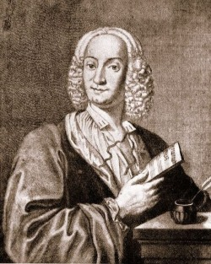

Year 3
Autumn …
Lesson …
Unit Title
Antonio Vivaldi

Slide 3

Let’s Listen
https://www.bing.com/videos/search?q=imagine+dragons+on+top+of+the+world+clean&view=detail&mid=8613234DC108F73B2F9B8613234DC108F73B2F9B&FORM=VIRE
What colour does this music put in your head?
How does the music make you feel? Why?
What is the tempo?
What style of music do you think this is?
What is the general feel of the music?

Slide 4
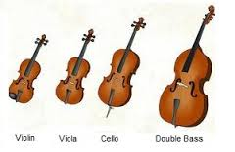
Prior Learning
Vivaldi’s Autumn created images and emotions.
The Concerto used the string family.
What instruments do you recall from Vivaldi’s Autumn?
How did they create the autumn scene?

Slide 5
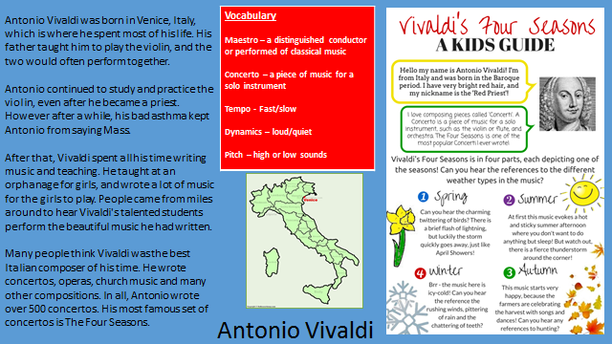
Our Knowledge Organiser

Slide 6
Key Vocabulary
Vivaldi
Concerto
Winter
Autumn
Priest
Italy
Sonnet
maestro
Strings
Violin
Cello
Double bass

Slide 7
L.O: to know that we can tell a story through music.
Success Criteria: To know the musical elements. To know Vivaldi created a concerto about Winter. To know that music can tell a story.
Here are today’s key words:
Movement
Sonnet
soundscape

Slide 8
Teach
Whole Class
Read the Winter sonnet by Vivaldi:
“Frozen and shivering amid the chilly snow,
Our breathing hampered by the horrid wind
As we run, we continually stamp our feet
Our teeth chatter with the awful cold.
We move to the fire and contented peace
While the rain outside comes down in sheets.
We walk on the ice with slow steps
Careful how we walk, for fear of falling.

Slide 9
Teach
Whole Class
If we move too fast, we slip and fall to the ground
Again treading heavily on the ice
Until the ice breaks up and dissolves
We hear from behind closed doors
Boreal winds and all the winds of war.
This is winter, but one that brings joy.”

Slide 10
Listen and talk task
Whole Class
Listen to Winter.
Discuss how Vivaldi wrote the sonnet before he created the concerto.
Which words are being recreated in movement 2.
https://www.youtube.com/watch?v=gCtxT_rw6Y8
Which words are in movement 3?
https://www.youtube.com/watch?v=O_XKi_DaPsc
How does it make you feel?
What does it remind you of ?

Slide 11
Task
Write the 3rd movement into Music books and add musical ideas.
This is a soundscape!
If we move too fast, we slip and fall to the ground
Again treading heavily on the ice
Until the ice breaks up and dissolves

Slide 12
And finally…
Talk to your partner about your ideas for your
Soundscape. Discuss percussion choices.

