Slide 1
Geography
LO – to compare geographical features.

Slide 2
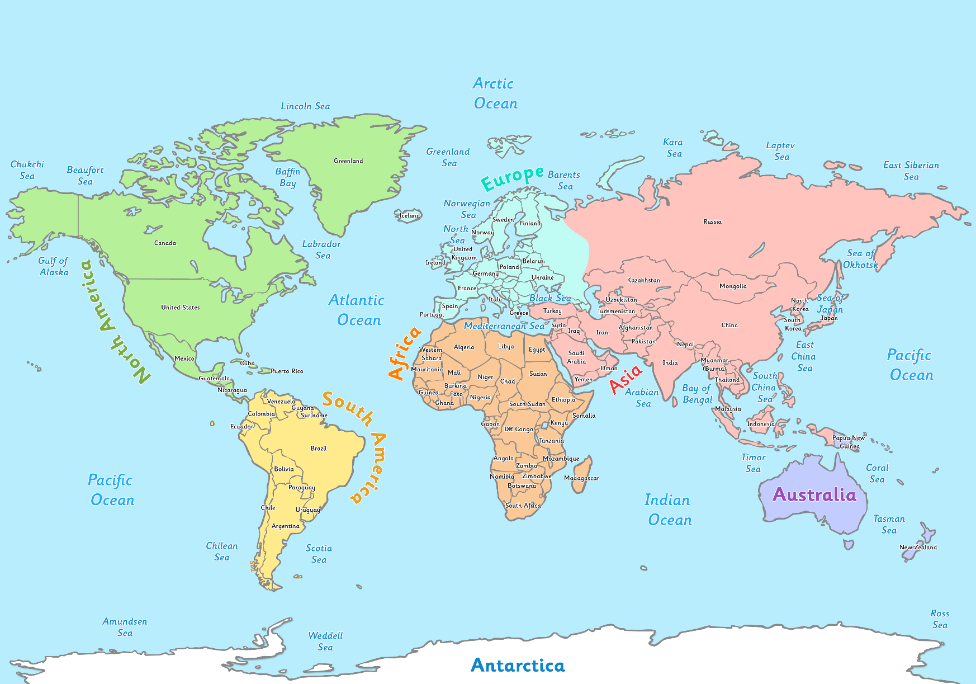
Where in the World?
United Kingdom
The United Kingdom is made up of England, Scotland, Wales and Northern Ireland. It is in the Atlantic Ocean.
Australia
Australia is a country and a continent surrounded by the Indian and Pacific Oceans.

Slide 3
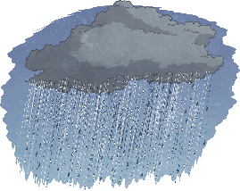
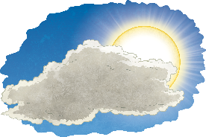
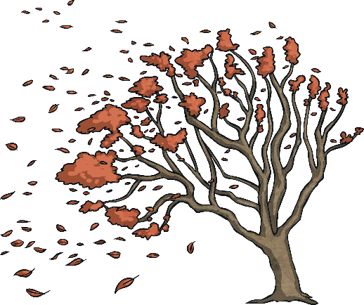
Weather in Australia
The weather in Australia changes over the year. Australia has different seasons of weather.
In Australia, the four seasons are summer, autumn, winter and spring. The seasons are identified by the group of calendar months which they belong to.
In Summer (December, January and February), the weather is hot. Some parts of Australia are humid and other parts are dry.
In Autumn (March, April and May), the weather becomes cooler.
In Winter (June, July and August), the weather is cold and rain
and storms are common. Some places in Australia get snow.
In Spring (September, October and November), the weather
becomes warmer, however, it is still very mixed. There can be rain,
wind and cool days.

Slide 4
Weather in the UK
The weather in the UK also follows a seasonal pattern, and it is similar to the weather pattern in some parts of Australia, but is opposite in the corresponding months.
The Winter (December, January and February) usually sees the coldest weather. It is cold, wet and windy and it sometimes snows. The average winter temperature is around 3 degrees Celsius and the average rainfall is about 5cm.
In Spring (March, April and May), the weather turns milder. It can still be wet and windy, especially in April. The average temperature is 11 degrees Celsius and the average rainfall is 5cm.
In Summer (June, July and August), the weather gets warmer.
Average temperatures go up to around 19 degrees Celsius and the
average rainfall is around 4.5 cm.
The Autumn (September, October and November) sees the weather
turn colder and wetter. The average temperature is 13 degrees
Celsius and the average rainfall is about 6cm.

Slide 5
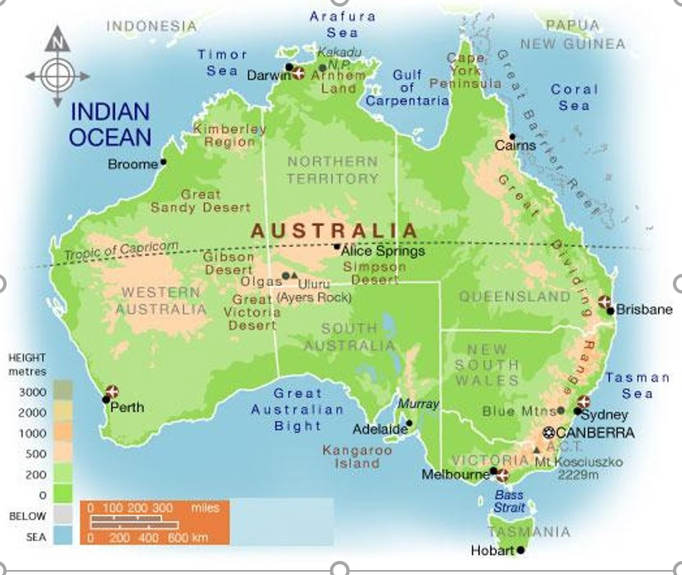
Australia’s landscape -

Slide 6
Australia
Australia is an island country in the Southern hemisphere and belongs to
Oceania/Australia. Australia is surrounded by the Indian Ocean and
the Pacific Ocean. It is the 6th largest country in the world.
The country is divided into six states (Southern Australia, Western Australia,
New South Wales, Queensland, Victoria and Tasmania) and two self-governing territories:
Northern Territory and Australian Capital Territory (which is around Canberra, the capital city).
The biggest cities in Australia are Sydney, Melbourne, Perth, Brisbane and Adelaide. These cities are all located at the coast or close to the coast and are the only metropolitan cities in Australia with more than one million inhabitants.
Canberra is Australia's capital city and the only major city of the country further away from the coast. Canberra is located about 150 km/ 93 miles inland from the Pacific Ocean coastline and about 280km/ 173 miles to the southwest of Sydney.

Slide 7
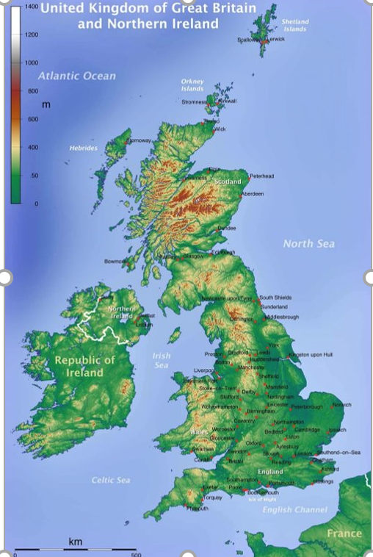
UK Landscape
Scotland
Northern Ireland
Wales
England

Slide 8
UK
The United Kingdom of Great Britain and Northern Ireland (UK for short) is a funny kind
of jigsaw of a country. It slots four little nations, together into one big one.
England, Scotland, Wales and Northern Ireland are all countries in their own rights, with their own capital cities, histories and politicians.
People who live in these countries are very patriotic – remember when we were listening to patriotic music, we heard the National Anthems for each country as well as our National Anthem.
In Wales, you will hear people speaking in Welsh and some people in Scotland and Northern Ireland speak Gaelic.
England’s capital city is London; Scotland’s is Edinburgh; Wales is Cardiff and Northern Ireland's is Belfast.

Slide 9
Australian Beaches

Slide 10
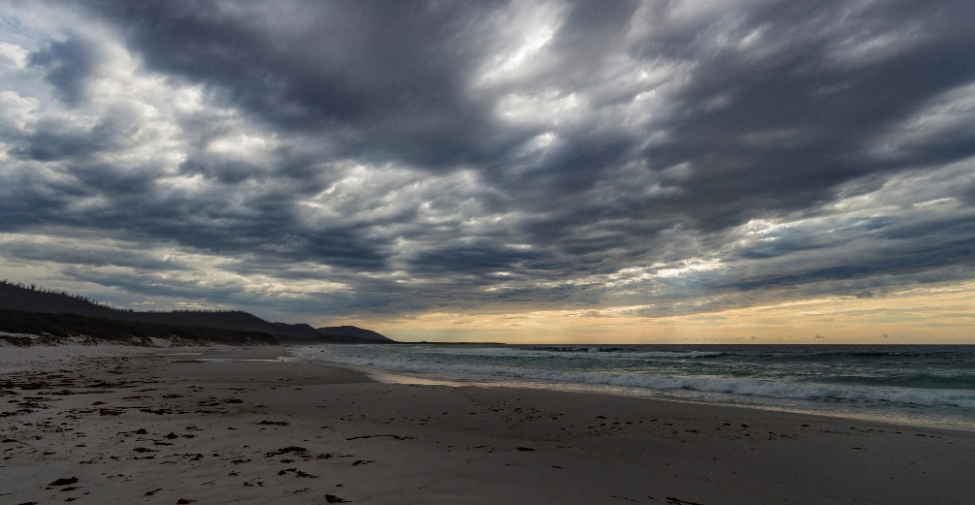
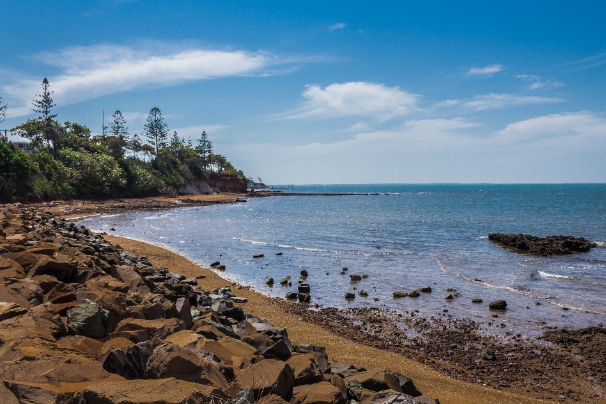
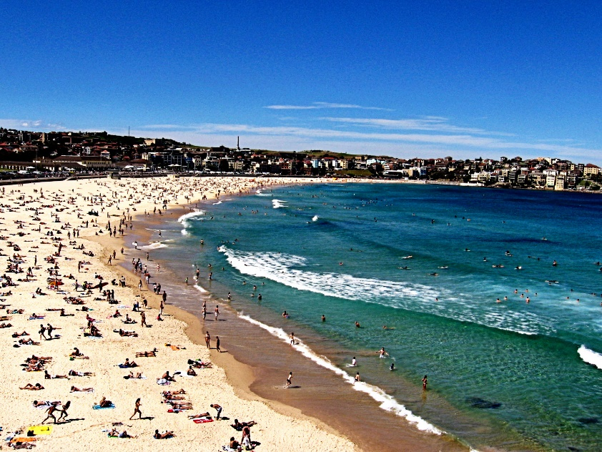
“The Friendly Beaches, Tasmania” by Steven Penton is licensed under CC BY 2.0
“Scarborough Beach” by Matthew Hamm is licensed under CC BY 2.0
“Bondi Beach” by Penreyes is licensed under CC BY 2.0

Slide 11
UK Beaches

Slide 12
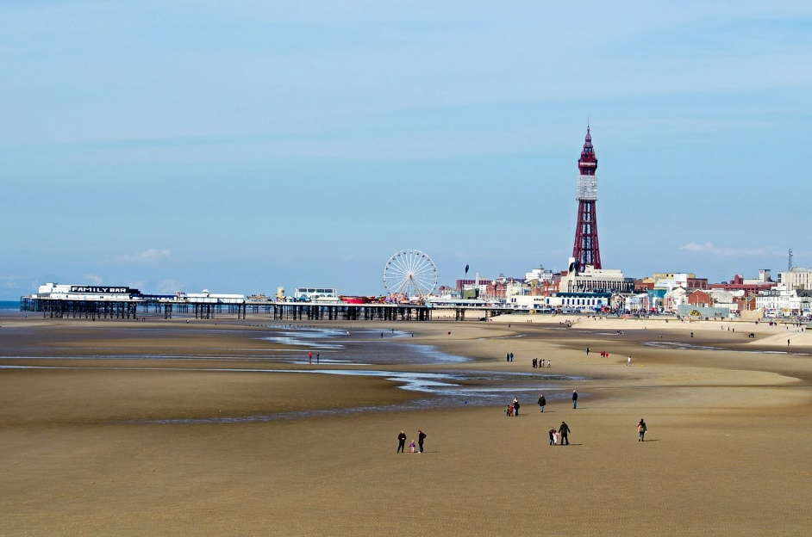
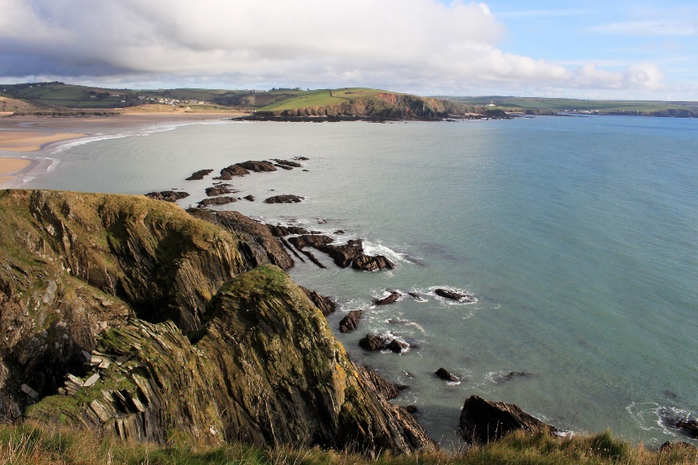
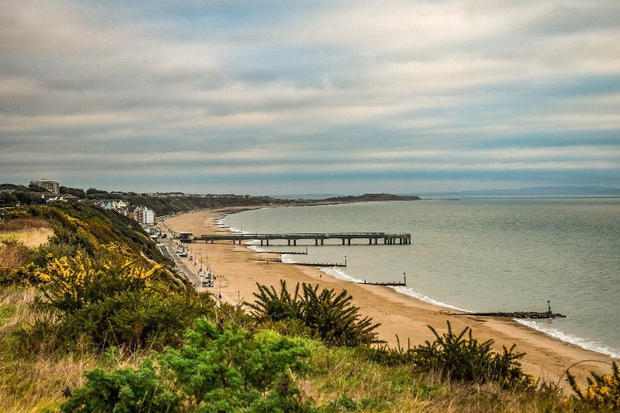

Slide 13
Your task
Look at Australia and UK, can you find them in the atlas?
Now, see if you can find any similarities and differences between the countries.
What physical features can you identify? Are there any mountains that you can name?
What rivers can you find?
What are the surrounding seas called?

Slide 14


