Slide 1
Forgiveness

Slide 2
Learning Objective
To explore the meaning of forgiveness
Success Criteria
I have developed my understanding of forgiveness

Slide 3
Fred’s Diary Monday 16th November 2020
Dear Diary
I had a rotten day today. It all started at morning play when I was playing football with the others as usual having a really good time.
Suddenly my best friend Steve kicked my football over the school fence. He said sorry and I knew it was an accident but at the same time I just felt really angry. I shouted at him and called him stupid and then I said I’d never let him play again.

Slide 4
We didn’t talk to each other all day and now I just feel really miserable and wish I could make every thing all right. I didn’t mean any of those things I said to Steve.
What can I do to make friends with him again? What if he won’t forgive me? Is there anyway I can put this right?

Slide 5
Monday 16th November 2020
Dear Diary
Today was much better! Every thing is sorted out between us; Steve and I are best friends again.
I saw him walking ahead of me as we were going to school today and I ran to catch up with him.
I was nervous in case he just ignored me or wouldn’t talk to me. I said I was sorry for yesterday and that I didn’t mean what I said .
Steve was really good about it he could have just ignored me or refused to talk to me but he forgave me .
The best thing was when we got to school we were friends and there was my football. Some one had thrown it back over the fence!

Slide 6
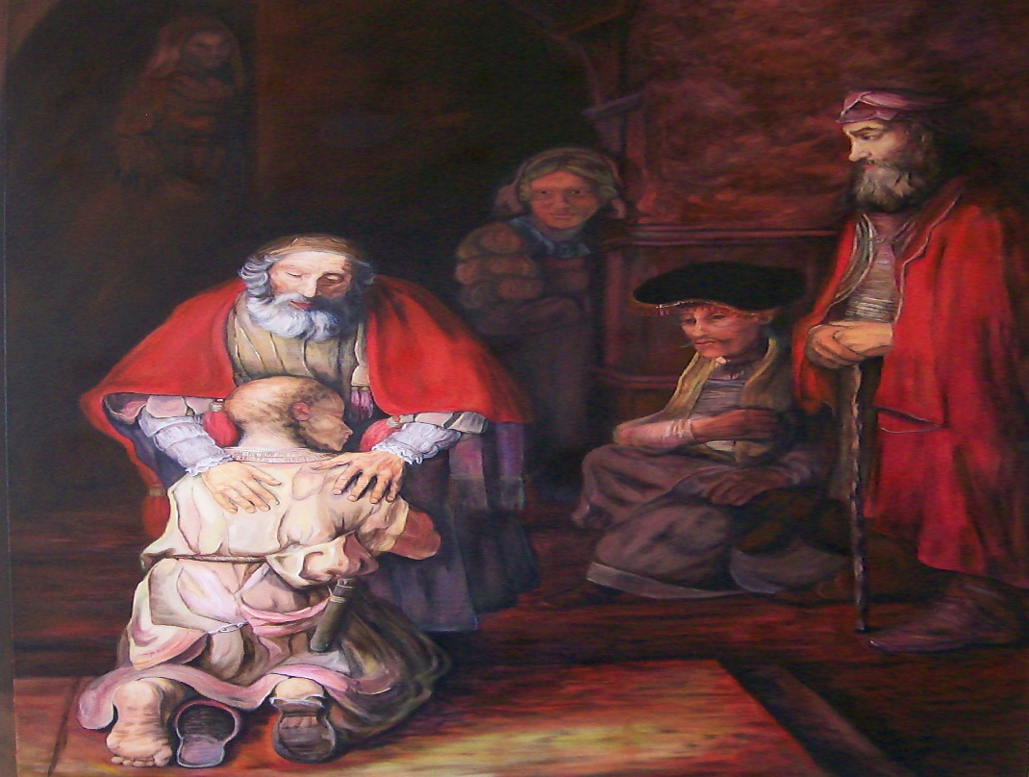
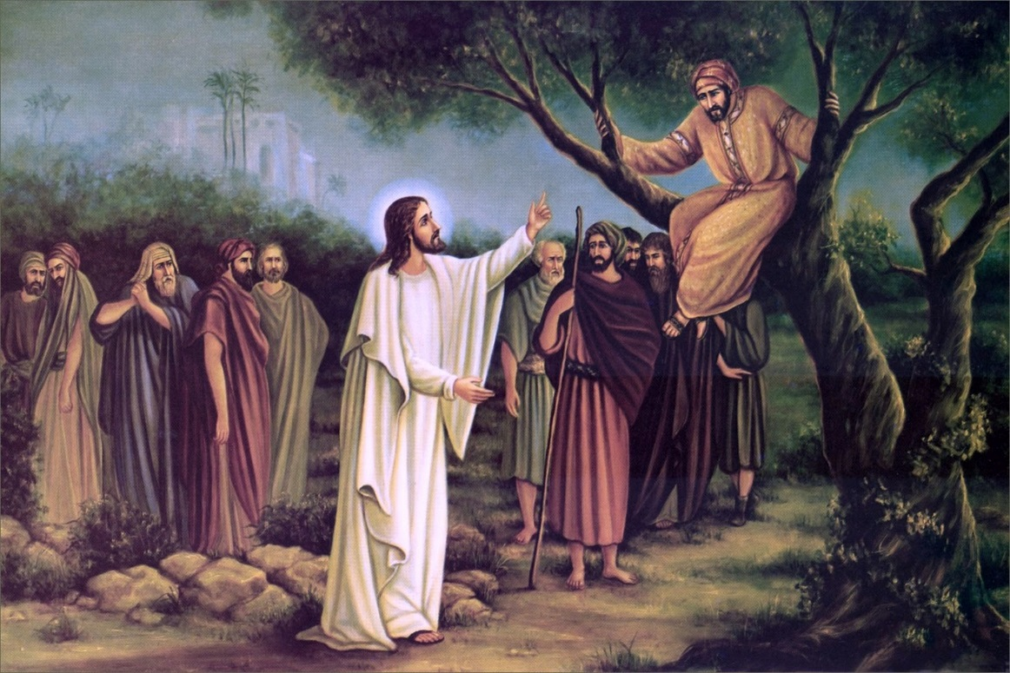
Talk to your partner about what you have learnt about forgiveness from these two readings,
Parable of the Prodigal Son
Jesus meets Zacchaeus

Slide 7
God asked us to
LOVE ONE ANOTHER

Slide 8
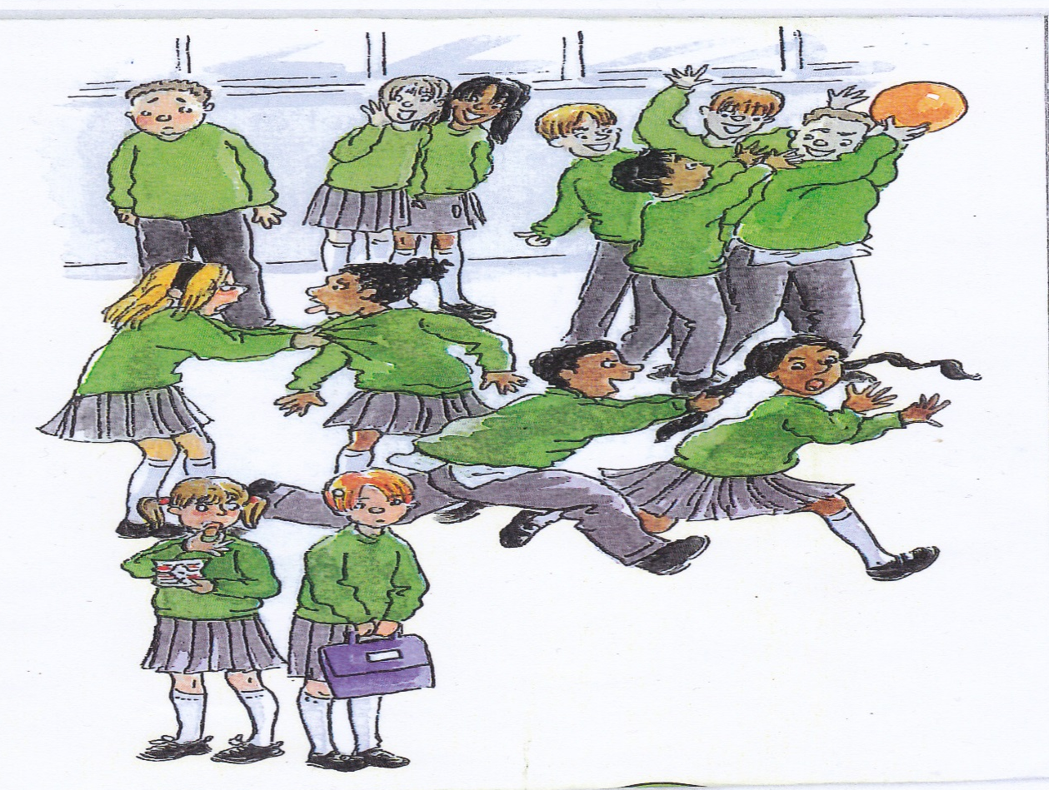
Can you think of choices we have made that made God sad and upset?

Slide 9
Task
L.O. to create a poem of forgiveness.

Slide 10
Learning Objective
To explore the meaning of forgiveness
Success Criteria
I have developed my understanding of forgiveness

Slide 11
Prayer
For the times we say unkind things to each other.
We are sorry God. Please forgive us.
For the times we have not shared our time or our toys
We are sorry God. Please forgive us.
For the times we have not treated others with respect.
We are sorry God. Please forgive us.
For the times we have hurt others by our words and actions.
We are sorry God. Please forgive us.

Slide 12
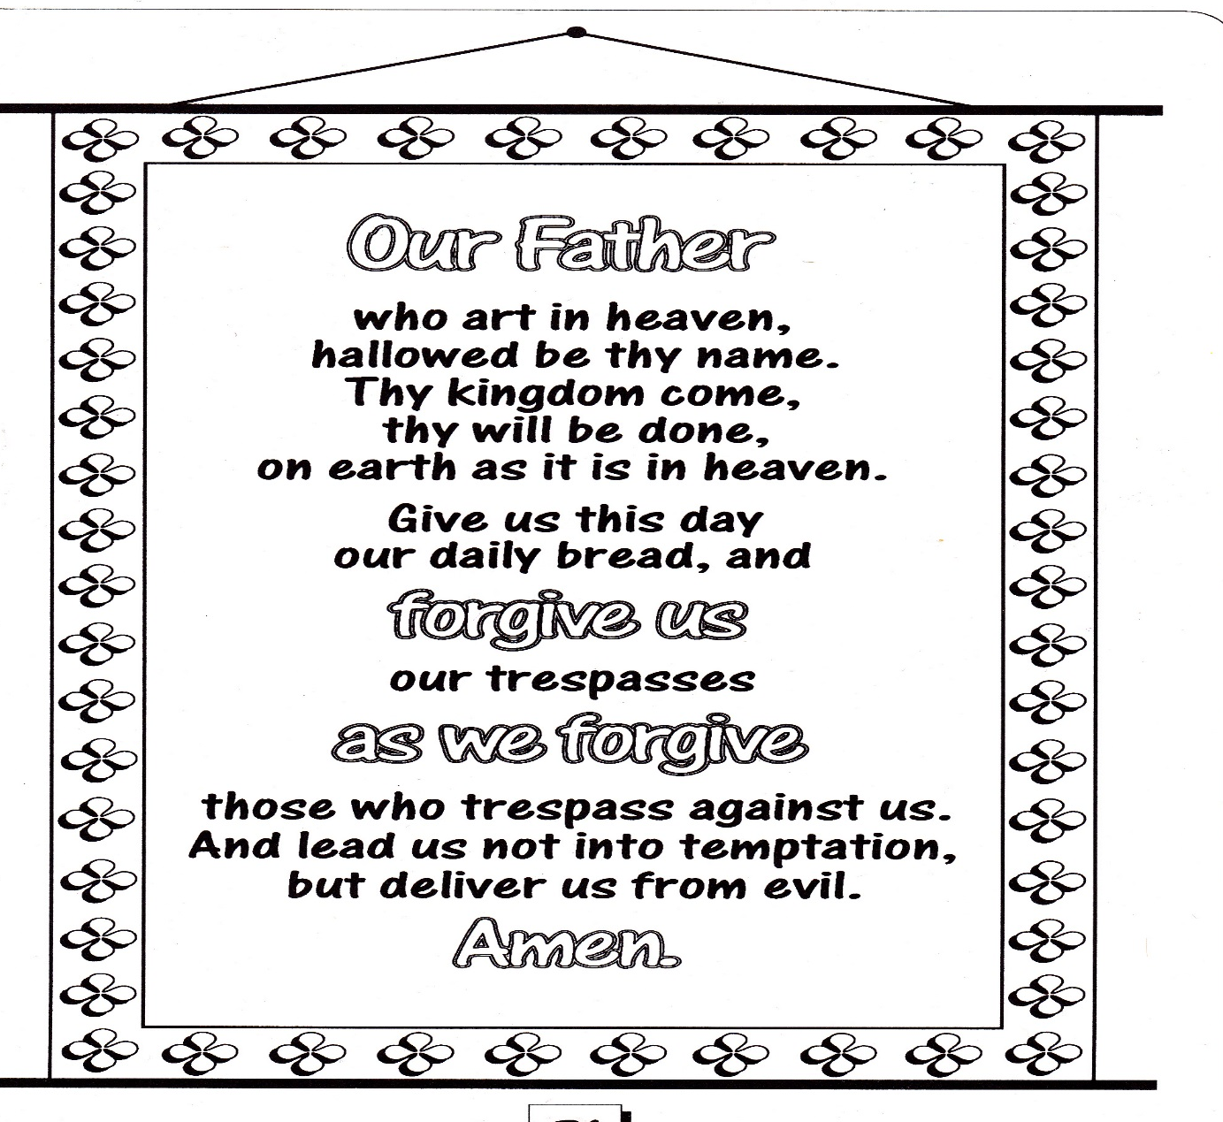
Our Father

Slide 13
Father I have sinned
1.Father I have sinned,
help me find my way.
Remember not my sins,
just let me hear you say
I forgive you, I love you
You are mine, take my hand.
Go in peace, sin no more,
Beloved one.
2.Father I have turned,
my back and walked away
Depended on my strength
and lived life my own way
3.Father I have closed,
my heart to those in need.
Thought only of myself,
a victim of my greed.
4.Father I have loved,
if love’s the word to use.
I’ve played so many games,
they’ve left me so confused.
5.Father I’ve returned,
I’m home with you to stay.
Standing at your door,
knowing that you’ll say

