Slide 1
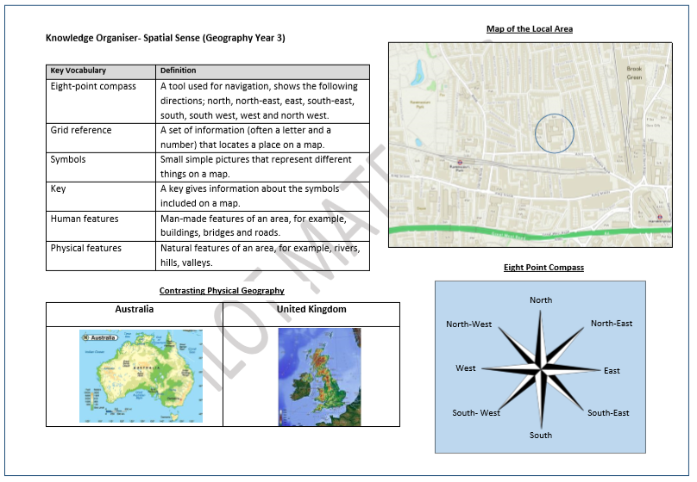

Slide 2
Key Vocabulary:
Grid
Reference
Location
Map
Horizontal
Vertical
Horizon

Slide 3
LO – to create a map.
You may use your skills to draw a map of your room, house or even the route to the local shops.
I wonder if you can give directions using your 8 point compass.

Slide 4
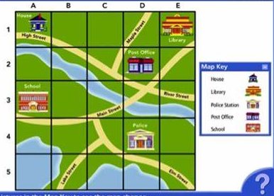
Grid References
Grid Reference - A picture representation of an area of land or sea showing physical features, cities, roads.

Slide 5
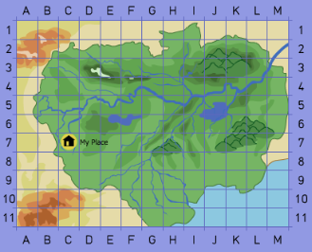
Finding a grid reference
To find a grid reference we need vertical and horizontal grid lines.
The horizontal line is always first. So, to find a location at B6 on a map, we would trace our finger along the horizontal line, going east, until we find the square beginning with B, then we trace our finger going north to the square beginning with 6.
What would the reference be for my place?
What reference would I find the sea?
Notes:
Model this several times

Slide 6

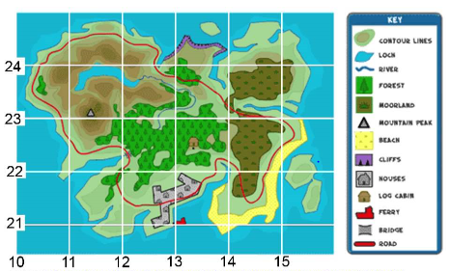
Talk Task - How would I find D2? Explain what you would find there
4
3
2
1
A
B
C
D
E
F

Slide 7
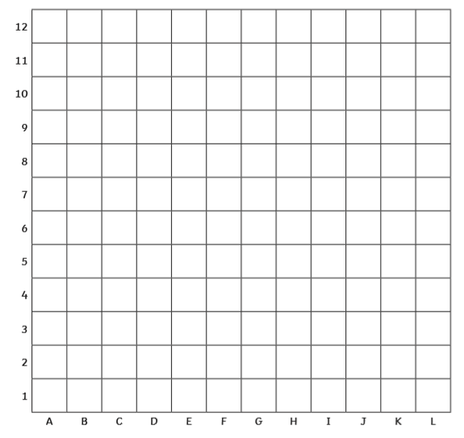
Task -
Draw several features on the map (e.g. a house, a shop, a tree, a bridge) and then ask them to write the grid references where the features can be located.

Slide 8

Step to Depth -
Can you make your own game of battleships?
Notes:
The game ‘Battleships’ provides a good opportunity to practise using grid reference

Slide 9
Partner Teach-
Work with you partner to check their grid references are correct.
Write your own definition for reference
Notes:
Refer back to knowledge organiser.

Slide 10
Key Vocabulary:
Grid
Reference
Location
Map
Horizontal
Vertical
Horizon | the line where the sky and the land appear to meet

