Slide 1
Week 3
Outcome: to write a folktale.

Slide 2
Monday 16th November 2020
Words of the day – treat
Grammar focus
To explore expanded noun phrases.
Follow the Oak academy link.
https://classroom.thenational.academy/lessons/to-explore-expanded-noun-phrases-ccwk8d

Slide 3
Read through this weeks spellings.
gently
simply
humbly
nobly
horribly
terribly
impossibly
incredibly
comfortably
probably
LO: To create adverbs using ly correctly when the root word ends in le.
Write your sentences out. Check that you understand the meaning of each word.
Read , what are the different places it is set?

Slide 4
Maths
LO: to subtract a 2 digit number from a 2 digit number with exchanging.

Slide 5
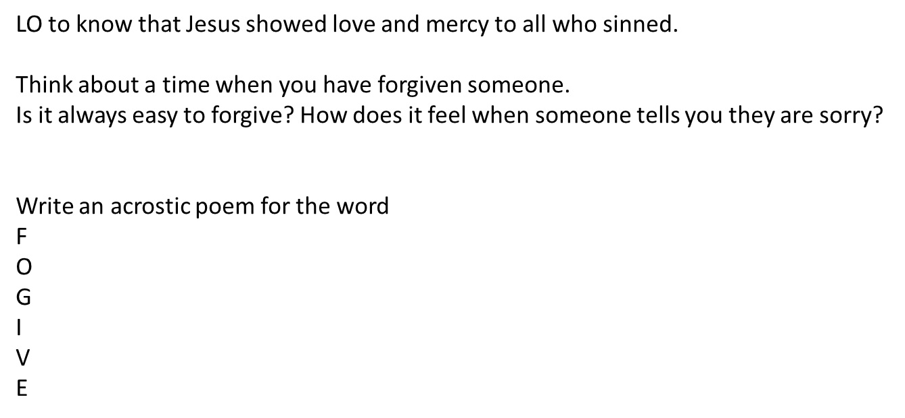
R.E.

Slide 6
PE
Practice throwing and catching.

Slide 7
Tuesday 17 November 2020
LO to explore the features of a folktale.
Word of the day – ultimate.
Re -read the model text, Baba Yaga . Look at the how to write a folktale poster. Can you find examples of these features in the model text.
Look at other examples of folktales and find examples of features from the poster included in the resource pack.
Have you found any descriptions that clearly put a picture in your head?

Slide 8
Maths
LO :to subtract a 2 digit number from a 3 digit number, crossing 10 and 100.

Slide 9
R.E.
sequence and structure the Rite of Reconciliation.

Slide 10
Wednesday 18th November 2020
Lo to plan a folktale
Word of the day – hastily
Look at the writer’s craft task using the instruction sheet and introduce the task (to retell a folktale). You should use the ‘report margin planner’ to organise your writing.
You should plan your own retelling of the Baba Yaga folktale or an original folktale following similar themes, using the margin planner.
Carefully practise joining your letters whilst writing

Slide 11
Maths
LO : to add 3 digit numbers crossing 10 and 100.

Slide 12
Geography
LO – to create a map.
Use the powerpoint to explore the map symbols. Then you may choose to create a map of your chosen space. It may be your room, your route to the shops or to school.

Slide 13
Science
LO – to explore rock formation.
https://www.bbc.co.uk/bitesize/topics/z9bbkqt/articles/zsgkdmn

Slide 14
Thursday 19th November 2020
LO: to write a folktale.
Over the next two days you will have the opportunity to write your folktale –
Check what is needed for you to develop your own writing, use the how to… poster, and recapping writing skills where necessary. Look at the writing skills check and think how they you can use these skills in your writing
Word of the day- devour.

Slide 15
Maths
LO :Subtract a 2 digit number from a 2 digit number crossing 10.
Please follow Whiterose link
https://whiterosemaths.com/homelearning/year-3/week-6-number-addition-subtraction/

Slide 16
History
LO to deepen your understanding of the Ancient Greeks.
See history folder.

Slide 17
Friday 20th November 2020
LO to edit my folktale.
Now it’s time to proof read and you’re your writing using the writing skills check at regular intervals. You will need to focus on changing grammar, punctuation and vocabulary when editing their work.
Word of the day- inexpensive.
See Fridays comprehension resource. Answer questions in full sentences

Slide 18
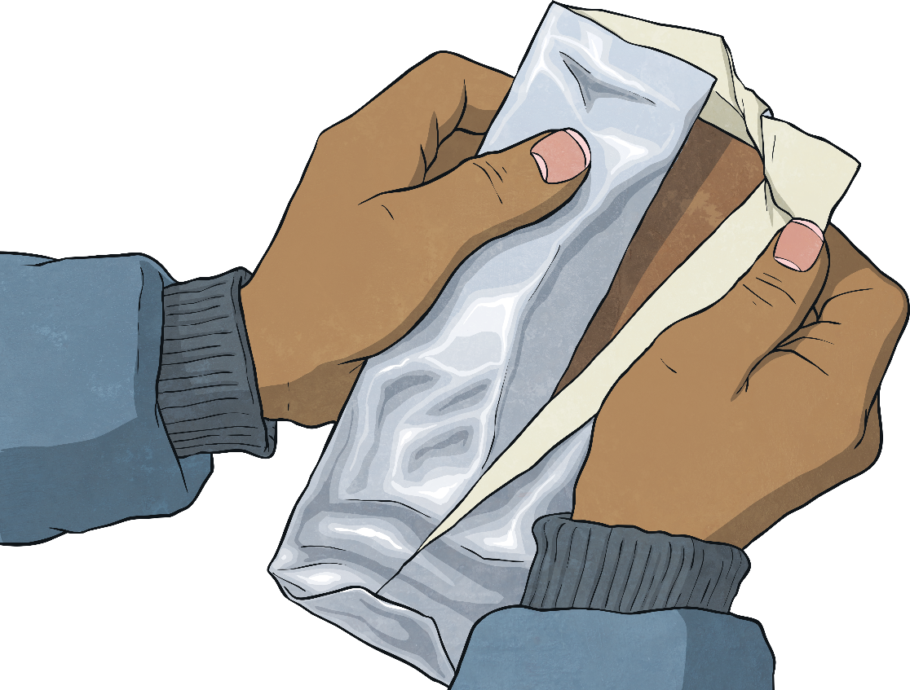
Week 5 – Writing Task
Write a radio advert to promote a brand new chocolate bar.
Your advert should try and persuade people to buy this new
chocolatey snack.
How many points
can you score?
Word of the Week | Points
treat | 1
ultimate | 2
hastily | 3
devour | 2
inexpensive | 2

Slide 19
Maths
LO : to add a 3 digit number to a 3 digit number with exchange.

Slide 20

Music
LO to know that music can tell a story.
See music lesson power point.
L.O: to know that we can tell a story through music.

