Slide 1
LO – to know about Greek Philosophy.
Look at the images on the next slide, what can you find out about them?

Slide 2

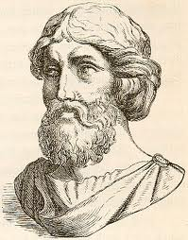
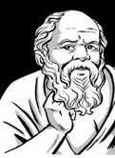
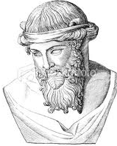
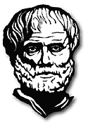
Pythagoras b.580-d.507 BC
Socrates
b.469-d.399 BC
Plato
b.427-d.347 BC
Aristotle
b.384-d.322 BC
Homer
8th Century BC

Slide 3
What do you think the word ‘philosophy’ means?

Slide 4
How was Socrates different from earlier Greek philosophers?
As the Athenian empire collapsed Athenian philosophy burst into magnificent bloom.
Some Greeks began to use reason to try to understand the world. This is the beginning of philosophy
Reason – the ability of the mind to think and understand

Slide 5
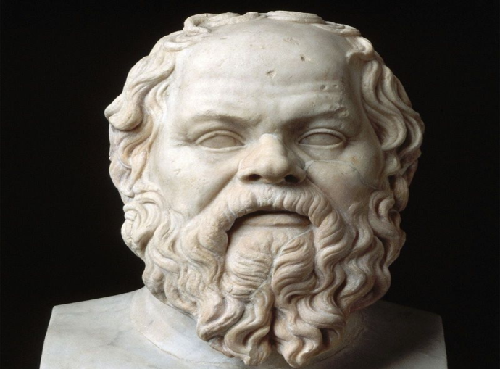
Socrates
One of the most famous of the Greek philosophers and teachers was an Athenian named Socrates who lived from 469 BCE to 399 BCE. Most of what we know about the philosophical ideas of Socrates come from the writings of one of his students, named Plato. Socrates himself wrote nothing.

Slide 6
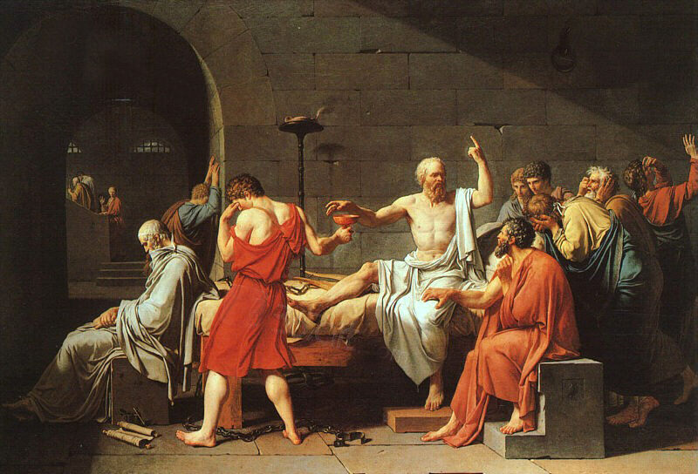


Slide 7
Socrates was interested in questions about how human beings should behave than about where the world came from or what it might be made of.
Instead of just sitting in his room and writing about philosophical questions, he went to the Athenian market place called the agora, and talked with other Athenians. In this way Socrates made philosophy personal.
During discussions Socrates tried to get the Athenians to examine their lives

Slide 8
Socrates asked his listeners questions instead of giving them direct answers. This method is known as The Socratic Method - when your teacher asks you a series of questions trying to get you to understand he or she is using The Socratic Method.
He wanted the role of the philosopher to include the important task of examining how people live their lives .
He wanted people to choose goodness and live rightly every day. That is why his contributions to philosophy are still important to us all these centuries later
Resource -Horrible histories video clips on Socrate’s rescue and the Greek thinkers song

Slide 9
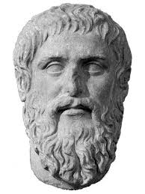
Plato
Plato was a pupil of Socrates.
He wrote down many of the conversations he had with Socrates, which is one of the reasons for his fame.
He is also known for his philosophical ideas. He wrote two books called “The Republic” and “The Laws” in which he described how an ideal state should be run. He also started up and academy which was the world’s first university.

Slide 10
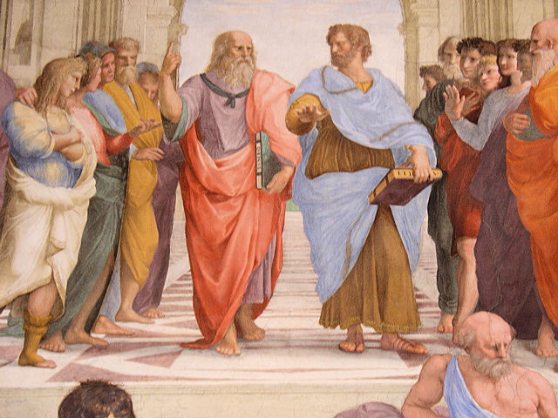

Slide 11
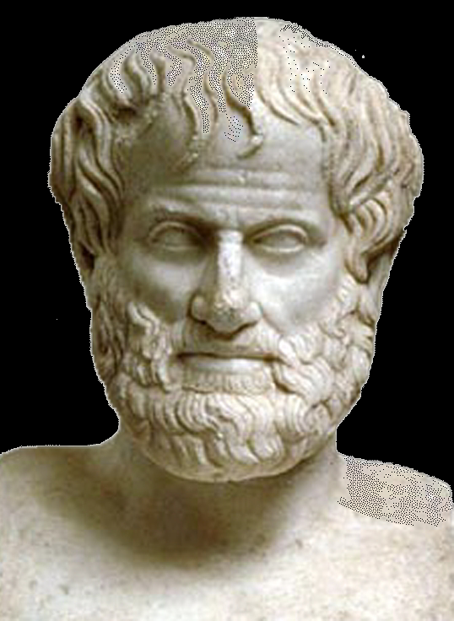
Aristotle
Aristotle was a Greek philosopher who was more interested in Science than some of his contemporaries. He was the first one to split knowledge into different categories, like biology and psychology. He also created a classification system for the government that is still used today, including monarchies, oligarchies, tyrannies, democracies, and republics. He also had lots of ideas about the power of persuasive speech.

Slide 12
Talk partners
Talk task:
Choose a philosopher. Tell your partner a fact about the philosopher.
Can you tell me who I am thinking of?
E.G. He was the student of Plato?

Slide 13
Task
Resource sheet 1A
Group the 5 descriptions under the name of the correct philosopher

Slide 14
Step for depth
Can you come up with your own philosophical question?

Slide 15
Partner teach/ Plenary
Who do you think was the most influential philosopher and why?

