Slide 1
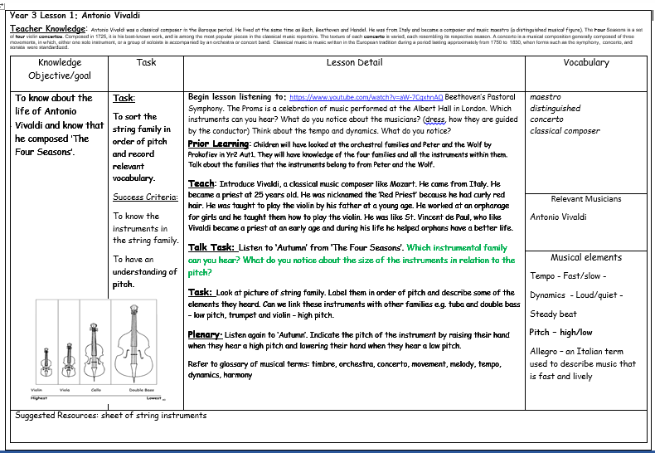
Lesson 1: Antonio Vivaldi

Slide 2

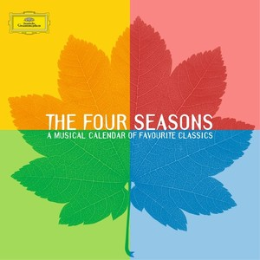


Year 3
Autumn 2
Lesson 1

Slide 3
Let’s Listen
https://www.youtube.com/watch?v=aW-7CqxhnAQ
Introduce Beethoven’s Pastoral Symphony. Tell children that ‘The Proms’ is a celebration of music performed at the Albert Hall in London.
Which instruments can you hear?
What do you notice about the musicians?
Think about the tempo and dynamics. What do you notice?

Slide 4
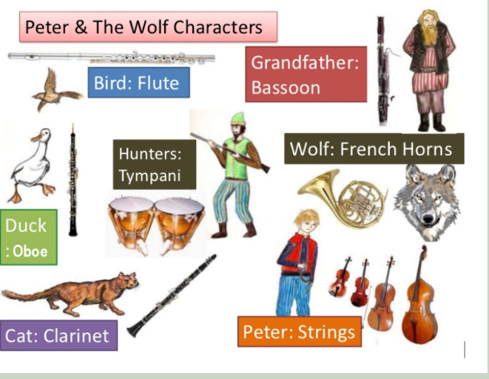
Prior Learning
Hunters:
Timpani
Which instrumental families do these instruments belong to?

Slide 5
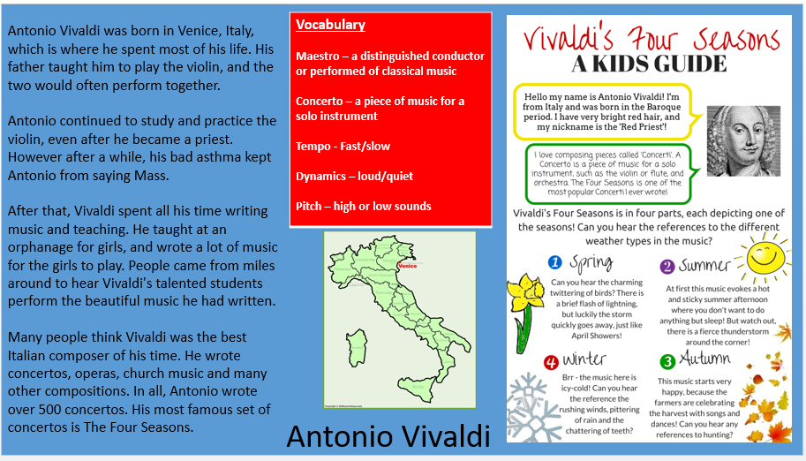
Our Knowledge Organiser

Slide 6
Key Vocabulary
maestro
distinguished
concerto
classical composer

Slide 7
L.O: To know about the life of Antonio Vivaldi.
Success Criteria: To know the instruments in the string family. To have an understanding of pitch.
maestro distinguished concerto Classical composer
Here are today’s key words:

Slide 8
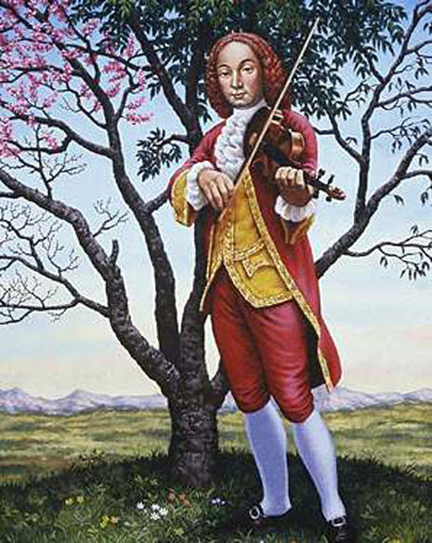
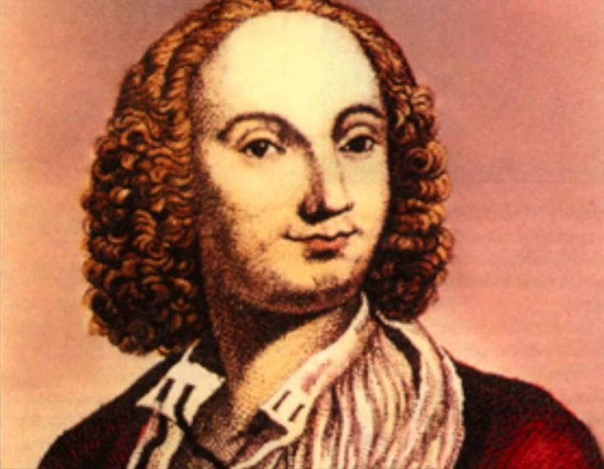
Teach
Antonio Vivaldi was a classical composer like Mozart. He came from Italy. He began studying to be a priest when he was 15 years old and was ordained when he was 25 years old. He was nicknamed the ‘Red Priest’ because he had curly red hair.

Slide 9
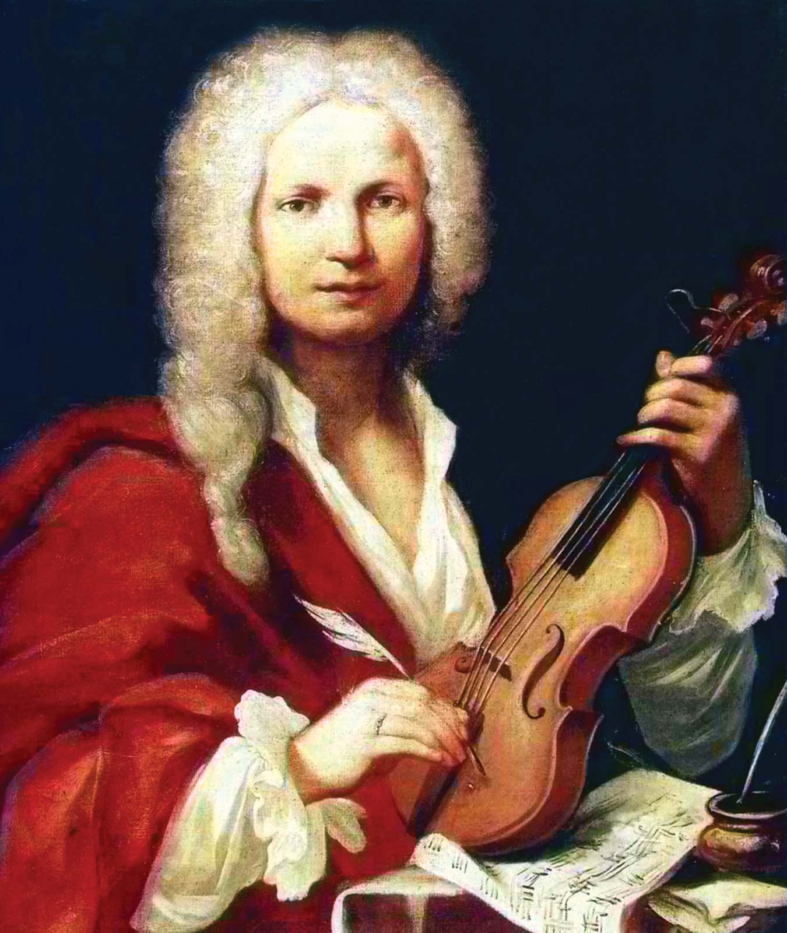
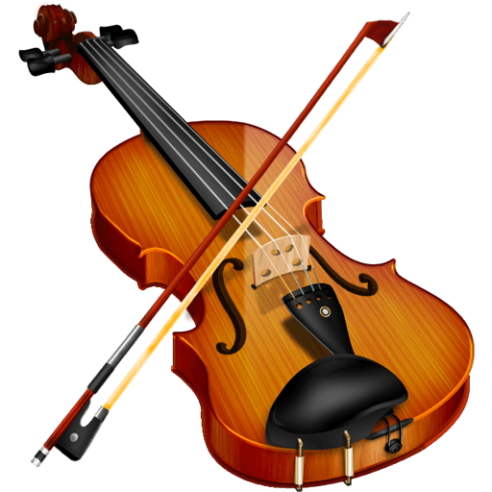
Teach
He was taught to play the violin by his father at a very young age. He later went on to work at an orphanage for girls where he taught them how to play the violin.

Slide 10

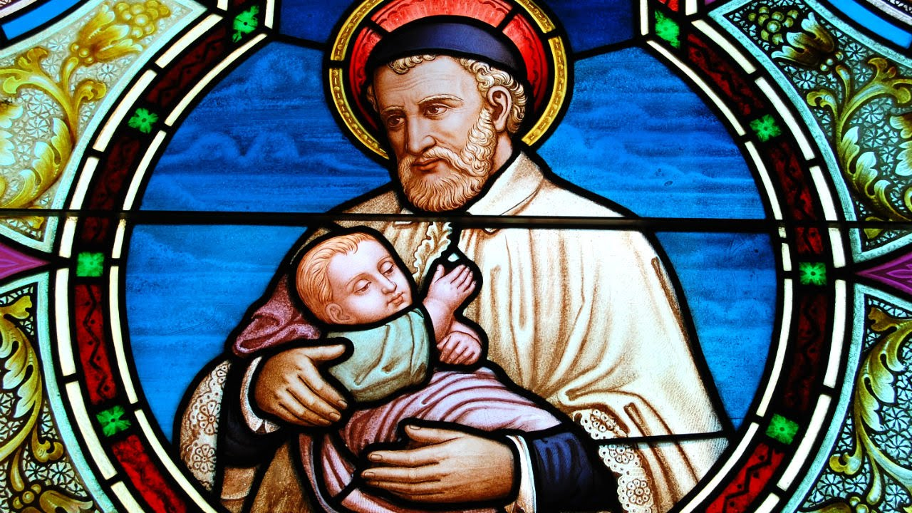
Teach
He was like St. Vincent De Paul, who like Vivaldi, became a priest at an early age and during his life helped orphans have a better life.

Slide 11
Talk Task
Listen to ‘Autumn’ from ‘The Four Seasons’
https://www.youtube.com/watch?v=8x4GC0-Z0ZI
Discuss with your partner:
Which instrumental family can you hear?
Can you name all the instruments in this family?
What do you notice about the size of the instruments in relation to the pitch.

Slide 12
Teach
The pitch is how high or low a note sounds.
The size of an instrument (and the length of strings on a string instrument) affects how high or low the notes are that it produces.

Slide 13
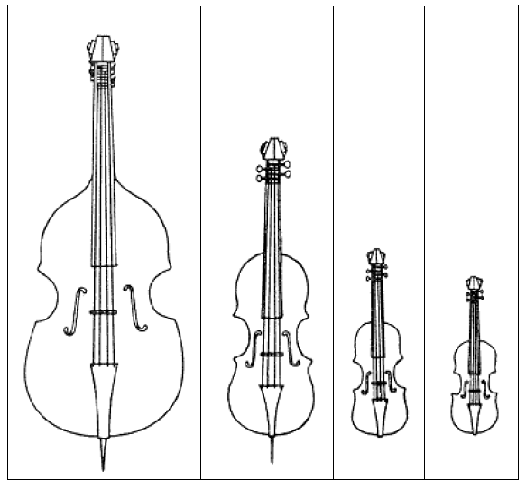
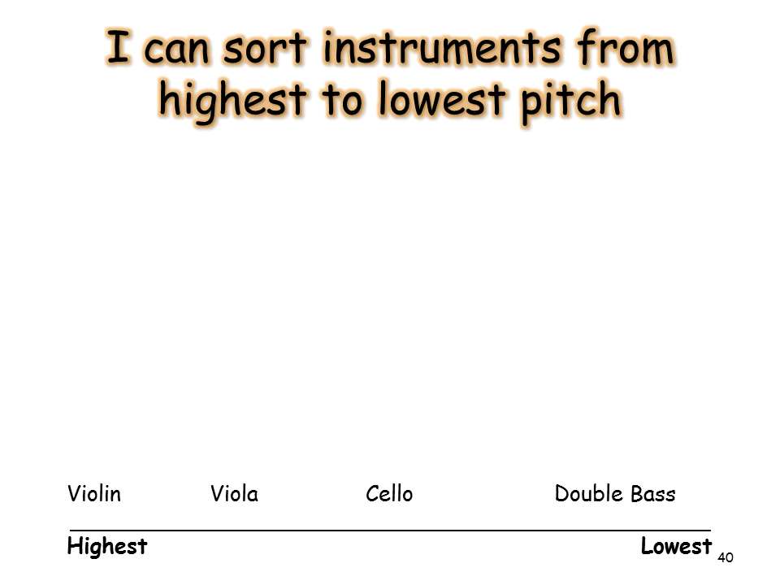
Task
Draw and label the string family in order of pitch.
Jot down the musical elements you heard.
Can you link these instruments with other instrumental families? E.g. tuba and double bass are low in pitch.

Slide 14
And finally…
Listen once again to ‘Autumn’ from ‘The Four Seasons’. Indicate the pitch of the instruments using your hand. Raise your hand when you hear a high pitch and lower your hand when you hear the low pitch.
Think about:
timbre tempo
melody dynamics

