Slide 1


LO – to about different types of rocks.
What is a Rock?
Get ready to rule rocks!
©Deepening Understanding LTD 2020

Slide 2

Know the Science
Rocks are everywhere!
No matter where you are in the world, there are
always rocks somewhere beneath you.
Did you know that the earth’s crust is made of rock?
©Deepening Understanding LTD 2020

Slide 3
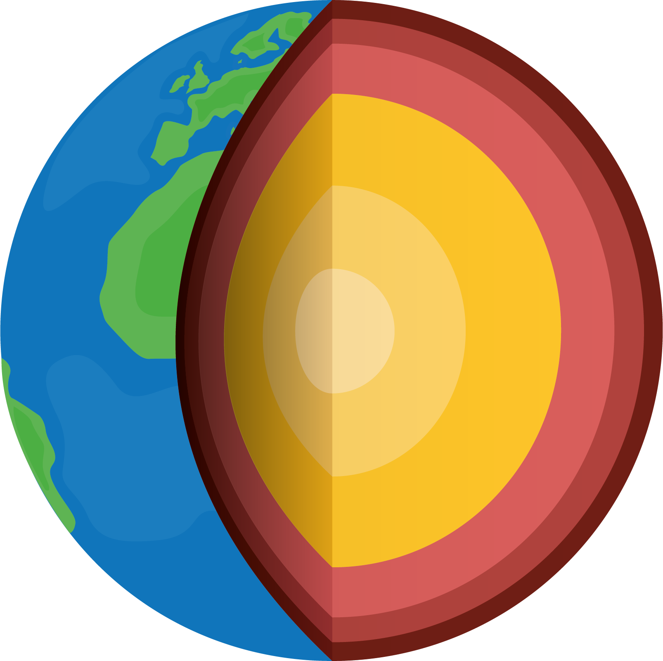
Know the Science
Below the earth’s crust is the mantle, which is also made of rock.
The mantle is so hot that it is in liquid form!
crust
mantle
©Deepening Understanding LTD 2020

Slide 4
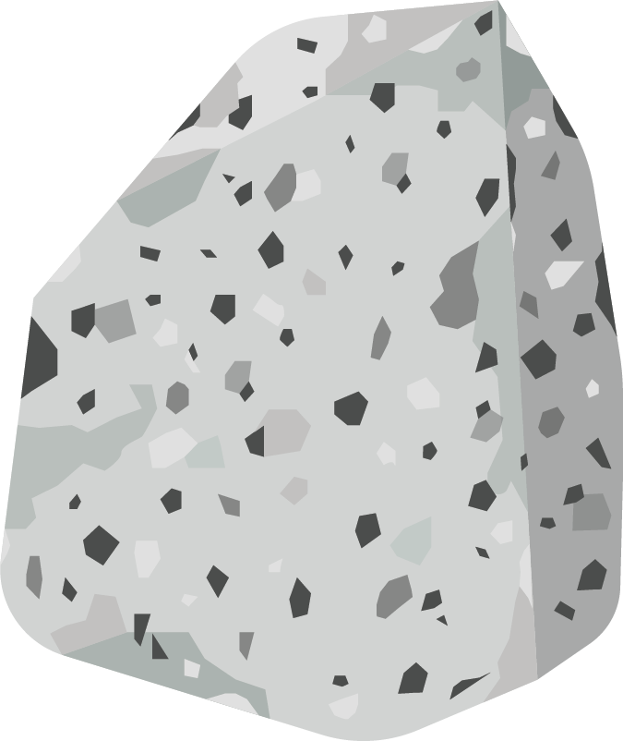

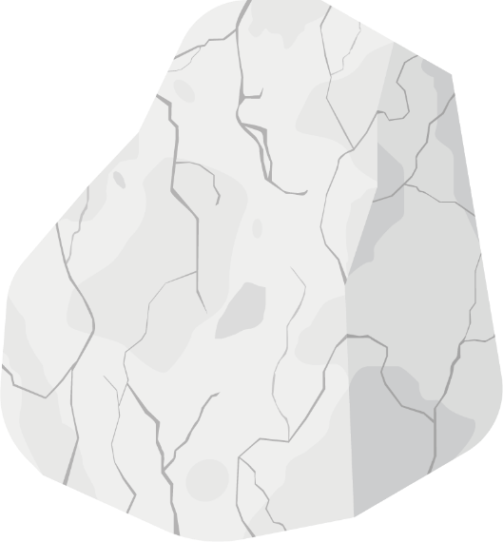

Talk like a Scientist
Look down at the ground.
Can you see any rocks?
Why can’t we see them?
They are covered by ___________.
©Deepening Understanding LTD 2020

Slide 5

Talk like a Scientist
Where are the rocks in this picture?
©Deepening Understanding LTD 2020

Slide 6


Talk like a Scientist
Where are the rocks in these pictures?
©Deepening Understanding LTD 2020

Slide 7

Talk like a Scientist
Where are the rocks in this picture?
©Deepening Understanding LTD 2020

Slide 8
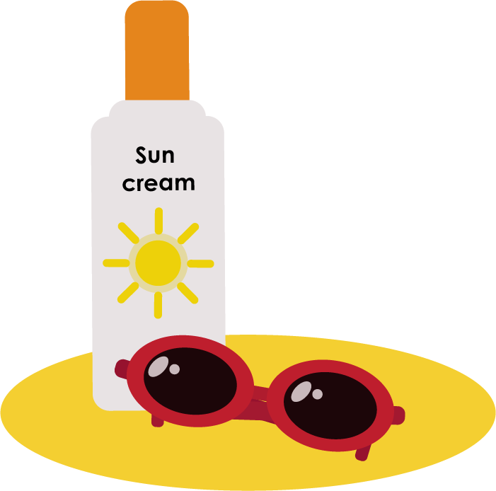

Talk like a Scientist
Where are the rocks when you are…
…on the beach?
…in the garden?
©Deepening Understanding LTD 2020

Slide 9
Talk like a Scientist
Take a rock from the selection in your classroom.
NOW… Discuss Caleb’s question with your partner.
What is a rock?
©Deepening Understanding LTD 2020

Slide 10
Know the Science
A rock is a solid collection of mineral grains
that grow or cement together.
©Deepening Understanding LTD 2020

Slide 11
Know the Science
Rocks can be naturally occurring…
©Deepening Understanding LTD 2020

Slide 12
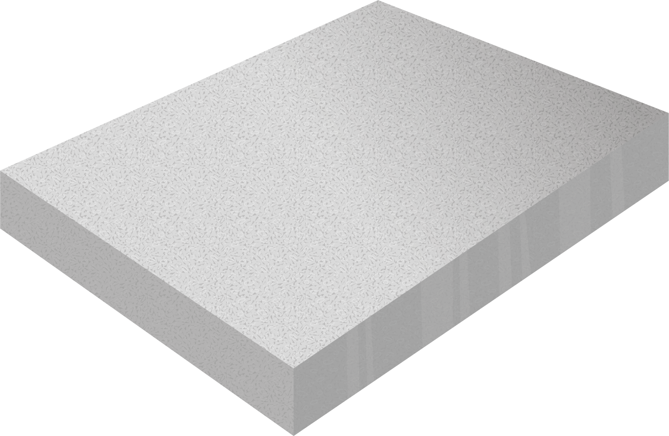
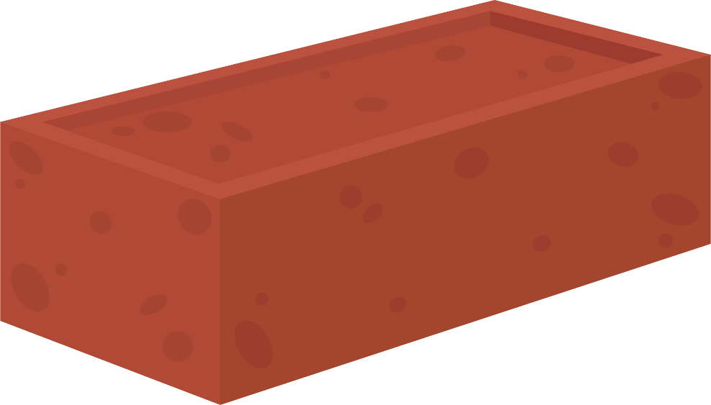
Know the Science
…or they can be manmade.
©Deepening Understanding LTD 2020

Slide 13
Talk like a Scientist
What do we use bricks and concrete for?
Why do you think they make good building materials?
©Deepening Understanding LTD 2020

Slide 14





Talk like a Scientist
Which of these items are made out of rocks?
Why do you think they are made using rocks?
Why would rocks not be suitable to make the other items?
©Deepening Understanding LTD 2020

Slide 15
Act like a Scientist
Compare your rocks.
What is the same and what is different about them?
Use this vocabulary to help you describe them…
Are there any other words you would use to describe the rocks?
hard
soft
smooth
gritty
rough
jagged
strong
brittle
crumbly
sparkly
©Deepening Understanding LTD 2020

Slide 16

Act like a Scientist
Name that rock!
Research your rocks to find out what they are called.
You could use information books and the internet to find out more!
Find THREE facts about your rock to share with the rest of the class!
©Deepening Understanding LTD 2020

Slide 17
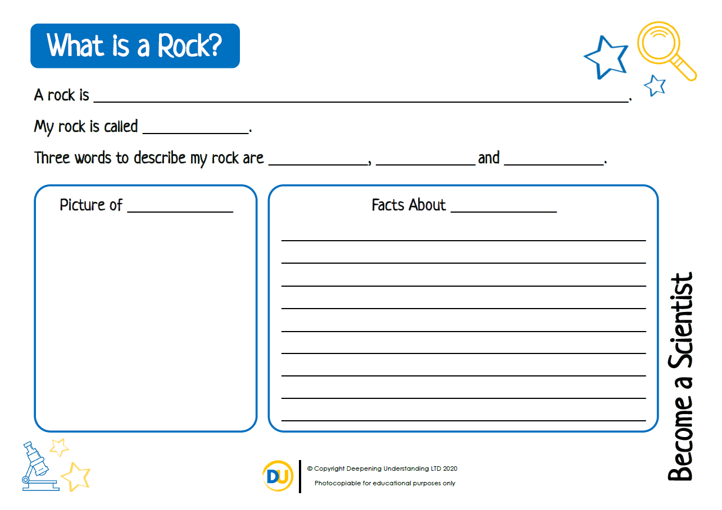
Independent Task
Become a Scientist
©Deepening Understanding LTD 2020

Slide 18

Act like a Scientist
If you can, collect rocks from your area.
.
How many different ways could we sort and classify them?
How could we present our groupings?
©Deepening Understanding LTD 2020

Slide 19

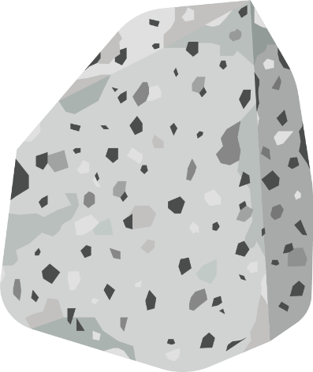
Think like a Scientist
Who do you agree with?
Rocks are always hard.
Ranjit
Rocks are sometimes hard.
Rocks are never hard.
Alfie
Asha
©Deepening Understanding LTD 2020

Slide 20
Exit task – Checking the tricky bits
Let‘s try answering Caleb’s question again…
What is a rock?
©Deepening Understanding LTD 2020

