Slide 1
Week 2
Outcome: to use a range of descriptive techniques to describe the witches house .

Slide 2
Monday 9th November 2020
Words of the day – haven
Grammar focus
To use question marks correctly.
Follow the power point to turn commands into
Sentences.

Slide 3
Read through this weeks spellings.
happily
angrily
lazily
easily
busily
greedily
messily
wearily
cheekily
clumsily
LO: To create adverbs using ly correctly.
Write your sentences out. Check that you understand the meaning of each word.
Read , what are the different places it is set?

Slide 4
Maths
LO: to add and subtract 100’s.
Please follow the Whiterose link
https://whiterosemaths.com/homelearning/year-3/week-6-number-addition-subtraction/

Slide 5
R.E.
Multi Faith Week
See Powerpoint for learning.

Slide 6
PE
Practice throwing and catching.

Slide 7
Tuesday 10th November 2020
LO to explore a range of descriptive techniques .
Word of the day – forbidden.
Read Baba Yaga model text illustrated .
Look out for words that describe what is looks like.
Can you see how noun phrases, prepositional phrases and figurative language can help to create rich descriptions of settings and characters?
Can you write the nouns and adjectives used?
Have you found any descriptions that clearly put a picture in your head?

Slide 8
Maths
LO : to spot a pattern, making it explicit.
Please follow Whiterose link
https://whiterosemaths.com/homelearning/year-3/week-6-number-addition-subtraction/

Slide 9
R.E.
Multi Faith Week
See Powerpoint for learning.

Slide 10
Science
Lo: to know about different types of rocks.
See powerpoint.

Slide 11
Wednesday 11th November 2020
Lo to use a range of descriptive techniques to describe .
Word of the day – peacefully.
You will need to write a paragraph, describing a witch’s house that is different from, but just as weird as, Baba Yaga’s, making sure that you use noun phrases, prepositional phrases and figurative language.
Carefully practise joining your letters whilst writing

Slide 12
Maths
LO : to add2 digit numbers crossing 10.
Please follow Whiterose link
https://whiterosemaths.com/homelearning/year-3/week-6-number-addition-subtraction/

Slide 13
RE
Multi Faith Week
See powerpoint fore learning.

Slide 14

Music
L.O: To know about the life of Antonio Vivaldi.
Please follow the music PPT.

Slide 15
Thursday 12th November 2020
LO: to using a thesaurus to find synonyms.
Read through your description from yesterdays lesson. Today you are going to edit it. If you have a thesaurus at home, use it to look up better adjectives and verbs. This will make your description even more exciting.
Can you include a question?
Word of the day- ponder.

Slide 16
Maths
LO :Subtract a 2 digit number from a 2 digit number crossing 10.
Please follow Whiterose link
https://whiterosemaths.com/homelearning/year-3/week-6-number-addition-subtraction/

Slide 17
RE
Multi faith week
See powerpoint resource.

Slide 18
Friday 13th November 2020
LO to answer inference questions.
Word of the day- unreasonable.
See Fridays comprehension resource. Answer questions in full sentences

Slide 19
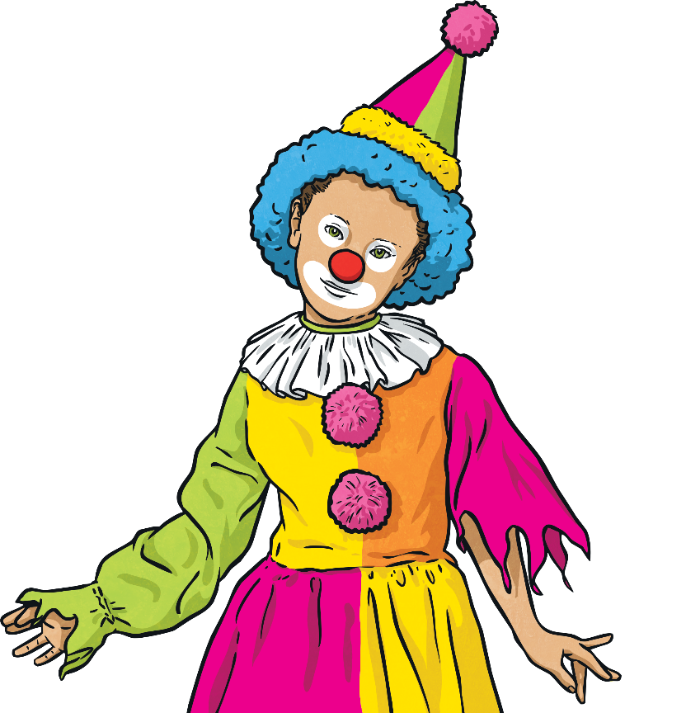
Week 3 – Writing Task
Magda and Tina are pen pals. During the half-term holiday, Tina was supposed to be staying with Magda for a few days. Magda’s mum had bought two tickets so the two friends could go and see the clown show at the circus. Unfortunately, Tina caught a bug and couldn’t visit Magda.
Write a letter from Magda to Tina including a recount of what happened at the show.
How many points
can you score?
Word of the Week | Points
comedian | 1
hidden | 2
humorously | 2
launch | 2
irresistible | 3

Slide 20
Maths
LO : to answer mixed addition and subtraction pronlems.
Please follow Whiterose link
https://whiterosemaths.com/homelearning/year-3/week-6-number-addition-subtraction/

Slide 21
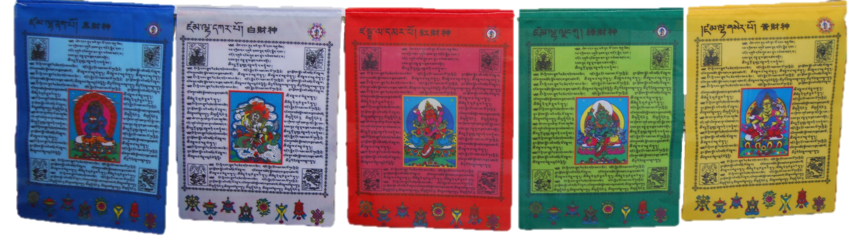
RE
Multi faith week.
LO: to understand how and why Tibetan Buddhists create prayer flags.
See powerpoint for learning.

