Slide 1
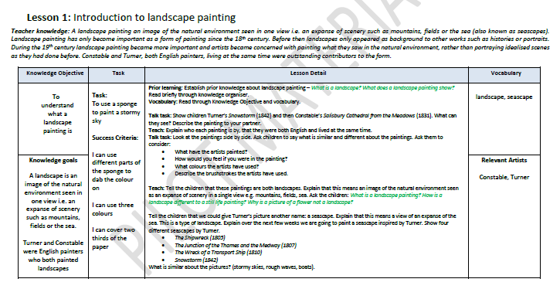
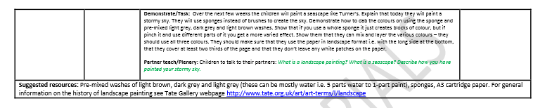

Slide 2
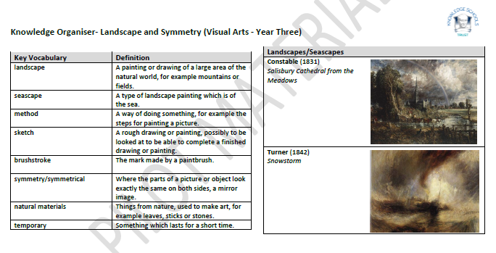
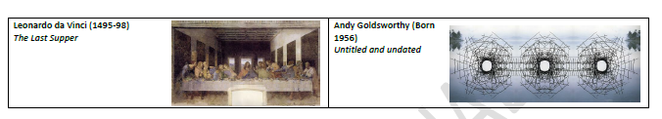

Slide 3
Prior Learning –
What is a landscape?
What does a landscape painting show ?
Write your answer for each question on a post-it note and add it to the whiteboard!

Slide 4
Vocabulary –
landscape | brushstroke
seascape | symmetry
method | natural materials
sketch | temporary
What do you think these words are referring to?

Slide 5
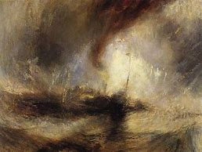
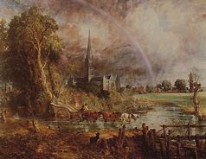
Talk Task –
Look at these pictures that have been painted by famous artists.
Tell your partner one thing that you notice about these images.
Snowstorm by Turner
Constable

Slide 6
Talk Task –
What have the artists painted?
How would you feel if you were in the painting ?
What colours have the artists used?
Describe the brushstrokes the artists have used.

Slide 7
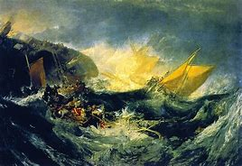
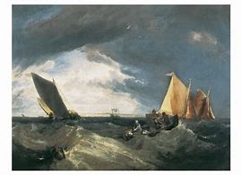
Teach –
What is a landscape painting?
How are they different to still life paintings?
Why is a picture of a flower not a landscape?
Both the paintings are landscapes.
Landscapes are images of a natural environment.
seascape
What is similar about these three seascapes?

Slide 8
Task – PAINT A STORMY SKY
Instructions:
Turn your paper so it is landscape.
Use sponges to create your sky, use two thirds of the page..
Mix and layer colours.
Make sure you use light grey, dark grey and light brown paint.
Do not leave any white on the page.
What you will need:
A3 paper
Sponges
Paint

Slide 9
Partner teach/plenary – discuss these questions with your partner and share everything that you have learnt!
What is a landscape?
What is a seascape?
How did you create your stormy sky?

