Slide 1
Week 1
Out come:to use ambitious vocabulary in a conversation using inverted commas.

Slide 2
Monday 2nd November 2020
Words of the day –comedian
Grammar focus
To understand what a determiner is and which to use when.

Slide 3
Read through this weeks spellings.
kindly
quickly
Safely
rudely
sweetly
Strongly
bravely
secretly
finally
usually
LO: To create adverbs using ly correctly.
Write your sentences out. Check that you understand the meaning of each word.

Slide 4
Monday 2nd November 2020
LO – to know the story of Zacchaeus.
Thoughts to ponder:
I wonder why the people in the story of Jesus and Zacchaeus behaved as they did.
I wonder if you can explain the story of Zacchaeus
I wonder what the story of Jesus and Zacchaeus teaches me about Jesus

Slide 5

Starter:
What would you do if someone cheated in a test?
Ignore them?
Tell the teacher?
Tell all of your friends?
Explain WHY?
Why might someone disagree with you?

Slide 6
Zacchaeus
A little man who became big in the Kingdom of God.
Featuring the Art of Henry Martin
Presented by
Sermons 4 Kids

Slide 7
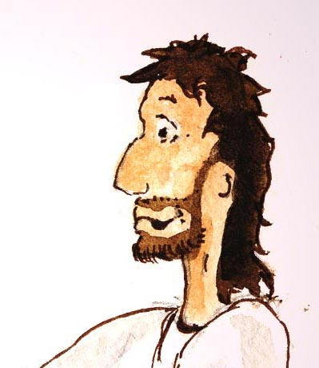
One day, Jesus went to visit the city of Jericho.

Slide 8
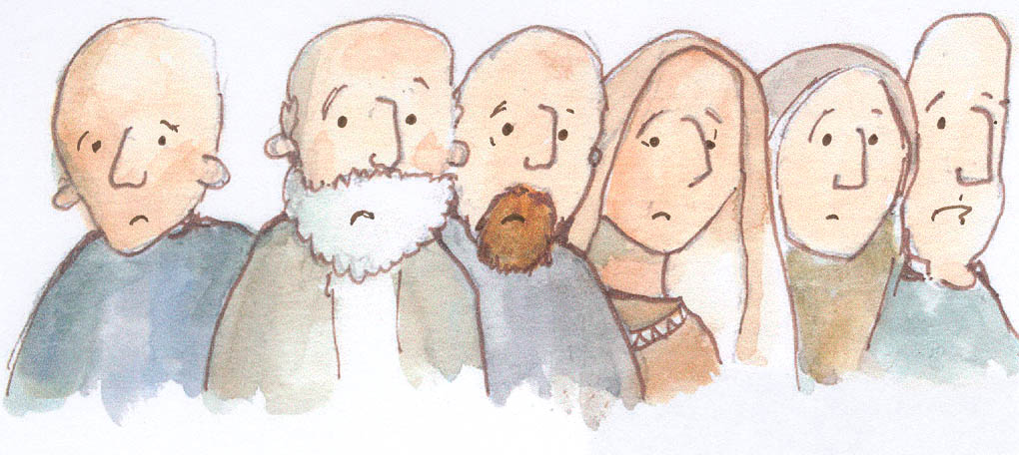
The people of Jericho were a very sad people. Why were they sad? They were sad because they had to pay taxes … and their taxes were very high.

Slide 9
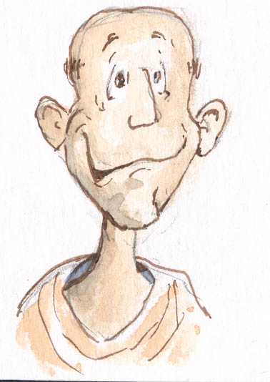
The reason their taxes were so high was that there was a dishonest tax collector in the city.
The tax collector’s name was Zacchaeus.

Slide 10
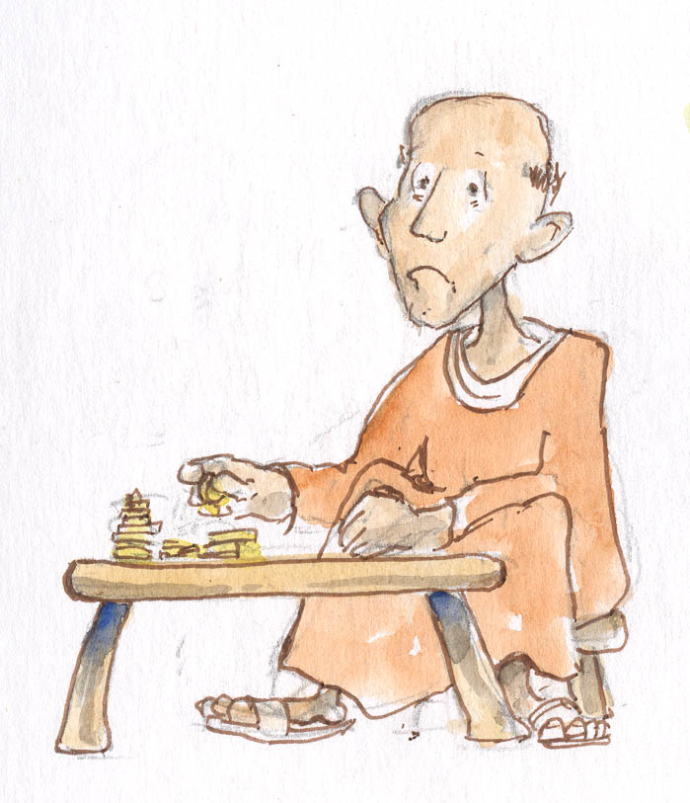
Zacchaeus would always collect more tax than people owed.
He would give part of the money to the Roman government and keep the rest for himself!

Slide 11
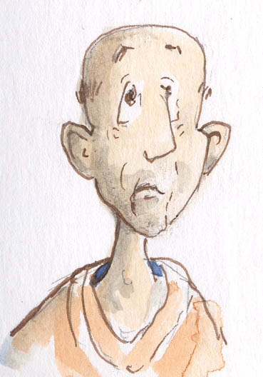
Zacchaeus heard that Jesus was coming to Jericho. He wanted to see Jesus, but he was so short that he could not see above the heads of the people who crowded around Jesus.
He saw a Sycamore tree nearby and decided to climb the tree so that he could see Jesus.

Slide 12
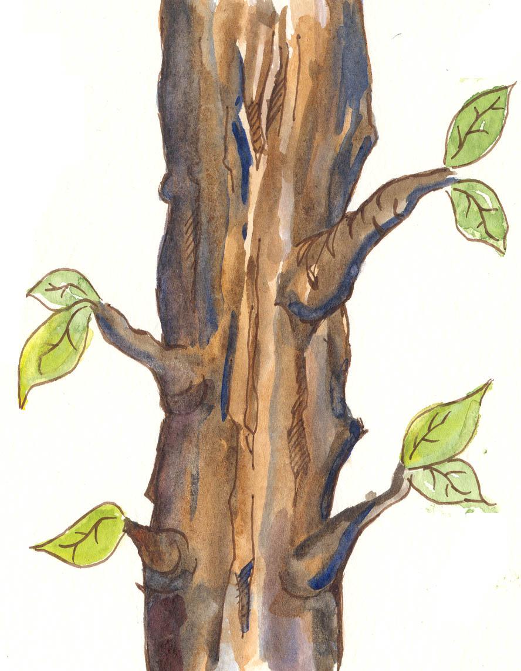
He climbed…

Slide 13
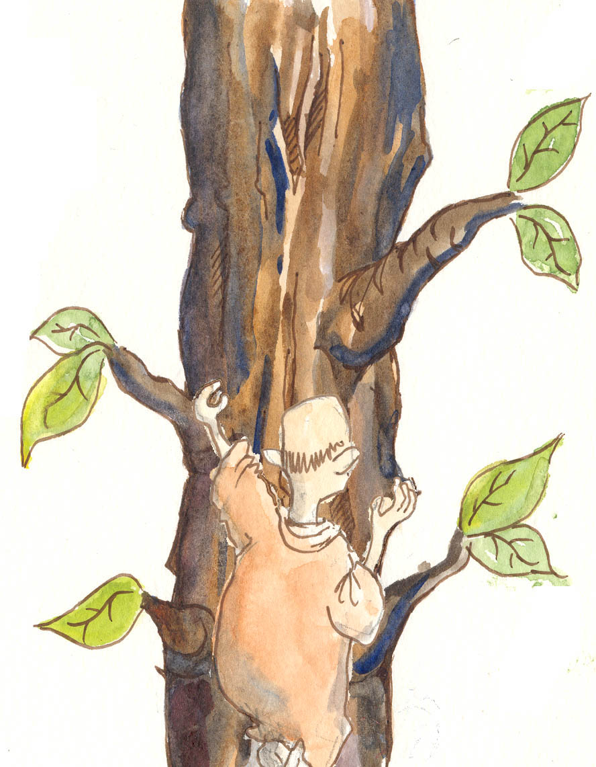
And climbed…

Slide 14
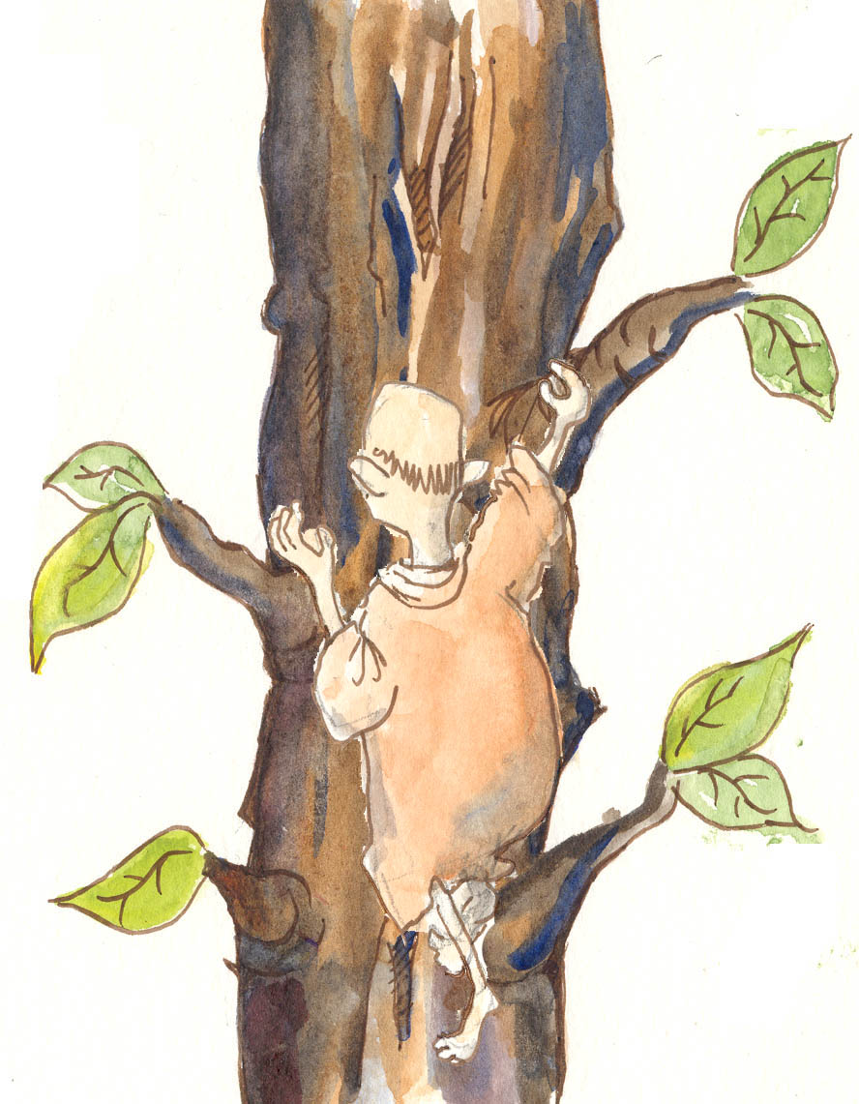
And climbed…

Slide 15
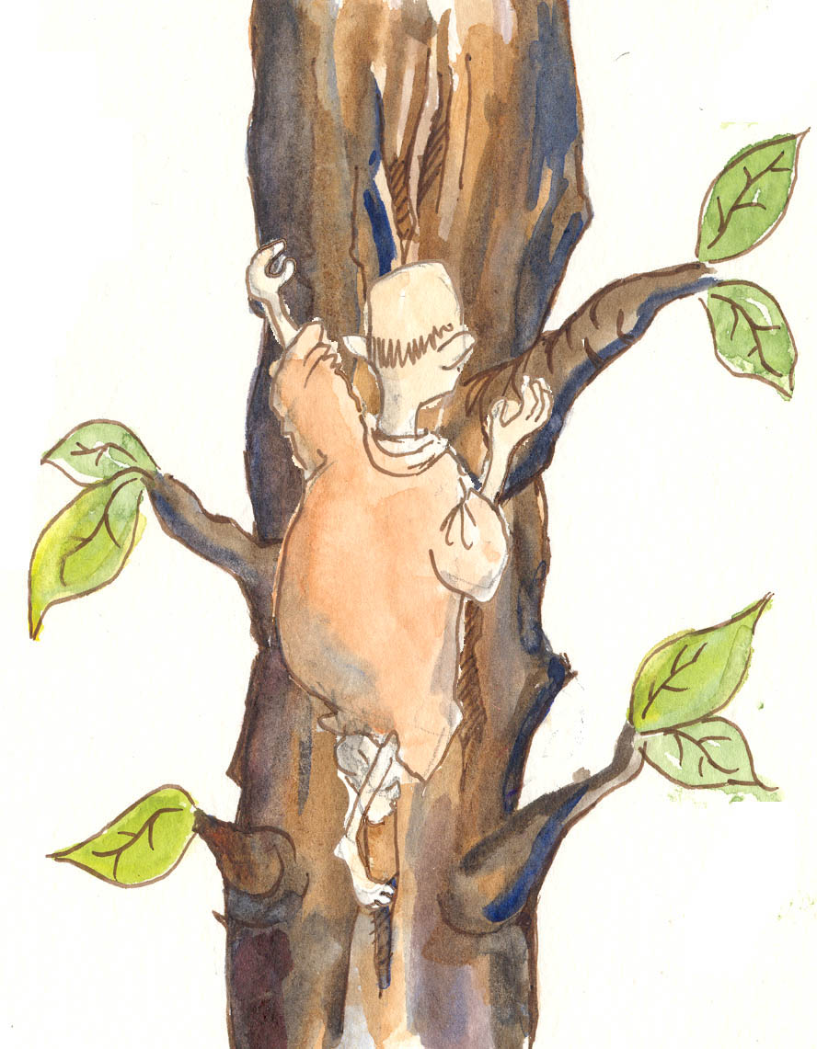
And climbed…

Slide 16
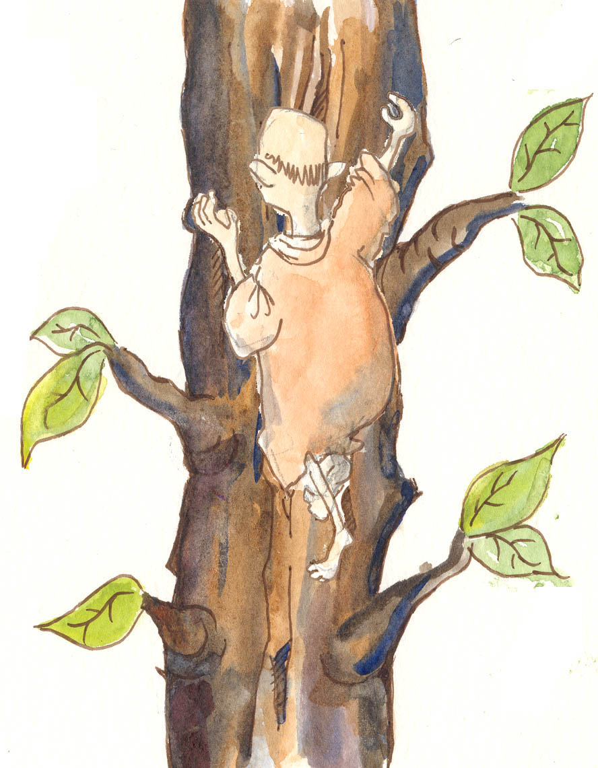
And climbed…

Slide 17
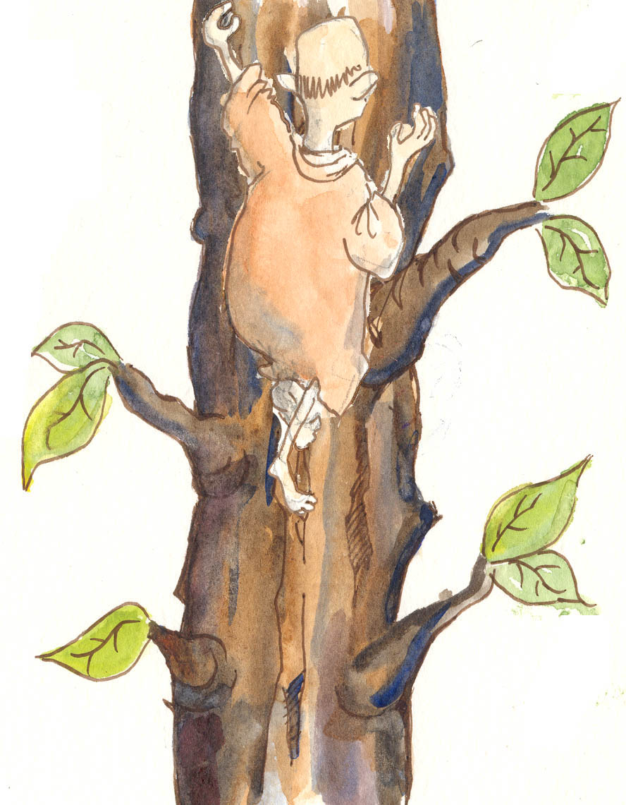
And climbed…

Slide 18
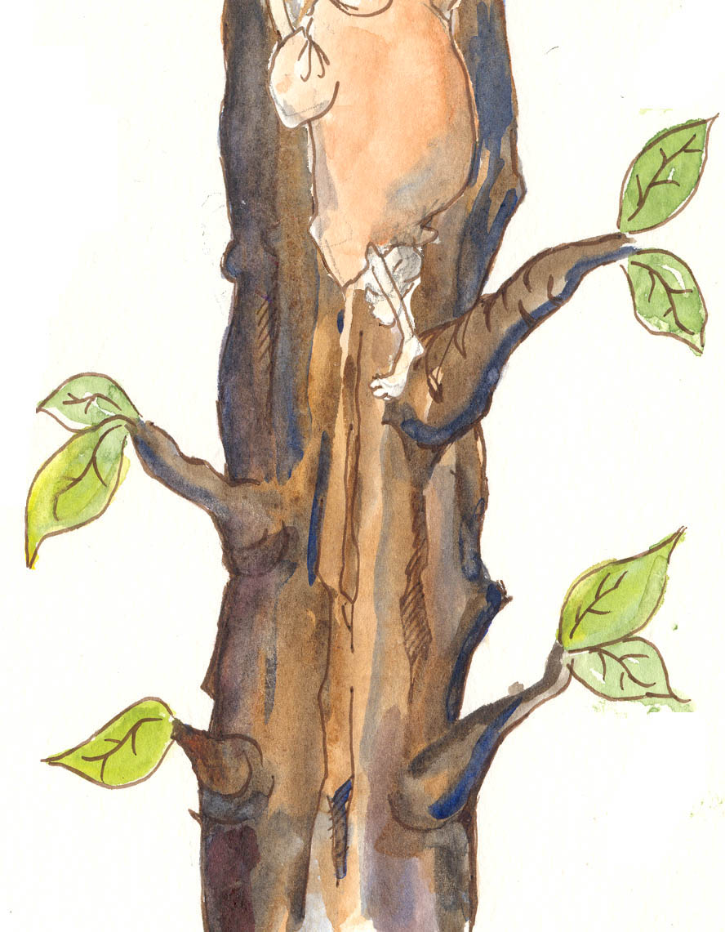
And climbed…

Slide 19
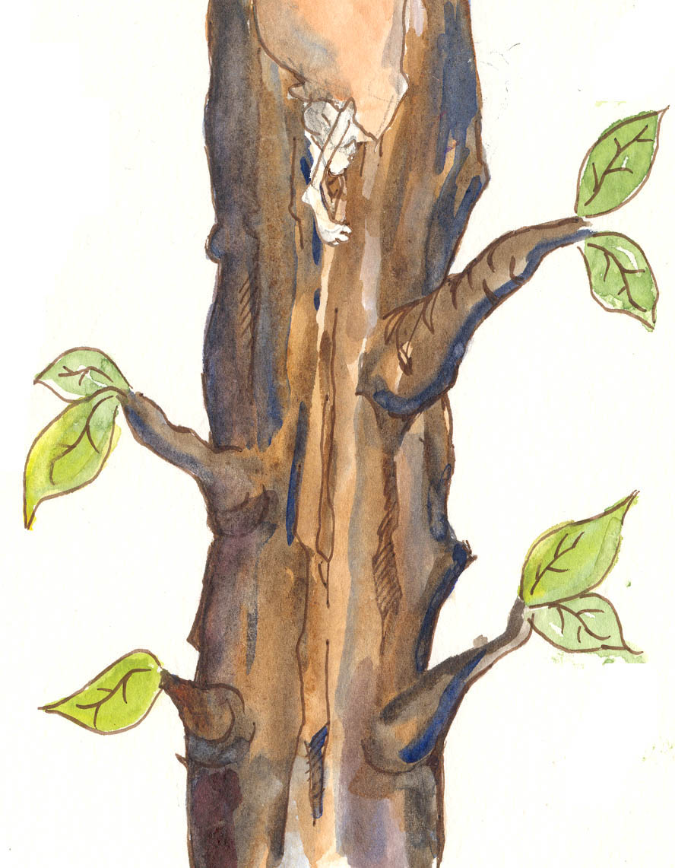
And climbed…

Slide 20
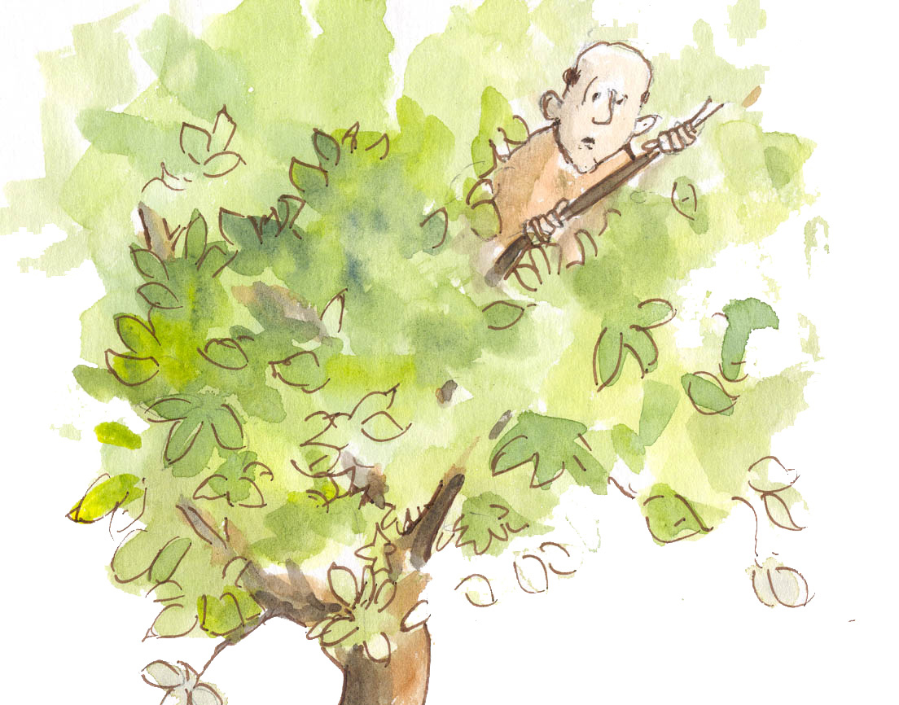
Until finally, he was perched high in the top of the tree!

Slide 21
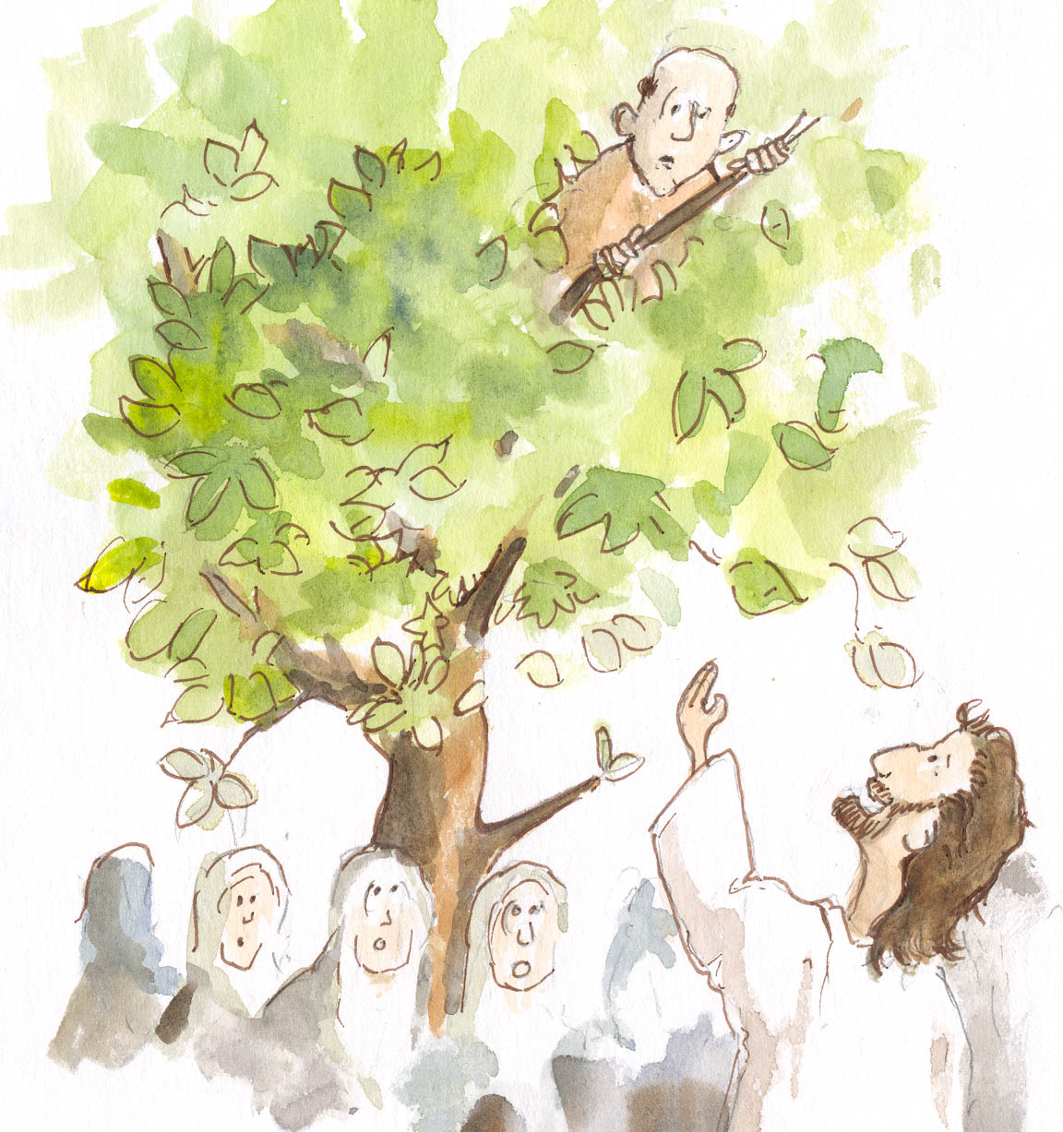
When Jesus passed by, he looked up in the Sycamore tree and saw Zacchaeus.
“Zacchaeus, you come down,” Jesus said. “I am going to your house today.”

Slide 22
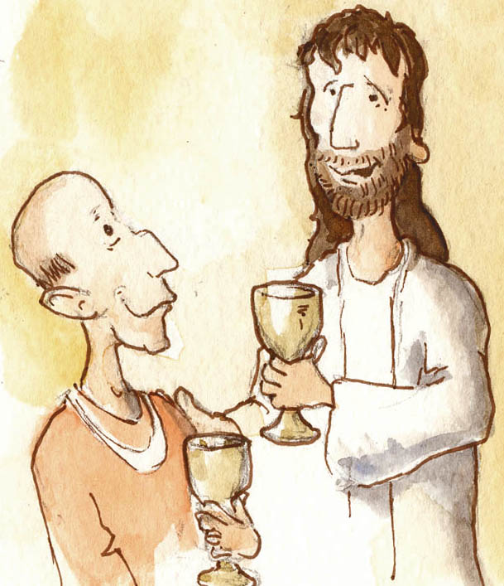
Zacchaeus climbed down from the tree as fast as he could.
Jesus went with Zacchaeus to his house and had dinner with him.

Slide 23
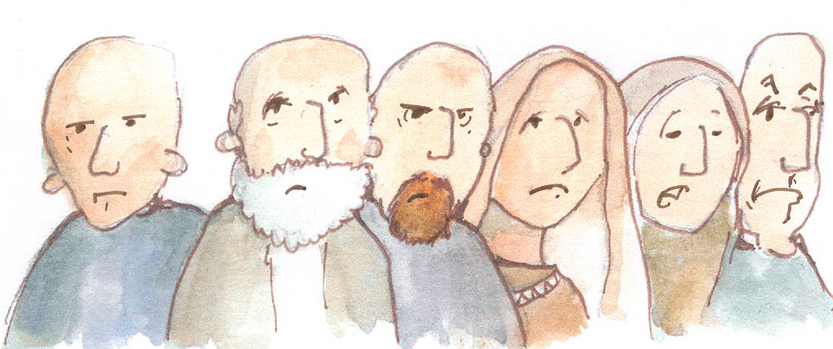
Some of the people were very angry with Jesus because he went to the home of Zacchaeus.

Slide 24
But once Jesus was in his home, Zacchaeus changed.
He told Jesus that he would give half of his money to the poor -- and if he had cheated anyone -- he would pay them back. He promised to repay them four times the amount he had stolen.

Slide 25
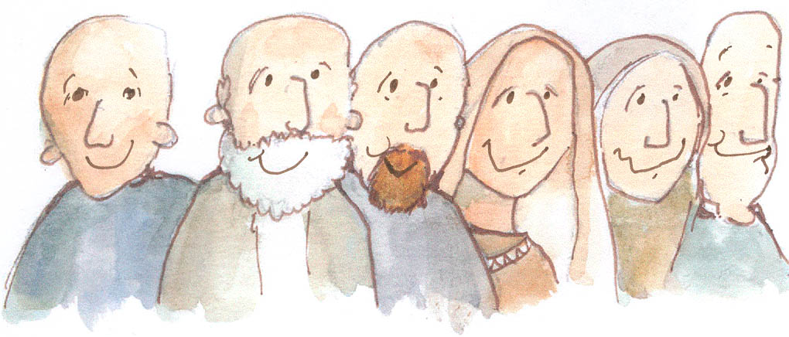
That day a lot of people in Jericho were much richer -- and much, much happier.

Slide 26
Zacchaeus was happy too!
Jesus had changed his life!

Slide 27
The End
© 2004 by Henry Martin and Sermons 4 Kids All rights reserved.
Your task is to retell the story through drawings. Remember to say what you like about the story

Slide 28
Tuesday 3rd November 2020
LO to read the story of Baba Yaga.
Word of the day – hidden.
Read Baba Yaga model text illustrated .
What type of writing is this? (Folktale). How do you know?
Can you spot verbs in the past tense?
Can you spot commas for lists, coordinating conjunctions, subordinating conjunctions and find examples if these in the model text.
Make a list of these.

Slide 29
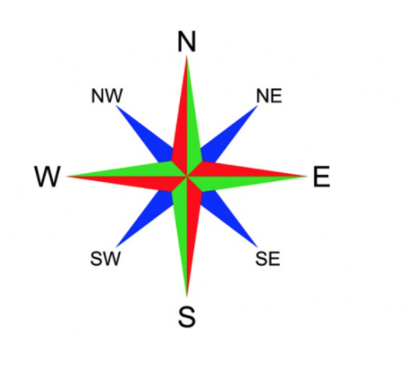
Geography
LO – to know the countries of Europe
Look at the next few slides. If I travelled from England, south,
across the English Channel, which country would I reach?
Which countries could I travel through in Western Europe?

Slide 30
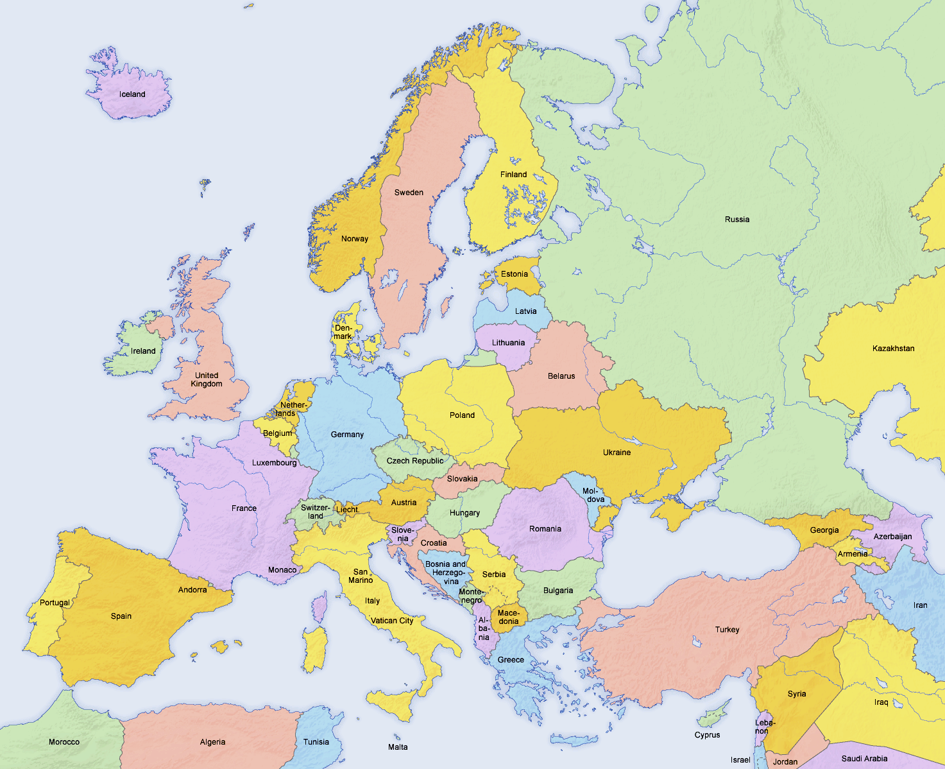
Europe

Slide 31
Europe is one of the world’s seven continents.
The others are Africa
North and South America, Antarctica, Asia and Australia.

Slide 32
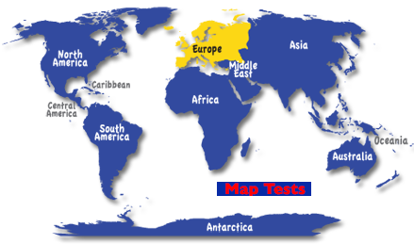
Where is Europe?

Slide 33
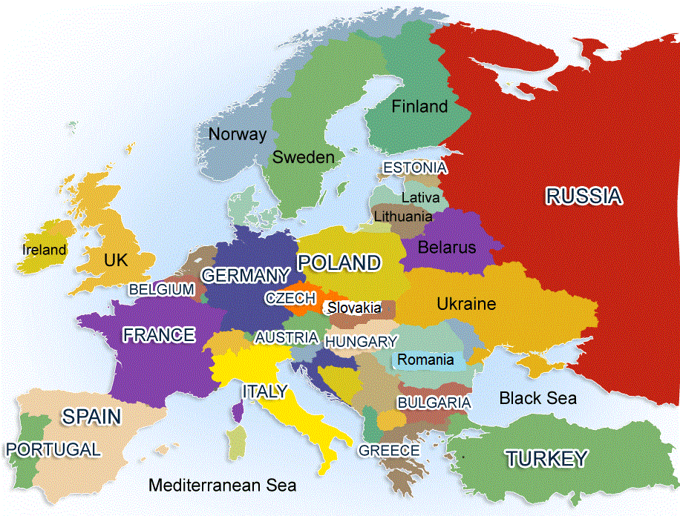
There are at least 50 countries in Europe.

Slide 34
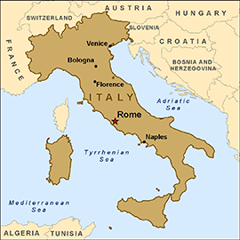
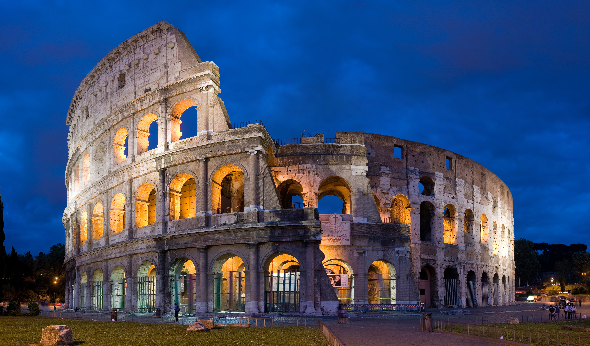

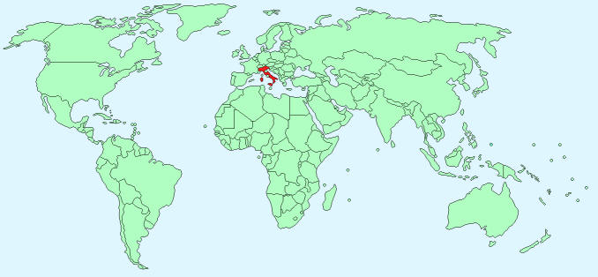
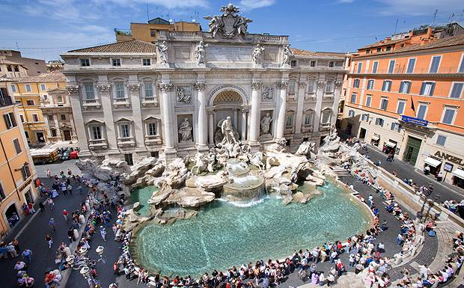
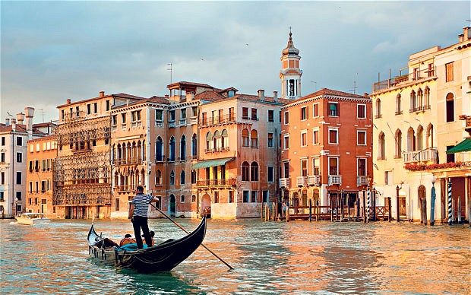
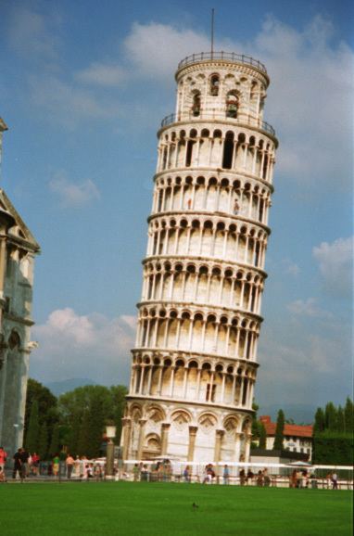
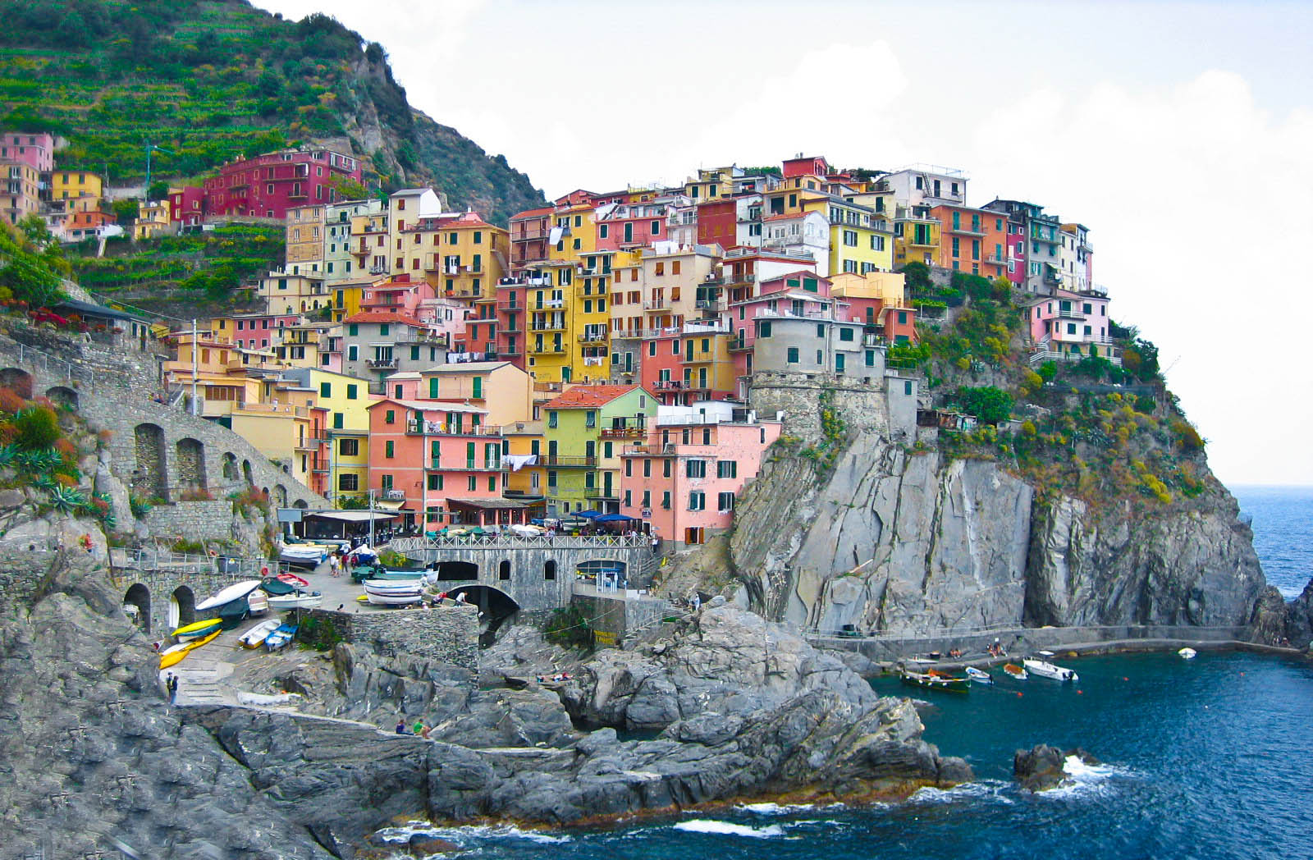
Countries in Europe
Italy

Slide 35
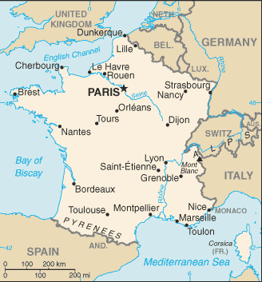

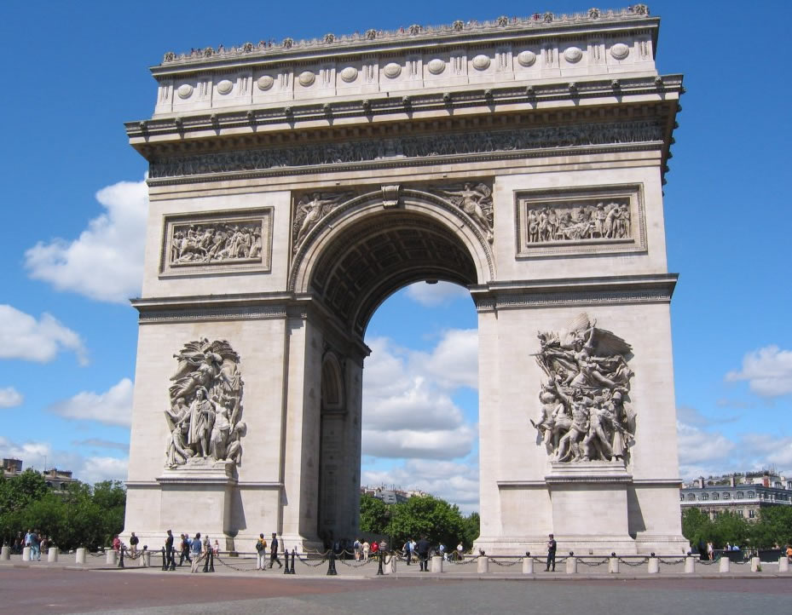
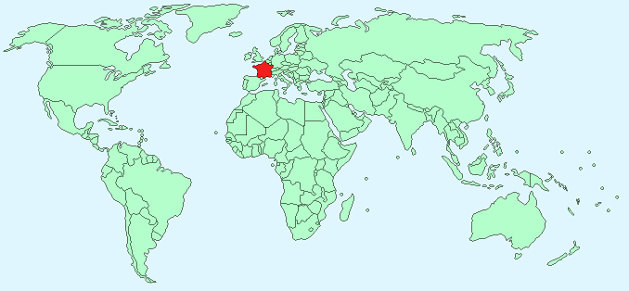
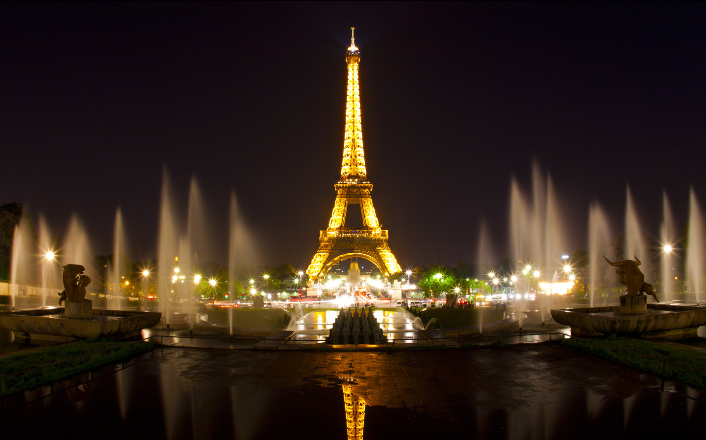
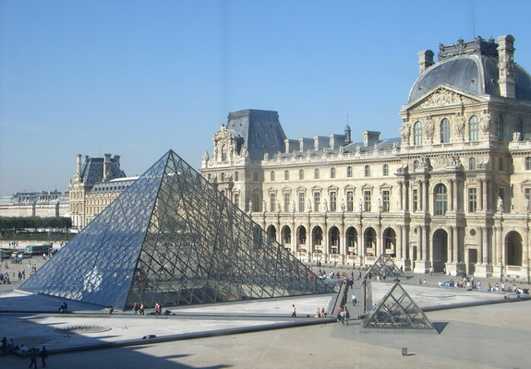
France

Slide 36
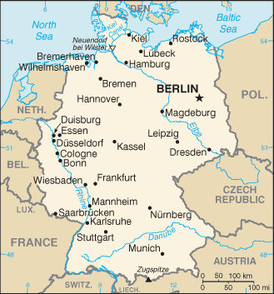

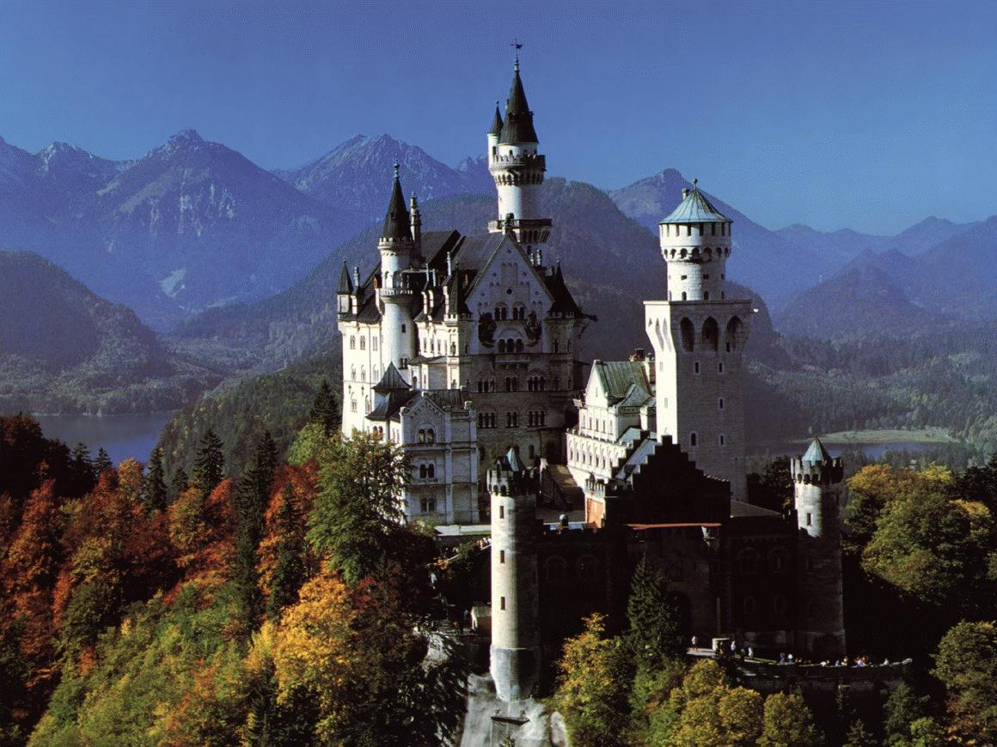
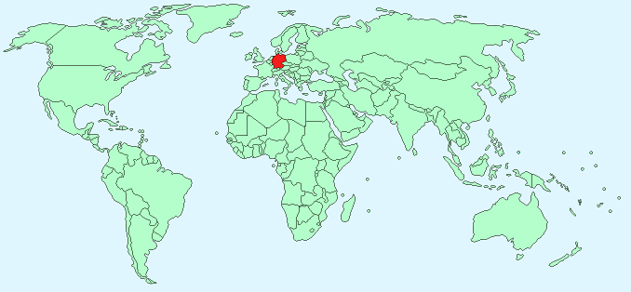
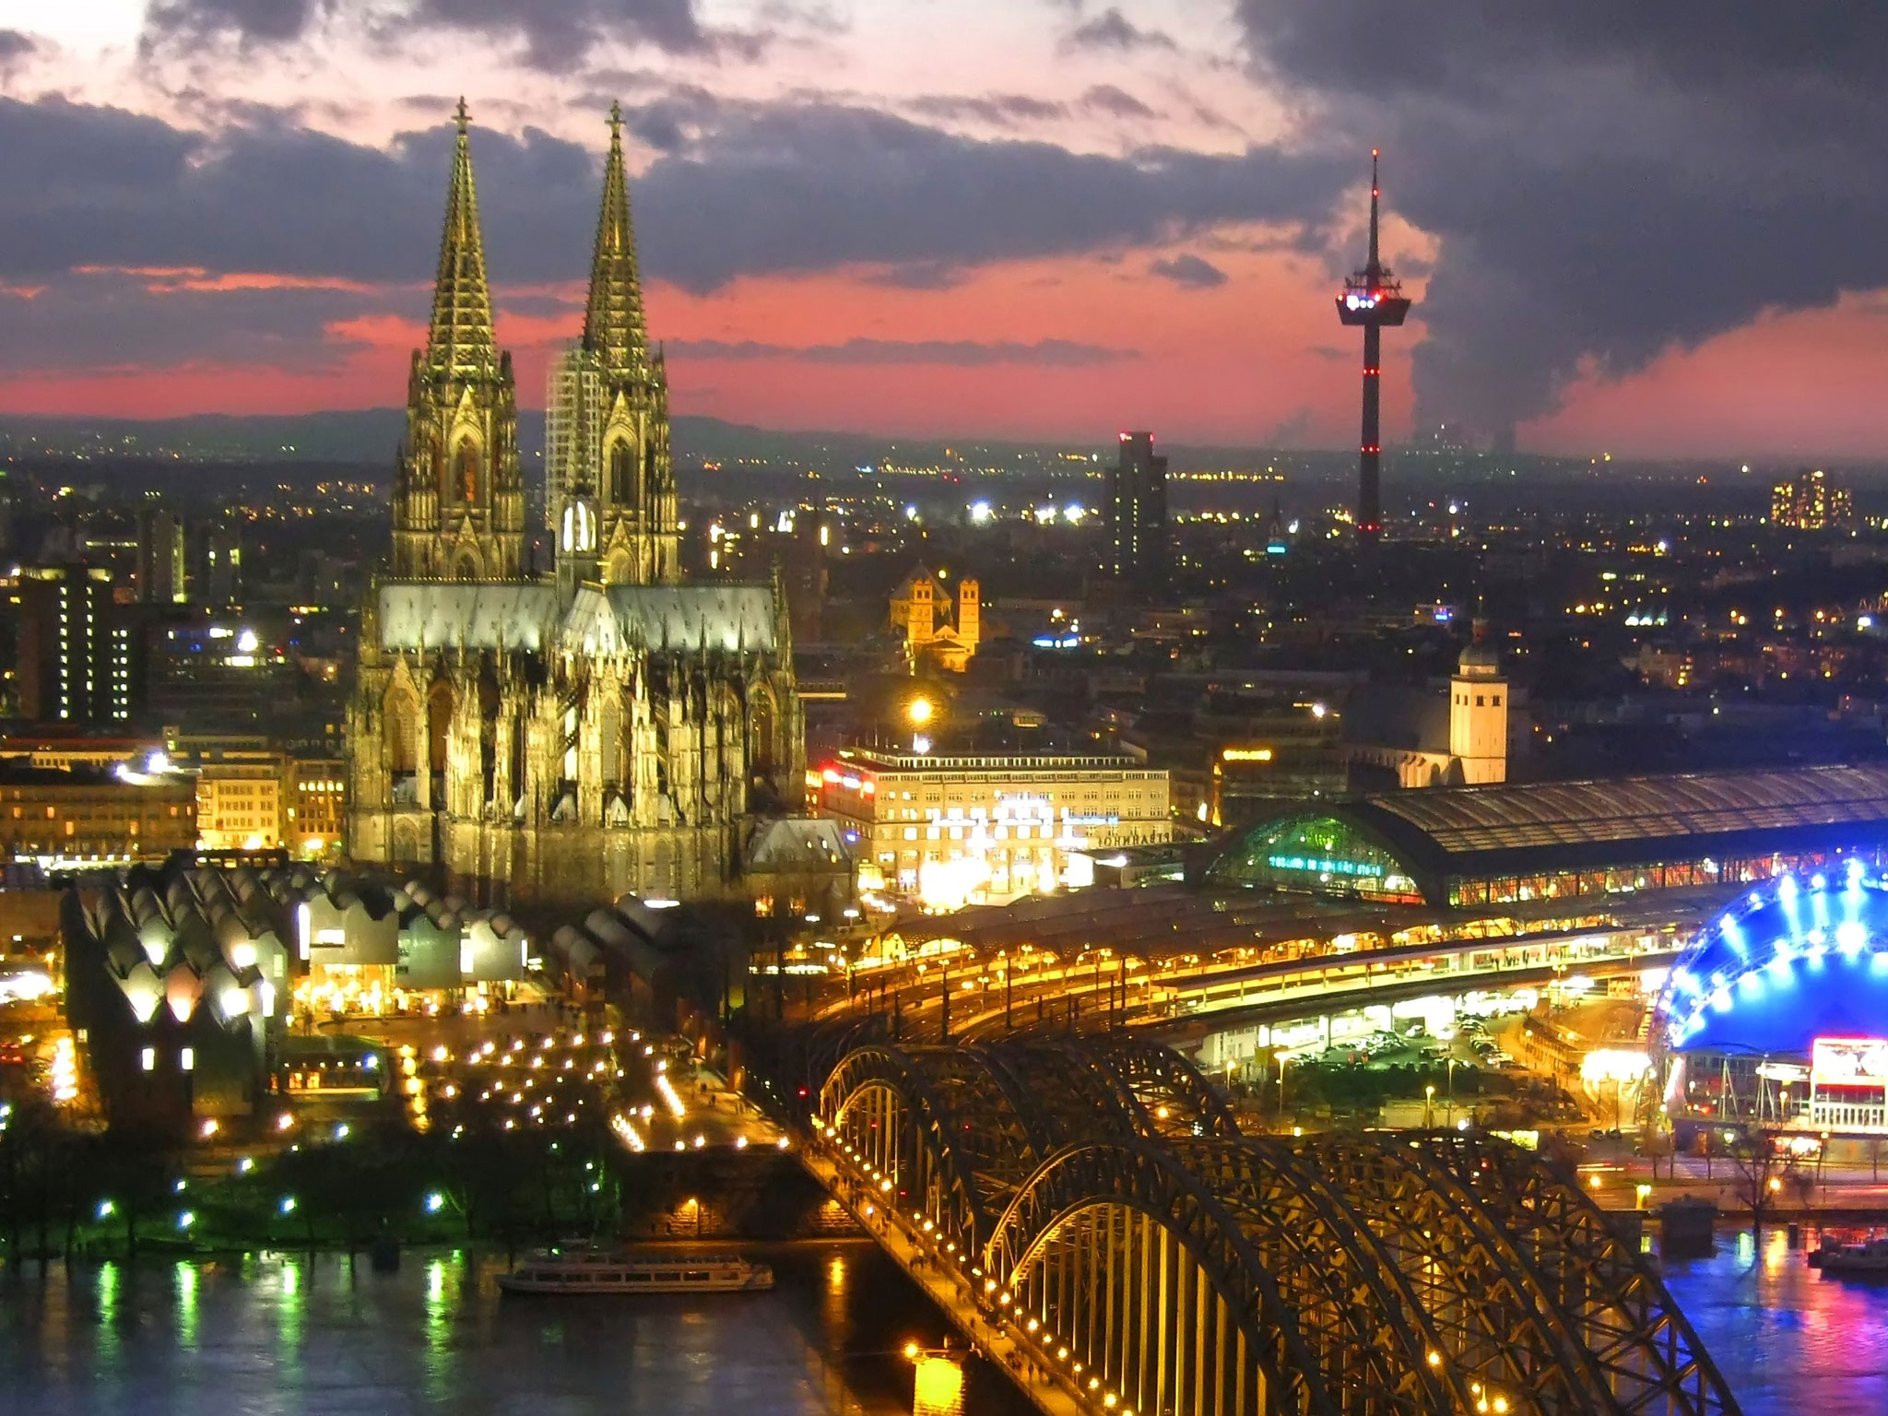
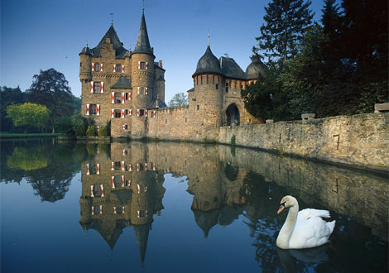
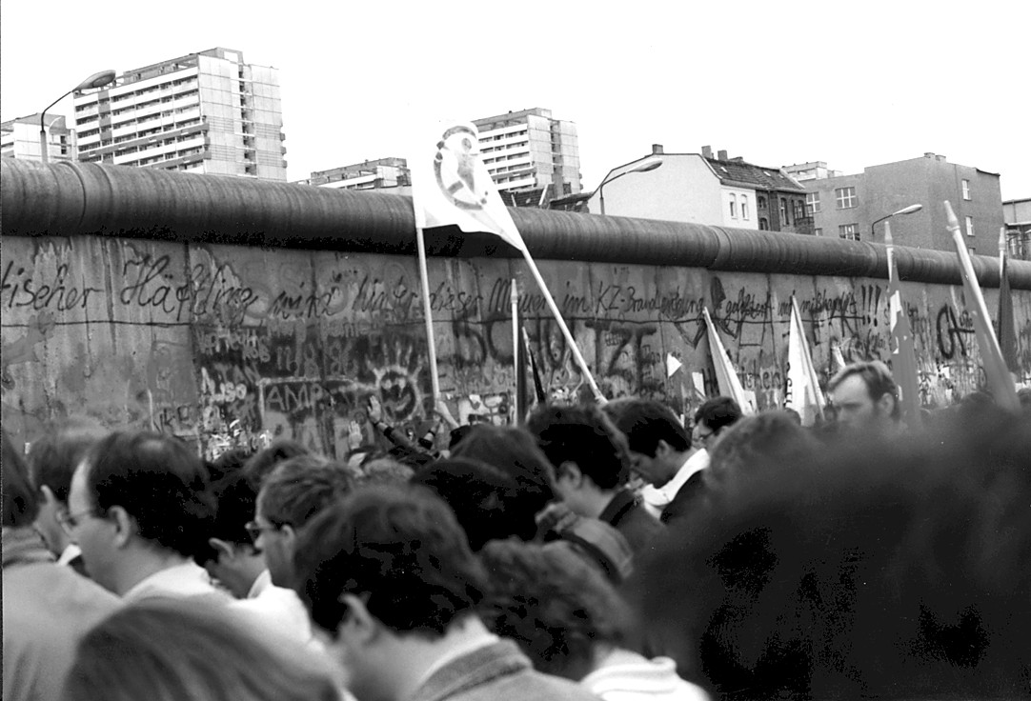
Germany

Slide 37
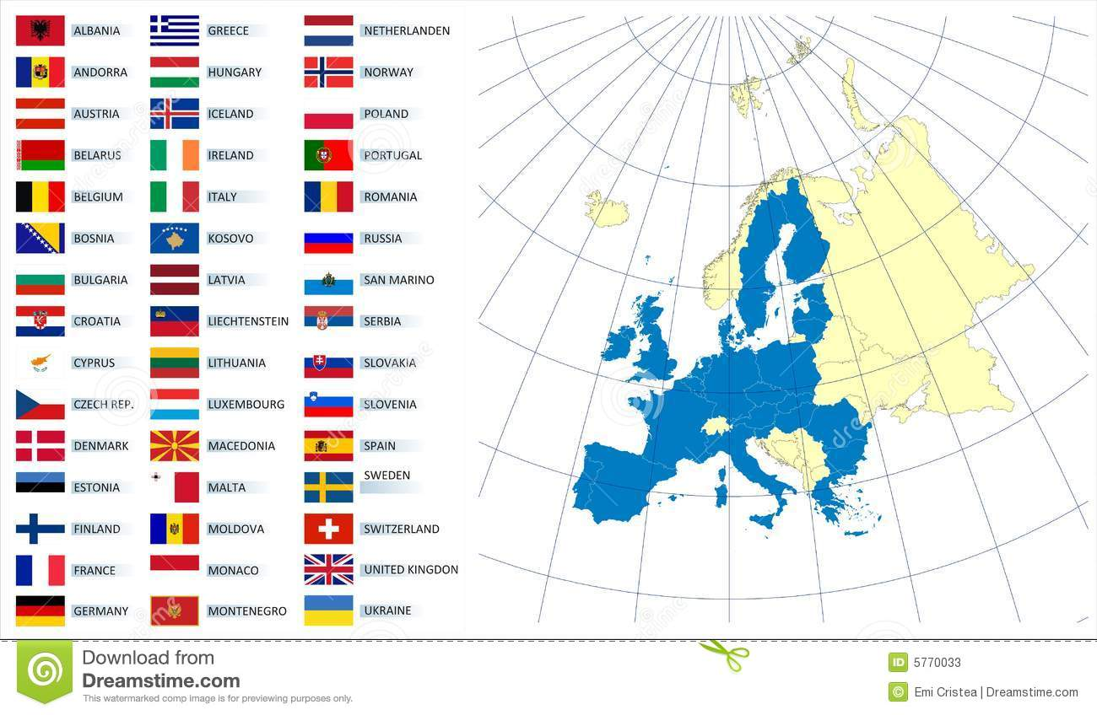
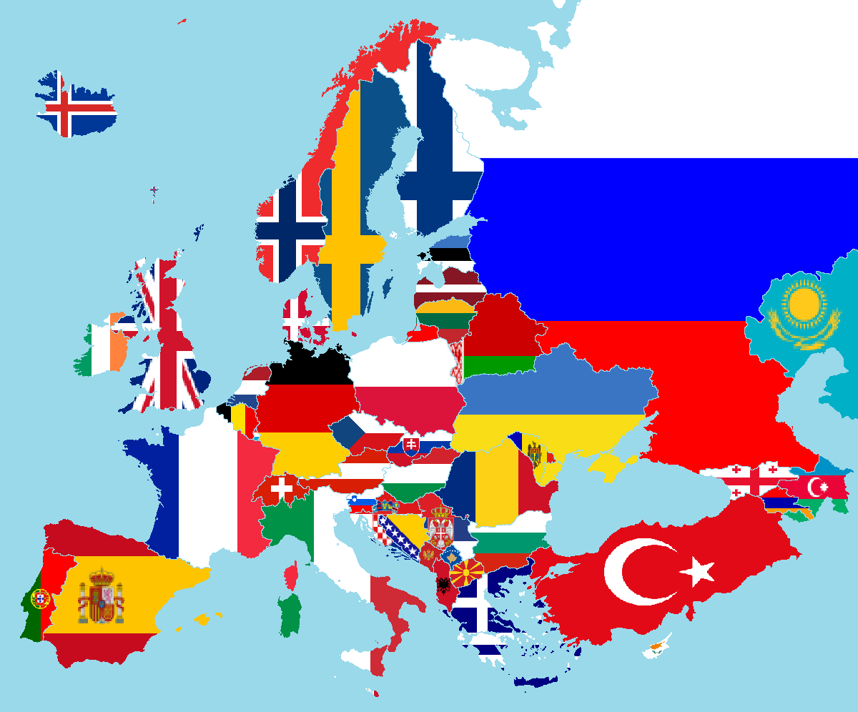
And all the rest…

Slide 38
What do I know about Europe?

Slide 39
Wednesday 4th November 2020
LO. To use imperative verbs.
Word of the day – humorously.
What in ingredients would you put into a magic potion that would spread hope around the world.
Write a recipe with four or five stages for how to make your potion.
Carefully practise joining your letters whilst writing

Slide 40
Wednesday 4th November 2020.
LO: to understand that being accepted and forgiven by Jesus enabled Zacchaeus to change.
Look back at the story of Zacchaeus. As a character of your choice from the story, write an account of the day, saying how you felt at the start and end, having being helped by Jesus.

Slide 41
Thursday 5th November 2020
LO: to using a thesaurus to find synonyms.
If you have a thesaurus at home, use it to look up the words on the activity sheet.
Word of the day- launch.

Slide 42
History.
Thursday 5th November 2020.
LO – to research Ancient Greek architecture - the Parthenon.
Look at the following slides of Ancient Greek architecture.
Create a five-point fact file, choosing 5 of the most interesting facts that you have found out.

Slide 43
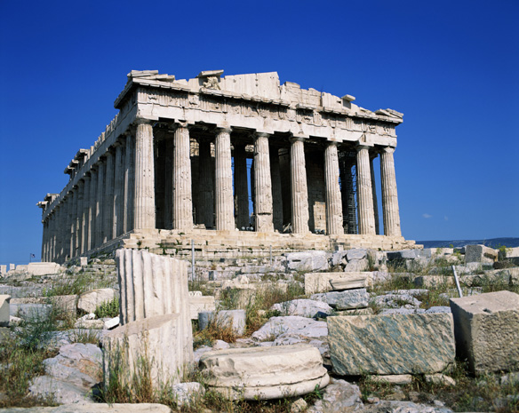
The Parthenon

Slide 44
In Greek this means ‘the sacred rock, or high city’.
In Greek times, the temple would have been surrounded by other buildings and houses.
But these no longer remain because they were destroyed during the Battle of Salamis in 480BC when the Athenians had to abandon the city.

Slide 45
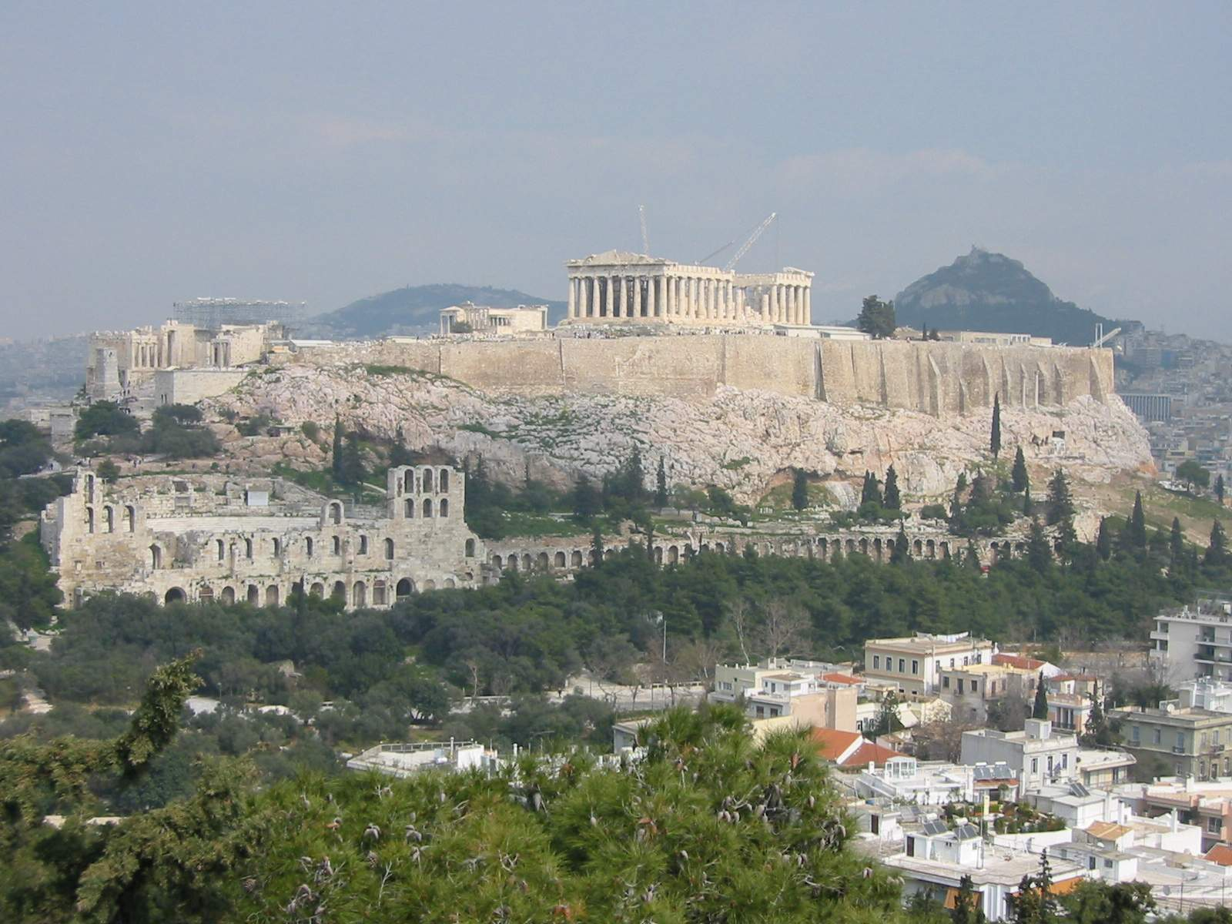

Slide 46
Why did the Ancient Greeks go to the temples?
To make offerings, such as jewellery or food
To ask for help
They believed that the Gods and Goddesses lived here
To perform sacrifices
They went frequently to a variety of temples- this was an important way of life

Slide 47
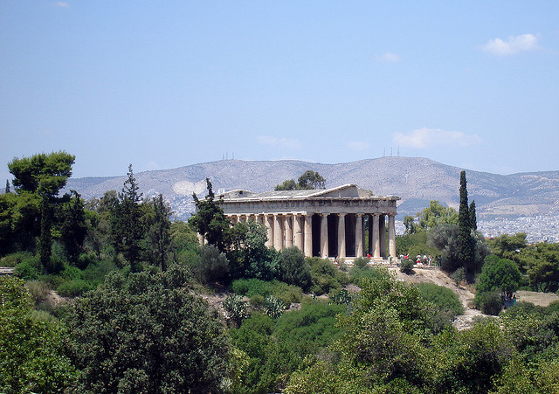
Temple of Hephaestus

Slide 48
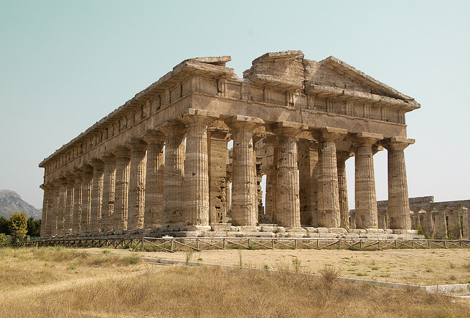
Temple of Hera

Slide 49
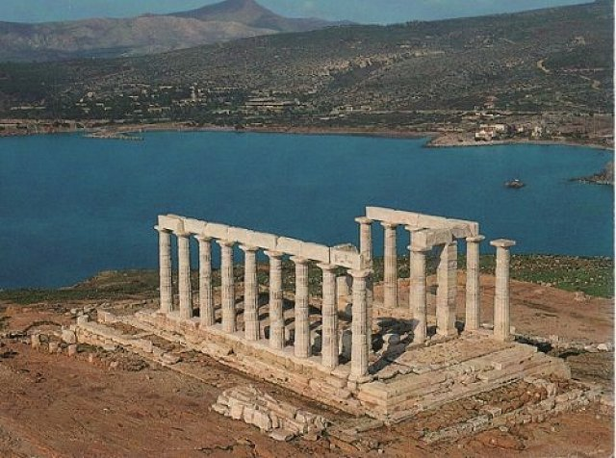
Temple of Poseidon in Western Greece

Slide 50
Features of the Temples
What are the key features we can see on these temples?

Slide 51
Features of the temples
Very large!
Sculptures- could be Gods or mythical heroes
Built of stone and marble
A precinct- this was the surrounding area of the temples, not the inside, where sacrifices took place.
Columns

Slide 52
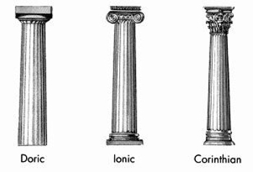
Features of the Temples
Different types of columns:
Simple, found on long rectangular buildings- Parthenon
Most decorative, popular with the Romans
Taller, slimmer, more decorative

Slide 53
Inside the temple
Large statue of the God or Goddess in a strong room or cella
In this room expensive offerings would be placed
Elaborate mosaics and decorations
Different colours and patterns
Shows the wealth of the Ancient Greeks

Slide 54
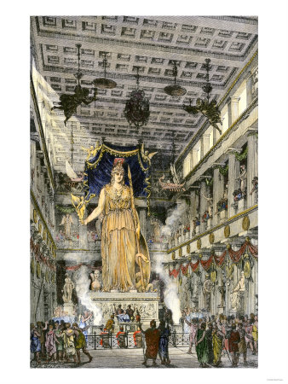

Slide 55
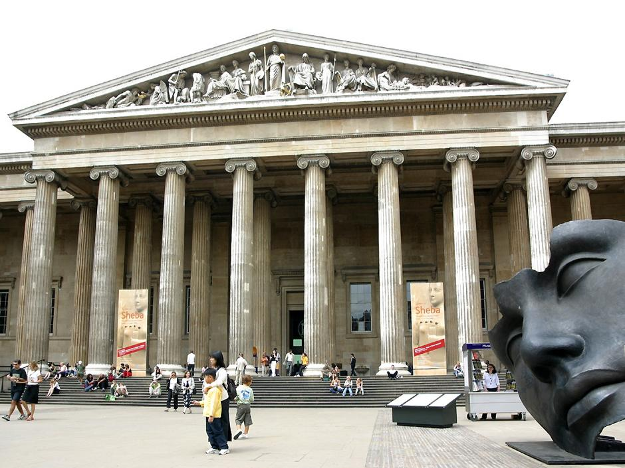
British Museum (London)

Slide 56

Blenheim Palace (Oxfordshire)

Slide 57

Edinburgh University

Slide 58
You may wish to
Design your own Greek temple for a particular God or Goddess. Think about which symbols you might use.

Slide 59
Friday 6th November 2020
LO to write and punctuate direct speech.
Word of the day- irresistible.
Look at the resource for Friday. Can you add inverted commas
To the direct speech?
Maybe you could write your own conversation between Baba Yaga and
Her doll.

