Slide 1
Week 8
Out come: to write my own version of a Greek Myth.

Slide 2
Monday 19th October 2020
Words of the day –triumph
Grammar focus
To use the suffix ed for past tense.
See Oak National Academy
https://classroom.thenational.academy/lessons/to-practise-and-apply-knowledge-of-suffixes-past-and-present-tense-including-a-test-61h3ce

Slide 3
Read through this weeks spellings.
Blowing
Reaching
Hiding
Staring
Spotting
Running
Flying
Trying
Trembling
whispering
Write your sentences out. Check that you understand the meaning of each word.
Read , what are the different places it is set?

Slide 4
Lo : to continue to explore complex sentences.
https://classroom.thenational.academy/lessons/to-explore-complex-sentences-c8r34r

Slide 5

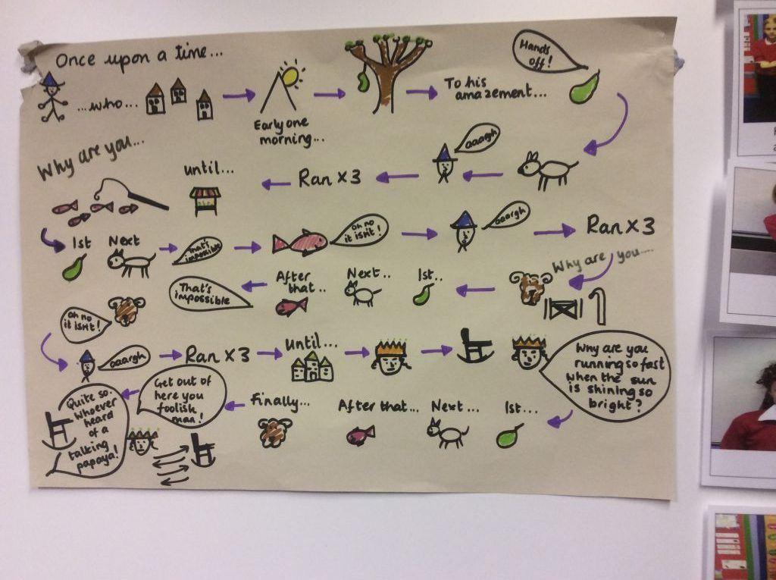
Tuesday 20th October 2020
LO to plan a myth
Word of the day – lopsided.
Using pictures and key words, draw a map that tells us your Greek Myth. It could be based around a myth you have enjoyed reading over the last half term. You must change three things.
It could be ….
The baddie could be your creature.
One of the settings to one we explored last week .
Now be bold and change the ending!
Still on the cartoon strip don’t forget!

Slide 6
Wednesday 21th October 2020
LO to write a myth.
Word of the day – lovingly.
You are going to write your own Greek myth, following your plan from yesterday. Your myth will have a clear beginning, middle with a problem and ending.
Think about your character, describe them remembering what you used in your character descriptions.
Describe the settings, thinking about what you can see, hear, smell, feel, touch. Remember it must be Greece!
Use a simple sentences, compound sentences and complex sentences.
Full stops, full stops, full stops
Capital letters, capital letters , capital letters
Have fun!
Carefully practise joining your letters whilst writing

Slide 7
Thursday 22th October 2020
LO: to answer questions about the mythical creature, the Lochness Monster.
Read through the information pack all about the Lochness monster. See if you can answer the questions from the pack.
Word of the day- create.

Slide 8
Friday 23th October 2020
Word of the day- successfully.

Slide 9
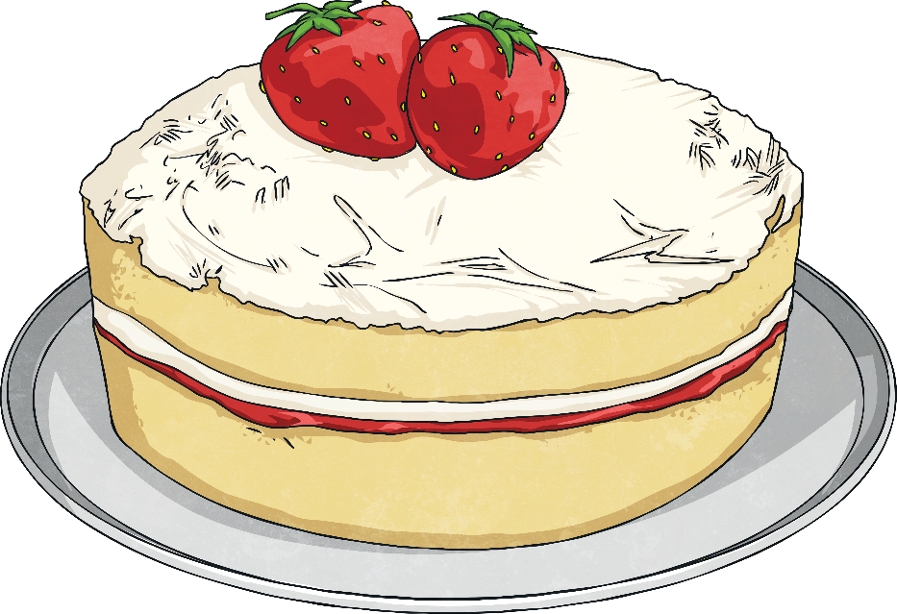
Writing Task
This weekend you baked and decorated your first ever cake. You’ve entered it into the school baking competition. Describe your cake, the other entries and reveal the outcome of the competition in your diary.
Dear Diary….
How many points
can you score?
Word of the Week | Points
triumph | 2
lopsided | 3
lovingly | 2
create | 1
successfully | 2

