Slide 1
Week 7
Out come: to write my own version of a Greek Myth.

Slide 2
Monday 12th October 2020
Words of the day –ogre
Grammar focus
To use the suffix ed for past tense.
See Oak National Academy
https://classroom.thenational.academy/lessons/to-investigate-suffixes-past-and-present-tense-6nhkjc

Slide 3
Read through this weeks spellings.
Peered
Rained
Looked
Slipped
Stepped
Spied
Hurried
Closed
Climbed
snatched
Write your sentences out. Check that you understand the meaning of each word.
Read , what are the different places it is set?

Slide 4
Lo : to explore complex sentences.
https://classroom.thenational.academy/lessons/to-explore-complex-sentences-60t66c

Slide 5

Tuesday 13th October 2020
LO to summarise parts of a story into paragraphs.
Word of the day – dank.
Read Marcia Williams’ version of Theseus and the Minotaur. Using bullet points, summarise the main points in to this table. Can you use time adverbials?
First | Then | Next | Finally

Slide 6
Wednesday 14th October 2020
LO to empathise with a character applying your knowledge of complex sentences.
Word of the day - especially
Act out the story of Theseus from when he conquers the minotaur. Mime the scene. Can you go to the end?
Now, how did you feel as Theseus? Write a diary entry for Theseus, after he killed the monster - an account of the events - use senses to enhance description and create suspense/tension. I wonder if you can include compound and complex sentences?
Carefully practise joining your letters whilst writing

Slide 7
Thursday 15th October 2020
LO: to punctuate direct speech.
https://classroom.thenational.academy/lessons/punctuating-speech-correctly-applying-the-rules-when-writing-creatively-6mvp2r
Word of the day- trudge.
On a large piece of paper, draw the story from where you acted it out yesterday.
(From Theseus beating the Minotaur to the end).
Then add speech bubbles to the characters and write what down they said.
Write their words as direct speech, using inverted commas as shown in the Oak
academy clip.

Slide 8
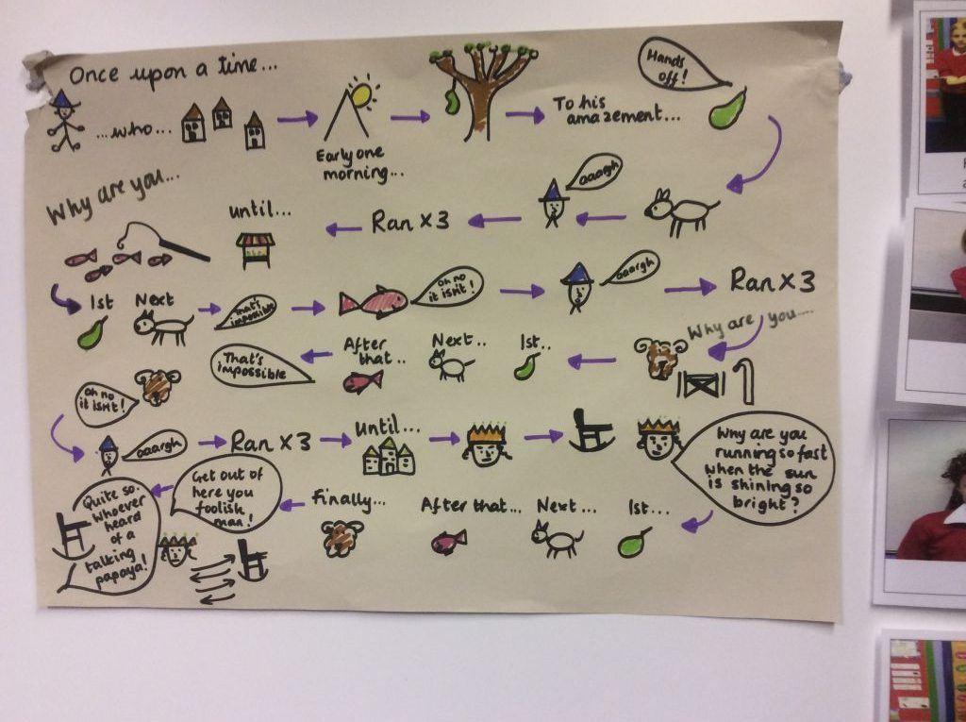
Friday 16th October 2020
LO: to create a story map for my own myth.
Word of the day- unattractive.
Using pictures and key words, draw a map that tells us the story of Theseus.
Now change :
the Minotaur to your creature.
One of the settings to one we explored last week.
Now be bold and change the ending!
Still on the story map don’t forget!

Slide 9
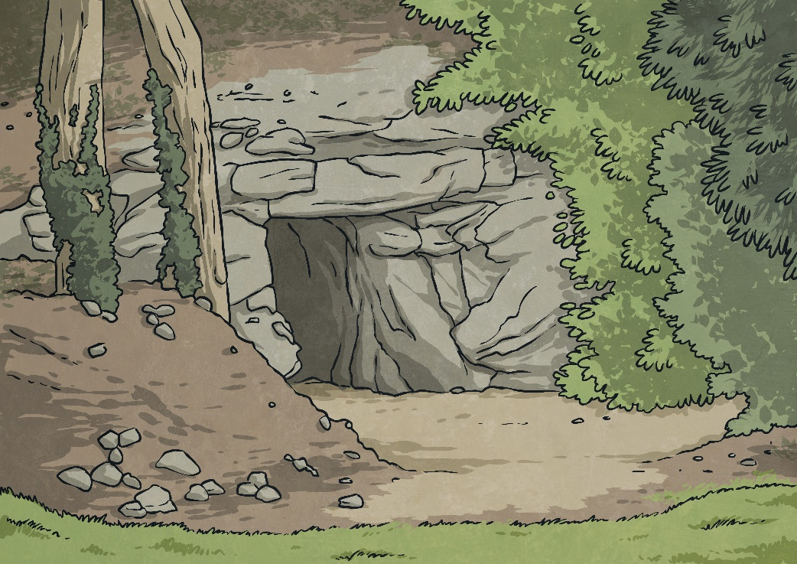
Writing Task
James is on a jungle expedition.
He hears a strange noise coming from the bushes.
Write about what happens next using the words from this week.
How many points can you score?
How many points
can you score?
Word of the Week | Points
ogre | 1
dank | 2
especially | 3
trudge | 3
unattractive | 1

