Slide 1
LO: I can describe settings
For a Greek myth.

Slide 2
In talk partners name all the setting you can recall from ‘Perseus and the Gorgons’ .
How many are inside?
How many are outside?

Slide 3
Why do you think most of the setting are outside?

Slide 4
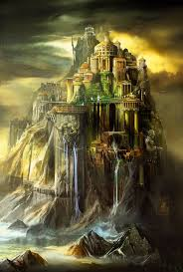

Slide 5
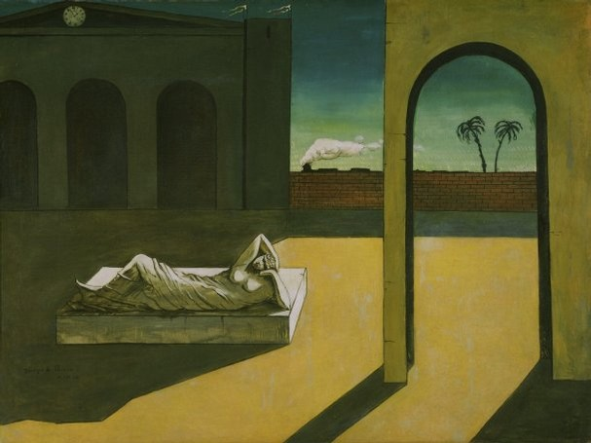

Slide 6
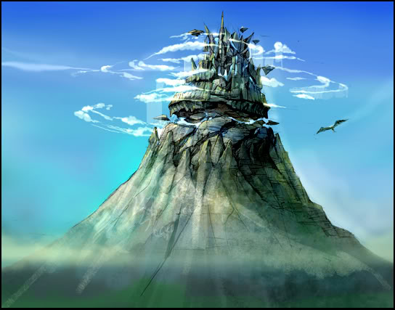

Slide 7
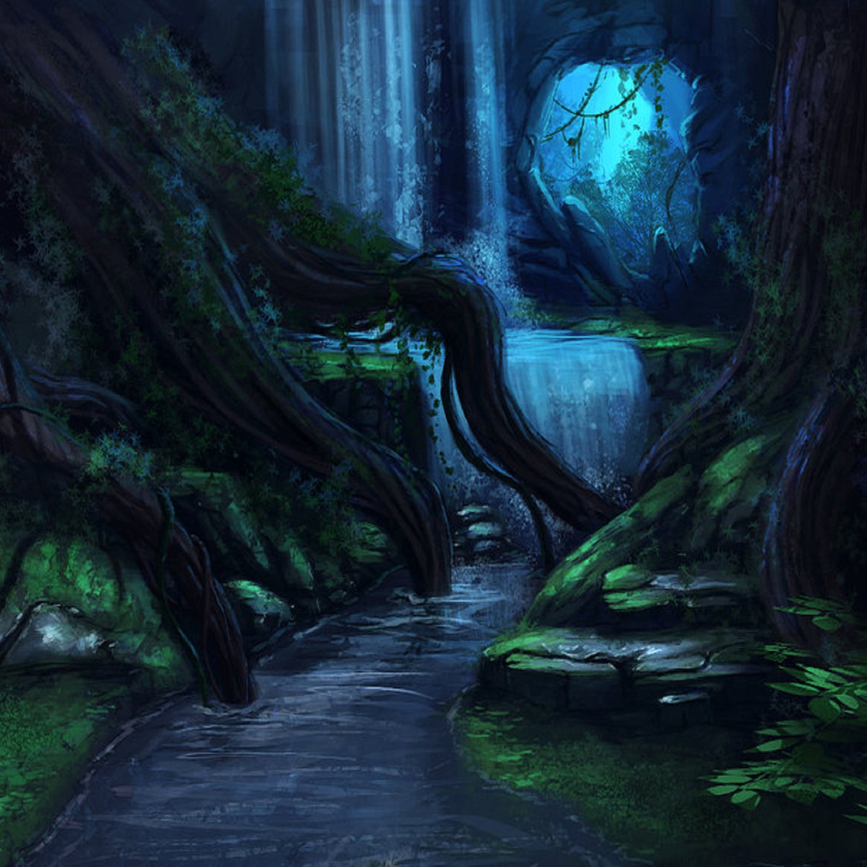

Slide 8
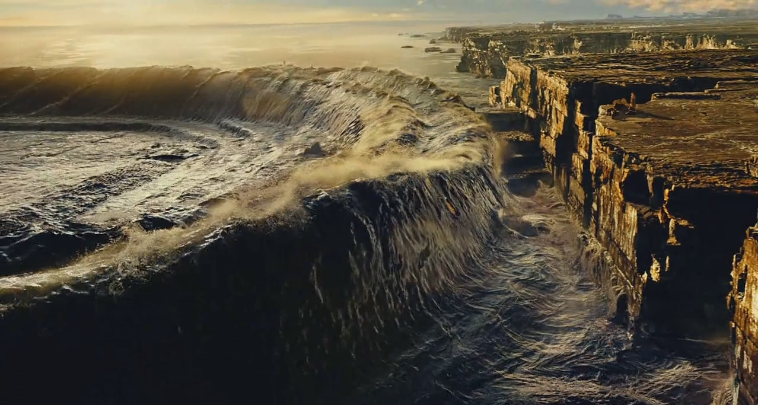

Slide 10
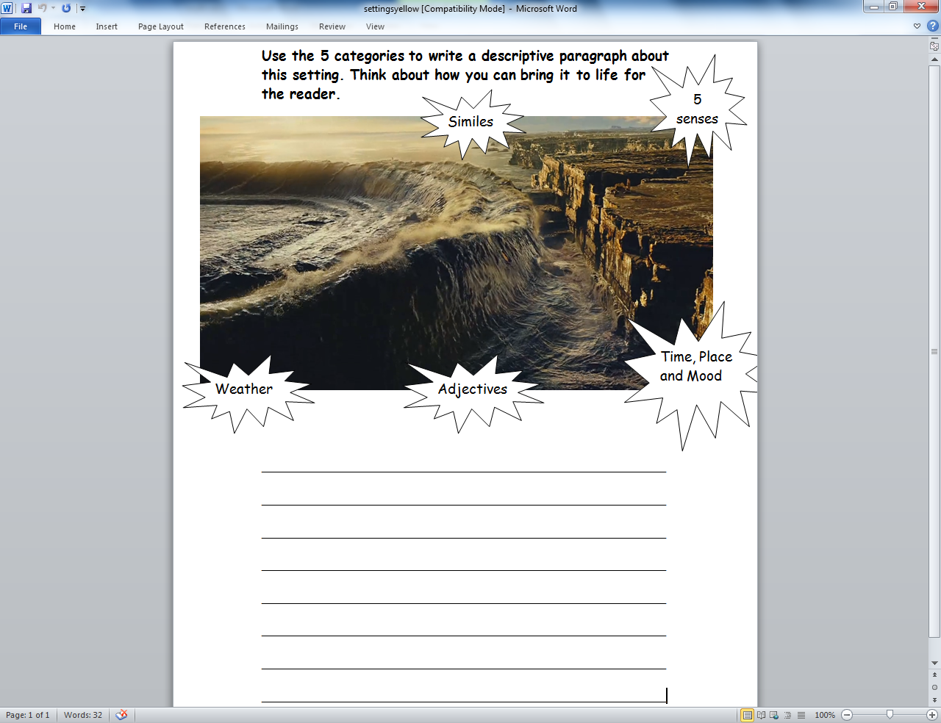

Slide 11
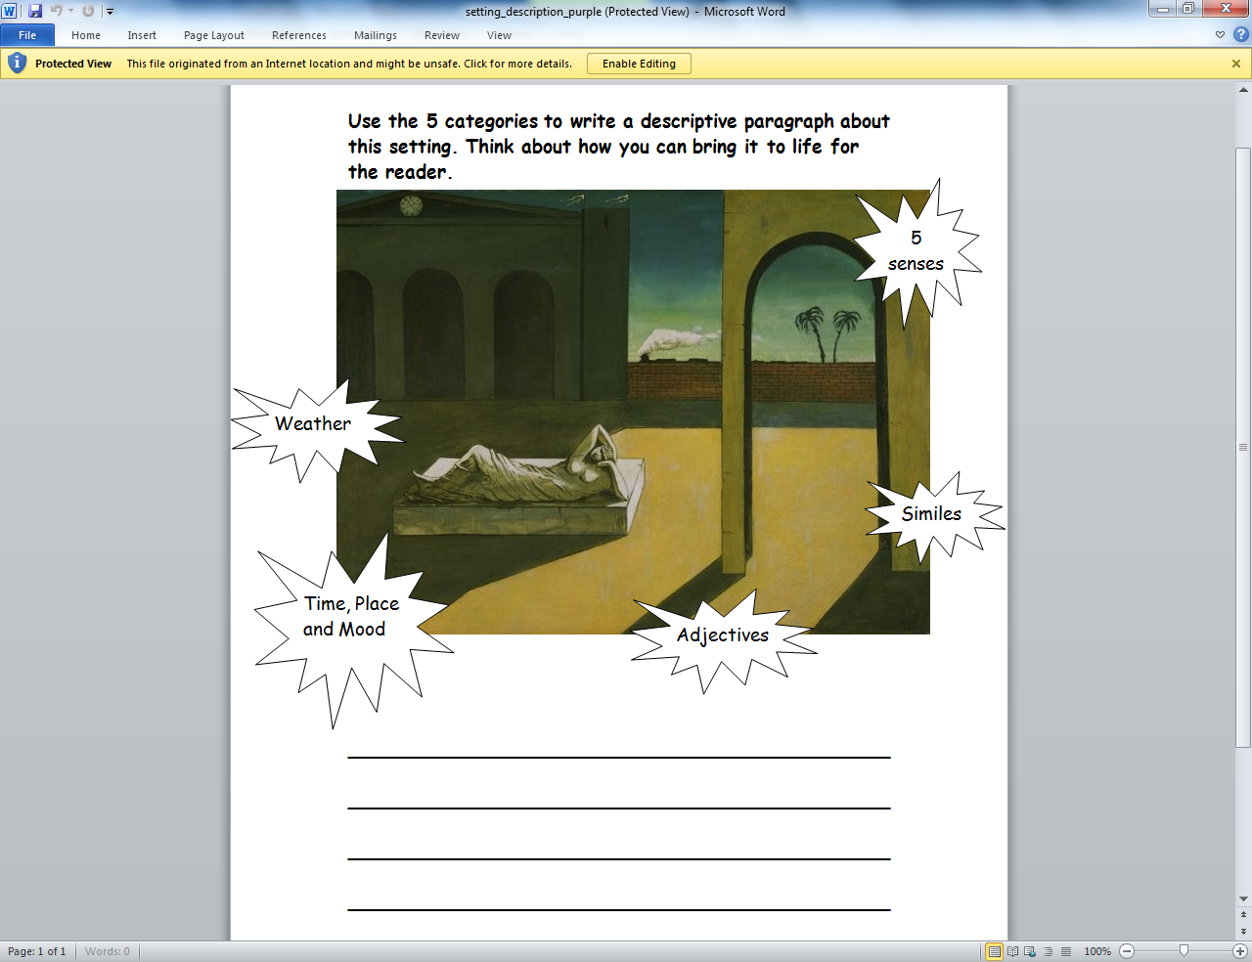

Slide 12
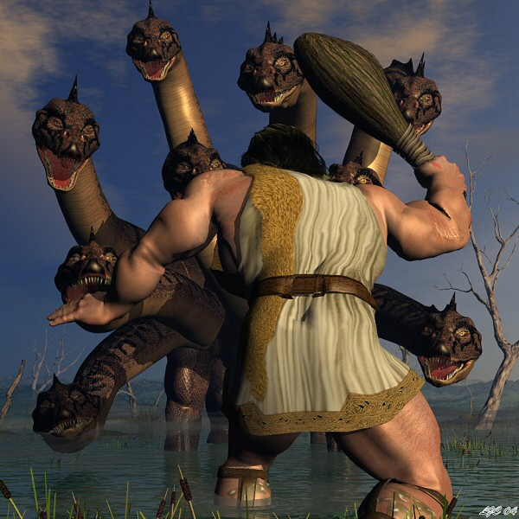
THE HYDRA
The Hydra lived in the swamps near Lerna in Greece. It had the body of a snake and many heads. One head could not be hurt by any weapon and if you cut off any of the other heads two would grow in its place.

Slide 13
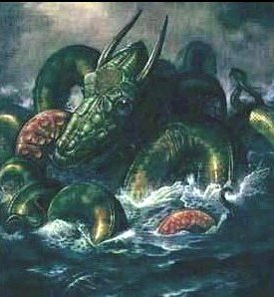
THE KRAKEN
For thousands of years, sailors have told stories of the kraken, a sea monster with huge, staring eyes and tentacles so powerful that it could wreck a large ship. Seamen from northern Europe and Scandinavia said that the kraken was so strong that it could kill a whale.

Slide 14
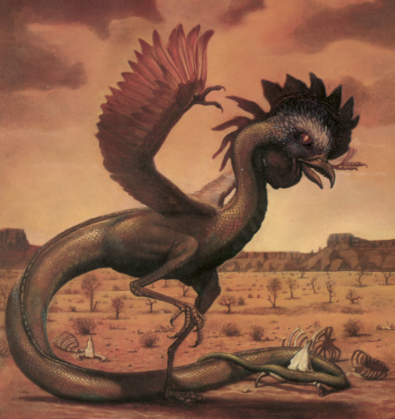
BASILISK
If looks could kill! The ancient Greeks and Romans got frightened if they thought there was a basilisk about.
A basilisk was a snake with the wings of a cockerel and a dragon's tail.

Slide 15
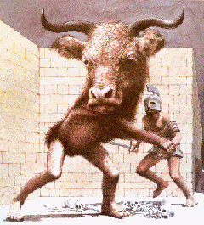
A half-man half-bull monster from Crete, it is the product of the Queen, Pasiphae and a bull sent by Poseidon. Her husband, Minos, commissioned that a labyrinth be built for this beast on Crete. The minotaur, usually pictured as having a human body and a bulls head, would be sent seven boys and seven girls yearly to be eaten. Eventually Theseus killed the minotaur in the labyrinth.

