Slide 1
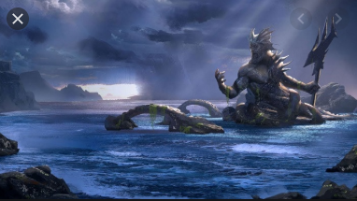
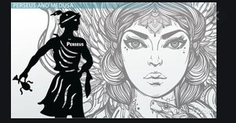
Week 6
Out come: to create a setting for a Greek myths.

Slide 2
Monday 5th October 2020
Words of the day –valuables
Grammar focus
To revise compound sentences.
See Oak National Academy

Slide 3
Read through this weeks spellings.
here
hear
heel
heal
main
mane
mail
male
knot
not
Write your sentences out. Check that you understand the meaning of each word.
Read Perseus , what are the different places it is set?

Slide 4
Watch Oak National Academy’s reading for pleasure. https://classroom.thenational.academy/lessons/to-develop-reading-for-pleasure-cgukgt
Can you make your reading river?

Slide 5
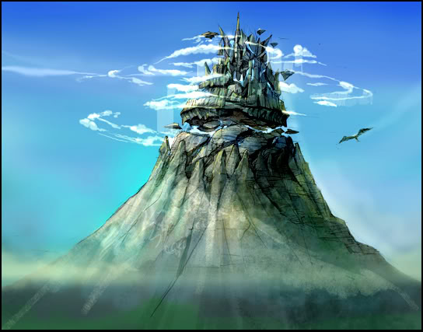
Tuesday 6th October 2020
LO to explore different settings in Greek myths.
Word of the day – outstanding.
Continueto read Perseus’ quest. Compare the different settings so far.
Look at images of the different settings.
See Power point for Tuesday.
Using a thesaurus find adjectives that help create the
images in our minds.

Slide 6
Wednesday 7th October 2020
LO to use compound sentences.
Word of the day - delicately
Carefully practise joining your letters whilst writing
See pictures of Greek myths.
Look at the pictures of different Greek settings for our myth.
Write captions for each one and add interesting adjectives to help us understand what you are seeing.
Plan a description of a Greek mythical setting. Carefully choose interesting adjectives and adverbs. Include compound sentences.

Slide 7
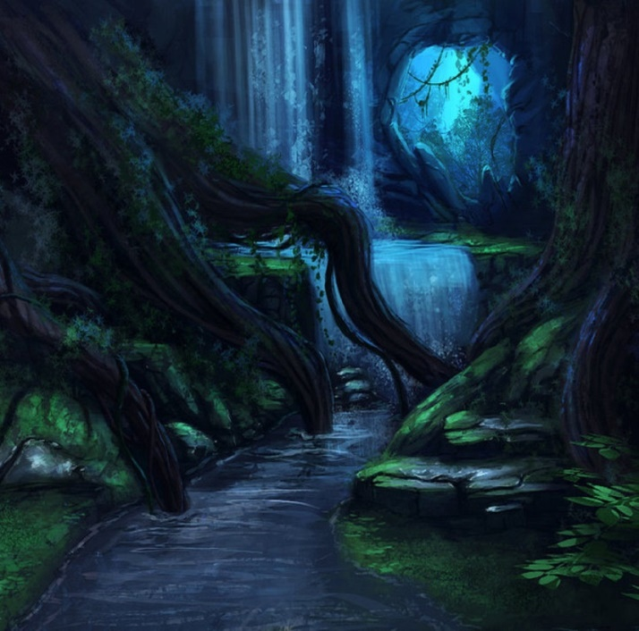
Thursday 8th October 2020
LO: to write a Greek mythical setting.
Word of the day- continue.

Slide 8
Using the planning you created yesterday, the adjectives of the scenes in Perseus’ quest, write a beautiful description of what he saw as he walked through one of the scenes.
You could chose Medusas’ Lair,

Slide 9
Friday 9th October 2020
LO: to answer comprehension questions about Perseus.
Word of the day- archeology
See comprehension PDF called Medusa, Perseus’ Quest.

Slide 10
Week 6 – Consolidate it
Play spelling ping-pong with a partner.
To spell the word, take it in turns to say the next letter.
Monday is Nounsday
valuables
Tuesday is Adjectiveday
outstanding
Wednesday is Adverbday
delicately
Thursday is Verbsday
continue
Friday is Long-Word-Friday
archaeology

