Slide 1
The Story of Icarus.
Reading Comprehension

Slide 2
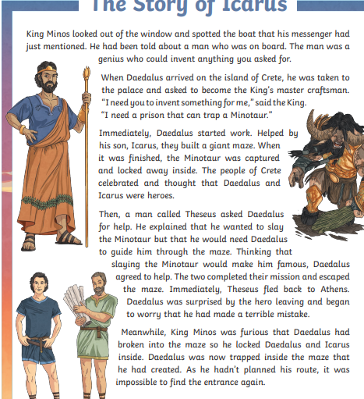

Slide 3
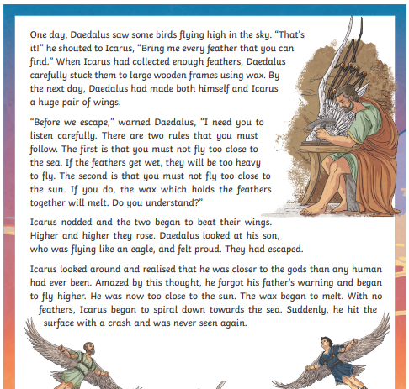

Slide 4
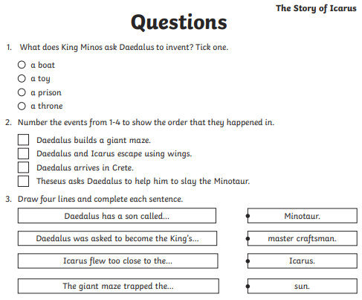

Slide 5


