Slide 1
Week 3
Out come: to write a character description.

Slide 2
Monday 21st September 2020
Words of the day –mansion
Grammar focus
To use powerful verbs.
Can you use these verbs in a sentence?
Scuttled
Fluttered
Scribbled
Oozed
Scrambled
Trickled
Lurched
thundered

Slide 3

Read through the resource titled Pandora’s box.
Copy out the verbs that you find in Pandora’s Box.
Then look up alternatives and use in a sentence of your own.
Don’t forget full stops and capital letters!

Slide 4
Read through this weeks spellings.
straight campaign contain brain faint waist claim praise complaint
afraid
Write your sentences out. Check that you understand the meaning of each word.

Slide 5
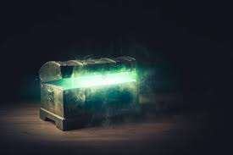
Tuesday 22 September 2020
LO to use new and effective vocabulary.
Word of the day – grimy.
From memory, talk through the story of Pandora’s Box. List the main events in a table like this :
First | Then | Next | Finally
Have

Slide 6
His mother was often sick with malaria, and even when she wasn’t sick she would be listless and sad. There were good days, days when she would play the piano for him and play hide-and-seek around the compound. Or he’d sit on her lap on the sofa out on the veranda and she’d just talk and talk, all about her home in England, about how much she hated the wildness and the loneliness of Africa, and about how Bertie was everything to her. But they were rare days. Every morning he’d climb into her bed and snuggle up to her, hoping against hope that today she’d be well and happy; but so often she wasn’t, and Bertie would be left on his own again, to his own devices.
Now, read the story for real. Did you get all of the important parts in the right order?
Remember, myths are stories that have been passed on through the years. Initially, thousands of years ago, they would not have been written down.
What might happen to the myth over the years?

Slide 7
Wednesday 23rd September 2020
LO to story map Pandora’s Box.
Word of the day - cautiously
Carefully practise joining your letters whilst writing the national anthem.
Draw out the story of Pandora’s Box in a story map. Try to carefully draw pictures that show what is happening in key points.
Add newly learned words to the map to help you tell the story.
Can you tell an adult the story using your story map?

Slide 8
Thursday 24th September 2020
LO: to use adjectives to describe a character.
Word of the day- trespass

Slide 9
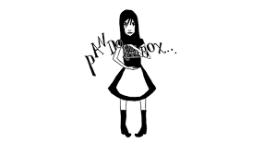
Using your story map for guidance, and what you know about Pandora?
List adjectives that describe her.
Thinking back to Monday, use your powerful verbs and make a list of adjectives
To write a paragraph about Pandora.

Slide 10
Friday 25th September 2020
LO: to use adjectives to describe a character.
Word of the day- disagreeable
Can you find a different version of Pandora’s Box?
How do they compare? Which do you prefer?
Now complete the Comprehension about Icarus on the other power point.

Slide 11
Week 4 – Consolidate it
Write a short paragraph using all the words correctly.
Monday is Nounsday
mansion
Tuesday is Adjectiveday
grimy
Wednesday is Adverbday
cautiously
Thursday is Verbsday
trespass
Friday is Long-Word-Friday
disagreeable

